Slide 1
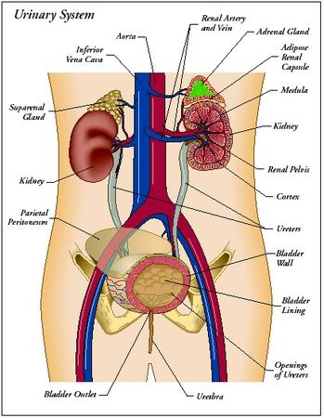
Urinary System

Slide 2
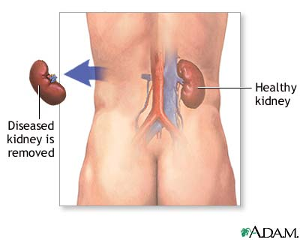
Introduction
Consists of the kidneys, ureters, urinary bladder, and urethra
Kidneys: high of the posterior wall of abdominal cavity

Slide 3
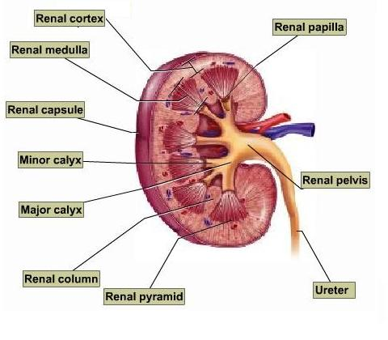
Kidney
Structure:
Renal Sinus: hollow region
Expand into renal pelvis
Renal papillae project into the renal sinus
Each kidney divides into a medulla and a cortex

Slide 4
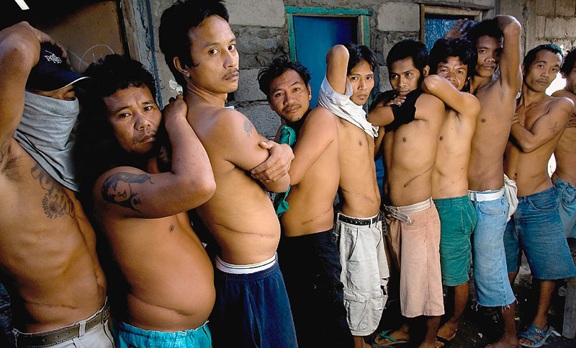
Kidney Functions
Remove and excrete metabolic wastes from blood
Regulate RBC production and blood pressure
Regulate the volume, composition, and pH of body fluids

Slide 5
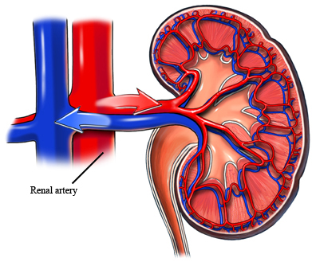
Renal Blood Vessels
Arterial blood flows through the renal arteries, interlobular arteries, arcuate arteries, afferent arterioles, glomerular capillaries, efferent arterioles, and peritubular capillaries
Venous blood returns through a series of vessels that correspond to the arterial pathways

Slide 6
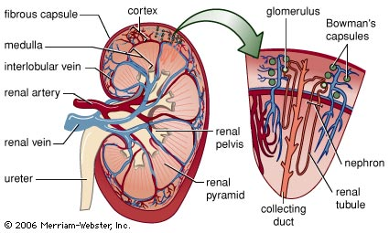

Slide 7
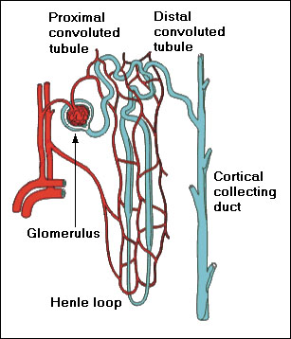
Nephrons
Functional unit of the kidney
Structure: consists of a renal corpuscle and renal tubule
Corpuscle: glomerrulus and glomerular capsule
Renal Tube include proximal convoluted tubule, nephron loop, distal convoluted tubule, and collecting ducts
Collecting ducts empty into minor calyx of renal pelvis

Slide 8
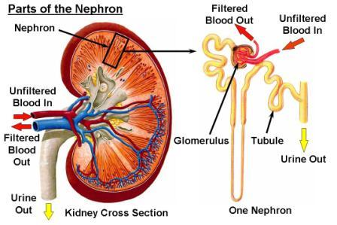

Slide 9
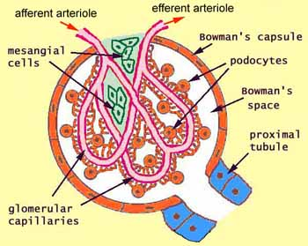
Blood Supply of a Nephron
Glomerular capillary receives blood from the afferent arteriole and passes it to the efferent arteriole
Efferent arteriole gives rise to the peritubular capillary system
Surrounds the renal tubule

Slide 10
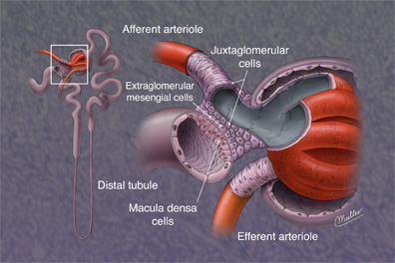
Juxtaglomerular Apparatus
Point of contact between the distal convoluted tubule and the afferent and efferent arteriole
Consists of the macula densa and juxtaglomerular cells

Slide 11
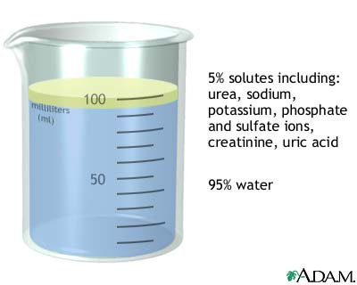
Urine Formation and Elimination

Slide 12
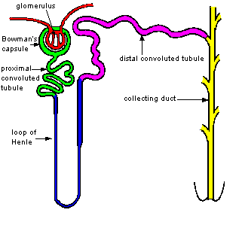
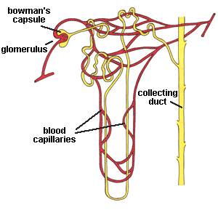
Urine Formation
Nephrons remove wastes from the blood and regulate water and electrolyte concentrations
Urine is the end product

Slide 13
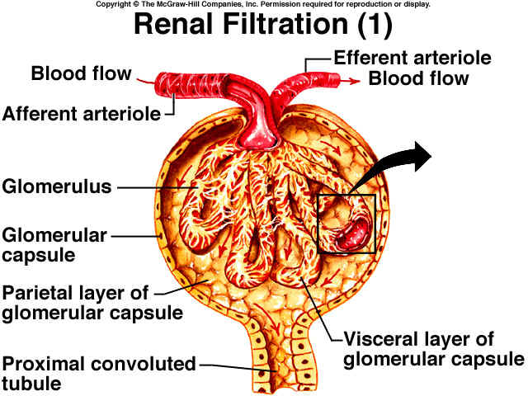
Urine Formation
Glomerular Filtration: urine formation begins when water and dissolved material filter out of the glomerular capillaries
Very premeable capillaries
Filtrate is very similar to tissue fluid

Slide 14
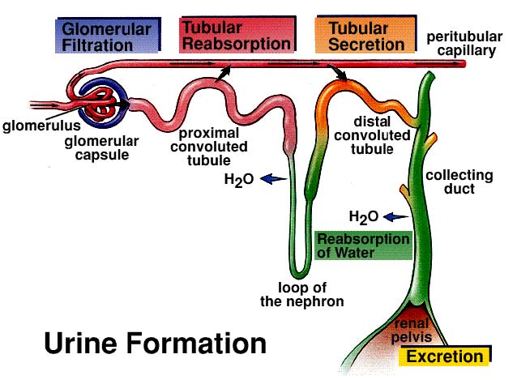

Slide 15
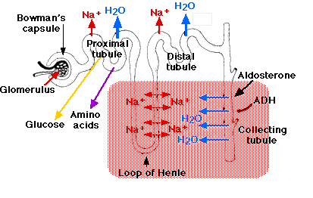
Filtration
Due to hydrostatic pressure and osmotic pressure
Rate: varies with pressure
Changes with the diameter of arterioles
As osmotic pressure or hydrostatic pressure increases, filtration rate decreases
Kidneys produce about 125mL of glomerular fluid/minute
Most is reabsorbed

Slide 16
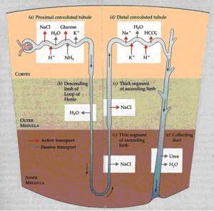

Slide 17
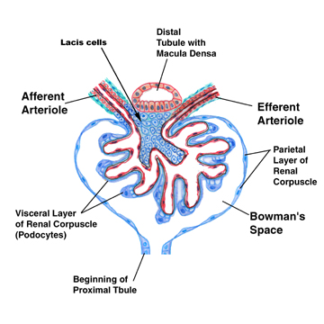
Regulation of Filtration
Rate remains relatively constant
Increased sympathetic nervous activity decreases glomerular filtration
Macula densa senses decreased amounts of Cl, K, and Na ions → juxtaglomerular cells release renin
Leads to vasoconstriction of afferent and efferent arterioles
Affects filtration rate and stimulates Na reabsorption

Slide 18
Tubular Reabsorption
Substances are selectively reabsorbed
Most occurs at the proximal tubule
Epithelial cells have microvilli
Active transport: glucose, amino acids, Na ions
Osmosis: water
Remaining substances are concentrated as water is reabsorbed

Slide 19
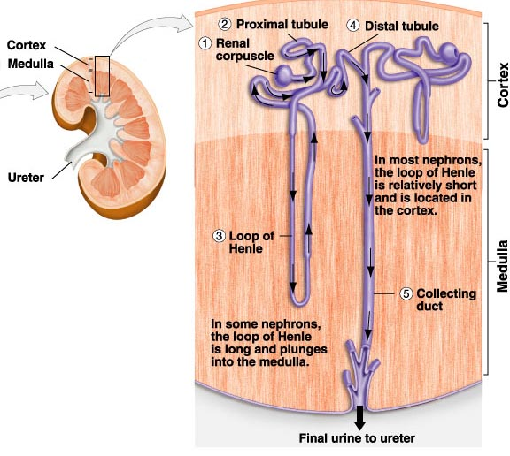

Slide 20
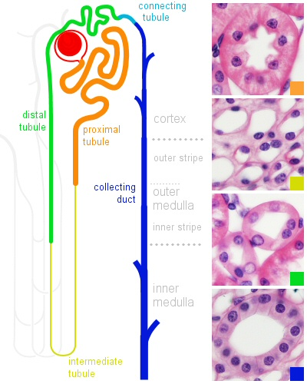
Regulation of Urine Concentration
Antidiuretic hormones increase the permeability of the distal convoluted tubule and collecting duct
Promoting water reabsorption
Diffusion: reabsorbs 50% of the urea

Slide 21
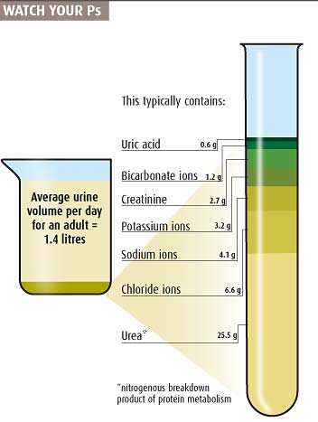
Urine
About 95% water
Urea and uric acid
Varying amounts of electrolytes and traces of amino acids
Volume varies with fluid intake and environmental factors

Slide 22
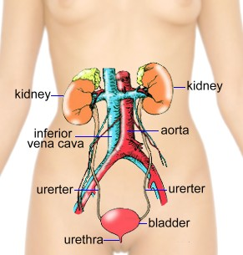
Urine Elimination
Ureter: extend from the kidney to the urinary bladder
Peristaltic waves force urine to the urinary bladder
Urinary bladder: stores urine and forces it through the urethra during micturition
Urethral Sphincter: detrusor muscle
Urethra: conveys urine from the urinary bladder to the outside

Slide 23
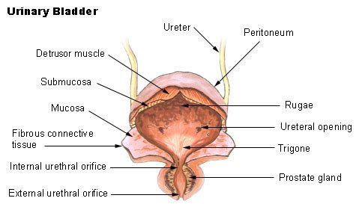
Micturition
Expelling of urine
Contracts the detrusor muscle and relaxes the external urethral sphincter

Slide 24
Micturition Reflex
Distension: stimulates stretch receptors in bladder wall
Micturition reflex center in the spinal cord sends parasympathetic motor impulses to the detrusor muscle
As the bladder fills, its internal pressure increases
Forces the internal urethral sphincter open
A second reflex relaxes the external urethral sphincter unless voluntary control maintains its contraction
Nerve centers in the cerebral cortex and brain stem aid in control of urination

Slide 25
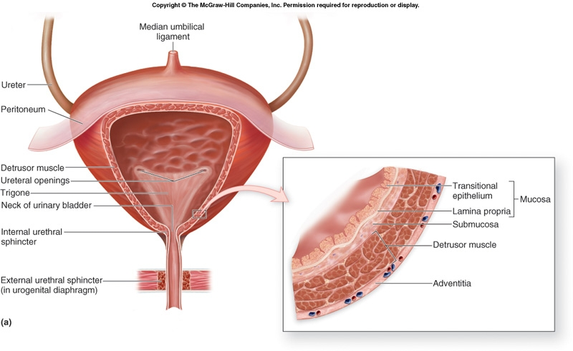

Slide 26
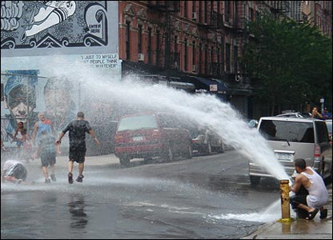
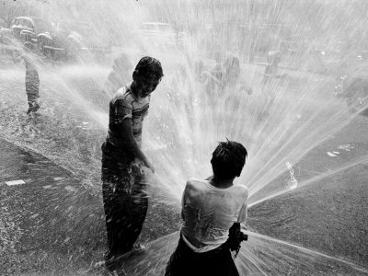
Water, Electrolyte, & Acid-Base Balance

Slide 27
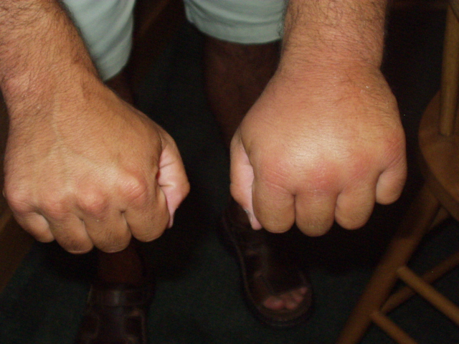
Introduction
Maintenance of water and electrolyte balance requires equal quantities of these substances entering and leaving the body.
Altering the water balance affects the electrolyte balance.

Slide 28
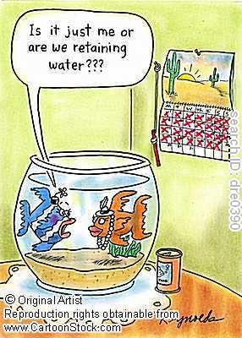
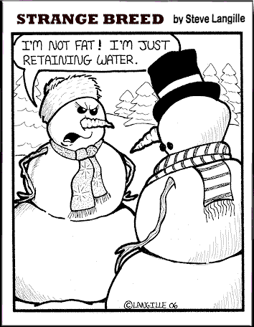

Slide 29
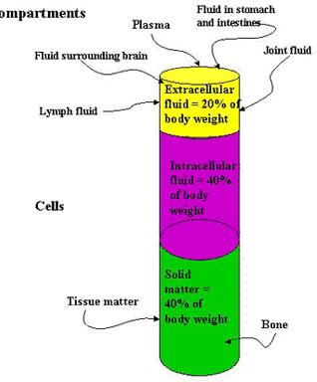
Distribution of Body Fluids
Fluid Compartments:
Intracellular: fluids and electrolytes inside cell membranes
High concentration of K, PO₄, Mg, SO₄ ions
Lower concentration of Na, Cl, and bicarbonate ions
Extracellular: fluid outside cell membrane
High concentration of Na, Cl, and bicarbonate ions
Lower concentration of Ca, Mg, PO₄, and SO₄ ions
Plasma contains more protein than interstitial fluid or lymph

Slide 30
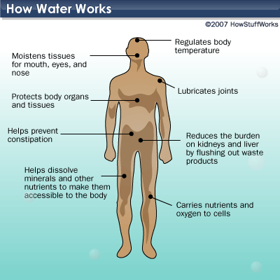

Slide 31
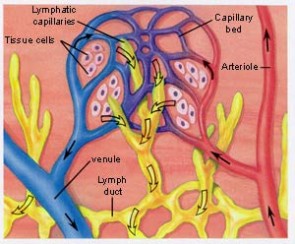
Movement of Fluid
Hydrostatic and osmotic pressure regulate movement
Hydrostatic: forces fluid out of plasma
Drives into lymph vessels
Osmotic: returns fluid to plasma
Regulates fluid in and out of cells
Na ion concentrations are especially important in fluid movement regulation

Slide 32
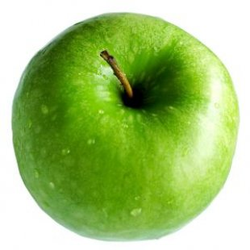
Water Balance
Most water comes from consuming liquids and moist foods
Oxidative metabolism produces some water

Slide 33
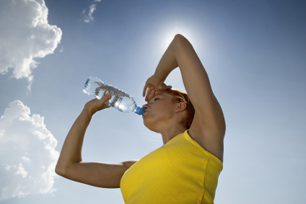
Water Balance
Water Regulation
Thirst
Drinking and stomach distension inhibit
Water is lost from urine, feces, and sweat
Distal convoluted tubules and collecting ducts of the nephrons regulate water output

Slide 34
Electrolyte Balance
Most Important: Na, K, Ca, Mg, Cl, SO₄, PO₄, H, and bicarbonate ions
Obtained from foods and beverages
Severe electrolyte deficiency may produce salt carvings
Lost through perspiration, feces, and urine
Na and K: regulated by adrenal cortex
Ca: parathyroid hormone and calcitonin

Slide 35
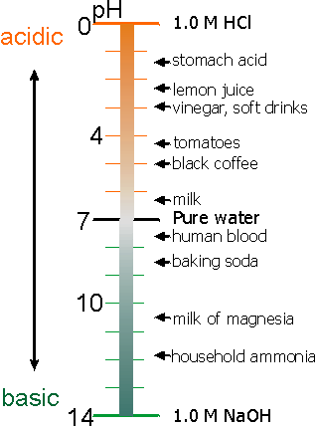
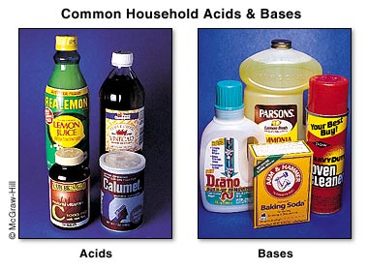
Acid-Base Balance
Acids: electrolytes that release H ions
Bases: combine with H ions

Slide 36
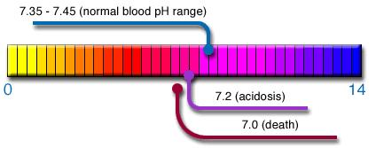
Regulation of pH
Acid-Base buffer system: minimize pH change
Buffer system converts strong acids into weaker acids, or strong bases into weaker bases
Bicarbonate buffer system, phosphate buffer system, and protein buffer system

Slide 37
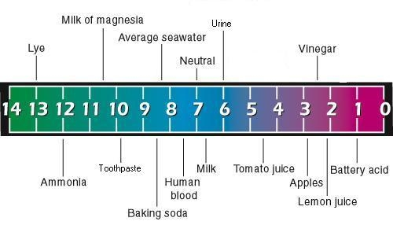
Regulation of pH
Respiratory center controls the rate and depth of breathing
Kidney nephrons secrete H ions
Chemical buffers act more rapidly that physiological buffers

