Slide 1
The Nature of Gases

Slide 2
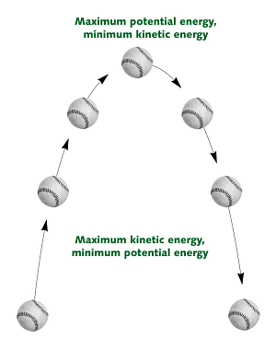
Kinetic Theory
Kinetic Energy: the energy of motion

Slide 3
Kinetic Theory
Gas particles are small, hard spheres with insignificant volume
No attractive or repulsive forces
Gas particle motion is rapid, constant, and random
Particles move in straight paths until they collide
O₂ travels at 1700km/hr
Move from D.C. to Mexico City in 115 minutes
All collisions between gas particles are elastic
Energy is simply transferred between particles

Slide 4
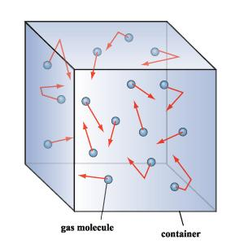
Radom Motion of Gas Particles

Slide 5
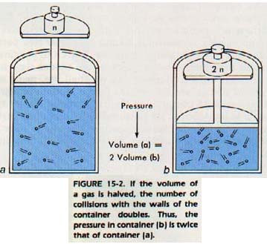
Gas Pressure
Results from the force exerted by a gas per unit area
Result of simultaneous collisions of billions of rapidly moving particles in a gas with an object
Vacuum: an empty space with no particles and no pressure

Slide 6
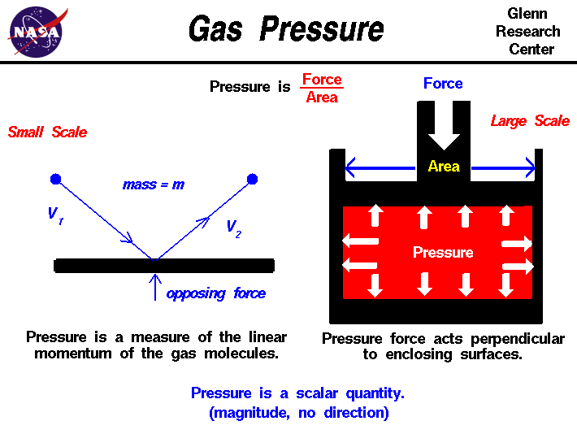

Slide 7
Pressure
Atmospheric Pressure: pressure from the collisions of atoms and molecules in air with objects
Decreases with altitude due to decrease in Earth’s density
Pascal (Pa): SI unit for pressure
Atmosphere (atm): older unit
1 atm = 760 mmHg = 101.3 kPa

Slide 8
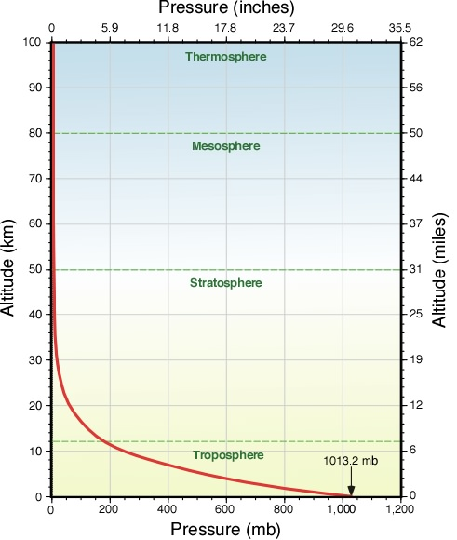

Slide 9
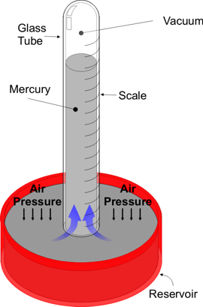
Barometer
Barometer: device used to measure atmospheric pressure

Slide 10
Average Kinetic Energy
Increase Temperature
Potential Energy: particles absorb some energy
Kinetic Energy: particles speed up
Average kinetic energy: at any given temperature, particles of all substances have the same kinetic energy
Average KE increase → Temp. Increases

Slide 11
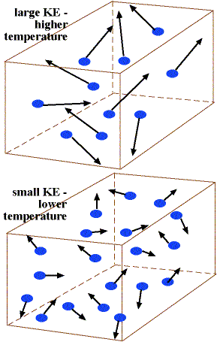
KE and Temperature

Slide 12
Kelvin
Kelvin Scale: reflects the relationship between temperature and average KE
EX. He (g) at 200K and He (g) at 100K
At 200K, the KE is double
0 K: Absolute zero
Expect particles of all substances to stop moving
K = ºC + 273

Slide 13
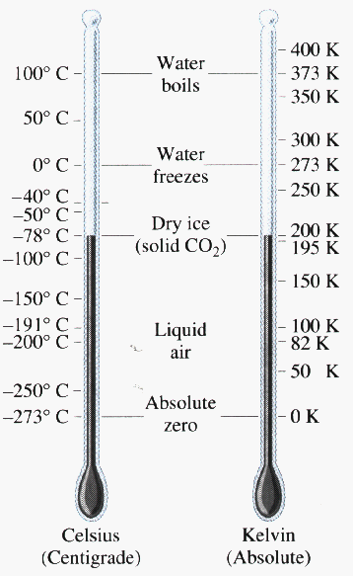
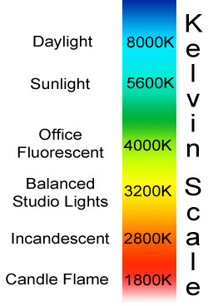
Kelvin Scale

