Slide 1
The Gas Laws

Slide 2
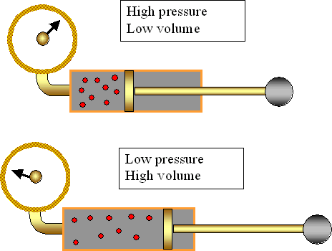
Boyle’s Law: Pressure and Volume
If the temperature is constant, as the pressure increase, the volume decrease
Inverse relationship
P₁V₁ = P₂V₂

Slide 3
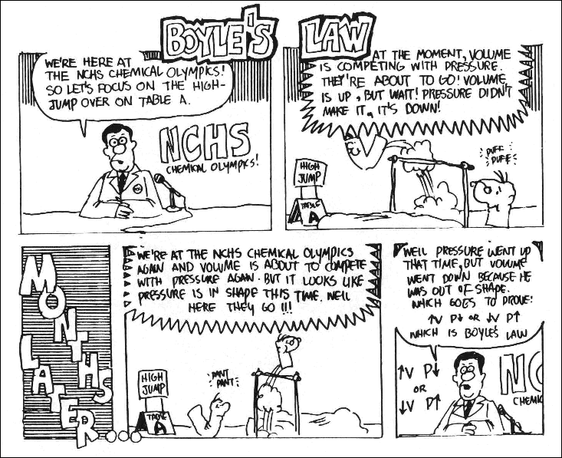

Slide 4
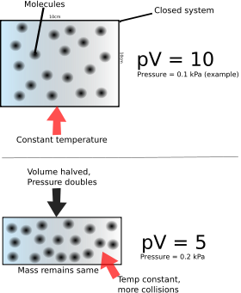
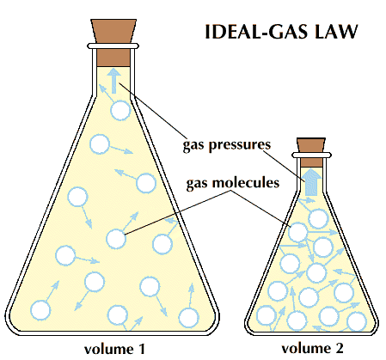
Pressure and Volume

Slide 5
Boyle’s Law: Example Problem
A balloon contains 30.0L of He(g) at 103 kPa. What is the volume of the helium when the balloon rises to an altitude of 25.0kPa?
P₁=103kPa P₂=25.0kPa
V₁=30.0L V₂= ?L
P1V1=P2V2
(103 kPa)(30.0L) = (25.0kPa)V₂
V₂ = (103 kPa)(30.0L)/(25.0kPa)
V₂ = 1.24 x 10² L

Slide 6
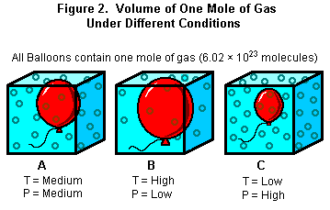
Charles’s Law: Temperature and Volume
As the temperature of an enclosed gas increases, the volume increase, if the pressure is constant
Proportional relationship
Use Kelvin at temperature

Slide 7
Why do hot air balloons float?

Slide 8
Charles Law: Example
A balloon is inflated to a volume of 4.00 L at 24 ºC. The balloon is heated to a 58ºC. What is the new volume?
Must convert temp. to Kelvin. K = ºC + 273
V₁ = 4.00 L V₂ = ? L
T₁ = 297 K T₂ = 331K
V₂ = V₁ x T₂/ T₁
V₂ = (4.00L x 331 K)/279K = 4.46 L

Slide 9
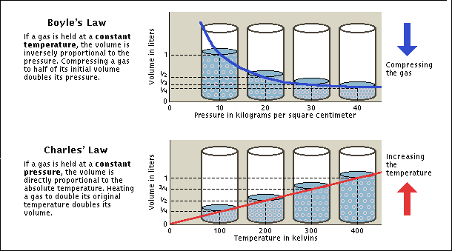
Gas Laws

Slide 10
Gay-Lussac’s Law: Pressure & Temperature
As temperature increases, the pressure increase
Proportional relationship
Remember to use Kelvin

Slide 11
Gay-Lussac’s Law: Example
The gas in a used aerosol can is a pressure of 103 kPa at 25ºC. If the can is thrown into a fire, what will the pressure be when the temperature is 928ºC?
P₁=103 kPa P₂ = ? kPa
T₁ = 298 K T₂ = 1201 K
P₂ = (103 kPa x 1201K)/(298K)
P₂ = 415 kPa

Slide 12
Combined Gas Law
Combines previous laws and allows you to calculate for situation in which only the amount of gas is known

Slide 13
Combined Gas Law Example
The volume of a balloon is 30.0 L at 313K and 153kPa. What would the volume be at STP?
V₁= 30.0L V₂=?L
P₁=153kPa P₂=101.3kPa
T₁=313K T₂=273K
V₂ = (V₁P₁T₂)/(P₂T₁)
V₂= (30.0L x 153kPa x 273K)/(101.3kPa x 313K)
V₂ = 39.5L

Slide 14
