Slide 1
Taxation
“In this world nothing can be said to be certain, except death and taxes.”
Benjamin Franklin

Slide 2
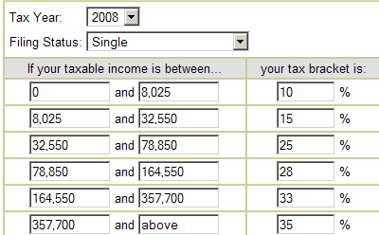
US Federal Tax Rates: (only 3 % of Americans make over $250,000)

Slide 3
Net Income
Gross income: How much you earn
Net income: how much you keep
Net income = gross income - gross income*tax rate

Slide 4
World Tax Rates
Corporate
Tax rate
Sales
Tax
Country
Income
Tax
United Kingdom | 21-28% | 0-40 % | 17.5%
Ireland | 12.5 % | 20-41% | 21 %
Mexico | 29% | 3-29 % | 15 %
Sweden | 28 % | 0-59 % | 25 %
Slovakia | 19 % | 19 % | 19 %
Hong Kong | 15 % | 0-15 % | 0 %
United Arab Emirates | 0 % | 0 % | 0 %

Slide 5
What are “Good Taxes”?
According to Adam Smith:
Simple to understand
Don’t provide negative incentives
Avoid loopholes
IRS manual – 2,500,000 pages
(4 X size of the Bible)

Slide 6
Income Tax in USA
IRS – tax collection agency in USA
Taxes are deducted throughout year
Every citizen must file every year by:
If you paid more during the year then you need to: you get a refund
If you paid more during the year then you need to: you must pay the difference

Slide 7
Property tax
Tax on something you own
Usually expensive like your house or boat

Slide 8
Proportional Income Tax
Tax on a household income
% of stays the same
“flat tax”
Rare in USA

Slide 9
Progressive Income Tax
Tax on a household income
% of changes based on income
“tax the rich more!”
The more you make, the higher your tax

Slide 10
Regressive Tax
Smaller % taken the higher your income
Sales tax

Slide 11
Estate tax
Tax on inheritance
Sometimes called “death tax”
In US today, $2,000,000 and up
45% rate

Slide 12
Gift tax
Tax on gifts or rewards
Games shows, gambling, lottery
Rate depends on gift
35-60 %
Incentive?

