Slide 1
STUDY SKILLS

Slide 2
Lesson 1: Get Organized
The Notebook.
Make learning materials easy to find.
Folders and binders with dividers are great to organize notes, assignments and test results.
Have separate, labeled notebooks for each class.
Assignments.
Write down assignments for all classes in one designated place.
Include due dates and important information for each one.
Ask the teacher to explain unclear assignments.
Keep records of the grades received.
Notice the types of assignments that need more work.

Slide 3
Lesson 2: Note Taking
Improving Your Note Taking
Learning how to take good notes in class is an important part of study preparation.
The information provided and topics covered by your teacher are what you will be studying.
If you don’t take good notes in class, you won’t know what to study once class is over.

Slide 4
Make clear and accurate notes
(1) understand the subject matter
(2) concrete what is being taught in your mind
(3) go back after class and review.
Compare your notes
When class is over, compare your notes to those taken by other students.
Sometimes other students will pick up on things discussed by the teacher that you missed or didn't find important.
Minimize distractions
If you're serious about your education then you'll want to remove any distractions that keep you from concentrating on class lectures and taking copious notes.
Sit close to the front of the room.
Don't sit next to individuals you are tempted to talk to during class
Try to stay away from any other situation that would distract you during class.

Slide 5
Come to class prepared
Organize your notes Start each class with a clean sheet of paper.
Put the day's date at the top of your notes along with any other relevant information (i.e. history notes, chemistry notes, etc.).
This will help you to keep track of each day’s notes and increase your ability to go back and review your notes for exams and quizzes.
Use abbreviations and symbols In some classes it can be difficult to write down everything that the teacher is saying.
Use short sentences and phrases and easily remembered abbreviations and symbols in order to make sure you're able to keep up.

Slide 6
Write clearly
It doesn't matter how many notes you can take if you can't make sense of your notes after the lecture is over.
Make sure to write clearly -- especially if you're using abbreviations.
Its also useful to leave plenty of blank space in the left margin or in between ideas or new concepts so that you can come back later and add more information.
Review your notes
Review your notes as soon as you can.
Reviewing your notes directly following a lecture will make sure that
(1) you understand your notes
(2) you understood the lecture
(3) you make concrete in your mind the concepts and information you learned.

Slide 7
Write down questions
Quite frequently you're going to find -- especially as you enter college -- that is can be difficult-- if not impossible-- at times to understand everything the teacher is talking about.
Make sure to write down any questions you have or concepts you didn't completely understand so that you can go back after class and ask the teacher specific questions or use reference resources to better understand difficult concepts.

Slide 8
Lesson 3: Effective Listening
Learning requires listening. Learning effectively requires effectively listening. Even though listening is one of the most important skills for effective learning, most people are not good listeners. Since most of what you are required to learn in school is going to be communicated by a teacher, it is imperative that you learn to listen. Don’t make the mistake of thinking that hearing and listening are the same thing—they are very different. When you listen to what someone is saying, you are not only hearing what they are saying; you are also processing what they are saying.
The following are tips for improving your ability to listen:

Slide 9
Listen for meaning
Pay attention not only to the words being spoken by your teacher but to the thoughts and messages they convey. Identify the main idea, concept, or subject being addressed--and the relating issues.
Listen for explanations, descriptions, and clarifications.
Again, don't just hear the words; listen to the meanings being communicated.

Slide 10
Adjust your note taking style to the type of lesson
Poor listeners try to write down everything, believing a detailed outline and effective notes are the same thing.
They get frustrated when they cannot see the meaning behind what they are writing down, or they go to review their notes and don't understand the concepts that were taught in class.
Effective listeners adjust their note-taking to the lecture style.
They listen to what’s important, they try to understand concepts, and they take notes that clarify, organize, and reiterate important details of the lecture.
*************

Slide 11
Tackle difficult-to-understand material
Frequently, when a teacher starts to speak on a topic or concept that is difficult to understand, students stop listening.
They are hearing what the teacher is saying, but they are not processing the information they are hearing.
Effective listeners tackle difficult material and expend the brain power required to process what they are hearing—even when it is difficult.

Slide 12
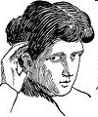
Concentrate and pay attention
Poor listeners frequently are poor concentrators.
Effective listening requires that you concentrate and pay attention.
Remove all thoughts of home, friends, fun, and ancillary activities from you head while the teacher is speaking.
Learning to focus and concentrate will help you become an effective listener and a much more effective student.

Slide 13
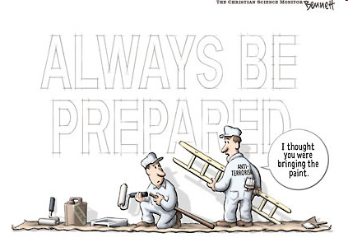
Be prepared
It is difficult to listen and mentally process what you're hearing when you come to your class unprepared.
If your teacher gives you a reading assignment or homework designed to prepare you to understand a topic, it’s important that you are familiar with the topic before it is discussed in class.
Being ready to listen means being prepared for each class ahead of time.

Slide 14
Focus on what is important
Poor listeners focus on fact.
They may retain a few of those facts, but the information is usually garbled.
Effective listeners focus on main ideas, fundamental concepts and vital issues.
Choose to be interested
One of the most tell-tale signs of poor listeners is that they just can't find what the teacher is talking about to be interesting.
They don't listen with real intent and often miss important topics and details being addressed.
Good listeners are able to decide to be interested in the subject matter being addressed by the teacher.
They listen more intently and effectively.

Slide 15
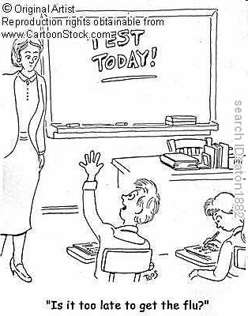
Lesson 4: Dealing With Test Anxiety
It’s completely normal to experience anxiety at some time or another – we all do. And while we may not enjoy feeling anxious, a little bit of anxiety can be beneficial. A little bit of anxiety helps to keep you motivated, focused, and alert. However, too much anxiety may interfere with your ability to study, learn, remember things, and perform well when taking tests. Too much anxiety about taking tests is referred to as test anxiety.
The following are a few tips for dealing with too much test anxiety:

Slide 16
Develop good study habits. Good study habits will not only prepare you to address test material, but they will also provide you with confidence that will help to reduce unhealthy test anxiety.
Be prepared. Being totally prepared for a test is the most important thing you can do to reduce anxiety. Knowing that you know the material on the test will provide you the confidence you need to overcome anxiety and the ability to perform. You've got good reason to be overly anxious if you go into a test unprepared.
Don't cram! Cramming for tests can lead to test anxiety. If you'll prepare for your test ahead of time, you'll be able to reduce a lot of test anxiety associated with last minute cramming.

Slide 17
Get adequate exercise
Getting adequate exercise and staying in shape is believed to help sharpen the mind.
Get plenty of sleep
Getting a good night's sleep before an exam can help reduce test anxiety dramatically. Conversely, not getting a good night’s rest before an exam will make you tired while taking an exam and will lead to increased test anxiety.
Get plenty to eat
Don't take an exam on an empty stomach. It’s quite common not to want to eat before an exam due to anxiety. However, if you'll get a good meal before taking an exam, you'll experience less anxiety, and your mind will be more keen.

Slide 18
Create a Study Environment
Real learning takes time and attention. Reinforce a consistent approach to learning by creating a specific place and routine time for studying. Don't forget to allow for breaks!
Set a Place. Choose a place that is quiet with few distractions and that has pens, pencils, paper, a dictionary, and a ruler at hand. Study space should be well-lighted.
Set a Time. Designate study time when you are alert, fresh, and relaxed and, ideally, at the same time daily. Don't forget short breaks to refresh the mind. During the break, take a walk outdoors or try deep breathing exercises. Research studies show that physical well-being promotes mental well-being and renewed energy.

Slide 19
Stay positive
Don't focus on failing the test.
Focus on acing the test.
Thinking about what might happen if you fail will lead to unnecessary anxiety and just might become a self- fulfilling prophecy.
Focus on the learning experience
Don't think of a test as the final judgment.
View each test as a learning experience
Stay relaxed
Take slow, deep breaths
stay in control.

Slide 20
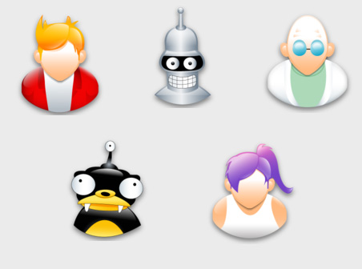
Lesson 5: Finding Your Learning Style
There are many different learning styles and learning preferences. The most common include
Visual Learning Style (the most common)
Auditory Learning Style
Tactile (Kinesthetic) Learning Style Additional learning styles and preferences include Logical (mathematical), Social (interpersonal), and Solitary (intrapersonal). There is no right mix, nor are your styles fixed. Some people may find that they have a dominant style of learning, with far less use of the other styles. Others may find that they use different styles in different circumstances. You can develop ability in less dominant styles, as well as further develop styles that you already use well.

Slide 21
Visual Learning Style
learn best when ideas or subjects are presented in a visual format
written language
Pictures
Diagrams
Videos
learn best when the teacher provides
written study notes
writes on the chalkboard
uses an overhead projector to explain concepts
frequently take detailed notes in class, when studying from a textbook or listening to lectures
create diagrams and use pictures to understand and remember concepts and ideas

Slide 22
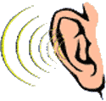
Auditory Learning Style
learn best by participating in class discussion
listening to your teacher lecture
listening to audio tapes
listening to other language formats
learn, understand, and retain information better when they hear it rather than see it

Slide 23
Tactile/Kinesthetic Learning Style
hands-on learners
learn best when they are able to physically participate directly in what they are required to learn or understand
excel when they are able to handle something in order to learn about it
do especially well in classes where lab work is required
learn by touching and feeling.

Slide 24
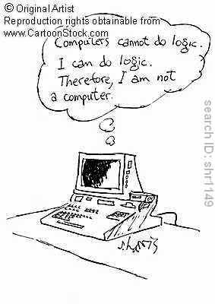
Logical Style
like using your brain for logical and mathematical reasoning
recognize patterns easily
logical connections between what would appear to most people to be meaningless content
classify and group information

Slide 25
Social Style
communicate well will others
verbally and non-verbally
good listeners
understand others’ views
People listen to you and come to for advice
prefer learning in groups or classes
typically like to spend one-on-one time with a teacher or an instructor

Slide 26
Solitary Style
private, introspective and/or independent
concentrate and focus on a specific subject, topic, or concept without outside help
very self aware
able to analyze the different ways you think and feel
prefer to work on problems by retreating to somewhere quiet and working through possible solutions by themselves
need to be careful, as they may spend too much time trying to solve a problem that they could more easily solve by talking to someone or working with a group.

Slide 27
Lesson 6: Improving Your Memory
Remembering information is essential to your ability to excel in school and later in your career. If you are unable to remember what you’ve learned, then you won’t be able perform well on tests, and you will be unable to apply what you’ve learned in the real world. Remembering information is an essential skill. The following are a few proven tips and strategies for improving your ability to remember information.

Slide 28
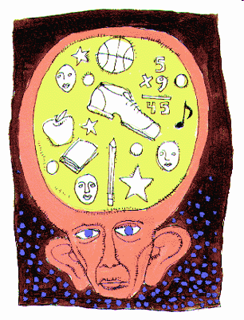
Make the information meaningful
One of the most common reasons that students don't remember is because material is presented in a way that is confusing or doesn't make sense.
Students who try to memorize information they don't fully understand struggle to remember what they've read or heard.
Don't try to memorize the author's words.
First, put the information you're reading or hearing into your words, as your own words are going to be meaningful and easy to understand.
If you can't put information, a concept, or idea in your own words, it’s very unlikely that you're going to be able to remember the material for very long.

Slide 29
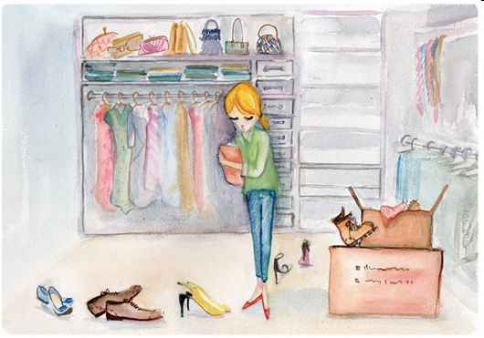
Organize the information
Organizing material into to logical categories will help you learn, memorize, and recall information more effectively.
For example, if you have several dates you need to remember for a history test, putting the dates in chronological order according to a sequential storyline can make recalling each date much easier.
Instead of memorizing random dates, you associate each date with a specific event that leads to another event.
Information that is well organized is much easier to learn and remember than information that is unorganized.

Slide 30
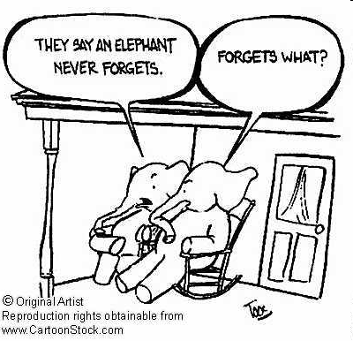
Use pictures to improve memory
More often than not, a person's memory for pictures or images is far better than his or her memory for words.
Creating a mental picture can enhance a person's memory of verbal and written information.

Slide 31
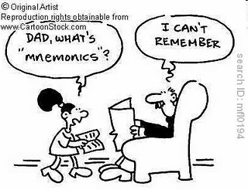
Mnemonic devices
Creating an acronym is a good strategy to use to remember information in any order.
An acronym is a word that is formed from the first letter of each fact to be remembered.
It can be a real word or a nonsense word you are able to pronounce.
For example, MADD is an acronym for Mothers Against Drunk Drivers (Destructive Decisions).

