Slide 1
Somatic and Special Senses

Slide 2
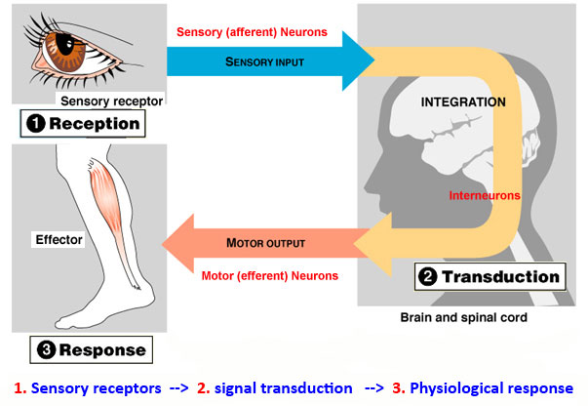
Sensation
Sensory Receptors detect changes in our body and surroundings
Trigger nerve impulses
Travels to CNS for interpretation
Perceive a sensation

Slide 3
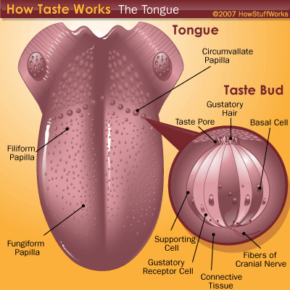
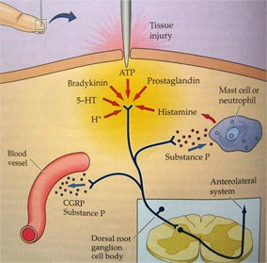
Types of Receptors
Chemoreceptors: changes in chemical concentration of substances
Pain Receptors: tissue damage

Slide 4
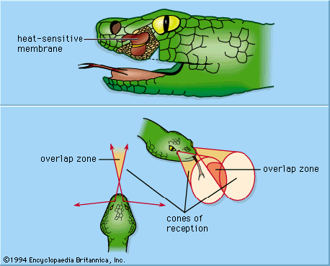
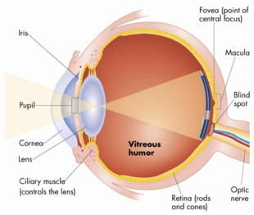
Types of Receptors
Thermoreceptors: changes in temperature
Mechanoreceptors: changes in pressure or movement
Photoreceptors: light energy

Slide 5
Sensations
A feeling that occurs when the brain interprets sensory impulses
Differences in impulse is due to which region of the brain receives the impulse
Sound vs. touch
Projection: cerebral cortex causes the sensation to seem to come from the stimulated receptor
Eyes see and ears hear

Slide 6
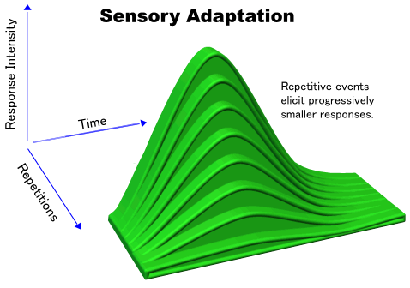
Sensory Adaptation
sensory receptors are continuously stimulated
Impulses leave at a decreasing rate until the signal stops
After adaptation, impulse can be triggered if the stimulus strength changes
Strong scent in a room

Slide 7
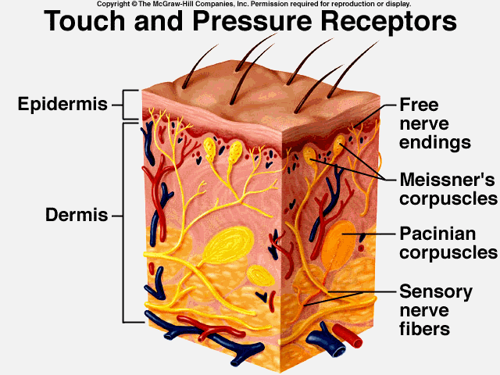
Somatic Senses
Receptors in the skin, muscles, joints, and viscera
Touch and Pressure: 3 types of receptors
Sensory nerve fibers: epithelial tissue

Slide 8
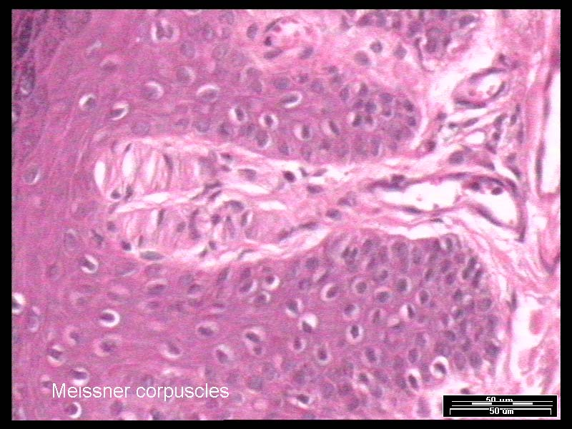
Touch and Pressure
Meissner’s corpuscles: small, oval masses of flattened connective tissue cells
Hairless portions of the skin: lips, fingertips, palms, soles, nipples, and external genital organs
Respond to the motion of objects that barely contact the skin, light touch

Slide 9
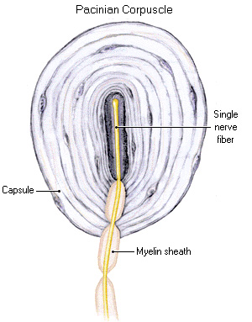
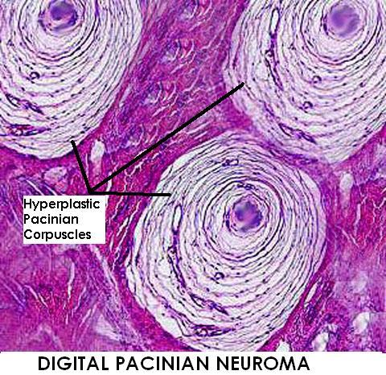
Touch and Pressure
Pacinian Corpuscles: relatively large structures composed of connective tissue fibers and cells
Subcutaneous tissues, muscle tendons, and joint ligaments
Respond to heavy pressure
Sensation of deep pressure

Slide 10
Temperature
Heat receptors: respond to warmer temp.
45ºC-25ºC, 113ºF-77ºF
Above this range, pain receptors are stimulated → burning sensation
Cold receptors: respond to colder temp.
10ºC -20ºC, 50ºF-68ºF
Below this, pain receptors simulate → freezing sensation

Slide 11
Pain
Free nerve endings
Widely distributed throughout the skin and internal tissues
Excepts in nervous tissue of the brain
Protection
Unpleasant stimulus → signals a person to remove the stimulus

Slide 12
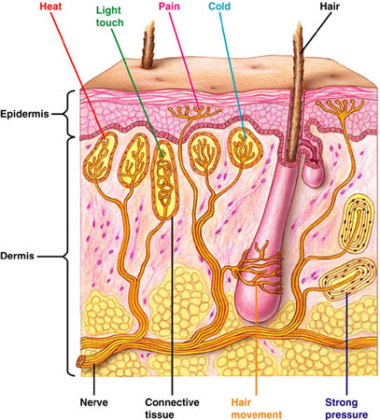

Slide 13
Visceral Pain
Pain receptors are the only receptors in viscera whose stimulation produces sensation
Intestinal tissues are stretches or smooth muscles in intestinal walls undergo spasms
Referred Pain: the origin of the pain is different than where it is perceived
Heart pain appears in left shoulder or left upper arm

Slide 14
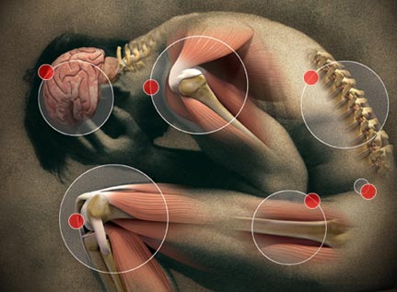
Pain Nerve Fibers
Acute Pain Fibers: thin, myelinated fibers
Conduct nerve impulses rapidly
sharp pain from the skin
Chronic Pain Fibers: thin, unmyelinated fiber
Conduct impulses more slowly
Dull, aching pain from deeper tissues
Difficult to pinpoint

Slide 15
Regulation of Pain Impulses
Awareness of pain arises when impulses reach the thalamus
Cerebral cortex: determine pain intensity, locates pain source, and mediates emotional and motor responses
Nerve fibers release biochemicals that block pain signals
Enkephalins: suppress acute and chronic pain, relieve sever pain
Similar to morphine and other opiates
Serotonin: stimulates other neurons to release enkephalines
Endorphins: extreme pain and natural pain control

Slide 16
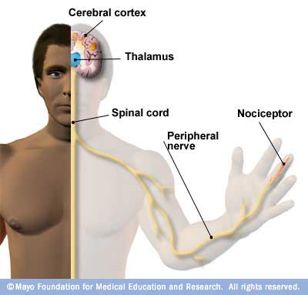

Slide 17
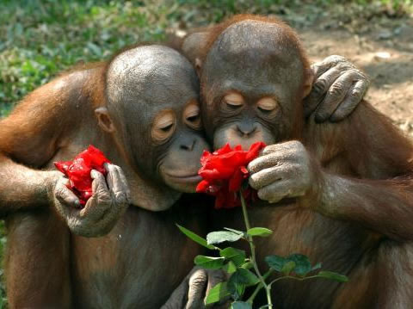
Smell, Taste, and Hearing

Slide 18
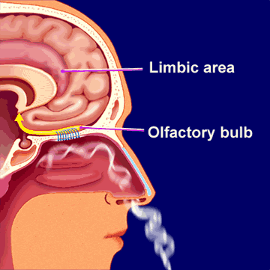
Smell
Olfactory organs → smell
Upper region of the nasal cavity
Chemoreceptors
Smell and taste function closely together
Aid in food selection

Slide 19
Olfactory Organs
Olfactory receptors: yellowish brown masses
Covers upper parts of the nasal cavity, the superior nasal conchae, and portion of the nasal septum
Bipolar neurons
Covered by hair like cilia at the distal ends
Sensitive parts of the receptors
Gases must dissolve into the watery fluids surrounding the cilia before receptors detect them

Slide 20
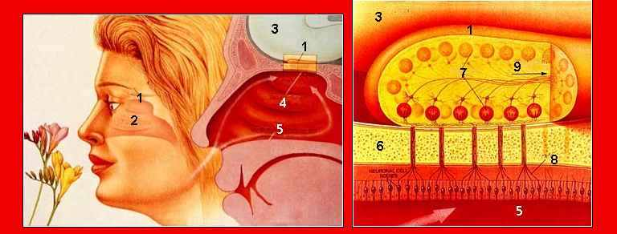
Olfactory Nerve Pathways
Olfactory bulbs analyze the impulse
Travels to limbic system
Interpreted in the temporal lobes and at the base of frontal lobes

Slide 21
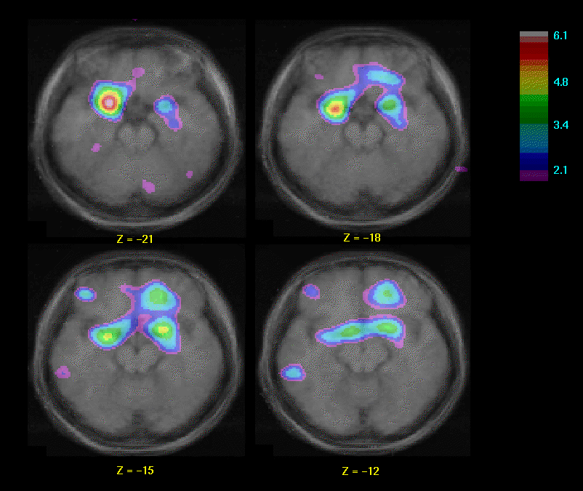
Olfactory Stimulation
Olfactory impulses may result when gaseous molecules combine with specific sites on cilia of receptor cells
Olfactory receptor cells adapt rapidly

Slide 22
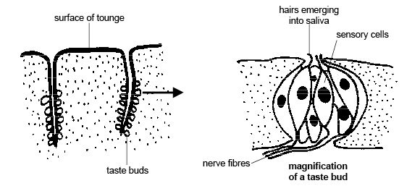
Sense of Taste
Taste Buds: specialized organ of taste
Surface of the tongue, roof of the mouth, walls of pharynx
Taste Cell: gustatory cells, receptors
Taste Port: opening
Taste hair: protrude from taste cell
Sensitive part of receptor cell

Slide 23
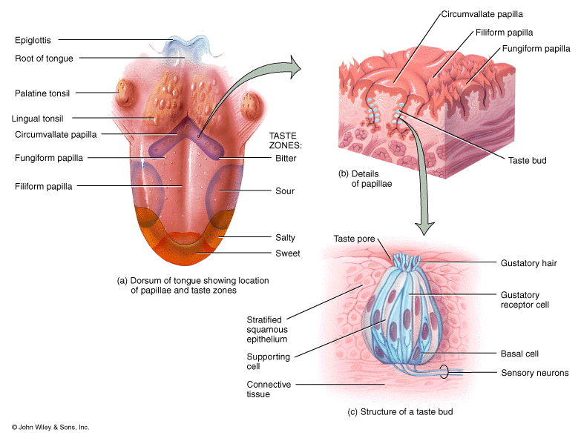

Slide 24
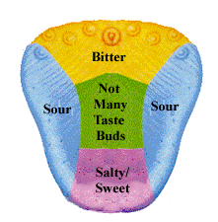
Taste
Before a chemical can be tasted, it must be dissolved in water
Provided by salivary glands
Generates a sensory impulse on a neighboring neuron

Slide 25
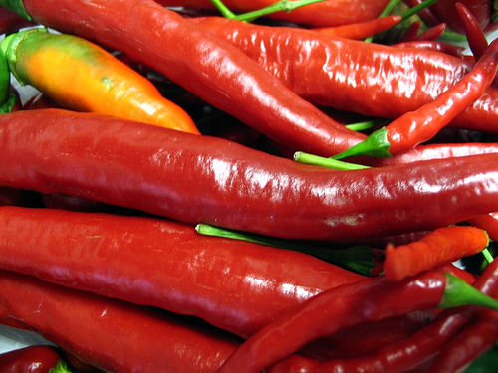
Taste Sensations
Each receptor type is concentrated in certain regions of the tongue
Sweet: sugar Sour: lemon
Salty: table salt Bitter: caffeine or quinine
Alkaline Metallic
Flavor: taste, odor, texture, and temperature
Burning: chili peppers or ginger

Slide 26
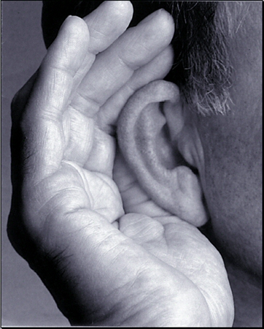
Sense of Hearing
Vibrating objects produce sound
Sound waves
Musical instruments: vibrating string or reed
Voice: vibrating vocal cords
External Ear:
Auricle or pinna: outer, funnel-like structure
Collects sound waves and directs them
External Auditory meatus: S-shaped tube
Leads inward through temporal bone

Slide 27
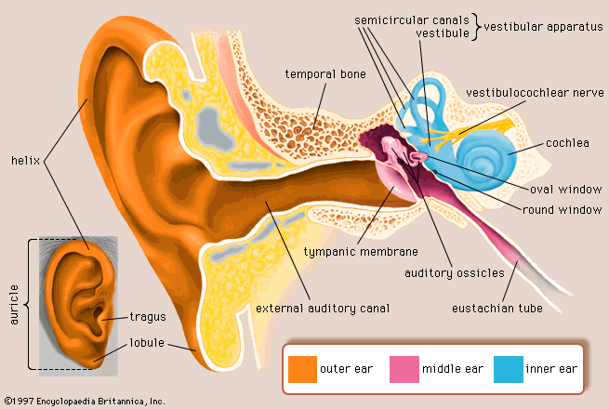

Slide 28
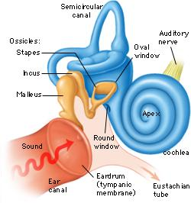
Middle Ear
tympanic cavity, eardrum(tympanic membrane), and auditory ossicle (3 small bones)
auditory ossicles of the middle ear conduct sound waves form the eardrum to the oval window on the inner ear

Slide 29
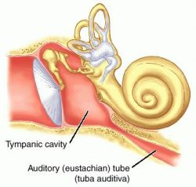
Auditory Tube
Connects the middle ear to the throat
Maintain equal air pressure on both sides of the ear drum
Detect problems when you have a sudden change in altitude
Equalizing the air pressure causes a popping sound → hearing returns

Slide 30
Inner Ear
Complex system of connected tubes and chambers
Osseous and membranous labyrinths
Corti contains the hearing receptors that vibrations in the fluid of the inner ear stimulate
Different frequencies of vibrations stimulate different sets of receptor cells

Slide 31
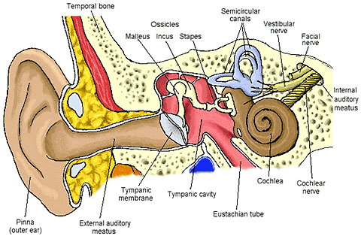

Slide 32
Equilibrium and Sight

Slide 33
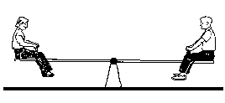
Equilibrium
Static Equilibrium
Maintains the stability of the head and body when they are motionless
Hair cells project upward in mass of gelatinous material
Moving the head bends the hair cells in response to gravity
Nerve impulse travels to CNS

Slide 34
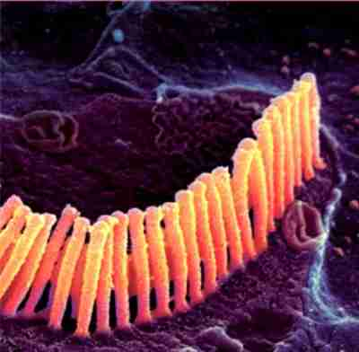
Equilibrium
Dynamic Equilibrium
Balances the head and body when they are moved or rotated suddenly
Hair cells extending upward in a gelatin mass
Movement of hair cells stimulate a nerve signal
Other Structures assisting in equilibrium
Eyes and mechanorecpetors of joints
In the neck

Slide 35
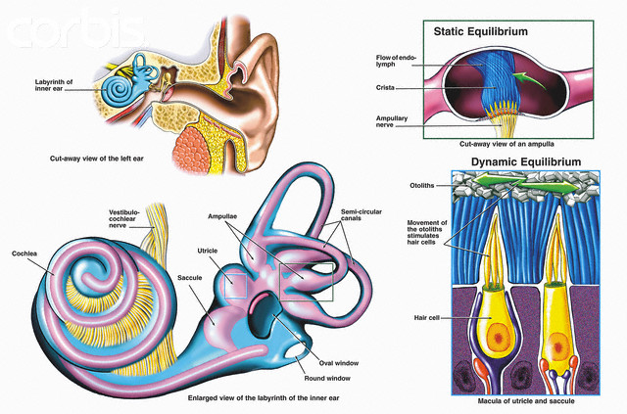

Slide 36
Sight
Visual accessory organs
Eyelids
4 layers: skin, muscle, connective tissue, and conjunctiva (mucus membrane)
Lacrimal apparatus: secretes tears
Moistens and lubricates eye’s surface
Contain antibacterial agents
Extrinsic muscles: 6 muscles that move the eye
arise from the orbit bone

Slide 37
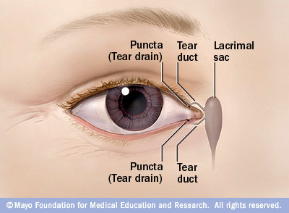
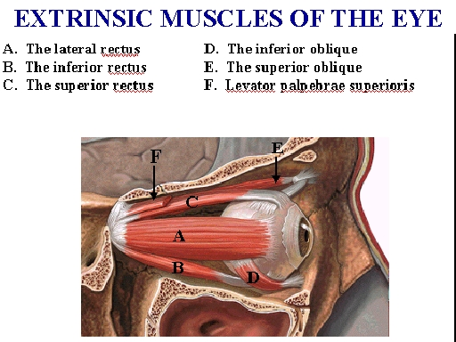

Slide 38
Structure of the Eye
Hollow spherical structure about 2.5 cm in diameter
3 Layers
Outer tunic: fibrous
Middle tunic: vascular
Inner tunic: nervous
Fluid filled
Supports walls and shape

Slide 39
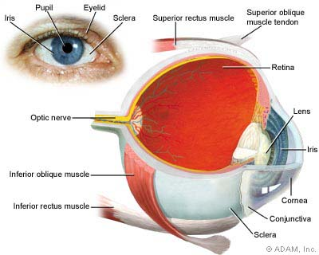
Parts of the Eye
Outer Tunic
Cornea: focus entering light rays
Transparent connective tissue
Loss of cornea transparency is leading cause of blindness
Sclera: white portion of the eye
5/6 of outer tunic
Protection & muscle attachment
Optic Nerve: back of eye

Slide 40
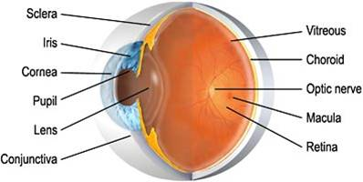
Parts of the Eye
Middle Tunic
Choroid Coat: posterior 5/6 of the globe
Contains melanocytes that absorb light
Maintain darkness inside the eye

Slide 41
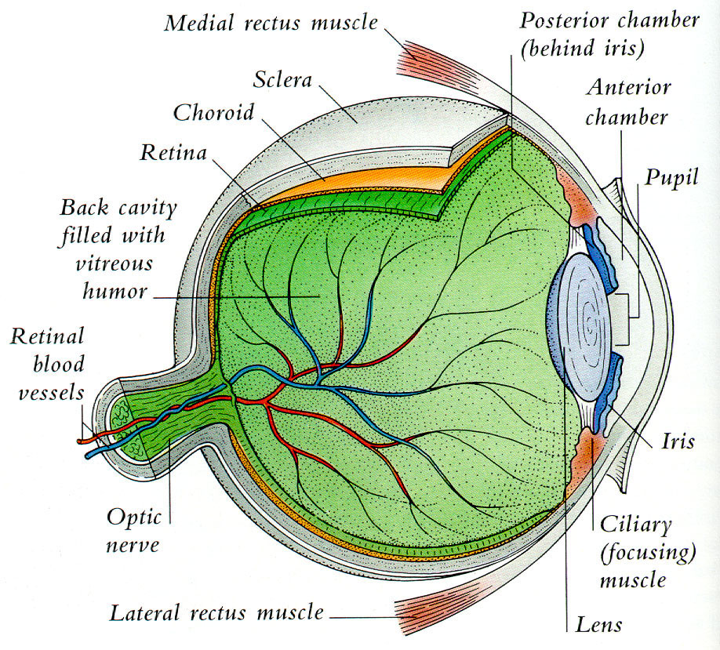
Ciliary Body: extends from choriod coat
Internal ring around the front of the eye
Lens: clear, membrane like structure
Lies directly behind the iris and pupil
Accommodation: lens can adjust shape to focus on an image

Slide 42
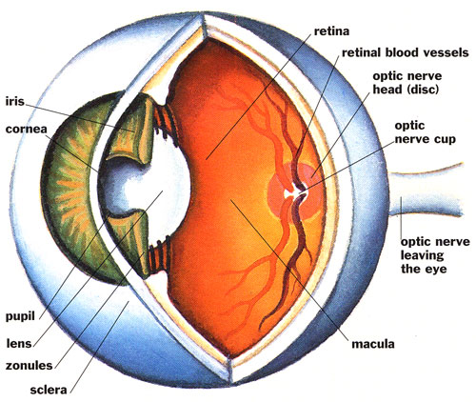
Middle Tunic
Iris: thin diaphragm composed of connective tissue and smooth muscle fibers
Colored portions of the eye
Muscle control the size of the pupil
Pupil: circular opening in the center of the iris
Opening that light passes into the eye

Slide 43
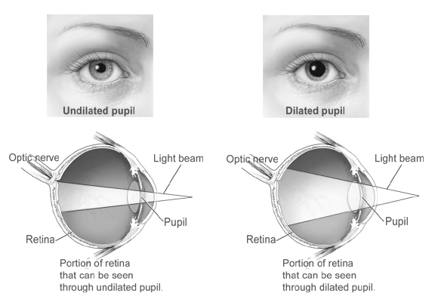

Slide 44
Inner Tunic
Retina: photorecptors
Continuous with optic nerve
Fovea centralis: region producing sharpest vision
Optic disk: nerve fibers leave the eye and join optic nerve
Blind spot: no receptor here
Vitreous Humor: transparent, jelly-like fluid
Supports internal parts of the eye
Maintains shape

Slide 46
Light Refraction
Bending of light waves to focus an image on the retina
Convex surface of lens causes the light waves to converge
Image focuses on retina like a project shows a movie
Image is upside down and reversed left-to-right
Visual cortex corrects the image

Slide 47
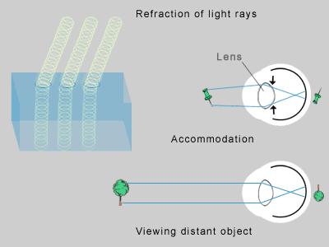

Slide 48
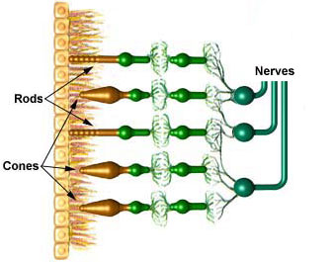
Visual Receptors
Rods: long, thin projections
100x more sensitive → dim light
Black and white
General outlines of objects
Cones: short, blunt projections
Colored images
Sharp images

Slide 49
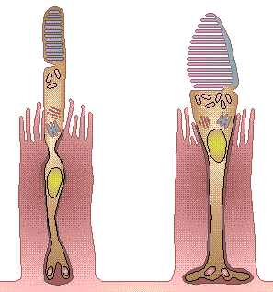
Visual Pigments
Decompose in the presence of light and triggers a complex series of reaction that initiate nerve impulses
Rods: rhodopsin
Cones: erythrolable (red), chlorolable (green), cyanolable (blue)

Slide 50
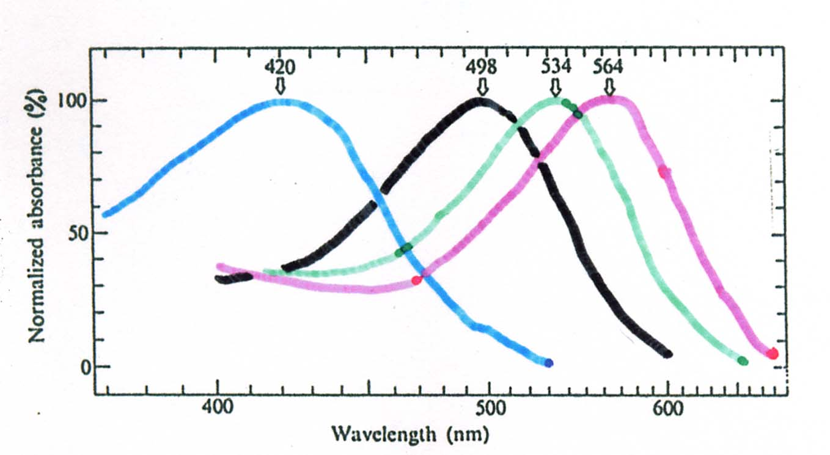
Visual Pigments

Slide 51
