Slide 1
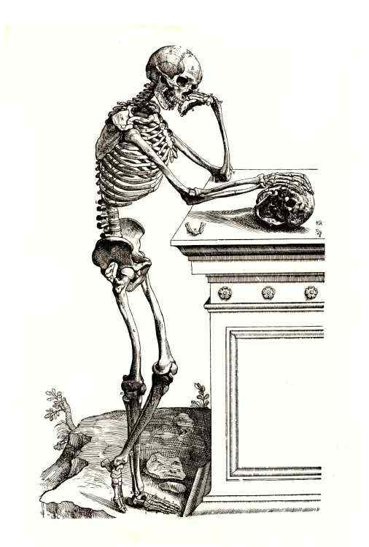
Skeletal System

Slide 2
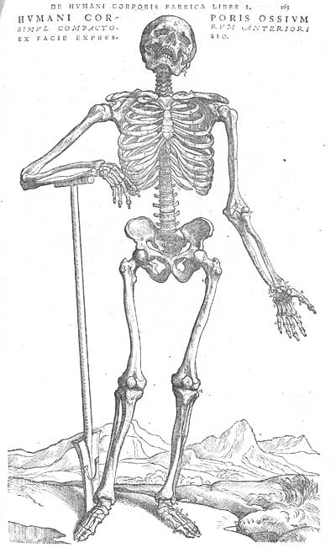
Bones
Appears as an inactive organ
Actually, very active
Active Bone Tissues
  bone tissue
  cartilage
  dense connective tissue
  blood
  nervous tissue
Bones
  vary in size and shape
  Similar in structure, development, and function

Slide 3
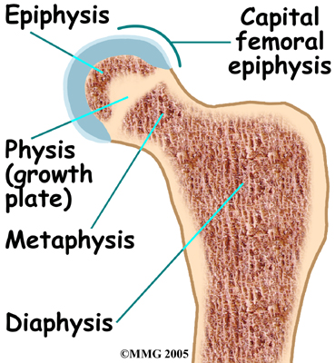
Bone Structure
Parts of Long Bones
  Groves and openings: passageways for blood vessels and nerves
  Epiphysis: expanded portion at the end of a bone
    Spongy Bone: thin layers of compact bone and many branching plates
      Irregular connecting spaces lessens bone’s weight
      Strong and resistant to bending
    Forms a joint with another bone
    Coated with hyaline cartilage, articular cartilage

Slide 4
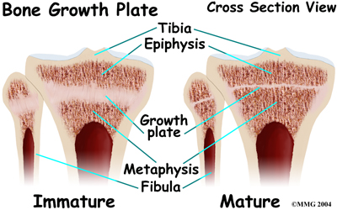
Parts of Bone
Diaphysis: shaft of the bone
  Compact Bone: tightly compact tissue
    Continuous matrix with no gaps
    Strong and resistant to bending
  Medullary Cavity: hollow chamber in compact bone
    Endosteum and marrow line area
      Endosteu: thin layer of cells
      marrow: soft connective tissue

Slide 5
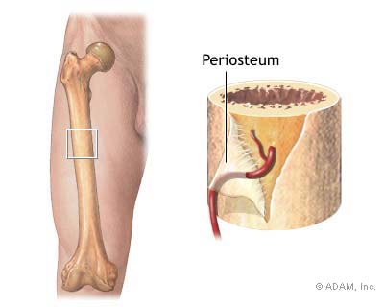
Parts of Bones
  Periosteum: tough, vascular covering of fibrous tissue
    Completely encloses the bone, except at the end
    Periosteal fibers are continuous with ligament and tendons
      Processes: bony projections
        site of ligament and tendon attachment
    Helps form and repair bone tissue

Slide 6
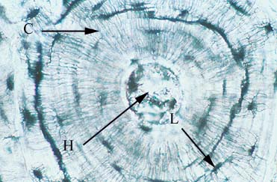
Microscopic Structure
Intracellular material: largely collagen and inorganic salts
  Collagen: strength and resilience
  Salts: hardness and resistance to crushing
Osteocytes (bone cells): located in bony chambers called lacunae
  Osteonic Canals: concentric circles
    Contains blood vessels and nerve fibers
    Surrounded by loose connective tissue

Slide 7
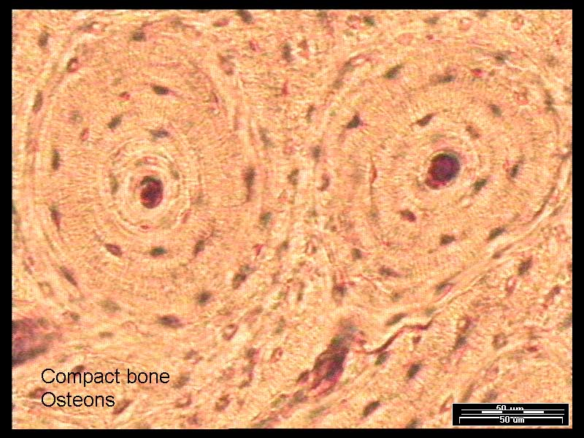
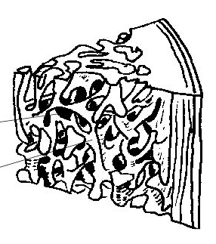
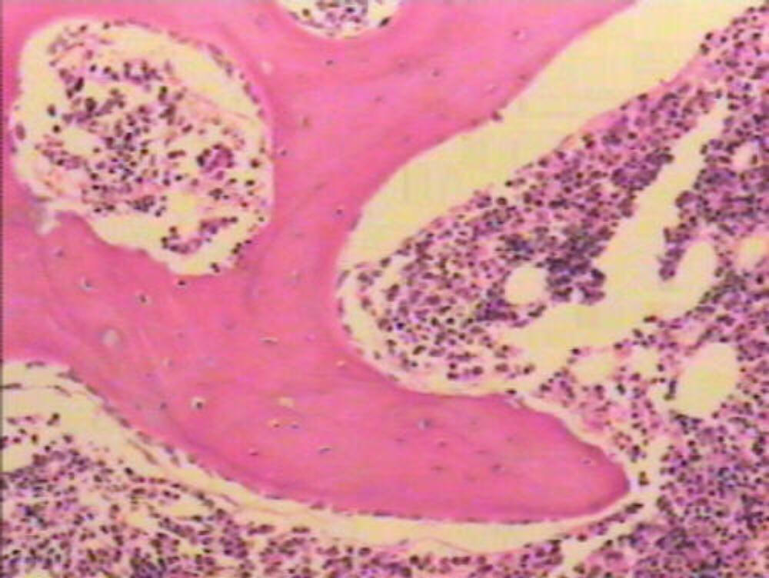
Microscopic Structure
Spongy Bone: bone cells don’t aggregate around osteonic canals
  Substances diffuse to the surface of this bony plates

Slide 8
Bone Development, Growth, and Function

Slide 9
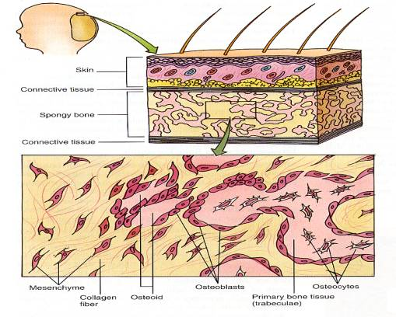
Bone Development
Begins during 1st weeks of pregnancy
Form by replacing existing connective tissue
  Intramembranous bones originate between sheet like layers of connective tissue
  Endochondral bones begin as masses of cartilage that bone tissue latter replaces

Slide 10
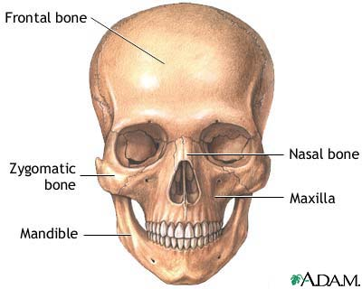
Intramembranous Bone
Broad, flat bones of the skull
During development, membrane-like layers of connective tissue appear at the sites of future bones

Slide 11
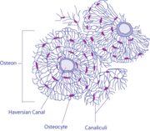
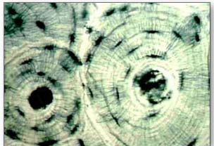
Intramembranous Bone
Some of the primitive connective tissue cells enlarge and differentiate into osteoblasts, bone-forming cells
  Becoming active with the membranes and deposit bony matrix around themselves
  Forms spongy bone tissue in all directions
Osteocytes: occurs when matrix completely surrounds osteoblasts

Slide 12
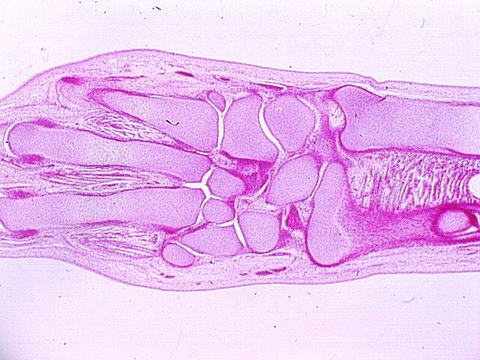
Endochondral Bones
Most bones of the skeleton
Develop from masses of hyaline cartilage shaped like future bone structure
Endochondral bones develop as hyaline cartilage that is later replaced by bone tissue

Slide 13
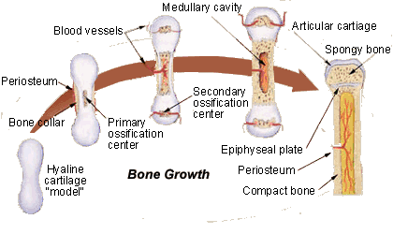
Endochondral Bones
Primary ossification center appears in the diaphysis, whereas the second appears in the epiphyses
Epiphyseal disk remain between the primary and secondary ossification centers
  Responsible for lengthening
  Long bones continue to grown until disk are ossified
  Growth and thickness are due to intramembranous ossification beneath the periosteum

Slide 14
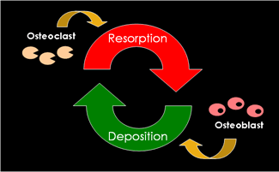
Homeostasis of Bone Tissue
Throughout life, bone is reabsorbed and deposited
  Osteoclasts resorb bone matrix
  Osteoblast replace it
  Regulated by hormones
  3-5% of calcium is exchanged per year in an adult

Slide 15
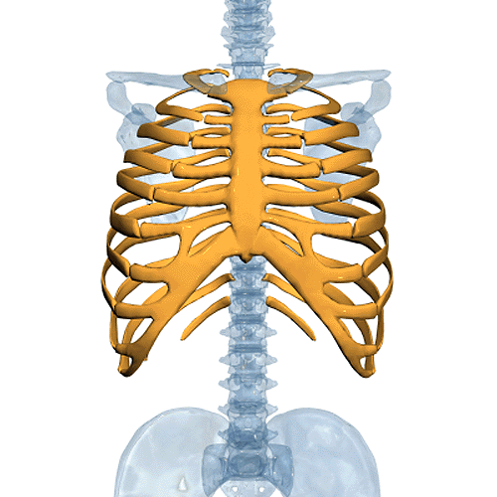
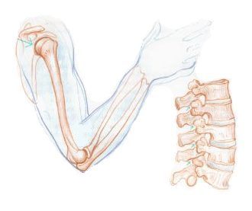
Bone Function
Shape, support, and protect body structures
Aid in movement
House tissues that produce blood cells
Store inorganic salts

Slide 16
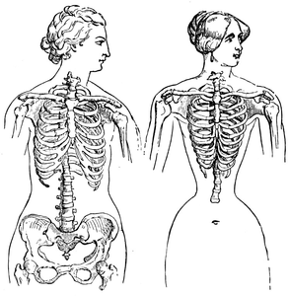
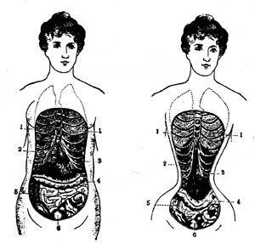
Support and Protection
Give shape to head, face , and thorax, and limbs
Lower limbs, pelvis, and backbone support the body’s weight
Skull: protects eyes, ears, and brain
Rib cage and Shoulder Girdle: protect the heart and lungs
Pelvic Girdle: protect the lower abdominal and internal reproductive organs

Slide 17
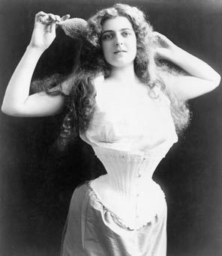
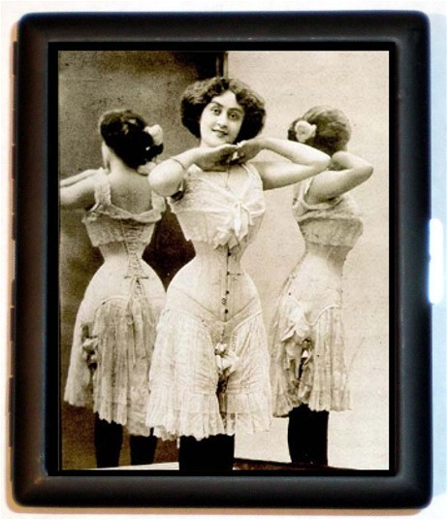
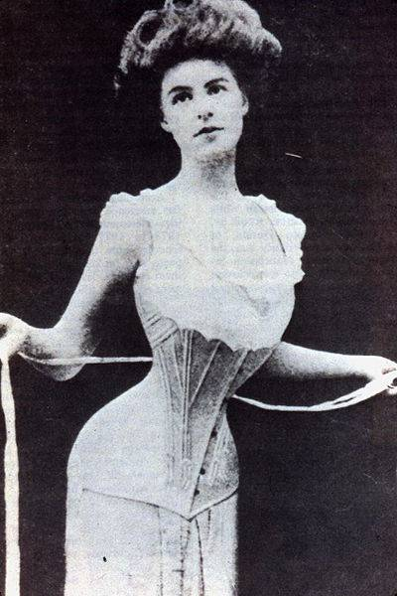
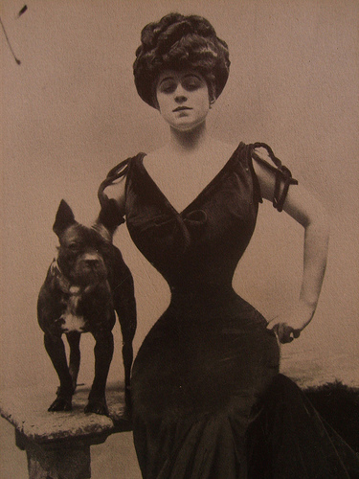
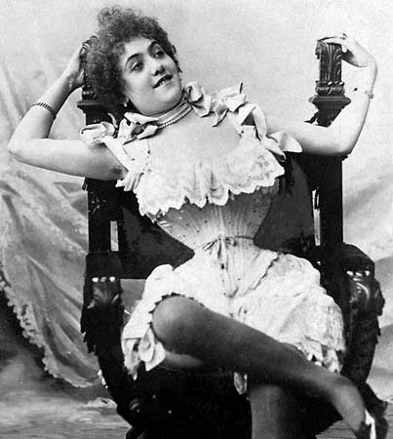

Slide 18
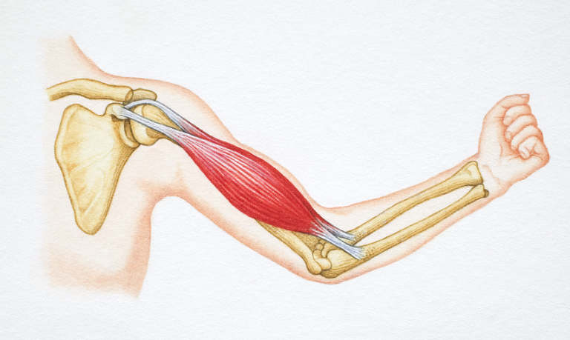
Body Movement
Levers: how bones and muscles interact
  Components of Leavers
    Rigid rod or bar → upper forearm bones
    Fulcrum or pivot on which the bar turns → elbow joint
    An object that is moved against resistance → hand is moved
    Energy supplying force → muscles supply force

Slide 19
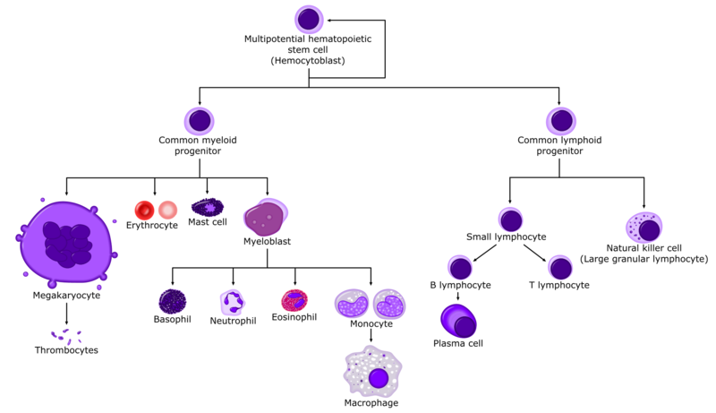
Blood Cell Formation
Hematopoiesis: blood cell formation
  Occurs in the yolk sac early in life
  Liver and spleen
  Bone marrow

Slide 20
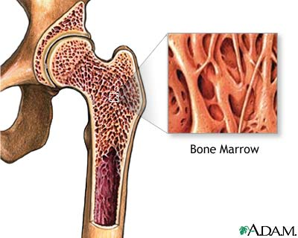
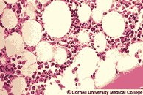
Blood Cell Formation
Marrow: soft, netlike mass of connective tissue
  Inside long bones
  Red Marrow: formation of RBC (eryothrocytes) , WBC (leukocytes), blood platelets (thrombocytes)
    Red because of hemoglobin in the RBC
    Adult: spongy bone of skull, ribs, sternum, clavicles, vertebrae, and pelvis
  Yellow Marrow: stores fat and is inactive in blood cell production
    Replaces red marrow with age

Slide 21
Storage of Inorganic Salt
Intercellular Matrix of bone tissue: rich in calcium salts
  Calcium phosphate
  Ca is vital in metabolic processes
When blood is low in Ca, parathroid hormone stimulates the break down of bone tissue
  Release Ca to the blood
When Ca is high, calcitonin from thyroid glad stimulates bone tissue formation
Bones also store Mg, Na, K, carbonate ions
  Toxins: lead, radium, or strontium

Slide 22
Skeletal Organization

Slide 23
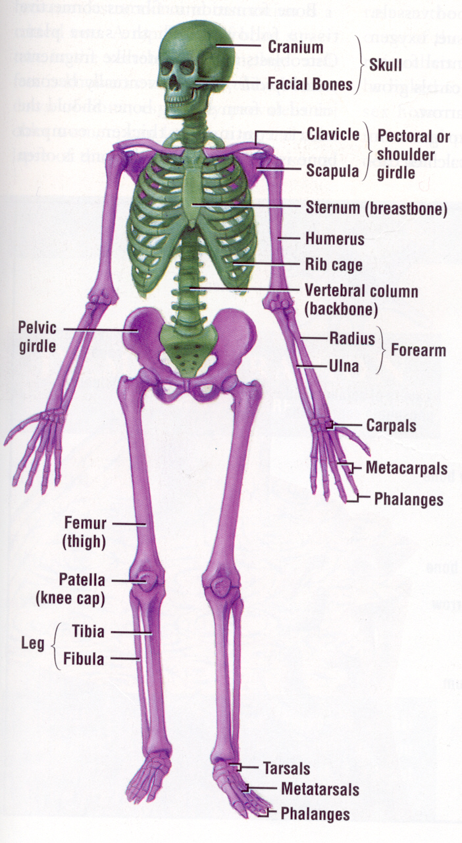
Skeletal Organization
Axial
  bony cartilaginous parts that support and protects the organs of the head, neck, and trunk
Appendicular
  bones of the upper and lower limb
  bones that anchor the limbs to the axial skeleton

Slide 24
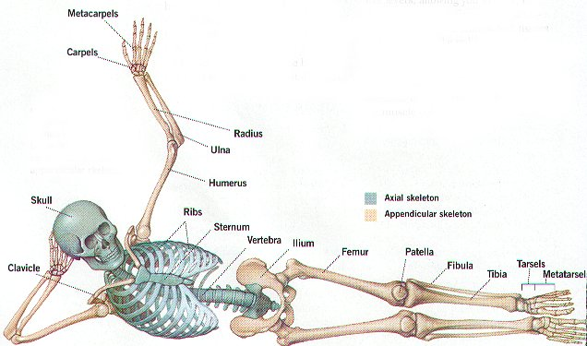
Axial Skeleton
Skull: cranium
Hyoid Bone: in the neck between the lower jaw and larynx
  Movement of the tongue

Slide 25
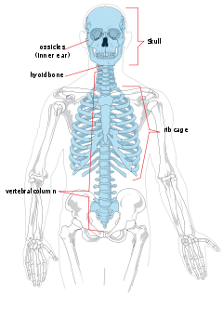
Axial Skeleton
Vertebral Column: backbone
  Vertebrae separated by intervertebral disk
  Sacrum: several fused vertebrae at the distal end
  Coccyx: small, rudimentary tailbone
Thoracic Cage: protects organs of thoracic & upper abdominal cavities
  Ribs: 12 pairs
  Sternum: to which most ribs are attached

Slide 26
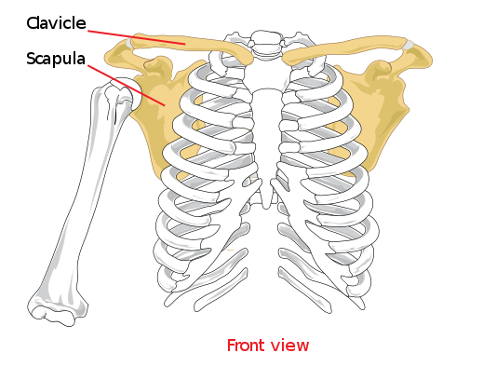
Appendicular Skeleton
Pectoral girdle: connects bones of the upper limbs to the axial skeleton
  Aid in movement
  Clavicle (collar bone) and scapula (shoulder blade)

Slide 27
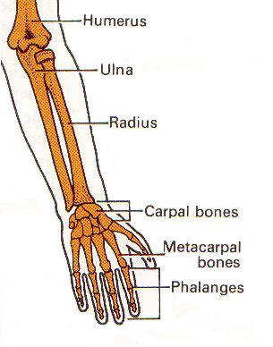
Appendicular Skeleton
Upper Limbs
  Humerus: arm bone
  Radius: forearm bone
  Ulna: beside forearm bone, smaller
  Carpals: wrist bones, 8
  Metacarpals: five bones of palm
  Phalanges: 14 finger bones

Slide 28
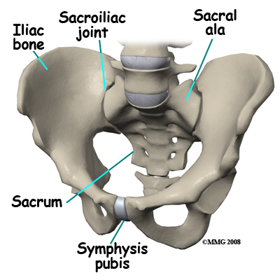
Appendicular Skeleton
Pelvic Girdle: connect lower limbs to the axial skeleton
  Coxal bones: hipbones
  Coxal and sacrum (part of backbone) form pelvis

Slide 29
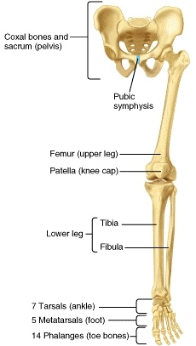
Appendicular Skeleton
Lower Limbs
  Femur: thighbone
  Tibia: larger bone in lower leg
  Fibula: smaller bone in lower leg
  Patella: knee cap
  Foot
    Tarsals: 7 anklebones
    Metatarsals: 5 bones of instep
    Phalanges: 14 bones of the toes

Slide 30
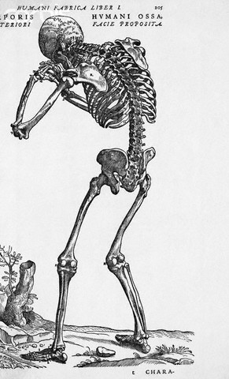
Skull &
Vertebral Column

Slide 31
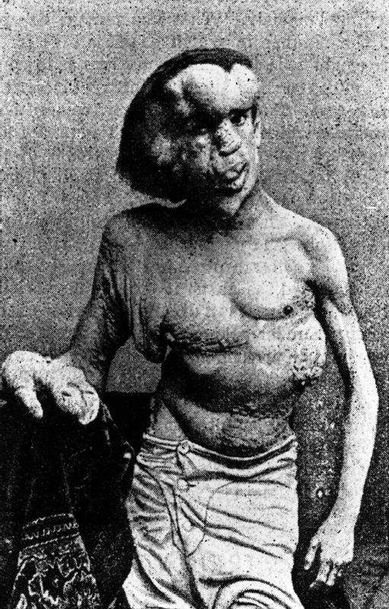
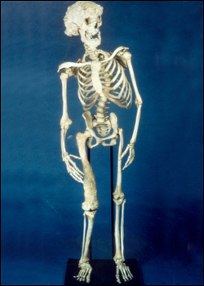
Elephant Man: Joseph Merrick

Slide 32
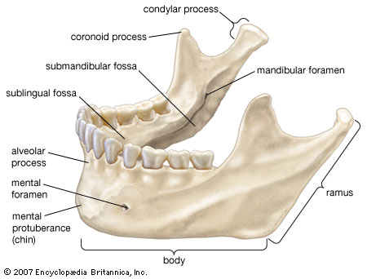
Skull
Consists of 22 bones
  All but the lower jaw are interlocked along suture line
  Cranium: 8 bones
  Facial Skeleton: 13 bones
Mandible: lower jawbone
  Moveable bone held in place by ligaments

Slide 33
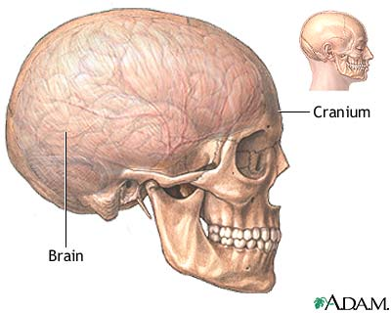
Cranium
Encloses and protects the brain
Provides attachment site for muscles
  Chewing and head movement
Paranasal sinuses: air filled cavities in some bones
  Lined with mucous membranes
  Connect to passageways to nasal cavity
  Reduce the skull’s weight and increase voice intensity
    Resonant sound chambers

Slide 34
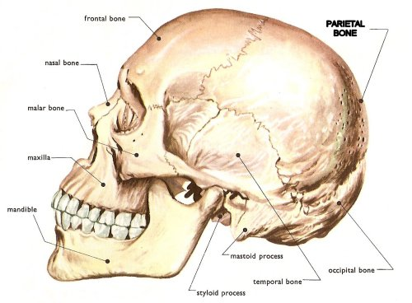
Cranium Bones
Frontal Bone: anterior portion of the skull above the eyes
  Supraorbital foramen: upper margin of each orbit (eye socket)
    Blood vessels and nerves pass of the tissues of the forehead
  Frontal Sinuses: one above each eye, near the middle
Parietal Bone: one on each side of the skull behind the frontal bone
  Bulging sides & roof of the cranium

Slide 35
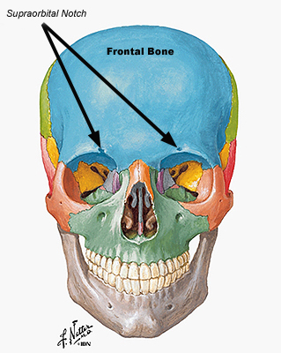
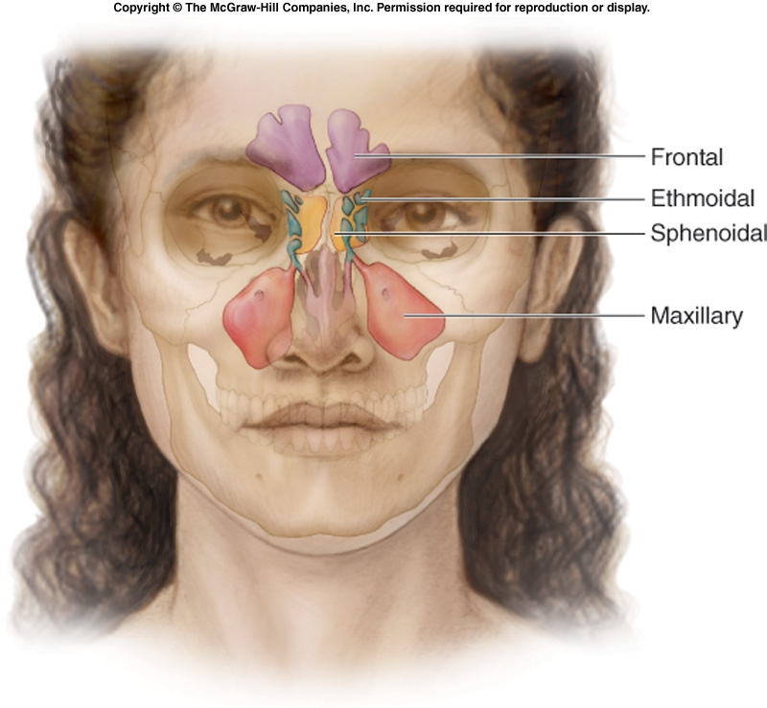
Skull

Slide 36
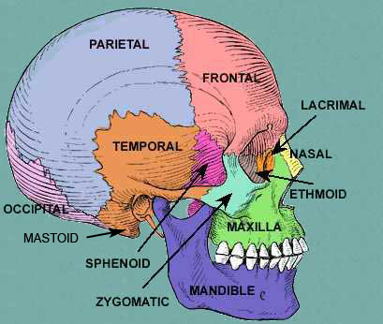
Cranium Bones
Occipital Bone: forms the back of the skull and base of the cranium
  Foramen magnum: opening from which nerve fiber pass from the brain to the spinal cord
Temporal Bone: parts of the sides and base of cranium
  External auditory meatus: leads to ear
  Mandibular fossae: where mandible adhears

Slide 37
Cranium Bones
Sphenoid Bone: forms the base of the cranium, the sides of the skull, and the floors and sides of the orbits
  Sella turcica: where pituitary glad resides
  Sphenoidal Sinuses: under eyes
Ethmoid Bone: part of the roof of the nasal cavity

Slide 38
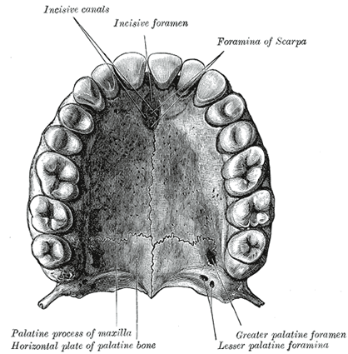
Facial Skeleton
Maxillae: upper jaw, parts of the roof of the mouth, floors of the orbits, and sides and floor of the nasal cavity
  Sockets for upper teeth
  Maxillary Sinuses: largest sinuses; beside the nose

Slide 39
Facial Skeleton
Palatine bones: hard mouth plate and floor of nasal cavity
Zygomatic bones: cheek bones
Lacrimal Bones: thin, scalelike structure
  Located in each orbit

Slide 40
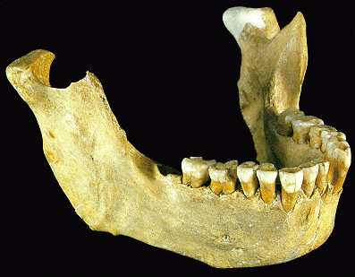
Facial Skeleton
Nasal Bones: long, thin and nearly rectangular
  Bridge of nose
Vomer Bone: thin, flat bone in the midline of nasal cavity
Inferior nasal conchae: support mucous membranes
  fragile, scroll-shaped bones in nasal cavity
Mandible: lower jaw bone
  Alveolar arch: hollow sockets that bear lower teeth

Slide 41
Infantile Skull
At birth, the skull is incompletely developed
  Fontanels: fibrous membranes connecting cranial bones
    Soft spots
    Allow some movement so developing skull is partially compressible and can slightly change shape
      Easier passage through the birth canal
    Eventually, the fontanels close as the cranial bones growth together
Small face, jaw, and nasal cavity
Prominent forehead and large orbits
Skull bones are thin and somewhat flexible
  Less easily fractured than adults

Slide 42
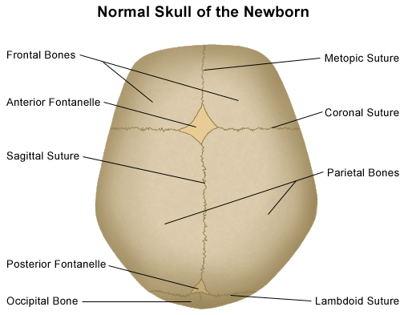

Slide 43
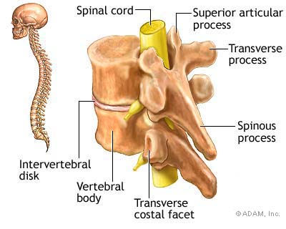
Vertebral Column
Supports the head and trunk of the body
Protects the spinal cord, which passes through the vertebral canal
Extends from the skull to the pelvis
Vertical axis of the skeleton
Composed of vertebrae
  Separated by masses of fibrocartilage called intervertebral disks
  Connect by ligaments

Slide 44
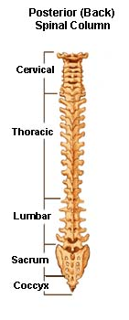
Vertebral Column
Cervical vertebrae: 7 vertebrae
  Bony axis of the neck
  Atlas: 1st vertebrae, supports the head
  Axis: 2nd vertebrae, atlas pivots on the axis
Thoracic vertebrae: 12 vertebrae
  Larger than cervical
  Has a pointed spinous process which increase with size as you move down the column
    Adapted to bear increasing loads of weight

Slide 45

Vertebral Column
Lumbar Vertebrae: 5 vertebrae
  Small of the back, loin
  Adapted with larger and stronger bodies to support more weight
Sacrum: triangular structure, composed of five fused vertebrae
  Forms base of the vertebral column
Coccyx: lowest part of vertebral column
  4 fused vertebrae
  Tail bone

Slide 46

Thoracic Cage, Pectoral Girdle, Upper Limbs

Slide 47

Thoracic Cage
Includes the ribs, thoracic vertebtrae, sternum, and costal cartilage between ribs and sternum
Support shoulder girdle and upper limbs
Protect viscera
Role in breathing

Slide 48

Thoracic Cage
Ribs: 12, one pair attached to attached to thoracic vertebrae
  True ribs: 1st 7
    join the sternum directly by costal cartilage
  False ribs: last 5
    their cartilages do not reach the sternum
    The upper 3 false ribs joins the seventh
    The last 2, or sometimes 3, are floating ribs
      No cartilaginous attachments
Sternum: breastbone
  Midline in the anterior portion of the thoracic cage

Slide 49
Pectoral Girdle
Shoulder girdle: 2 clavicles and 2 scapulae
  Incomplete ring
  Supports the upper limbs
Clavicles: collarbone
  Slender, rod-like bones with S-shape
  Brace the freely movable scapulae; hold shoulder in place
  Attachments for muscles of upper limbs, chest, and back
Scapulae: shoulder blades
  Broad, somewhat triangular bones
  Provides attachment for muscles of upper limbs and chest

Slide 50
Pectoral Girdle

Slide 51

Upper Limbs
Functions
  Form the framework of the arm, forearm, and hand
  Provide attachments for muscles
  Function in levers that move limbs
Bones
  humerus, radius, ulna, carpals, metacarpals, and phalanges

Slide 52

Upper Limb Bones
Humerus: heavy bone that extends from the scapula to the elbow
Radius: located on the thumb-side of forearm
  Extends from the elbow to the wrist
  Crosses over the ulna when the hand is turned
Ulna: longer than the radius and overlaps the end of the humerus posteriorly

Slide 53

Upper Limb Bones
Hand: wrist, palm, and five fingers
  Carpal Bones: 8 small bones of wrist
    Carpus: bones firmly bond in 2 row of 4
  Metacarpal Bones: 5 bones; one in line with each finger
    Framework of the palm
    Cylindrical with rounded distal ends that form knuckles
  Phalanges: finger bones
    Each finger has three phalanges, except the thumb, which has two

Slide 54

Bones of the Hand

Slide 55

Pelvic Girdle and Lower Limbs

Slide 56

Pelvic Girdle
Functions
  Supports the trunk of the body
  Provides attachment for lower limbs
  Protects the urinary bladder, distal end of large intestines, and internal reproductive organs
Form
  Two coxal bones
  Attached to each other anteriorly
  Attach with the sacrum posteriorly

Slide 57

Pelvic Bones
Coxal Bone: ilium, ischium, & pubis
  Ilium: largest and most upper portion
    Flares outward to form the prominence of the hip
  Ischium: lower portion
    L-shaped, pointing posteriorly and downward
    Supports body weight during sitting
  Pubis: anterior portion of the coxal bone
    Two pubis bones join at the at the midline

Slide 58

Lower Limbs
Functions
  Form the framework of the thigh, leg, and foot
Femur: longest bone in the body
  Extends from the hip to the knee
  Neck of the femur is the most common site of hip fracture
Patella: kneecap

Slide 59

Lower Limb Bones
Tibia: shin bone
  Larger of the two leg bones
  Located on the medial side
Fibula: long, slender bone on the lateral side of the tibia
  Doesn’t enter into the knee joint
  Doesn’t bear any body weight

Slide 60

Lower Limb Bones
Foot: ankle, instep, and five toes
  Tarsal Bones: 7 ankle bones
    Talus: can move freely where it joints the tibia and fibula
    Other bones are bond firmly together
    Calcaneus: heel bone; largest ankle bone
      Support body weight and muscle attachment site

Slide 61

Lower Limb Bones
  Metatarsals: five instep bones
    Distal ends form the ball of the foot
    Longitudinal Arch: heel to toe
    Transverse Arch: across the foot
      Arches provide stable, springy base for body
  Phalanges: toes
    Align with metatarsals
      Each toe has three, except the great toe, which has two

Slide 62

Joints

Slide 63


Joints
Fibrous Joints: lie between bones that closely contact one another
  Thin layer of connective tissue joins the bones
  No movement to very limited
  Suture between flat bones of the skull

Slide 64


Joints
Cartilaginous Joints: disks of fibrocartilage or hyaline cartilage connect the bones
  Disk absorbs shocks and helps equalize pressure
  Slight flexibility of disk allows for limited movement
  Separate the vertebrae, first rib

Slide 65

Joints
Synovial Joints: most joints
  Allow free movement
  Synovial fluid is released to lubricated joints
  Menisci: flatted, shock-absorbing pads of fibrocartilage
    Bursae: fluid filled sacs
    Patella

Slide 66


Types of Synovial Joint
Ball-and-socket: bone with ball-shaped head in a cup-shaped cavity
  Widest range of motion
  Movement in all planes
  Rotational movement around central axis
Condyloid Joint: oval-shaped condyle of one bone fits into an elliptical cavity
  Joint between metacarpals and phalanges
  Movement in variety of plans, but no rotation

Slide 67


Types of Synovial Joint
Gliding Joint: wrist and ankle joints
  flat articulating surfaces or slightly curved
  Sliding and twisting motion
  Sacroilic joints and joints formed in the ribs
Hinge Joint: convex surface of one bone fits into the concave surface of another
  Elbow and joints of the phalanges
  Movement in one plane

Slide 68


Types of Synovial Joint
Pivot Joint: cylindrical surface of one bone rotates within a ring formed of bones and ligaments
  Rotation around the central axis
  Proximal end of the radius and ulna
Saddle Joint: bones whose articulating surface have both concave and convex regions
  Variety of movements
  Carpal and metacarpal of thumb

