Slide 1
The Scientific Method

Slide 2
The Scientific Method
a logical, systematic approach to the solution of scientific problems
Observation – the use of your senses to obtain information
Hypothesis – proposed explanation for an observation
Experiment – procedure that is used to test a hypothesis
Manipulated variable – the variable you change
Responding variable – the variable that is observed
Theory – a well-tested explanation for a broad set of observations
Scientific Law – a concise statement that summarized the results of many observations and experiments

Slide 3
Scientific Measurement
Measurement – quantity that has both a number and a unit
Scientific Notation: used to express very large or very small numbers easily and with the correct number of significant figures
Represents a number as a power of ten
Example: 4,300 = 4.3 x 1,000 = 4.3 x 10³

Slide 4
Number Greater than 1
original decimal point is moved left x places
number is multiplied by 10^{x}
x is a positive number equal to the number of places the decimal point moved
5340 = 5.34 x 10³

Slide 5
Numbers less than 1
original decimal point is moved right x places
the resulting number is multiplied by 10^{-x}
The exponent x is a negative number equal to the number of places the decimal point moved
0.0534= 5.34 x 10⁻²

Slide 6
Accuracy, Precision, and Error
Accuracy – how close the true value is to the measurements
Precision - how close a series of measurements are to one another
Error
Accepted value – the correct value based on reliable references
Experimental value – the value measured in the lab
Error = experimental value – accepted value
Error can be positive or negative
Percent Error : always positive
Percent Error = |error | x 100
accepted value

Slide 7
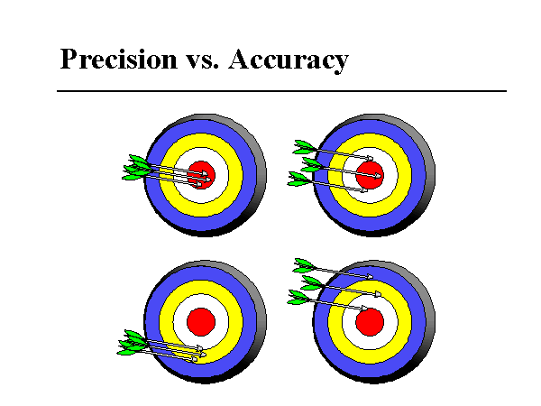

Slide 8
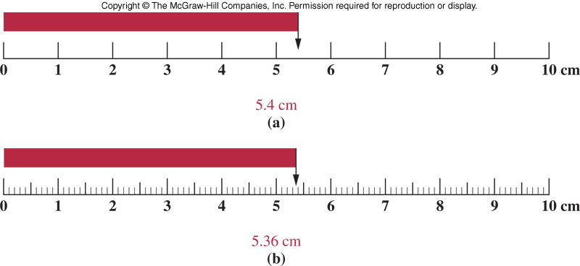
Significant Figures in Measurements
Information-bearing digits or figures in a number are significant figures (Sig Figs)
Number of Sig Figs is determined by the measuring device
Shows the amount of uncertainty in a measurement

Slide 9
Rules of Significant Figures
Significant Digit
All nonzero digits
7.314 has four significant digits
Significant digits are independent of the position of the decimal point
73.14 also has four significant digits
Zeros located between nonzero digits
60.052 has five significant digits
Zeros at the end of a number (trailing zeros) with a decimal point.
4.70 has three significant digits

Slide 10
Rules of Significant Figures
Insignificant Digit
Trailing zeros without a decimal point.
100 has one significant digit; 100. has three
Zeros to the left of the first nonzero integer
0.0032 has two significant digits

Slide 11
How many significant figures are in the following?
3.400
3004
300.
0.003040

Slide 12
Significant Figures in Calculations
Rules for Addition and Subtraction : the answer has the same number of digits after the decimal as the number with the smallest number of digests after the decimal in the problem
37.68 liters
6.71862 liters
108.428 liters
152.82662 liters
ADD = DAD : addition & subtraction = digits after the decimal

Slide 13
Rules for Multiplication and Division
The answer can be no more precise than the least precise number from which the answer is derived
The least precise number is the one with the fewest significant figures
Which number has the fewest significant figures? 4.2 x 10³ has only 2
The answer is therefore, 3.0 x 10⁻⁸

Slide 14
Practice Problems
Convert to Scientific Notation
5,230,000
0.000 000 6985
520,300,000,000,000
Determine the correct answer with the correct number of significant figures.
5.0 + 0.23 + 8.999
77.23 – 54.231
8.65 x 75 x 2
368.9/5.25

Slide 15
Measurements

Slide 16
Rules for Rounding Off Numbers
When the number to be dropped is less than 5 the preceding number is not changed
When the number to be dropped is 5 or larger, the preceding number is increased by one unit
Round the following number to 3 significant figures
3.34966 x 10⁴
Round off each number to 3 significant figures:
61.40
6.171
0.066494

Slide 17
Data, Results, and Units
Data - each piece is an individual result of a single measurement or observation
mass of a sample or temperature of a solution
Results - the outcome of the experiment
Data and results may be identical, however usually related data are combined to generate a result
Units - the basic quantity of mass, volume or whatever quantity is being measured
A measurement is useless without its units

Slide 18
English and Metric Units
English system - a collection of functionally unrelated units
Difficult to convert from one unit to another
1 foot = 12 inches = 0.33 yard = 1/5280 miles
Metric System - composed of a set of units that are related to each other decimally, systematic
Units relate by powers of tens
1 meter = 10 decimeters = 100 centimeters = 1000 millimeters

Slide 19
Basic Units of the Metric System
Mass gram g
Length meter m
Volume liter L

Slide 20
Common Prefixes in the Metric System
mega(M) 1 Mega-unit = 1,000,000 units
kilo (k) 1kilo-unit = 1,000 units
deka (da) 1 daka-unit = 10 units
deci (d) 10 deci-units = 1 unit
centi (c) 100 centi-units = 1 unit
milli (m) 1,000 milli-units = 1 unit
micro (µ) 10⁶ micro-units = 1unit
nano (n) 10⁹ nano-units = unit

Slide 21
UNIT CONVERSION : Dimensional Analysis
How many donuts are in one dozen?
We say: “Twelve donuts are in a dozen.”
Or: 12 donuts = 1 dozen donuts
This fraction is called a unit factor
Multiplication by a unit factor does not change the amount – only the unit
Example: How many donuts are in 3.5 dozen?

Slide 22
Practice Problems (R46 Appendix B)
Convert 12 gallons to units of quarts
Convert 4.00 ounces to kilograms
(1 pound = 16 ounces; 1 pound = 454 g)
Convert 5.5 inches to millimeters
Convert 50.0 milliliters to pints
Convert 1.8 in² to cm²

Slide 23
Units
Mass - the quantity of matter in an object (gram)
Weight = mass x acceleration due to gravity
Length - the distance between two points (meter)
Volume - the space occupied by an object (liter)
1 mL = 1 cm³
Time- metric unit is the second
Temperature - the degree of “hotness” of an object
K = ºC + 273 ºF = 1.8x(ºC)+32 ºC = (ºF-32)/1.8

Slide 24
A Few Problems
1. Convert 75ºC to ºF
2. Convert -10ºF to ºC
1. Ans. 167 ºF 2. Ans. -23ºC

Slide 25
Density

Slide 26
Energy
the ability to do work
kinetic energy - the energy of motion
potential energy - the energy of position (stored energy)

Slide 27
Characteristics of Energy
Energy cannot be created or destroyed
Energy may be converted from one form to another
Energy conversion always occurs with less than 100% efficiency
All chemical reactions involve either a “gain” or “loss” of energy
Basic Units: calorie or joule
1 calorie (cal) = 4.184 joules (J)
A kilocalorie (kcal) also known as the Calorie, or a food Calories.
1 kcal = 1 Calorie = 1000 calories
1 calorie = energy to increase 1 g of water 1ºC.

Slide 28
Density
the ratio of mass to volume
an intensive property
each substance has a unique density
The density of a substance generally decreases as its temperature increases
Values of density are often related to a standard
Units: g/mL, g/cm^{3,} g/cc
Density = mass/ volume = m/V

Slide 29
Practice Problem
2.00 cm³ of aluminum are found to weigh 5.40g. Calculate the density of aluminum in units of g/cm³.
Use the formula: d = m/V
Substitute our values: 5.40 g/ 2.00 cm³ = 2.70 g / cm³

Slide 30
More Practice
Air has a density of 0.0013 g/mL. What is the mass of 6.0-L sample of air?
Calculate the mass in grams of 10.0 mL if mercury (Hg) if the density of Hg is 13.6 g/mL.
Calculate the volume in milliliters, of a liquid that has a density of 1.20 g/mL and a mass of 5.00 grams.

