Slide 1
Radioactivity

Slide 3
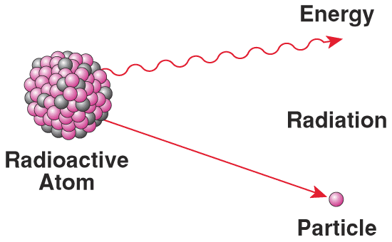
Radioactivity
In a normal chemical reaction, the nucleus of an atom remains unchanged
However, in nuclear reaction, the nucleus of an atom often changes. This reaction causes radiation to be given off.

Slide 4
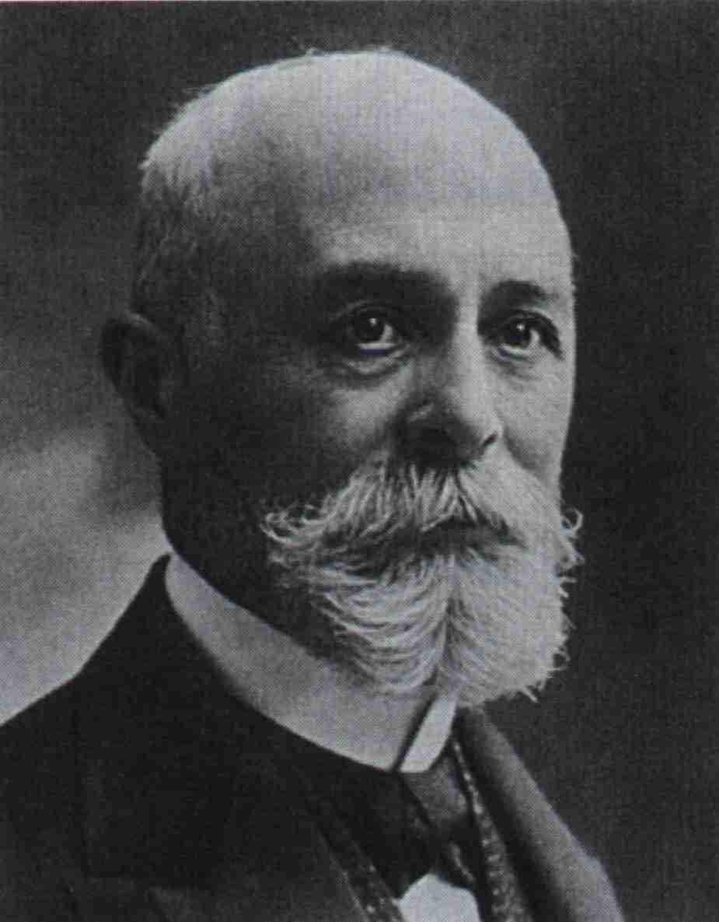
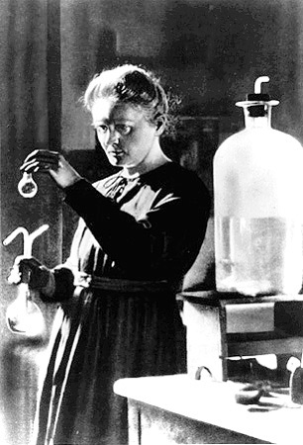
In 1896, Becquerel put uranium in a drawer with photographic paper, which became exposed because of radiation from uranium.
What holds the nucleus together?
Nuclear Force overcome the proton repulsion; neutrons are the “glue”
Why are some elements radioactive?
Proton repulsion is too great, so the nucleus is unstable and falls apart, giving off radiation.

Slide 5
Types of Radiation
-
or
Alpha: 2 protons & 2 neutron, positive
or
Low penetrating power, can be stopped by paper
Beta: high speed electrons, negative
or
Medium penetrating power; can be stopped by think, solid material
Gamma: energetic form of light; no charge
high penetration power; can be stopped by only concrete or lead

Slide 6
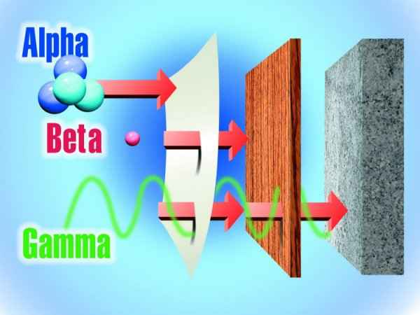

Slide 7
Writing Nuclear Reaction:
Here are some examples of nuclear reactions:
Alpha decay of radium-226
Beta decay of iodine-131

Slide 8
Questions to answer:
1) What do you notice about the sum of the mass numbers on either side of the arrow?
2) What do you notice about the sum of the atomic numbers on either side of the arrow?
3) Write the nuclear equation for the alpha decay of gold-185.
4) Write the nuclear equation for the beta decay of uranium-238.

Slide 9
Questions to answer:
3) Write the nuclear equation for the alpha decay of gold-185.
4) Write the nuclear equation for the beta decay of uranium-238.

Slide 10
Half-Life
the time it takes for one-half of a radioactive isotope to decay
Questions:
1) If the half-life of rubidium-87 is 60 billion years and you have 1.00 grams of it, how much will you have in 60 billion years? 120 billion years?
2) Gold-191 has a half-life of 12.4 hours. What mass of this isotope would remain after 49.6 hours if you started with a 7.50g sample?

Slide 11
Solving Half-Life Problems
Step 1: Determine how many half-lives have passed by dividing time passed by the half-life.
Step 2: Divide the amount of sample in half however many times the first step tells you.

Slide 12
1) If the half-life of rubidium-87 is 60 billion years and you have 1.00 grams of it, how much will you have in 60 billion years? 120 billion years?

Slide 13
2) Gold-191 has a half-life of 12.4 hours. What mass of this isotope would remain after 49.6 hours if you started with a 7.50g sample?

Slide 14
Uses of Radioactivity:
Radiocarbon dating (archaeologists use knowledge of isotopes to date objects)
Radiotracers
Cancer treatment
Food preservation
Smoke detectors
Nuclear Power

Slide 15
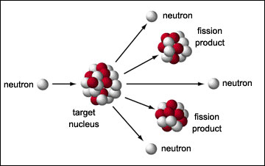
Nuclear Fission
A large nucleus is split into two smaller nuclei
Provides nuclear power
During nuclear fission, mass is lost (mass of products < mass of reactants)
This mass is converted into energy (E=mc²)
Even though mass lost is small, the amount of energy produced is great

Slide 16
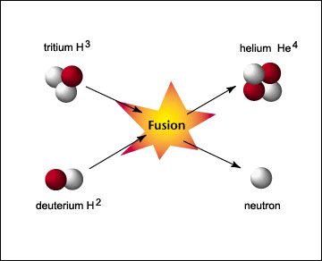
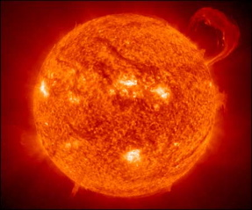
Nuclear Fusion
Two or more small nuclei join to form a larger nucleus
Occurs in the Sun
Just like fission, some mass is converted to energy

Slide 17
Questions
1) What law do fission and fusion reaction break? Who created this law?
Law of conservation of Matter/Mass, Lavoisier
2) Is this reaction a fission or fusion reaction?
3) Is this reaction a fission or fusion reaction?

Slide 18
Practice Problems
4.
5.
6.
7.
8.

Slide 19
Light and Electrons

Slide 20
Light & Wavelength
Spectroscopy - absorption or emission of light by atoms; used to understand the electronic structure
Electromagnetic Radiation- light moves as waves
Wavelength(λ): distance between crests
Each wavelength travels at the same velocity, but has its own characteristic energy
Amplitude: the wave’s height from zero to the crest
Frequency(ν): number of wave cycles to pass a given point per unit time
units: cycles per second, hertz(Hz) or s⁻¹

Slide 21
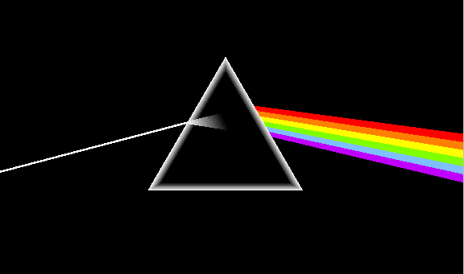
Equation: c=λν
where c=speed of light, 2.998 x 10⁸ m/s
wavelength and frequency are inversely proportional
Sunlight passes through a prism, the different frequencies separate into a spectrum of colors, a rainbow

Slide 22
Plank Equation
Max Plank explained why object give off certain frequencies of light when heated
Matter can gain or lose energy only in small, specific amounts.
Quantum: the minimum amount of energy that can be gained or lost by an atom; a packet of energy
Question: If energy is quantized, then that means that our cars can only go certain speeds. Why do our cars seem to drive smoothly?

Slide 23
Plank’s Equation
explain this behavior
E =hυ, where h=6.626x10⁻³⁴J·s
Question
Why are red lights used in photograph-developing lab?
Tiny water drops in the air disperse the white light of the sun into a rainbow.
What is the energy of a photon form the violet portion of the rainbow if it has a frequency of 7.23x10¹⁴s⁻¹?

Slide 24
The Bohr Atom
Quantization of energy: electrons exist in fixed energy levels, or Orbit, surrounding the nucleus
Ground state - the lowest possible energy state
Excited State: Promotion of electron occurs as it absorbs energy
Relaxation: Energy is released as the electron travels back to lower levels

Slide 25
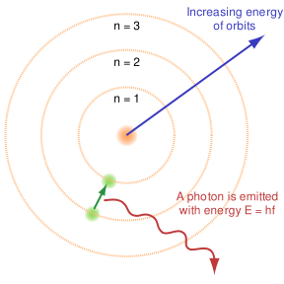
Bohr Model

Slide 26
Electronic Transitions
Amount of energy absorbed in jumping from one energy level to a higher energy level is a precise quantity
Energy of that jump is the energy difference between the orbits involved

Slide 27
Bohr Theory
Atoms can absorb and emit energy via promotion of electrons to higher energy levels and relaxation to lower levels
Energy that is emitted upon relaxation is observed as a single wavelength of light
Spectral lines are a result of electron transitions between allowed levels in the atoms

Slide 28
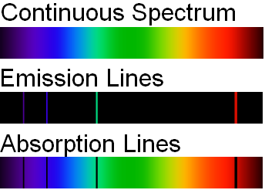
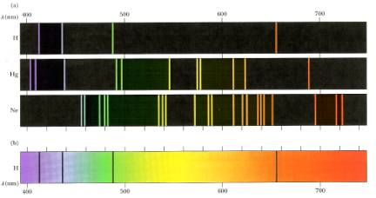

Slide 29
Bohr Theory
Orbits: quantized energy levels
Electrons are found only in these energy levels
Highest-energy orbits are farthest from the nucleus
Quantum: energy need to move an electron from one energy level to another

Slide 30
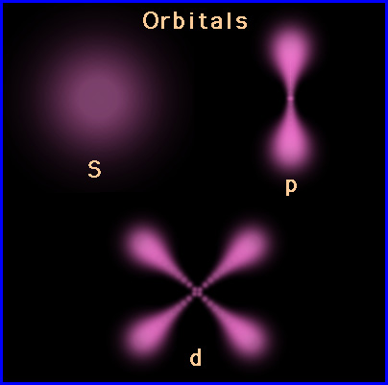
Modern Atomic Theory
Bohr’s model only works for H and electrons do not move in orbits
Atomic orbitals - regions in space with a high probability of finding an electron

Slide 31
Quantum Mechanics
Schrodinger solved mathematical equations describing the behavior of electrons
Quantum Mechanic Model determines the allowed energies an electron can have and how likely it is to find the electron in various locations around the nucleus
light could be describes as quanta of energy which behaves as particles
Photons: light quanta

Slide 32
Quantum Mechanics
De Broglie asked that given that light behaves as waves and particles, can particles of matter behave as waves?
Classical mechanics adequately describes the motions of bodies much larger that atoms, while quantum mechanics describes the motion of subatomic particles and atoms as waves

Slide 33
Heisenberg Uncertainty Principle
it is impossible to know exactly both the velocity and the position of a particle at the same time
critical in dealing with electrons

Slide 34
Electron Configuration and Orbital Diagram

Slide 35
Electron Configuration
indicates in what order electrons fill up the atom’s orbitals.
Energy Levels and Subshells
Principal Energy Levels: n = 1, 2, 3, …
The larger n, higher the energy level and greater distance from the nucleus the electrons are
Each energy level has sublevels (s, p, d, f)
# of sublevels = n
n = 1 → 1 sublevel; s
n = 2 → 2 sublevels; s & p
n = 3 → 3 sublevels; s, p, & d

Slide 36
Subshell
a set of energy-equal orbitals within a principal energy level
increase in energy: s < p < d < f
Orbital - a specific region of a sublevel containing a maximum of two electrons
1s, 2s, 3s, 2p, etc
Each orbital contains up to 2 e⁻

Slide 37
Energy Level | Sublevel | Orbitals | Electron
1 | S | 1 | 2
2 | s p | 1 3 | 2 6
3 | s p d | 1 3 5 | 2 6 10
4 | s p d f | 1 3 5 7 | 2 6 10 14

Slide 38
Orbital Shape
s is spherical
p: 3 dumbbell, p_{x} on the x-axis, p_{y} on the y-axis, and p_{z} on the z-axis
d: 4 are cloverleaf, p.132

Slide 39
Electron Configuration

Slide 40
Important Rules
Aufbau Principle: 1st fill the lowest-energy orbital
s<p<d<f
2 electrons in an orbital are said to be paired
Pauli Exclusion Principle: an atomic orbital may hold two electrons, but they must have opposite spin
clockwise and counterclockwise
Hund’s Rule: when filling orbitals of equal energy, one electron enters each orbital until all the orbitals contain one electron with the same spin.

Slide 41
General Rules
Pauli Exclusion Principle
Each orbital can hold TWO electrons with opposite spins.

Slide 42
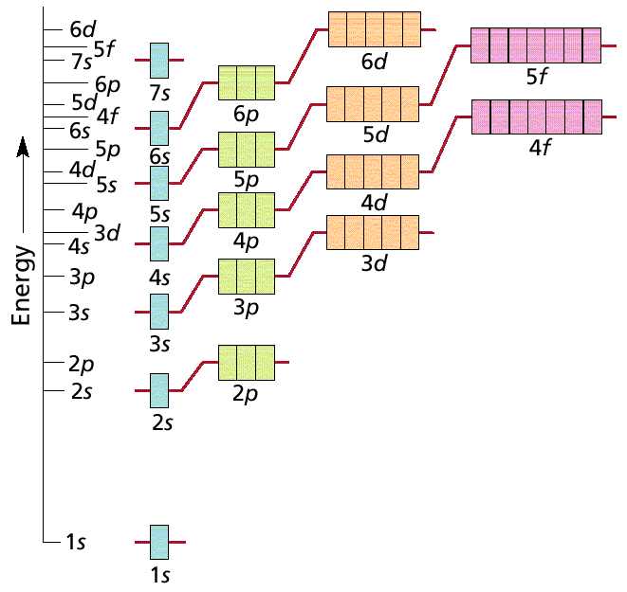
General Rules
Aufbau Principle
Electrons fill the lowest energy orbitals first.
So…4s fills before 3d and 5s fills before 4d
And…7s fills, then 5f, then 6d
Periodic Table helps you remember

Slide 43
General Rules
Hund’s Rule
Within a sublevel, place one e⁻ per orbital before pairing them.
“Empty Bus Seat Rule”
WRONG
RIGHT

Slide 44
B. Notation
Orbital Diagram
O
8e⁻
1s
2s
2p
Electron Configuration
1s² 2s² 2p⁴

Slide 45
Periodic Table
s
p
d(n-1)
f(n-2)

Slide 46
Exceptions
nd⁴ and nd⁹ position
Because the 3d and the and 4s sublevels are so close in energy, their electron configuration differs
Their half filled sublevels are less stable than filled, but more stable then other configurations
Expected: Cr: 1s²2s²2p⁶3s²3p⁶4s²3d⁴
Cu: 1s²2s²2p⁶3s²3p⁶4s²3d⁹
Actual: Cr:1s²2s²2p⁶3s²3p⁶4s¹3d⁵
Cu: 1s²2s²2p⁶3s²3p⁶4s¹3d¹⁰

Slide 47
Let’s Try These:
Bromine (Br):
Strontium (Sr):
Antimony (Sb):
Rhenium (Re):
Terbium (Tb):
Titanium (Ti):

Slide 48
Shorthand
As you can see, sometimes the configuration is long. Therefore, scientists have developed a short-cut called the noble gas configuration.
Write the symbol of the previous noble gas and finish the electron configuration.
Go back and write the noble gas configuration for the elements we just did.
Orbital diagrams not only show how the electrons fill-up their orbitals, but also the relative energies of the orbitals.

Slide 49
Practice
Example: Phosphorus
Try Fluorine:
Try Titanium:
Try Iron:

