Slide 1
Properties of Matter

Slide 2
Matter
has mass and occupies space
mass: the measure of the amount of matter
volume: measures the space occupies
States of Matter
Solids: definite shape and volume
Liquids: definite volume and indefinite shape
Gases: indefinite shape and indefinite volume
vapor: a gaseous state of a substance that is generally a liquid or solid at room temp.

Slide 3
Classification of Matter
Extensive: a property that depends on the amount of matter in a sample
Intensive: a property that is independent of the amount of matter; but depends on the type of matter
I is for independent
Substance: matter that has a uniform and definite composition; i.e. brass or gold
every sample of a substance has identical intensive properties

Slide 4
Physical Property and Physical Change
Physical Property: a quality or condition that can be measured without changing its composition
Physical Change: some properties of a material change, but identity doesn’t
Reversible: melt, freeze, boil, and condense
Irreversible: break, split, grind, cut, and crush

Slide 5
Mixtures
Mixture: a physical blend of two or more components
Phase: any part of a sample with uniform composition and properties
Heterogeneous Mixture: mixture that isn’t uniform; can see the various parts
>1 phase
Italian Dressing
Homogeneous Mixture: uniform composition; 1 phase
Solutions
Kool-Aid

Slide 6
Separating Mixtures
differences in physical properties can be used to separate mixtures
Filtration: process of separating a solid from a liquid in a heterogeneous mixture
Distillation: used to separate water from the other components of tap water
a liquid is boiled to produce vapor that is then condensed into a liquid

Slide 7
Elements & Compounds

Slide 8
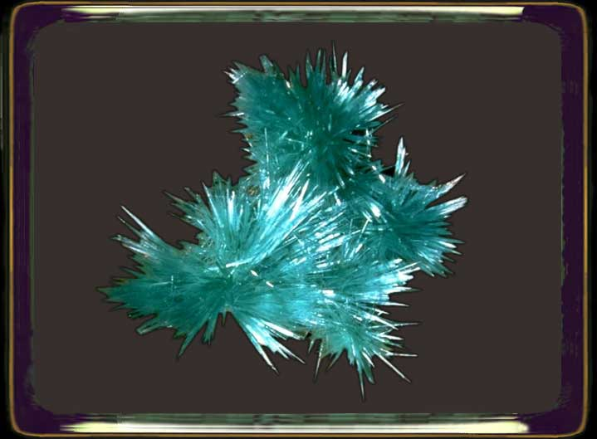
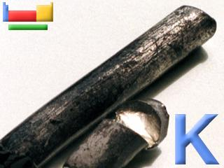
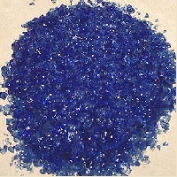
Elements and Compounds
Element: the simplest form of matter that has a unique set of properties
C, O, H, periodic table
Uranium Potassium Cobalt

Slide 9
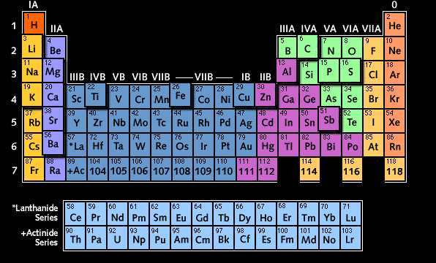
Periodic Table

Slide 10
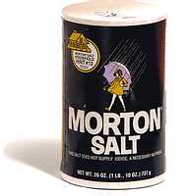
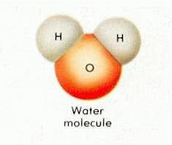
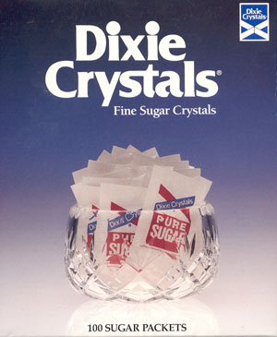
Compound
a substance that contains two or more elements chemically combined in a fixed ratio
H₂O
Symbols represent elements: C (carbon), O(oxygen)
Chemical Formulas represent compounds: H₂O (water), CO₂ (carbon dioxide)

Slide 11
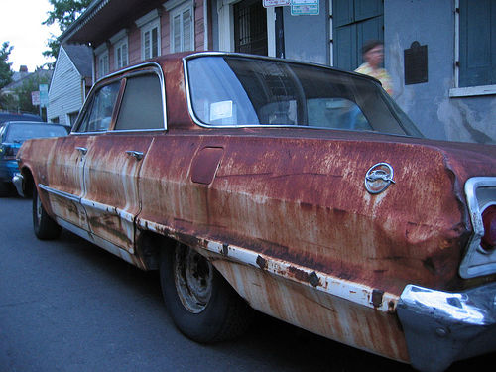
Chemical Change or Chemical Property
Physical Methods can be used to break down mixtures, but not compounds
Chemical Change: a change that produces matter with a different composition than the original matter
Compound can be broken down by chemical means, but elements cannot
burn, rot, rust, decompose, ferment, explode, and corrode

Slide 12
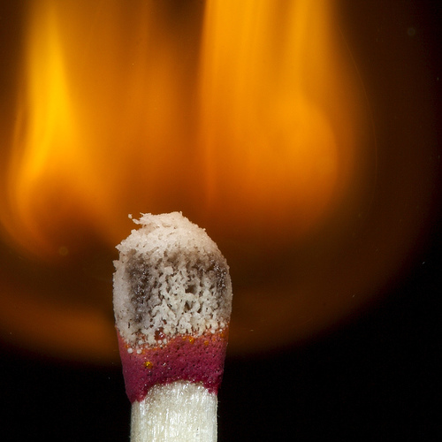
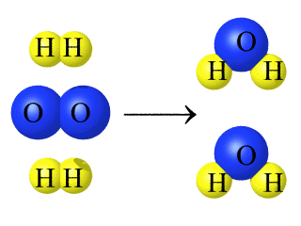
Chemical Reaction
one or more substance changes into a new substance
reactant: substance present at the start
product: substance produced by the reaction
mass of the products must equal the mass of the reactants
2H₂ + O₂ → 2H₂O

Slide 13
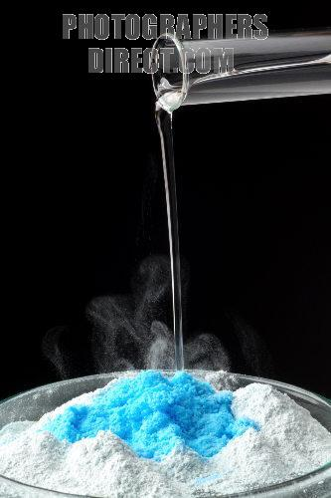
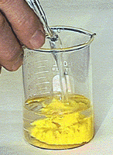
Evidence of a Reaction
Transfer of Energy
Color Change
Production of a Gas
Formation of Precipitate
precipitate: a solid that forms and settles out of a liquid mixture

