Slide 1
Properties of Gases

Slide 2
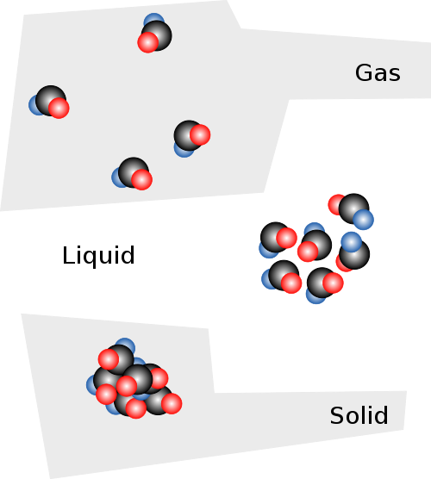
Compressibility
The measure of how much the volume of matter decreases under pressure
Gases are easily compressible because of the space between the particles in a gas
At room temperature, the distance between particles is 10x their size

Slide 4
Factors Affecting Gas Pressure
Amount of Gas
→ Increasing number of particles
→ Increase rate of collision
→ Increases pressure
Pressure of the gas in a sealed container is lower than the air pressure, air will rush in
Vacuum packed
Pressure of the gas in a sealed container is higher than the air pressure, air will rush out
Aerosol Cans

Slide 5
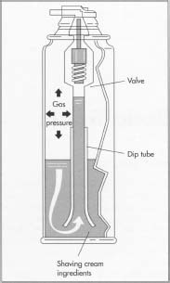
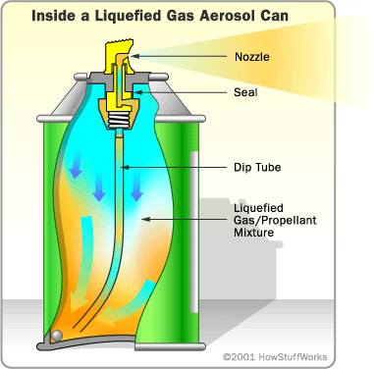

Slide 6
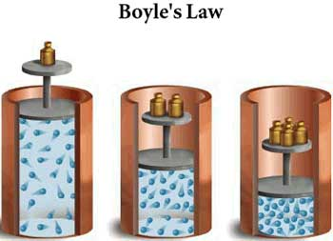
Factors Affecting Gas Pressure
Volume
Can raise the pressure of a gas by reducing the volume
More compression
Greater the pressure
Inverse relationship
Double the volume, half the pressure

Slide 7
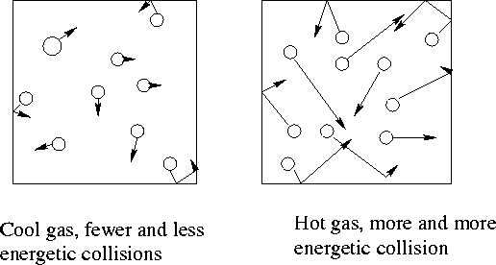
Factors Affecting Gas Pressure
Temperature
Increase in temperature
Increase pressure
Increasing the temperature increase KE
Particle move faster → Increases pressure
An empty aerosol can will explode if thrown into a fire

