Slide 1
Preparing for College: A Guide for Families

Slide 2
Workshop Goals
Understand the benefits of a college education.
Learn the pathways to college.
Learn how to prepare for college admission.

Slide 3
Why Go To College?
To have more job opportunities.
More and more jobs require education beyond high school. Many jobs rely on new technology and “brainpower.”
To gain more knowledge that will be helpful throughout students’ lives.
To broaden perspectives - meet new people from diverse backgrounds, learn to be independent.

Slide 4
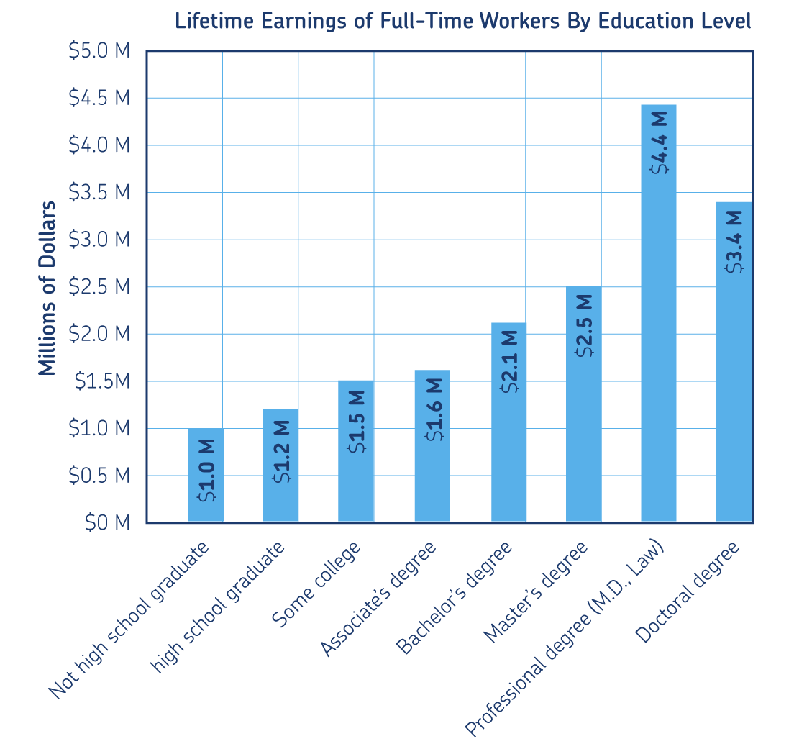
Why College? continued
A 4-year college graduate (with Bachelor’s degree) earns almost $1 million more over his/her lifetime than a high school graduate.
Source: U.S. Census Bureau

Slide 5
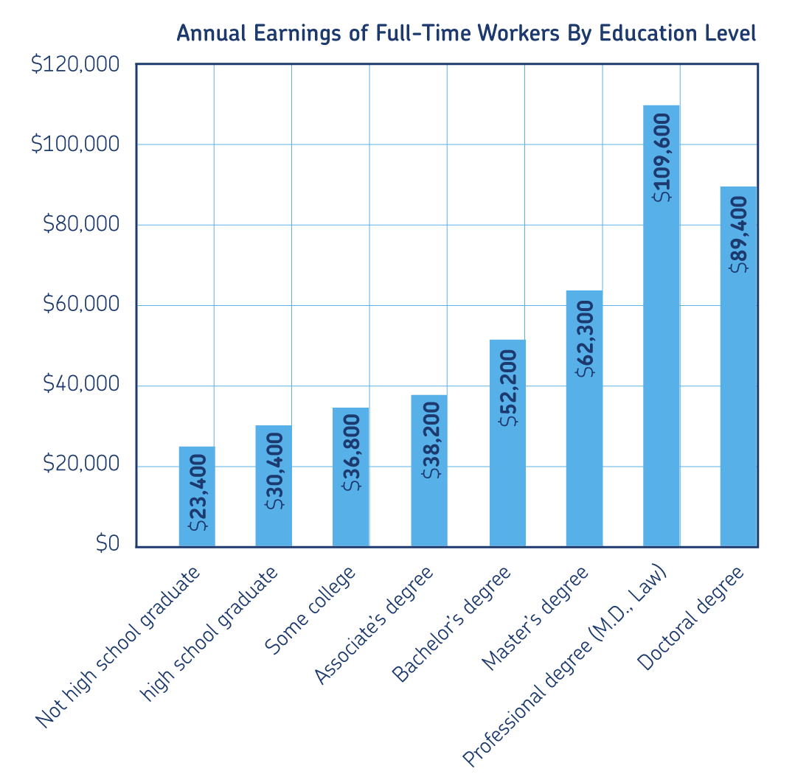
Why College? continued
A 4-year college graduate earns about $52,200 annually on average, compared to $30,400 for a high school graduate.
- Source: U.S. Census Bureau

Slide 6
Why College? continued
Increased education is also associated with:
Better working conditions;
Longer job tenure;
More on-the-job training opportunities;
More promotion opportunities.

Slide 7
Pathways to College
High School
Work
2-Year College
4-Year College
4-Year University

Slide 8
What types of schools are there?
Two-Year Colleges
Four-Year Colleges
Universities
Public Colleges/Universities
Private Colleges/Universities
Military Academies
Single-Sex
Religious
Historically Black Colleges

Slide 9
Two-Year Colleges
Award Associate degrees or certificates of study
Can prepare students for transferring to a 4-year college or university or…
Offers technical training in specific occupations (bookkeeping, culinary arts)
Most have an open admissions policy, requiring only a high school diploma or equivalent
Most are nonresidential; students live off-campus
Students can attend part-time or full-time
Most public 2-year colleges have very low fees

Slide 10
Technical colleges
Usually award certificates of study in career-specific programs
Auto repair
Computer technology
Medical assistance
Bookkeeping or accounting
Some award Associate degrees
Note: Some community colleges offer similar certificate programs but at a lower cost.

Slide 11
Four-Year Colleges
Award four-year (bachelor) degrees
Some also award master’s degrees
Emphasis is on liberal arts education
Broad education in social sciences, humanities, sciences
Smaller enrollment and class size, offering greater individual attention
Emphasis is on teaching rather than research
There are both public and private 4-year colleges

Slide 12
Universities: Public
Same as four-year college, but also have graduate school
Competitive admission requirements
More expensive than two-year colleges
Lower cost for in-state students
Usually give preference to in-state residents
Secular (no religious affiliation)

Slide 13
Universities
Award bachelor degrees and graduate/professional degrees
Master’s, Ph.D., Law, and Medical degrees
Emphasis is on liberal arts education or specialized training (e.g., teaching, engineering)
Strong emphasis on research
Tend to have larger enrollments and larger class sizes than 4-year colleges
Can be public or private

Slide 14
Military Academies
Co-ed: Both men and women
High standards for admission
Military service required upon graduation
Tuition is free
Less freedom than other schools and incorporates physical training and discipline

Slide 15
Single-Sex Colleges and Universities
Over 90 all-female two- and four-year colleges
Can offer a comfortable and supportive environment
Very few all-male schools

Slide 16
Religious Colleges and Universities
Focus on a particular faith
Students may or may not practice religion to attend.
Religion and theology incorporated into curriculum.
Some may have behavior rules.

Slide 17
Historically Black Colleges
Over 100 predominantly Black colleges
Can offer academic and social communities that promote success.
Tuition may be lower than at comparative schools.

Slide 18
Think….
Start thinking about the pros and cons of each type of school.
How does each school fit with your goals and needs?
We will go into further detail next week.

Slide 19
References
Rochester, L., and Mandell, J. (1989). The one hour college applicant: You don’t need to read a 300-page book to apply to college. Memphis: Mustang Publishing Company.

Slide 20
College Admission Requirements
Most 4-year colleges require students to fulfill 4 requirements to be considered for admission:
Complete the sequence of college- preparatory courses
Complete the college entrance tests (the SAT or ACT)
Earn good grades
Submit an application and personal statement or admission essay

Slide 21
#1 College-Preparatory Courses
History/Social Science - 2 years minimum
English - 4 years minimum
Math - 3 years minimum, 4 recommended
Laboratory Science - 2 years minimum, 3 recommended
Language Other than English - 2 years, minimum in the same language, 3 years recommended
Electives - 1 year minimum, 2 recommended

Slide 22
Tips on Choosing College-Prep Courses
High school graduation requirements may differ from college admission requirements.
Check with your high school counselor and enroll your students in courses that meet both requirements, where possible
Honors or Advanced Placement are courses that provide accelerated or advanced study.
Some four-year colleges and universities give extra weight to these courses
Be assertive with your child’s high school counselor; don’t be afraid to provide input on which courses your child should be enrolled in.
Create an academic plan.

Slide 23
#2 Grades and GPAs
Colleges look closely at the grades that students earn in college-prep courses.
The grades are converted into points (A=4, B=3, C=2, D=1, F=0). The total points are divided by the number of courses to determine a Grade Point Average (GPA).
For example, a “Straight-A average” = 4.0
The minimum GPA required for admission to a 4-year college or university varies widely.
But strive for at least a “B” average or 3.0 GPA

Slide 24
Grades & GPA continued
A higher GPA in rigorous courses will increase your chances of admission to more selective colleges and universities.
Some colleges have an “eligibility index” where the GPA and test scores are combined and used to determine eligibility.

Slide 25
#3 College Entrance Tests
Most 4-year colleges and universities require:
SAT I or the ACT
Some colleges also require or recommend the SAT II subject tests
Take practice tests to become familiar with test format:
Most high schools offer the Preliminary SAT (PSAT) or ACT-Explore or ACT-Plan
Most 2-year colleges do not require the SAT or ACT, but may require students to take placement exams in math or English.

Slide 26
#4 Admission Application
At most 4-year colleges, the application consists of:
Application form
A personal statement or essay
High school transcript
Some colleges also require:
Letters or recommendation
An interview
Submit the application by the filing deadline (usually in November - December)
Check the requirements of individual colleges no later than the end of junior year in high school.

Slide 27
Not Required but Recommended
Colleges and Universities look for “well-rounded” students!
Participate in extracurricular activities:
Sports
Student Government
Music, Drama, Visual Arts
Community/Volunteer Service
Part-Time jobs

Slide 28
How to start preparing now for college
READ, READ, READ -
Good readers make good thinkers and good writers. “The more you read, the more you know.”
Promote good study habits.
Turn off the TV.
Set aside a homework time and a quiet study space.
Meet with your child’s teachers to learn about his/her performance.
Tell the teachers that you have high expectations for your child.

Slide 29
How to start preparing now for college
Learn the college-preparatory course requirements:
Push to get into these courses in high school
Push to get into honors and AP courses in high school, if available
What you do outside of class matters:
Sports, Clubs, Work, Church, Honor Societies, etc.
Take the PSAT by the 9th or 10th grade —
It’s good practice for the SAT!

Slide 30
How to start preparing now for college
Visit college campuses!
Find colleges in your area and schedule a tour.
Make a college visit part of your vacation.
Ask your counselor if your school is planning a field trip to a college you’re interested in.
Check out college websites, many have virtual tours.

Slide 31
Factors to consider when choosing a college.
Size - What is the total student population? How big are the typical freshman classes?
Location - How far is the college from home? Is it in a rural, urban, suburban setting? What is the area surrounding the campus like?
People - Who are the students and where do they come from?
Academics- What majors are available? Who teaches the courses? What is the academic reputation of the college?
Social Opportunities: What clubs and teams are available? Are there fraternities and sororities?
Cost : What is the total cost of attendance, including tuition, room and board, books? What kind of financial aid is available?

Slide 32
College Search Tools
The College Board
www.collegeboard.com
ACT/College Net
www.act.org
Peterson’s Guide to College
www.petersons.com
Also available in paperback
FinAid: The SmartStudent Guide to Financial Aid
www.finaid.org

Slide 33
Paying for College
The average cost of attendance at a 4-year college/university ranges from $10,636 to $26,854 per year
More than 60% of undergraduates receive some form of financial aid (grants, scholarships, loans or work-study).
Some Tips:
If you can, save.
Apply for financial aid, even if you think you don’t qualify.

Slide 34
Points to Remember
The more you learn, the more you earn.
The U.S. has 3,500 colleges; one (or more) is right for you.
It’s never too early or too late to prepare for college.
Advocate for your child with his/her teachers and school.
The more you read, the more you know.
Apply for financial aid.

