Slide 1
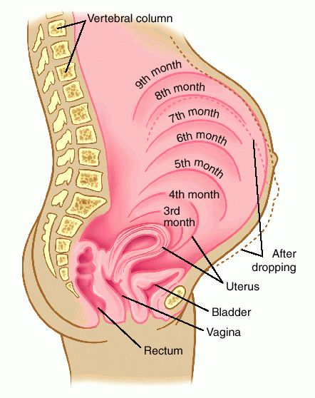
Pregnancy

Slide 2
Birth Control
Voluntary regulation of the number of children produced and when they are conceived.
Coitus interrupts: withdrawal of the penis from the vagina before ejaculation.
Rhythm method: abstinence from sexual intercourse for several days before and after ovulation.
Mechanical barriers: male and female condom, and female diaphragms and cervical caps.

Slide 3
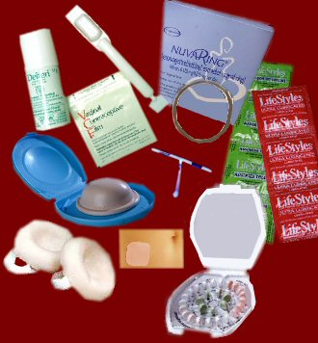
Birth Control
Chemical barriers: spermicidal creams, foam, and jellies provide an unfavorable environment for sperm survival.
Oral contraceptives: birth control pills
synthetic estrogen & progesterone substances
Disrupt a female’s gonadotropin secretion.
Prevents ovulation
Prevents normal buildup of uterine lining

Slide 4
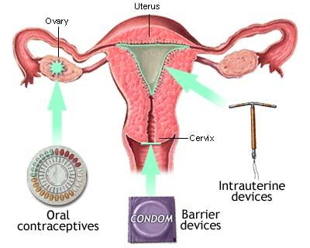
Birth Control
Inject able contraception:
intramuscular injection
medroxyprogesterone acetate
every 3 months
Acts similarly to oral contraceptives
Intrauterine devices (IUD)
Solid object inserted in the uterine cavity that prevents pregnancy by interfering with implantation
Surgical methods: surgical sterilization
Male: vasectomies
Female: tubal ligations

Slide 5
Sexually Transmitted Diseases
STDs are passed during sexual contact and may go undetected for years
Silent infections: early stages do not produce symptoms, especially in women

Slide 6
Sexually Transmitted Diseases
20 recognized STDs have similar symptoms
Burning sensation during urination
Pain in the lower abdomen
Fever or swollen glands in the neck
Discharge from the vagina or penis
Pain, itch, or inflammation in the genital or anal area
Pain during intercourse
Sores, blisters, bumps, or a rash anywhere on the body, particularly the mouth or genitals
Itchy, runny eyes

Slide 7
Pregnancy Rates for Birth Control Methods
(For One Year of Use)
Method | Typical Use Rate of Pregnancy | Lowest Expected Rate of Pregnancy
Sterilization:
Male Sterilization | 0.15% | 0.1%
Female Sterilization | 0.5% | 0.5%
Hormonal Methods:
Implant (Norplant) | 0.09% | 0.09%
Hormone Shot (Depo-Provera) | 0.3% | 0.3%
Combined Pill (Estrogen/Progestin) | 5% | 0.1%
Minipill (Progestin only) | 5% | 0.5%
Intrauterine Devices (IUDs):
Copper T | 0.8% | 0.6%
Progesterone T | 2% | 1.5%
Barrier Methods:
Male Latex Condom¹ | 14% | 3%
Diaphragm² | 20% | 6%

Slide 8
Pregnancy Rates for Birth Control Methods
(For One Year of Use)
Method | Typical Use Rate of Pregnancy | Lowest Expected Rate of Pregnancy
Barrier Methods (continued):
Vaginal Sponge (no previous births)³ | 20% | 9%
Vaginal Sponge (previous births)³ | 40% | 20%
Cervical Cap (no previous births)² | 20% | 9%
Cervical Cap (previous births)² | 40% | 26%
Female Condom | 21% | 5%
Spermicide: (gel, foam, suppository, film) | 26% | 6%
Natural Methods:
Withdrawal | 19% | 4%
Natural Family Planning (calendar, temperature, cervical mucus) | 25% | 1-9%
No Method: | 85% | 85%

Slide 9
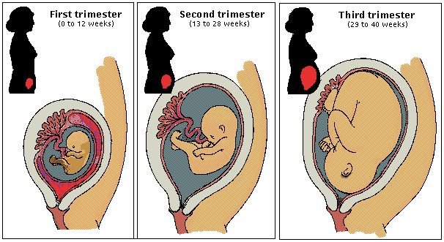
Pregnancy
Growth in an increase in size.
Development is the process of changing from one life phase to another.
Pregnancy is the presence of a developing offspring inside the uterus.
Consists of 3 3-month periods called trimesters
40 weeks from the 1st day of the last period
Fertilization: union of an egg cell and a sperm cell

Slide 10
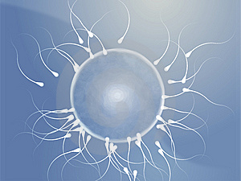
Pregnancy
Prior to fertilization, a female ovulates an egg cell, or secondary oocyte
Enters uterine tube
Transport of sex cells
Male deposits semen in the vagina during sexual intercourse.
Sperm must move up the vagina, through the uterus, into the uterine tube
Sperm cells reach the upper portion of the uterine tube within an hour following sexual intercourse
Many sperm cells may reach an egg, but only one can fertilize it

Slide 11
Assistance in Transport
Prostaglandin in semen
stimulate a sperm cell to lash its tail to move
muscular contractions in the uterus and uterine tube
High estrogen levels in the female
1st part of the menstrual cycle
Stimulate the uterus and cervix to secrete a thin, watery fluid
Promotes sperm transport and survival
Higher progesterone levels
During the latter portion of the cycle
secretion of a viscous fluid
Inhibits sperm transport and survival

Slide 12
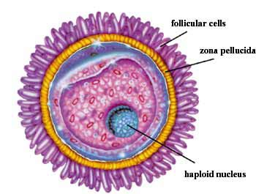
Fertilization
A sperm cell that reaches the egg cell invades the follicular cells that adhere to the egg cell’s surface
Bind to the zona pellucida surround the egg cell membrane
Acrosome of the sperm releases an enzyme
Hyaluronidase: aids in penetration
Several hundred sperm cells must be present to produce enough enzyme for one to penetrate
Males with low sperm count are often infertile

Slide 13
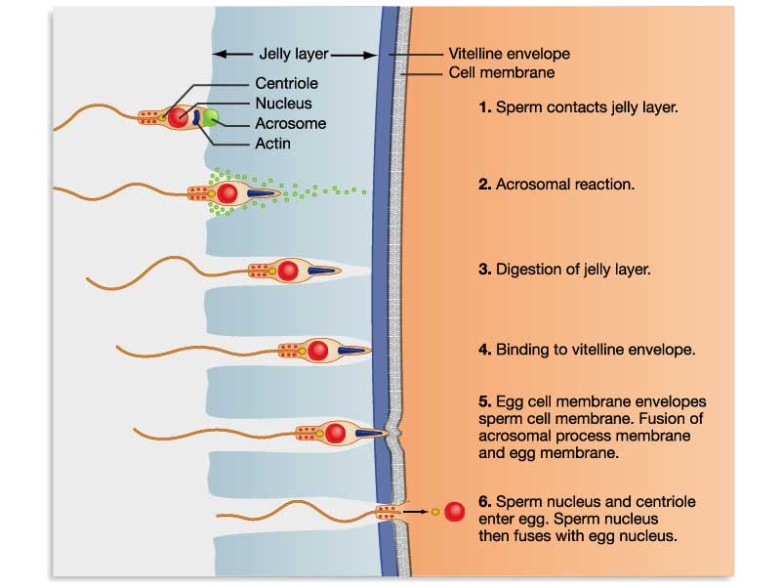

Slide 14
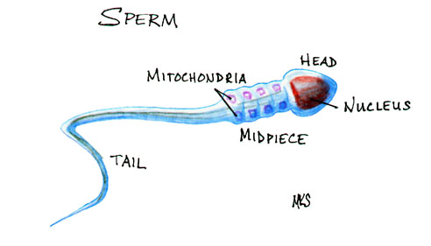
Fertilization
Union of the egg cell and sperm cell triggers lysosome-like vesicles just beneath the egg cell membrane
Releases an enzyme that hardens the zona pellucida
Reduces the chances of another sperm penetrating the membrane

Slide 15
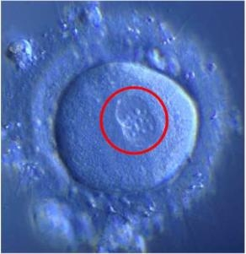
Fertilization
Once a sperm cell enters the egg cell’s cytoplasm, the nucleus of the sperm cell’s head swells
Egg cell then divides unequally
Large cell
Tiny polar body, later expelled
Nuclei of the egg and sperm cells unite
Nuclear membranes fall apart
Chromosomes intermingle
Completes fertilization
Zygote: 46 chromosomes
1st cell of the future offspring

Slide 16
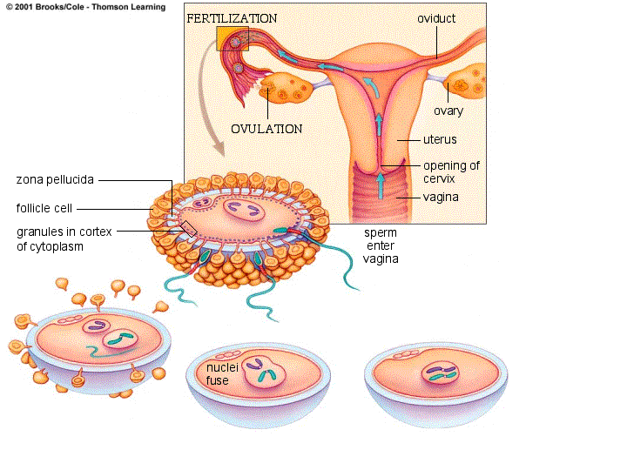

Slide 17
Prenatal Period

Slide 18
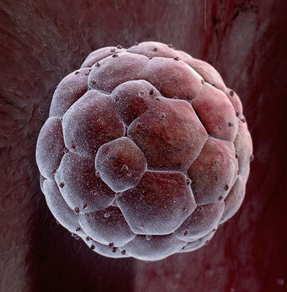
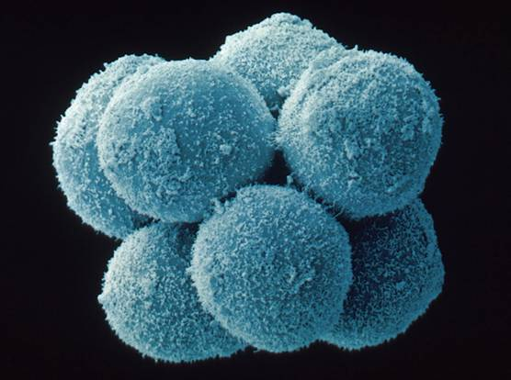
Early Embryonic Development
Zygote begins mitosis after 30 hours
Cleavage: phase of early rapid cell division
Tiny mass of cell moves through the uterine tube into the uterine cavity in ~3 days
Morula: 16 cell stage; Latin for mulberry
Blastocyst: 3 days, the morula hollow out
Begins to attach to uterine lining

Slide 19
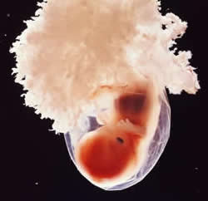
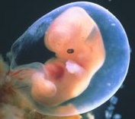
Early Embryonic Development
Embryonic Stage: cells organize into a group
Gives rise to the offspring
Termed embryo until the end of the 8th week
Basic structural form of human body is recognizable
Rudiments of all organs are present at the end of embryonic development

Slide 20
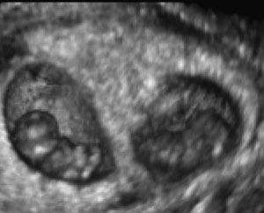
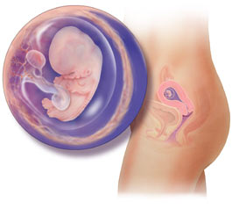
Early Embryonic Development
Fetus: 8 weeks until birth
During fetal development, organs and other structures enlarge and specialize

Slide 21
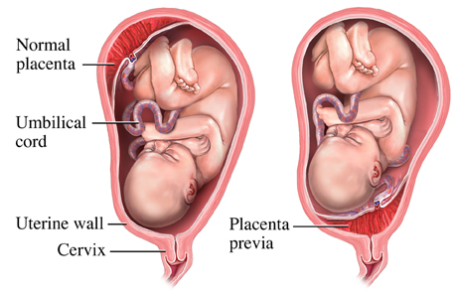
Early Embryonic Development
Placenta: forms from cells surrounding the embryo
Highly vascular
Attaches the embryo to the uterine wall
Exchanges nutrients, gases, and wastes between maternal blood and blood of the embryo
Secretes hormones
Fetal blood carries a greater concentration of oxygen that does maternal blood

Slide 22
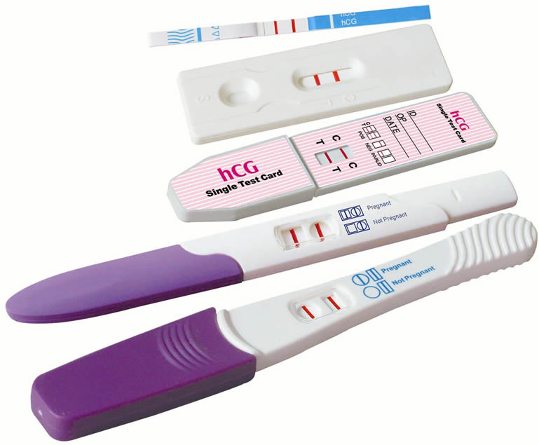
Hormonal Changes
human chorionic gonadotropin (hCG)
Prevents pregnancy loss
Secreted from cells surrounding the embryo
Inhibits the release of FSH and LH, halts normal menstrual cycles
Hormone used in pregnancy tests
Placental estrogen and progesterone
Maintain uterine wall during pregnancy

Slide 23
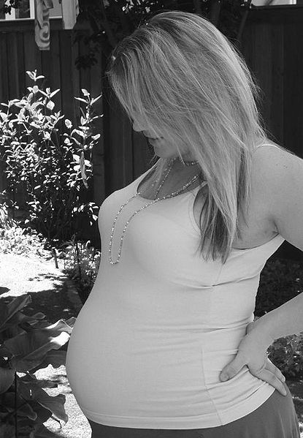
Hormonal Changes
Placental lactogen
Stimulates breast development
Prepares mammary glands for milk secretion
Relaxin: relaxes ligaments joining the symphysis pubis and sacroiliac joints during the last weeks of pregnancy
Aids in fetal passage
Aldosterone: promotes Na reabsorption
Water retention

Slide 24
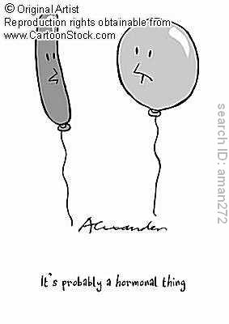

Slide 25
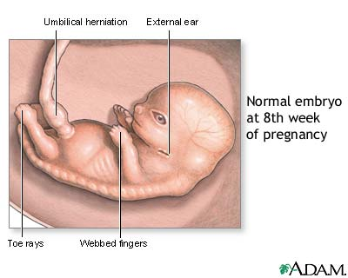
Embryonic Stage
2nd week through the 8th week
Placenta forms
Main internal organs develop
Major external body structures appear

Slide 26
Embryonic disk
Ectoderm
nervous system and sensory organs
epidermis, hair, nails, and glands of the skin
lining of the mouth and anal canal
Mesoderm
muscle, bone, marrow, blood, and blood vessels
lymphatic vessels and connective tissue
internal reproductive organs and kidneys
epithelial linings of the body cavity
Endoderm
epithelial lining of the digestive tract, respiratory tract, urinary bladder, and urethra

Slide 27
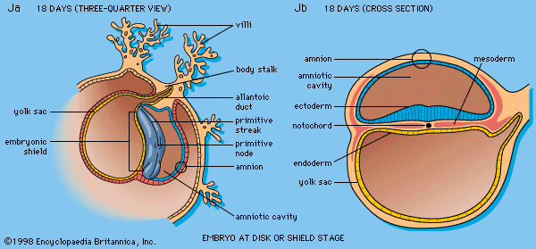
Embryonic Disk

Slide 28
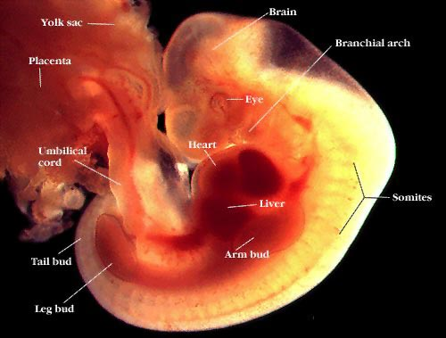
Embryonic Stage
4th week
head and jaw develops
Heart beats
Tiny buds that will be arms and legs form
5th-7th
Head grows rapidly, becomes rounded, and erect
Face develops eyes, nose, and mouth
Upper and lower limbs elongate
Fingers and toes appear
End of 7th
All internal organs are present

Slide 29
Embryonic Stage
Amnion: membrane that develops around the embryo during the 2nd week
Fills with amniotic fluid
Allows growth without the compression from surrounding tissues
Protects from jarring motions of mother
Umbilical cord: attachment between embryo and placenta
3 blood vessels
2 umbilical arteries and 1 umbilical vein
Suspends the embryo in the amniotic cavity

Slide 30
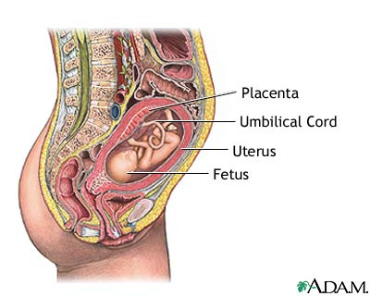
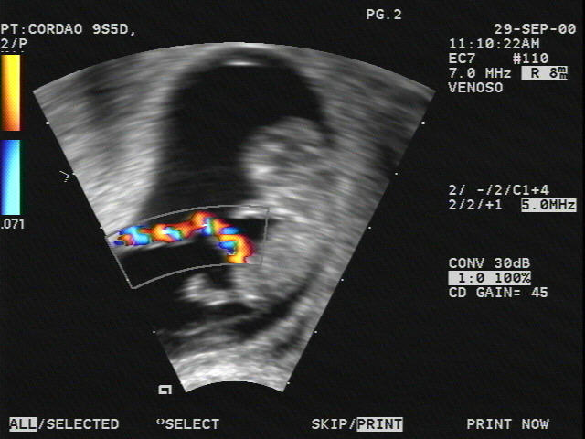
Umbilical Cord

Slide 31
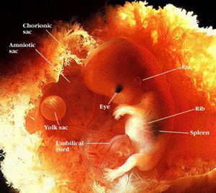
Embryonic Stage
Yolk Sac: 2nd week
Attaches to underside of embryonic disk
Forms blood cells during early development
Gives rise to cells that later become sex cells
Allantois: 3rd week
Tube from yolk sac to embryo
Forms blood cells
Gives rise to umbilical arteries and vein
8th week
Length: 30 mm (1.2 in)
Weight: 5 g (0.7 oz)

Slide 32
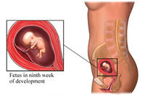
Fetal Stage
End of 8th week to birth
Rapid growth
Body proportions change considerably

Slide 33
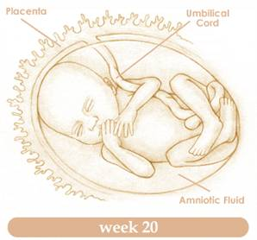
Fetal Stage
3rd month
Growth in body length accelerate, but head growth slows
Limbs reach length that maintain throughout development
Ossification centers appear in most bones
20th Week: discern reproductive organs

Slide 34
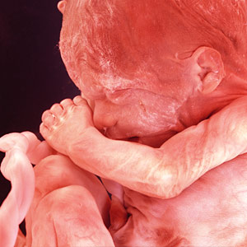
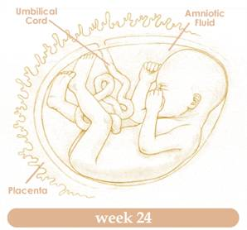
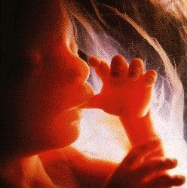
Fetal Stage
5th month
Growth rate decreases
Lower limbs reach final proportions
Skeletal muscles become active
Able to detect fetal movement
Appearance of hair
Fine, downy hair and cheesy mixture of dead epidermal cells and sebum covers the skin

Slide 35
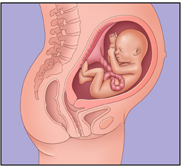
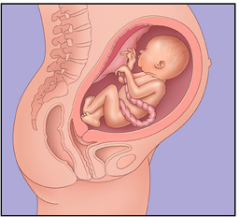
Fetal Stage
6th Month
Fetal body gains substantial weight
Eyebrows and eyelashes appear
Skin is wrinkled and translucent
Blood vessels give fetus reddish appearance
7th month
Fat is deposited in subcutaneous tissue
Skin is smoother
Eyelids, which fused during the 3rd month, reopen
Length: 40cm = 15.7 in

Slide 36
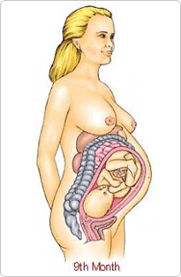
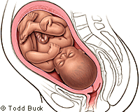
Fetal Stage
Final Trimester
Fetal brain cells rapidly form networks
Organs specialize and grow
Layer of fat completes formation below the skin
Males: testes descend into the scrotum
Digestive and respiratory system matures last
Premature babies have difficulty with digesting milk and breathing

Slide 37
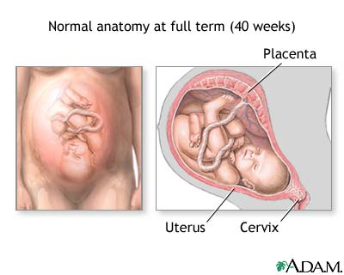
Fetal Stage
9th month (266 days)
Full Term
Length: 50 cm (19.7 in)
Weight: 2.7-3.6 kg (5.9-7.-9 lb)
Skin lost downy hair
Maintain sebum and dead epidermal coat
Hair usually covers the scalp
Fingers and toes have well developed nails
Skull bones are largely ossified
Fetus is usually position upside down
Head toward the cervix

Slide 38
Birthing and Postnatal Period

Slide 39
Preparing for Labor
Declining progesterone concentration plays a major role in initiating birth
Progesterone suppresses uterine contractions
As placenta ages, progesterone declines
Stimulates synthesis of prostaglandins that promotes uterine contractions
Cervix thins and opens
May begin a week or two before labor

Slide 40
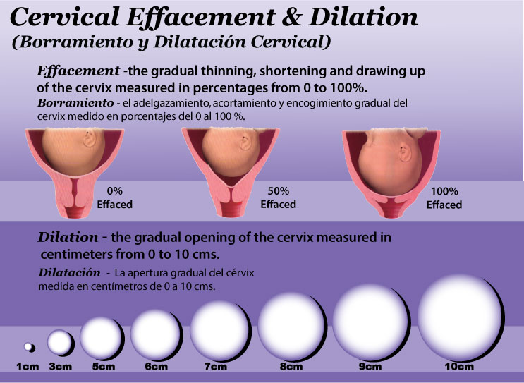

Slide 41
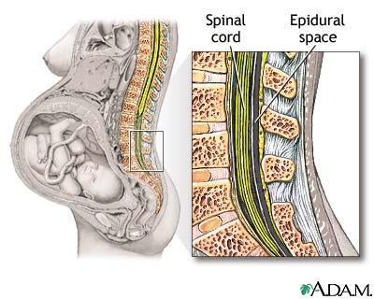
Preparing for Labor
Stretching of uterine and vaginal tissue late in pregnancy
Signals the release of hormone oxytocin from posterior pituitary gland
Stimulates powerful uterine contractions

Slide 42
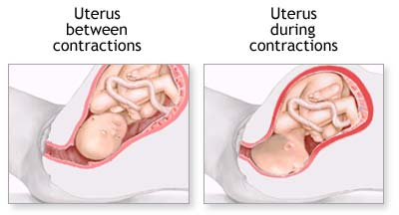
Labor
Rhythmic, muscular contractions begin at the top of the uterus and extend down its length
Forces the head against the cervix
Elicits a reflex that stimulates still stronger labor contractions
Positive feedback system: uterine contractions stimulate more intense uterine contractions
Cervix dilation stimulates the posterior pituitary to increase oxytocin release

Slide 43
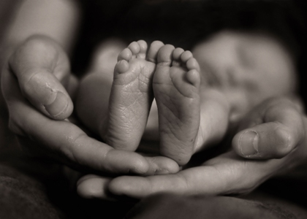
Labor
Abdominal walls are stimulated to contract
Helps force the fetus through the cervix and vagina to the outside
Following birth, the placenta separates from the uterine wall
Uterine contractions expel it through birth canal
Accompanied by bleeding
Oxytocin stimulates continued uterine contractions, which compress the bleeding vessels and minimizes blood loss

Slide 44
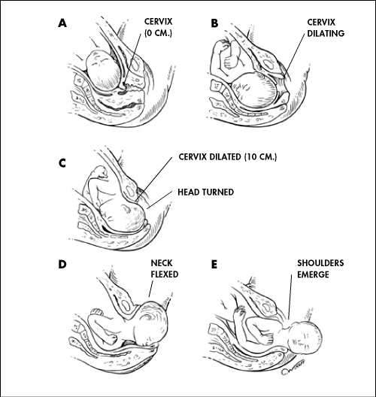

Slide 45
Postnatal Period
Milk production and secretion
During pregnancy, placental estrogen and progesterone stimulate mammary gland development
Estrogen causes the ductile system to grow and branch, and deposits fat around them
Progesterone stimulates the development of alveolar glands at the ends of the ducts
Hormonal activity doubles breast size and mammary glands become capable of producing milk

Slide 46
Postnatal Period
After birth, placental hormones decline rapidly
2 to 3 days, prolactin stimulates milk secretions
Glands secrete a thin, watery fluid called colostrum
Rich in proteins, but its carbohydrate and fat levels are low
Rich in antibodies from mother’s immune system

Slide 47
Postnatal Period
Reflex response to mechanical stimulation of the nipple stimulates the posterior pituitary to release oxytocin
Causes the alveolar ducts to eject milk
As long as milk is removed from the breasts, mammary glands will produce milk
If it is not removed regularly, mammary glands will stop milk production in a week or so

Slide 48
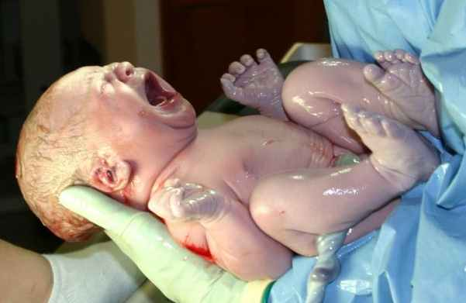
Neonatal Period
Begins after birth and extends for 4 weeks
Newborn must make quick physiological adjustments
Respire, obtain and digest nutrients, excrete wastes, and regulate body temperature
Most important: obtain O₂ and excrete CO₂
Fist breath must be forceful because the newborn’s lungs are collapsed and the small airways offer resistance to movement

Slide 49
Neonatal Period
High metabolic rate
Immature liver may be unable to supply enough glucose
Utilizes stored fat as energy
Kidneys
Unable to secrete concentrated urine
Produce a dilute fluid
Homeostatic control may not function correctly
Difficulty maintaining body temperature

Slide 50
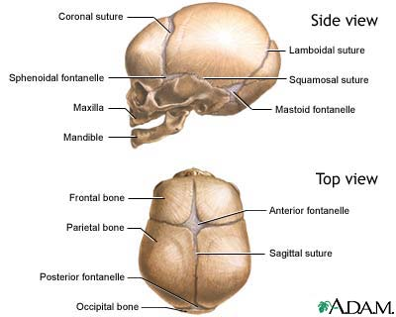

Slide 51
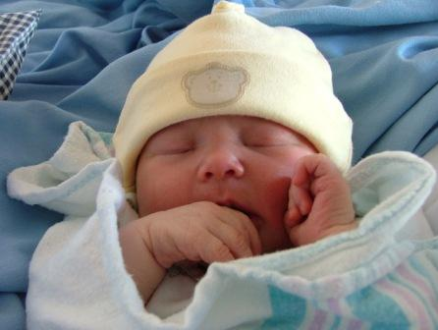
Neonatal Period
Umbilical vessels constrict
The ductus venosus constricts
A valve closes the foramen ovale as blood pressure in the right atrium falls and pressure in the left atrium rise
The ductus arteriosus constricts

