Slide 1
Nature of Solutions

Slide 2
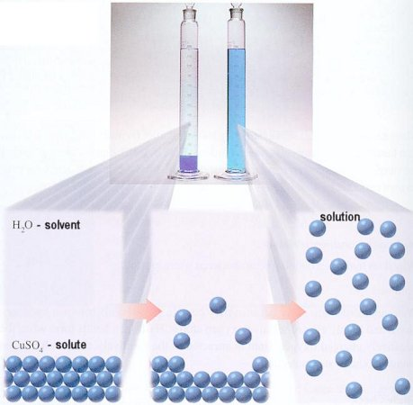
Parts of a Solution
Solvent: dissolving medium
water
Solute: dissolved particles
Solvent and Solute particles can be solid, liquid, or gas

Slide 3
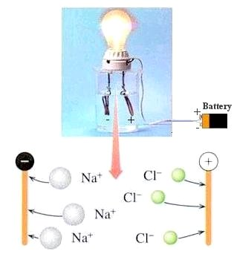
Electrolytes and Nonelectrolytes
Electrolytes: conducts electrical current
Ionic compounds
Separate in solution
NaCl → Na⁺ + Cl⁻
Nonelectrolytes: don’t conduct electrical current
Molecular compounds
Sugar and alcohol

Slide 4
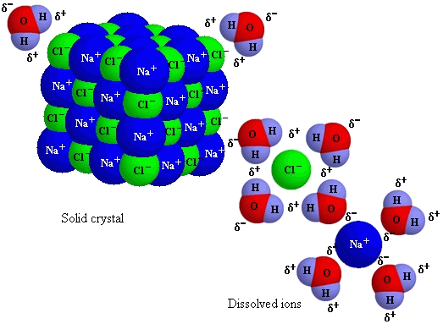
Electrolytes
Strong Electrolyte: ~ all separate into ions
Good conductor of electricity
NaCl
Weak Electrolytes: only a fraction separate into ions
Poor conductor of electricity
HgCl₂

Slide 5
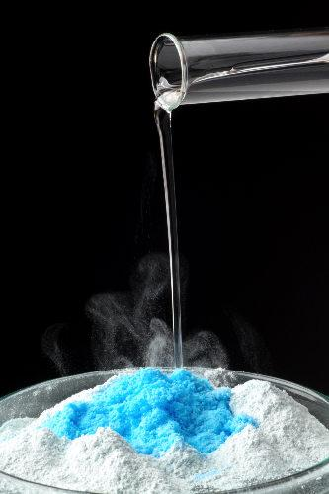
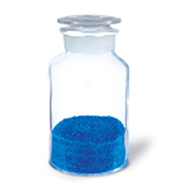
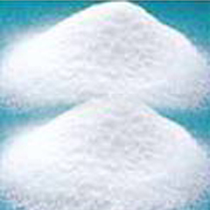
Types of Solution
Hydrate: compound that contains water molecules
CuSO₄ ·H₂O
Deliquescent Compounds: remove water from the air
Silica gel used in packaging
NaOH (lye)

Slide 6
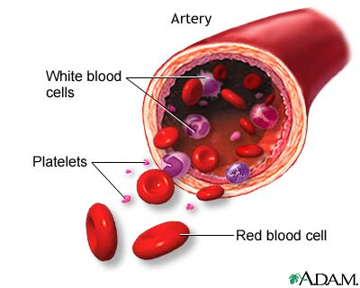
Heterogeneous Mixtures
Suspension: contains larger particles that don’t stay suspended forever
> 1000 nm
Muddy Water
Colloids: particle larger than solution and smaller than suspension
1 nm to 1000 nm
Whipped cream, blood

Slide 7
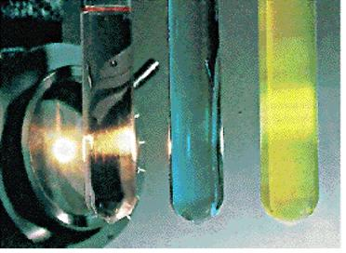
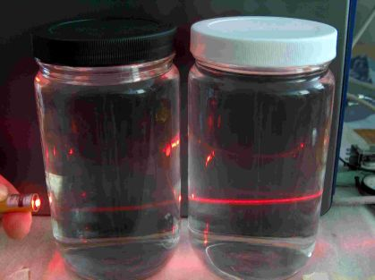
Tyndall Effect
Passing a beam of light through a liquid
Passes clear through a solution
Cloudy through colloid and suspension
Particles scatter the light

Slide 8
Solvation
Solvation: formation of a solution
Rate Affected By:
Agitation (stirring)
Increases rate
Temperature
Hi Temp → Hi KE
Inc Collision of Particles → increase rate
Surface Area of the solute particles
Inc surface area → Inc Collisions → Inc rate

Slide 9
Solubility
Solubility: amount of solute that will dissolves in a given quantity of solvent at specific temperature and pressure
g of solute/100g of solvent
g/L
Unsaturated S0lution: contains less than the maximum amount of solute
Saturated Solution: contains the maximum amount solute

Slide 10
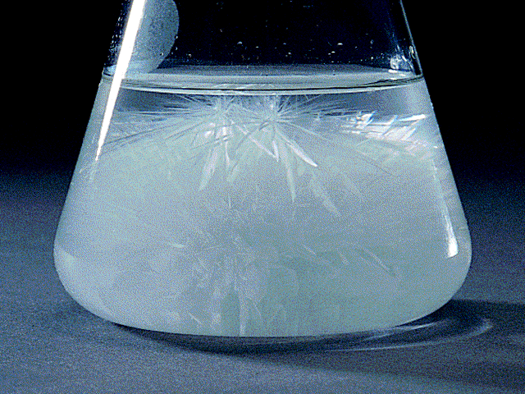
Solubility
Supersaturated solution: contains more solute than is can theoretically hold at a given temperature
Crystals form

Slide 11
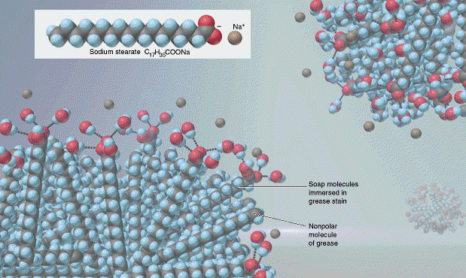
Solubility
Miscible: two liquids that dissolve in each other in all proportions
Alc0hol and Water
Immiscible: liquids that are insoluble
Oil and vinegar
Like dissolves Like
Polar and Polar
Nonpolar and nonpolar

Slide 12
Factors Affecting Solubility
Temperature and Pressure affect Solubility
Solubility Increases with Temperature
Pressure: gas solubility increases as the partial pressure of the gas above the solution increase
Carbonated beverages
Henry’s Law:

Slide 13
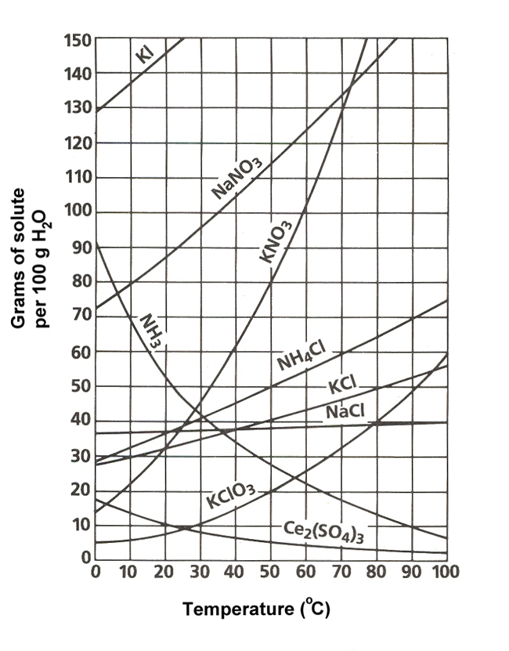
Solubility Curves

Slide 14
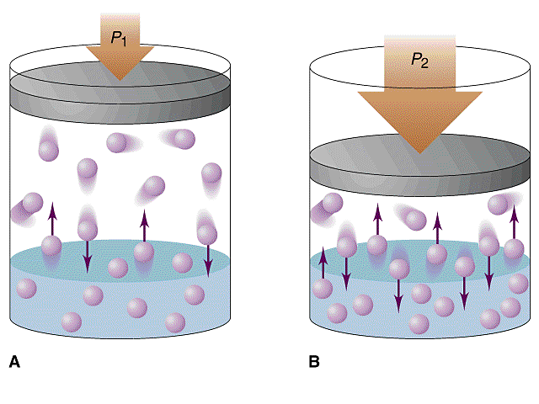
Henry’s Law
If the solubility of a gas in water is 0.77 g/L at 3.5 atm of pressure, what is its solubility at 1.0 atm of pressure?
P₁ = 3.5 atm S₁ = 0.77 g/L
P₂ = 1.0 atm S₂ = ?

