Slide 1
Muscular System

Slide 2
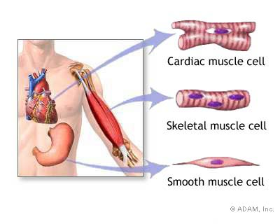
Introduction
Three Types
  Skeletal, smooth, and cardiac
  Skeletal Muscle: attaches to bone and is under conscious control

Slide 3
Structure of Skeletal Muscle
Components: skeletal muscle tissue, nervous tissue, blood, and connective tissue
Connective Tissue
  Fascia: layers of fibrous connective tissue
    Separate an individual skeletal muscle from adjacent muscles and hold it in position
    Surrounds each muscle
    Projects beyond the end to form cordlike tendon
      Intertwine with those in a bone’s periosteum
        Attaching muscle to bone
    Aponeuroses: connective tissue forms broad fibrous sheets
      Attach to the coverings of adjacent muscles

Slide 4
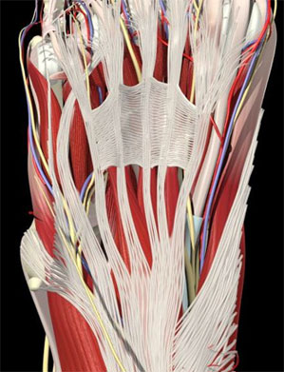
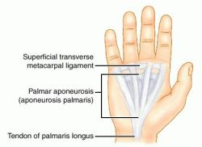
Fascia and Aponeurosis

Slide 5
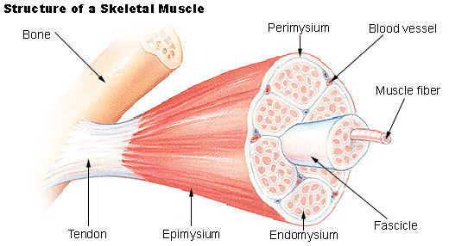
Layers of Connective Tissue
Epimysium: layer that surrounds the skeletal muscle
Perimysium: extend inward from the epimysium
  Separate muscle tissue into small compartments
  Fasciculi: bundles of skeletal muscle fibers
Endomysium: thin covering over each muscle fiber in fasciculi

Slide 6
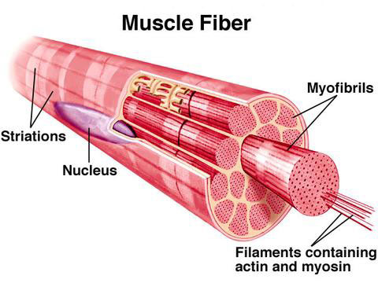
Skeletal Muscle Fibers
A single cell that contracts in response to stimulation and then relaxes when the stimulation ends
Thin, elongated cylinder with rounded ends
  May extend the full length of the muscle
  Myofibrils: contain protein filaments vital in muscle contraction
    Myosin: thick; A bands or dark bands
    Actin: thin; I bands or light bands
      Striations: alternation of the two protein filaments

Slide 7
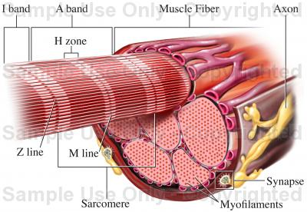
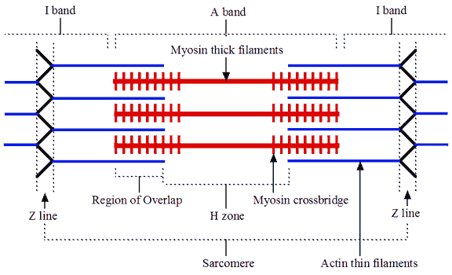
Myosin and Actin

Slide 8
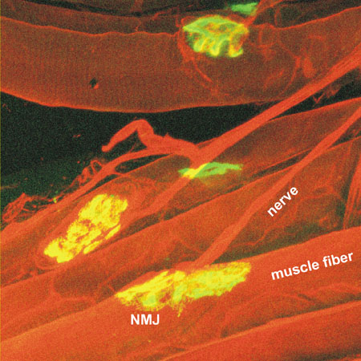
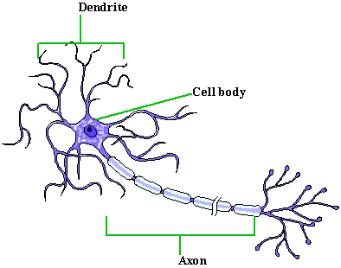
Neuromuscular Junction
Motor Neuron: where a muscle fiber connects to a fiber from a nerve cell
  Nerve fiber extends from brain → spinal cord→ muscle
  Muscle only contract when stimulated by motor neuron

Slide 9
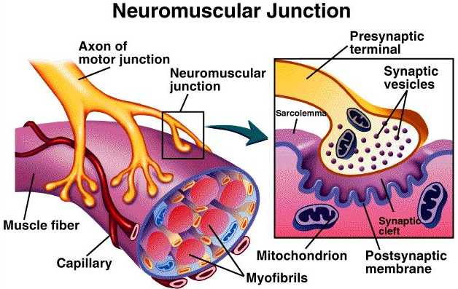
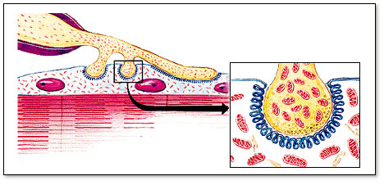
Neuromuscular Junction
Neuromuscular Junction : connection b/w motor neuron and muscle fiber
  Motor end plate: muscle fiber, nuclei, and mitochondria are abundant and cell membrane is extensively folded
  Neurotransmitters: chemicals released when a nerve impulse is sent from the brain
    Released b/w neuron and motor end plate, or synaptic cleft
      Contracts muscle

Slide 10
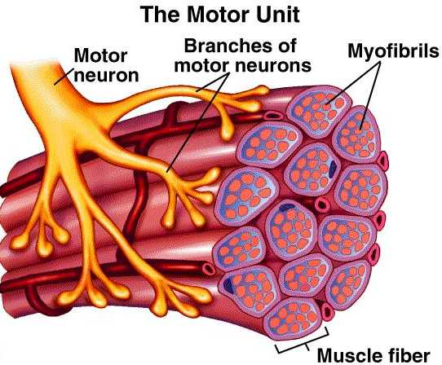
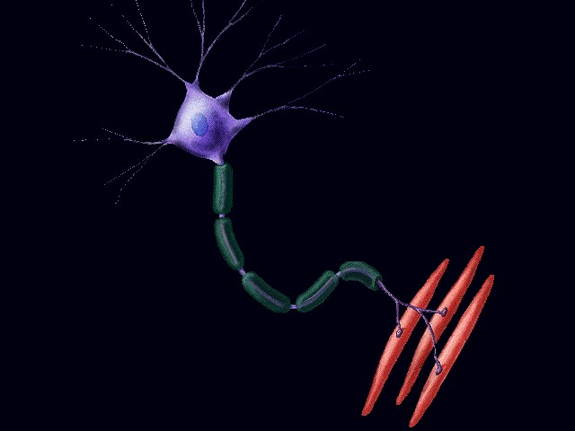
Motor Unit
Motor neuron and muscle fibers it controls
Because motor neurons are branched, many muscle fibers are affect by a single signal

Slide 11
Major Skeletal Muscles

Slide 12
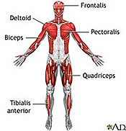
Major Skeletal Muscles
Pectoralis major: of large size located in the pectoral region, or chest
Deltoid: shaped like a delta or triangle
Biceps brachii: with two heads or points of origin and located in the brachium, arm

Slide 13
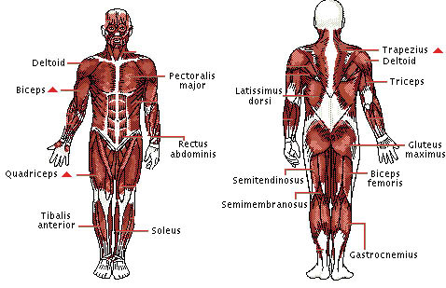
Major Skeletal Muscles
Sternocleidomastoid: attached to the sternum, clavicle and, and mastoid process
External oblique: located near the outside with fibers that run obliquely, or in the same direction

Slide 14
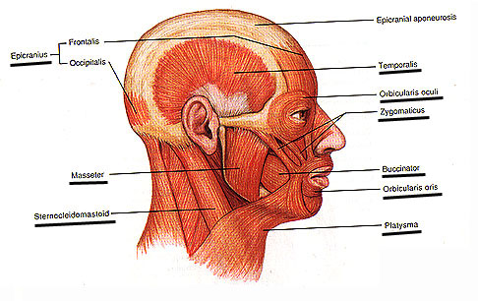
Muscles of Facial Expressions
Epicranius: occipital bone; raises eyebrow
    Frontalis & Occipitalis
Orbicularis oculi: maxillary and frontal bone; closes eyes
Orbicularis oris: muclses near the mouth
  Closes and protrudes the lips

Slide 15
Muscles of Facial Expressions
Buccinator: outer surface of maxilla and mandible
  Compresses cheeks inward
Zygomaticus: zygomatic bone; raises corner of your mouth
Platysma: fascia in upper chest; draws angle of mouth downward

Slide 16
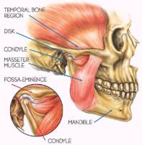
Muscles of Mastication
Muscles attached to the mandible
  chewing and biting movements
Masseter: closes jaw
Temporalis: closes jaw

Slide 17
Muscles of the Head
Sternocleidomastoid: anterior surface of sternum and upper surface of clavicle
  Pulls head to one side and toward chest
  Raises sternum
Splenius capitis: lower cervical and upper thoracic vertebrae
  Rotating head, bends head to one side, or brings head into upright position
Semispinalis capitis: lower cervical and upper thoracic vertebrae
    Extends head, bends to one side, or rotates head

Slide 18
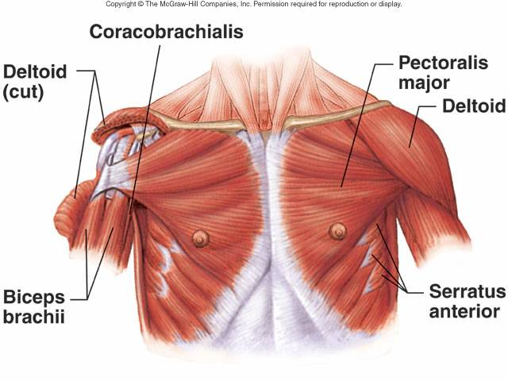
Pectoral Girdle
Connect to the scapula to nearby bones and closely associate with muscles of the arm
  Trapezius, rhomboideus major, levator scapulae, serrature anteriro, and pectroralis minor

Slide 19
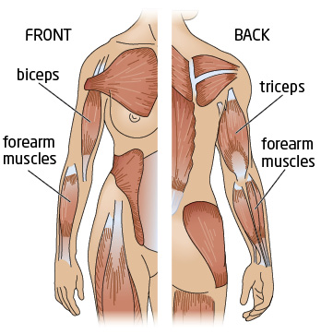
Arm Muscles
Muscles that move the arm
  Connect to the humerus to various region of pectoral girdle, ribs, and vertebral column
  Coracobrachialis, pectoralis major, teres major, latissimus dorsi, supraspinatus deltoid, subscapularis, infraspinatus, and teres minor

Slide 20
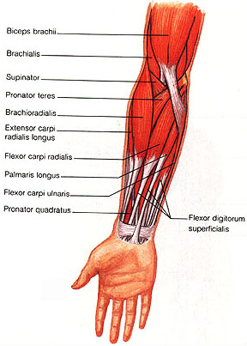
Movement of forearm
Connect the radius and ulna to the humerus or pectoral girdle
  Biceps brachii, brachialis, brachioradialis, triceps brachii, supinator, pronator teres, and pronator quadratus

Slide 21
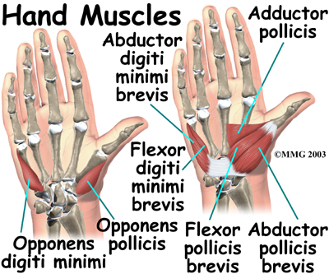
Hand, Wrist, and Fingers
Arise from the distal end of the humerus and from the radius and ulna
Flexor carpi radialis, flexor carpi ulnaris, palmaris longus, glexor digitorum profundus, extensor carpi radialis longus, extensor carpi radialis brevis, extensor carpi ulnaris, and extensor digitorum

Slide 22
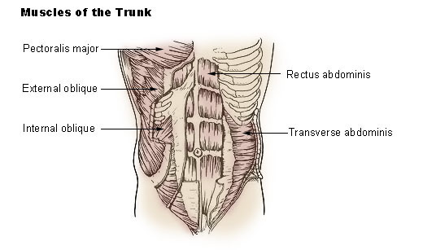
Muscles of Abdominal Wall
Connect the rib cage and vertebral column to the pelvic girdle
Include the external oblique, internal oblique, transversus abdominis, and rectus abdominis

Slide 23
Muscles of the pelvic outlet
Form the floor of the pelvic cavity and fill the space within the pubic arch
Levator ani, superficial transversus perinei, bulbospongiosus, and ischiocavernosou

Slide 24
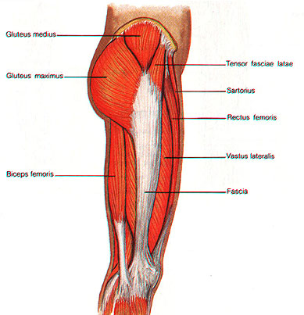
Muscles of the Thigh
Attach to the femur and to some part of the pelvic girdle
Psoas major, iliacus, gluteus maximus, gleteus medius, gluteus minimus, tensor fasciae latae, adductor magnus, and gracilis

Slide 25
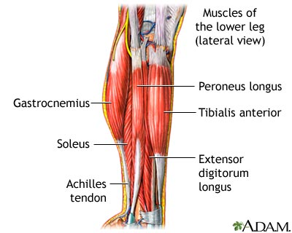
Movement of the Leg
Muscles connect the tibia or fibula to the femur or pelvic girdle
Biceps femoris, semitendinosus, semimembranosus, sartorius, and the quadriceps femoris

Slide 26
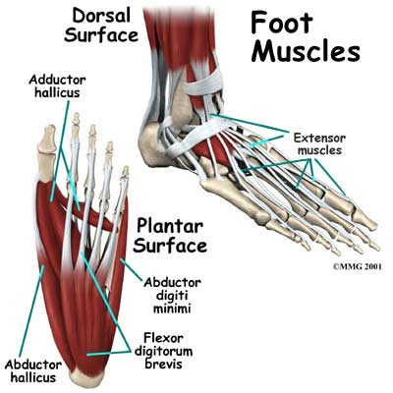
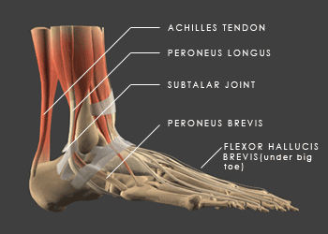
Ankle, Foot, and Toes
Attach the femur, tibia, and fibula to bones of the foot
Tibialis anteriro, peroneus tertius, extensor digitorum longus, gastrocnemius, soleus, flexor digitorum longus, tibialis posterior, and peroneus longus

Slide 27
Skeletal Muscle Contractions

Slide 28
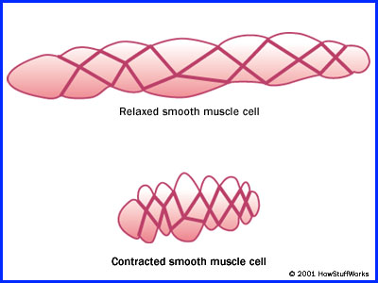
Skeletal Muscle Contraction
Movement within the myofibrils
  filaments of actin and myosin slide past one another
  shortening the muscle fiber
  pulling on it attachment
Muscles release large amounts of heat
  Transported throughout the body to regulate body temperature

Slide 29
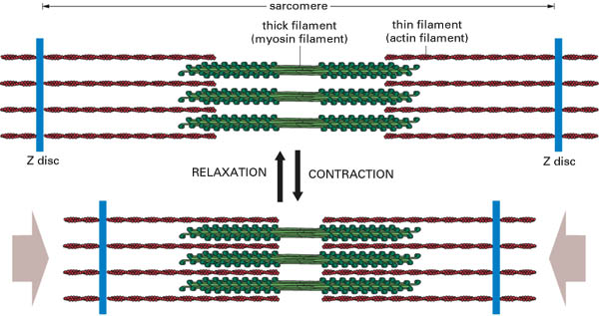
Role of Myosin and Actin
Myosin: two twisted protein strands
  Cross-bridges projecting outward
Actin: globular structure with a binding site to which the myosin cross-bridge attaches
  Actin Filament: twist into a double strand helix
  Proteins: troponin and tropomyosin

Slide 30
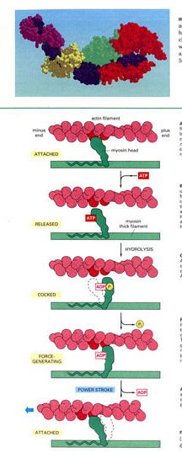
Sliding Filament Theory
Head of myosin cross-bridge can attach to an actin binding site
Bend slightly → pulling the actin filament within it
Head can release and straighten
Bind to a site further down and pull again

Slide 31
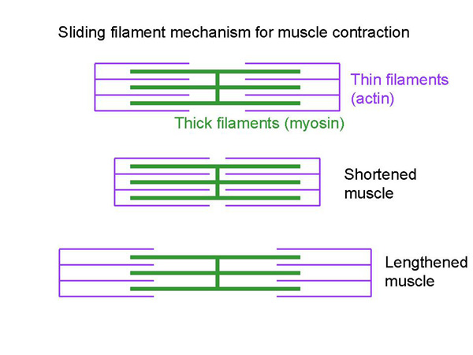
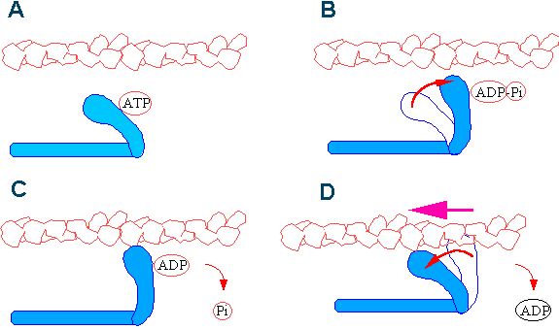
Sliding Filament Theory
ATPase: enzyme the breaks down ATP in myosin
  Causes the myosin to become cocked
  Triggers the pulling action once bond to the actin
  As long as ATP is present as an energy source, the muscle fiber is simulated to contract

Slide 32
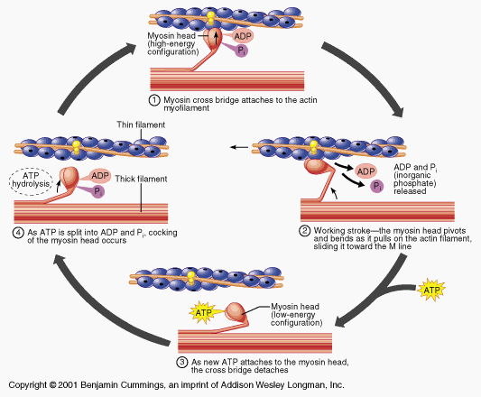
Sliding Muscle Theory

Slide 33
Stimulus for Contraction
Skeletal Muscle: contraction upon the stimulation of neurotransmitter
  Acetylcholine: neurotransmitter that stimulates a muscle impulse
    Travels in all directions over the fiber and reaches the sarcoplasmic reticulum
    Sarcoplasmic reticulum contains a high concentration of Ca²⁺
    Ca ions diffuse into the sarcoplasm of the muscle fiber
    With high Ca ion concentrations, troponin and tropomysoin interact to expose binding sites on actin
      Linkage of myosin and actin → muscle contraction

Slide 34
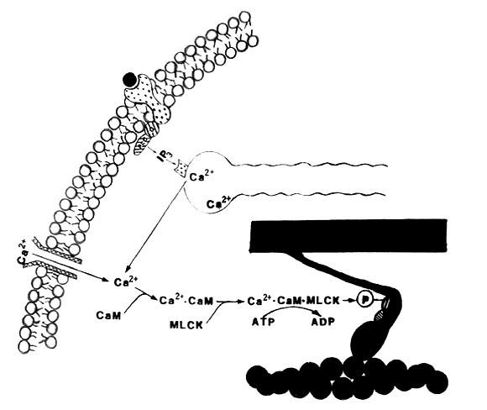
Stimulus for Contraction

Slide 35
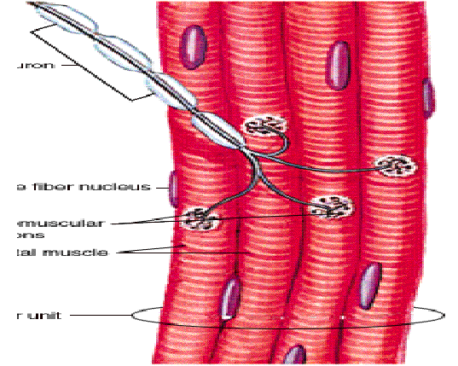
Stimulus for Contraction
Contraction persists as long as acetylcholine is released
Relaxation: acetylcholine is rapidly decomposed by acetylcholinesterase enzyme
Ca ions are actively transported back into the sarcoplasmic reticulum
  Linkage of myosin and actin break
  Muscle fiber relaxes

Slide 36
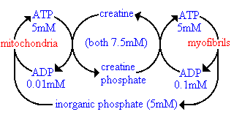
Energy Source for Contraction
ATP is the main energy source
  Short supply in muscle
Creatine Phosphate: helps cells regenerate ATP from ADP
  Stores excess energy from mitochondria in phosphate bonds
  Limited supply of energy

Slide 37
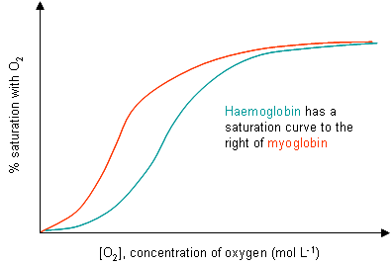
Oxygen Supply & Cellular Respiration
Glycolysis can occur without oxygen, but is required for cellular respiration
Hemoglobin: loosely binds O₂ and carries to muscles
Myoglobin: stored in muscles and picks up O₂ from hemoglobin
  Stronger affinity for O₂ allows oxygen to be stored in muscles

Slide 38
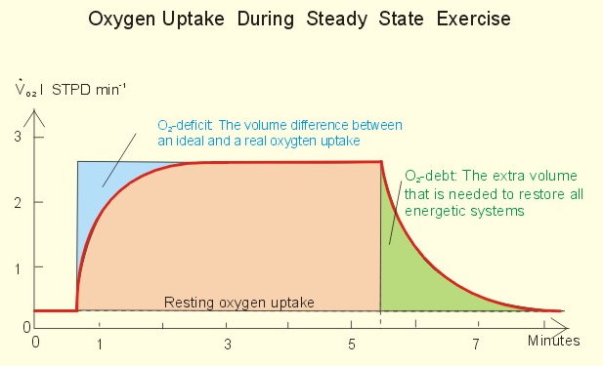
Oxygen Supply & Cellular Respiration
When muscle cells run out of oxygen, they acquire energy from lactic acid fermentation
  Produces sore muscles from the byproduct of lactic acid
Oxygen debt: amount of oxygen liver cells require to convert the accumulated lactic acid into glucose
  Restore ATP and creatine phosphate levels in muscle tissue

Slide 39
Muscle Fatigue
Fatigue: a muscle exercised strenuously and loses its ability to contract
  Interruption of muscle’s blood supply
  Lack of acetylocholine
  Accumulation of lactic acid
Muscle Cramp: muscle undergoes a sustained involuntary contraction
  Changes in extracellular fluid surrounding the muscle fibers and their neurons trigger uncontrolled stimulation

Slide 40
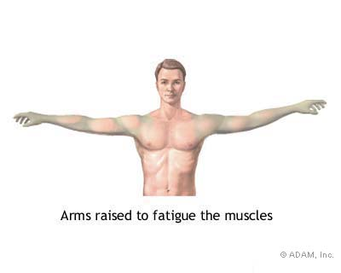

Slide 41
Muscular Responses

Slide 42
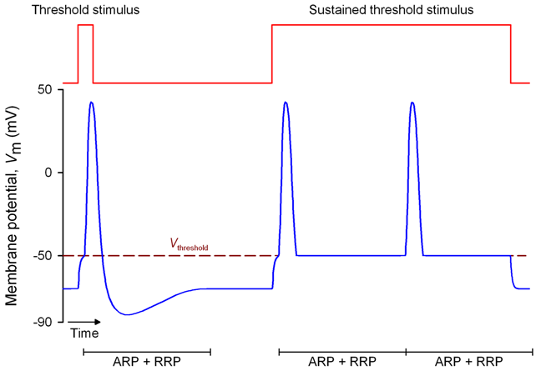
Muscular Responses
Threshold Stimulus: minimal strength required to cause a contraction
  Release of actylecholine
All-or-None Response: if the threshold is met, the muscle contracts completely
  Increase stimulus beyond threshold doesn’t increase response

Slide 43
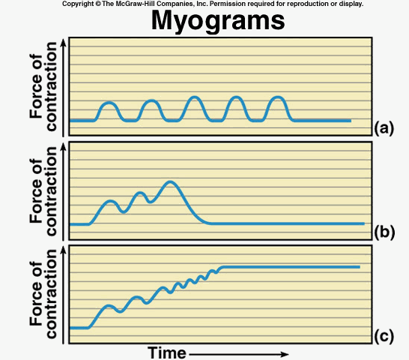
Muscle Contraction
Myogram: record or graph of muscle contraction
  Twitch: single contraction that last only a fraction of a second
  Latent Period: on a myogram, it’s the delay between the stimulus and muscle response
    Frogs: 0.01 seconds
    Humans: even shorter

Slide 44
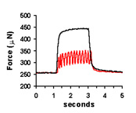
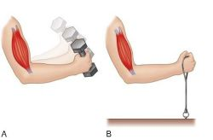
Muscle Contraction
Summation: when the frequency of the stimulus increases so that the muscle cannot relax before the next stimulus
  Forces of individual twitches combines
  Tetanic Contraction: resulting forceful, sustained contraction lacks even partial relaxation

Slide 45
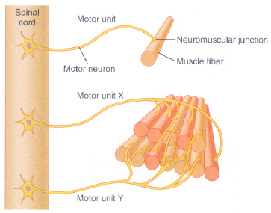
Recruitment of Motor Unit
Motor Unit responds in an all-or-none pattern
  Muscle fibers are organized into motor units
  Single neuron controls each motor unit
  All the muscle fibers in a motor unit are stimulated at the same time

Slide 46
Recruitment of Motor Unit
Single stimulus doesn’t affect entire muscle
  many motor unit
  Respond to different thresholds of stimulation
  At low intensity, only a few motor units respond
Recruitment: increases the number of motor units being activated by increasing the intensity of the stimulus
  When all motor units are recruited, the muscle contracts with maximum tension

Slide 47
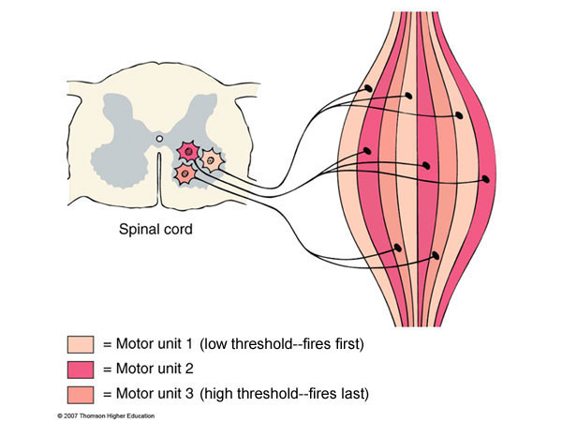

Slide 48
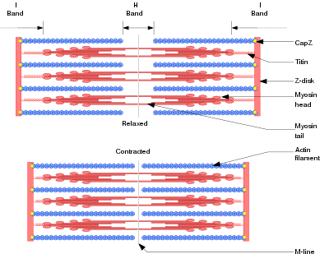
Sustained Contraction
As twitches combine, the strength of contractions may increase due to recruitment of motor units
  Motor units with finer fibers are easily stimulated and respond earlier
  Larger motor units: thicker fibers
    respond later and more forcefully

Slide 49
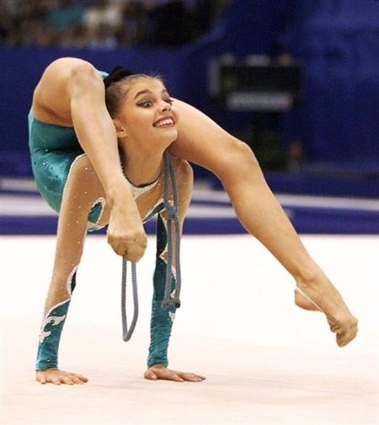
Sustained Contraction
Sustain Contraction: walking or lifting weights
  Responses to a rapid series of stimuli transmitted from the brain and spinal cord to motor neuron fiber
  Muscle Tone: even at rest, a certain amount of sustained contraction is occurring
    Stimulation of a few muscle fibers
    Important in posture
    If lost, person will collapse

Slide 50
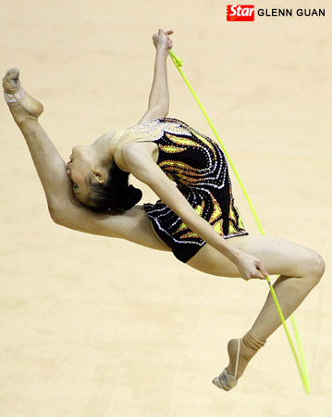
How’s Your Muscle Tone?

Slide 51
http://www.dnatube.com/video/1306/Muscle-contraction
http://www.blackwellpublishing.com/matthews/myosin.html
http://highered.mcgraw-hill.com/sites/0072495855/student_view0/chapter10/animation__breakdown_of_atp_and_cross-bridge_movement_during_muscle_contraction.html
http://www.andrew.cmu.edu/user/berget/Education/TechTeach/muscle/2DMACycle.html

Slide 52
Smooth, Cardiac, and Skeletal Muscle Action

Slide 53
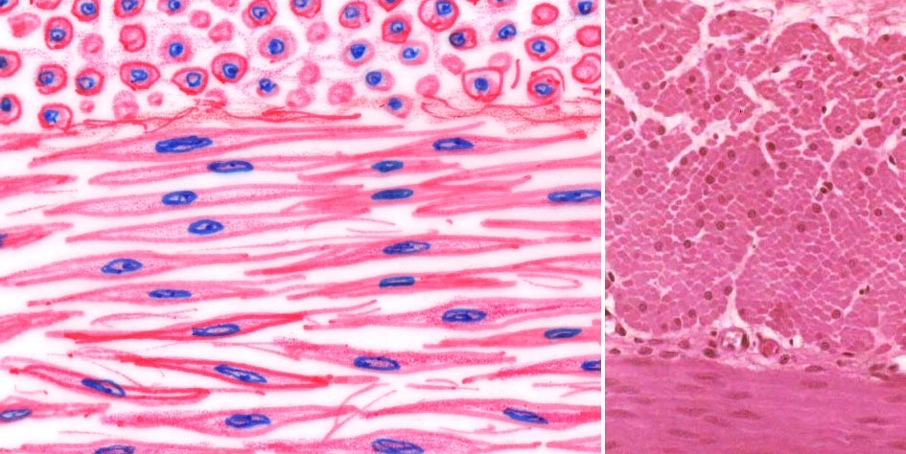
Smooth Muscle
Elongated cells with tapering ends
No striations
  Actin and myosin
    Extend the entire length of the cell
    more randomly organized

Slide 54
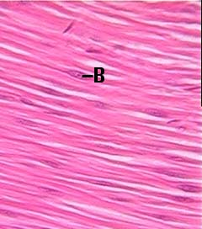
Types of Smooth Muscle
Multiunit Smooth Muscle: muscle fibers are separate
  Irises of the eyes and walls of blood vessels
  Contract in response to stimulation of motor neurons or hormones
Visceral Smooth Muscle: sheets of spindle-shaped cells
  Walls of hollow organs
  Fibers can stimulate each other
    Rhythmicity: pattern of repeated contractions
    Peristalsis: wavelike motion
      Intestines

Slide 55
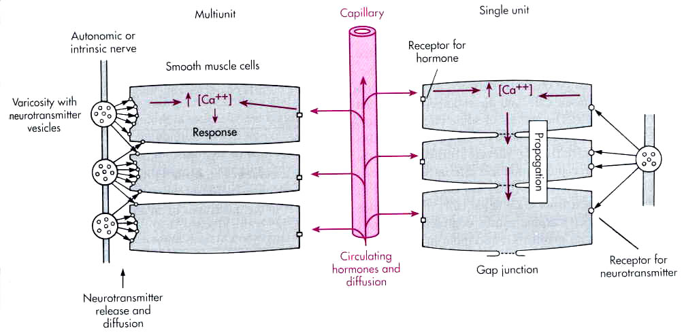
Smooth Muscle Contraction
Reactions of actin and myosin
Triggered by membrane impulses and increase in intracellular Ca ions
ATP energy source
Neurotransmitters: acetylcholine and norepinephrine
Muscles can be stimulated by hormones

Slide 56

Smooth Muscle Contraction
Slower to contract and relax than skeletal
Maintain forceful contraction longer
Can change length w/o changing tautness
  Stretch and maintain pressure
    Stomach and intestines

Slide 57

Muscle Contraction

Slide 58

Cardiac Muscle
Found only in the heart
Striated cell joined end to end forming fibers
  Fibers branch into 3-D networks
Longer twitches than skeletal
  Cells store less Ca ions than skeletal
  Release larger amounts of Ca during impulse

Slide 59

Cardiac Muscle
Intercalated Disks: junctions between cell membranes
  Transmits force of contraction from cell to cell
    Entire structure contracts as a unit
    Self-exciting and rhythmic → rhythmic heat contractions

Slide 60


Skeletal Muscle
Muscle movement depends on type of joints its attached to
Origin: end of muscle fastens to a fixed part
Insertion: end of muscle attached to moveable portion
  Contraction: insertion is pulled toward its origin
  Biceps: two origins

Slide 61


Skeletal Muscle
Flexion: decrease angle of joint
  Flexion of the forearm at the elbow
Extension: increase the angle of joint
  Extension of the leg at the knee

Slide 62

Interactions of Skeletal Muscles
Skeletal Muscles function in groups
  Nervous system must stimulate the appropriate groups of muscles for a movement to occur

Slide 63

Interactions of Skeletal Muscles
Prime Movement: muscle that provides most of the movement
Synergists: muscles that contract & assist the prime mover
Antagonists: muscles that resists a prime mover’s action and cause movement in opposite direction
  Raise upper limb vs. lowering upper limb

Slide 64
Synergists vs. Antagonists
http://www.bandhayoga.com/keys_recip.html

