Slide 1
Measuring Enthalpy Changes

Slide 2
Calorimetry
Calorimetry - the measurement of heat/ energy changes in a chemical reaction
Calorimeter: insulated device used to measure the absorption or release of heat in chemical or physical processes
Bomb Calorimeter: uses constant volume

Slide 3
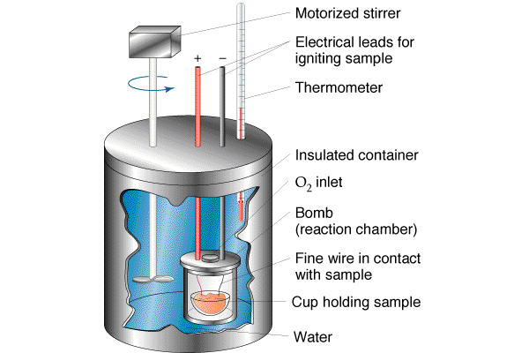
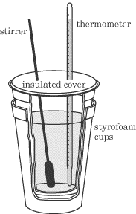
Calorimeter

Slide 4
Enthalpy
Enthalpy - represents heat energy
Change in Enthalpy (Δ Hº) - energy difference between the products and reactants
Exothermic: energy released, ∆ enthalpy (-)
In the combustion of CH₄, Δ Hº = –211 kcal
Endothermic: energy absorbed, ∆ enthalpy (+)
In the decomposition of NH₃, Δ Hº = +22 kcal

Slide 5
Measuring Enthalpy
Q_{surr} = m x C x ΔT
surr → surroundings
Q_{sys} = ΔH = -q_{surr} = -m x C x ΔT
m = mass of solvent
C = specific heat of solvent
ΔT = change in temperature
Solvent is generally water

Slide 6
Enthalpy Change Calculation
25.0 mL of water containing 0.025 mol HCl at 25.0ºC is added to 25.0 mL of water containing 0.025 mol NaOH at 25.0ºC in foam cup calorimeter.
Calculated the enthalpy change in kJ if the highest temperature observed is 32.0ºC.
Assume densities are 1.00g/mL.

Slide 7
Problem Continued
C_{water} = 4.18j/(g·ºC)
ΔT = (32.0-25.0)=7.0ºC
m=need to calculate
V_{final}=V_{HCl}+ V_{NaOH} = 25.0mL+25.0mL=50.0mL
Density=1.00g/mL
Enthalpy

Slide 8
Thermochemical Equations
Thermochemical Equation
CaO(s) + H₂O(l) → Ca(OH)₂(s) + 65.2kJ
Exothermic reaction
2NaHCO₃ +129kJ → Na₂CO₃ +H₂O +CO₂
Endothermic reaction
Heat of Reaction
CaO(s) + H₂O(l) → Ca(OH)₂(s) ΔH = -65.2 kJ
Exothermic: heat loss
2NaHCO₃ →Na₂CO₃ +H₂O +CO₂ ΔH =129kJ
Endothermic: heat gained

Slide 9
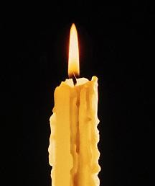
Heat of Combustion
Heat of Combustion: heat released in the complete burning of 1mole of a substance
Heat released → exothermic process
Hydrogen = -286 kJ/mol
Sucrose = -5645 kJ/mol

