Slide 1
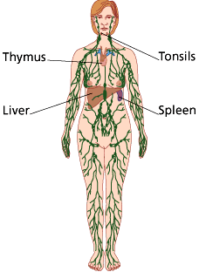
Lymphatic System and Immunity

Slide 2
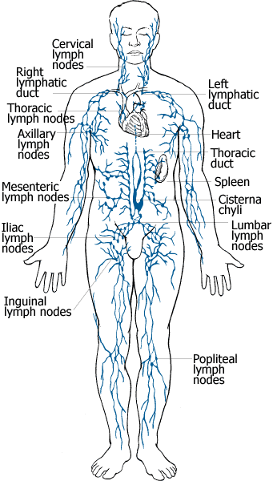
Introduction
Network of vessels that circulates fluid
Transport fluid from interstial space in most tissues and returns it to the blood stream
Absorbs fat in the small intestines
Defends the body against disease-causing agents

Slide 3
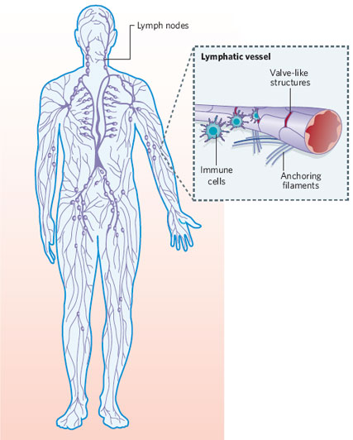
Lymphatic Pathways
Begin as lymphatic capillaries
Merge to form larger lymphatic vessels
Unite with veins in the thorax
Lymphatic capillaries: microscopic, closed end tubes
Extend into intersititial spaces
Form complex networks that parallel blood capillaries
Thin walls: squamous epithelial cells
Tissue fluid can easily enter: lymph

Slide 4
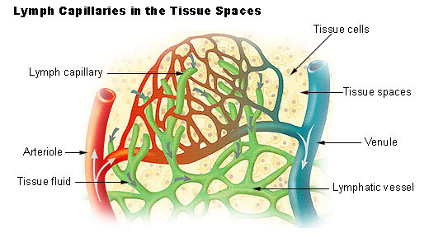
Lymphatic Vessels
Walls similar to veins, but thinner
Have flap-like valves to prevent backflow
Larger vessels lead to lymph nodes
From there, large vessels merge to form lymphatic trunks

Slide 5
Lymphatic Trunks and Collecting Ducts
Drain lymph
Thoracic duct: larger and longer collecting duct
Receives lymph form the lower limbs and abdominal regions, left upper limb, and left side of the thorax, head, and neck
Empties into the left subclavian vein
Right lymphatic duct
receives lymph form the right side of the head and neck, right upper limb, and right thorax
Empties into the right subclavian vein
After leaving the collecting ducts, lymph enters the venous system and becomes part of the plasma

Slide 6
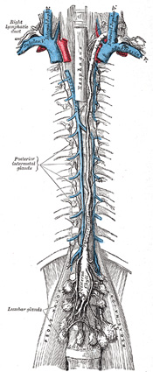
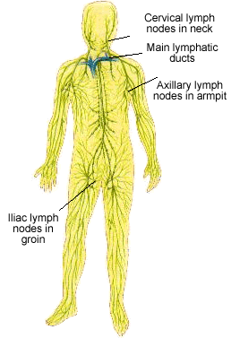
Lymphatic Trunks and Collecting Ducts

Slide 7
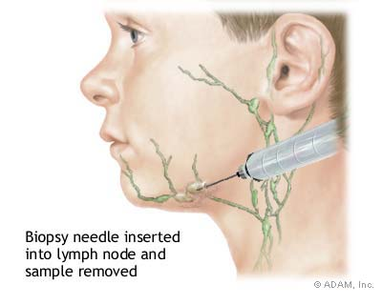
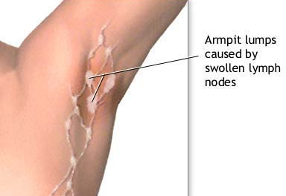
Tissue Fluid and Lymph
Tissue Fluid: originates from blood plasma
water and dissolved substances that leave blood capillaries by diffusion and filtration
nutrients and gases found in plasma, but lacks proteins
Lymph: tissue fluid that has entered the lymph system
Transports foreign particles, such as bacteria or viruses, to lymph nodes

Slide 8
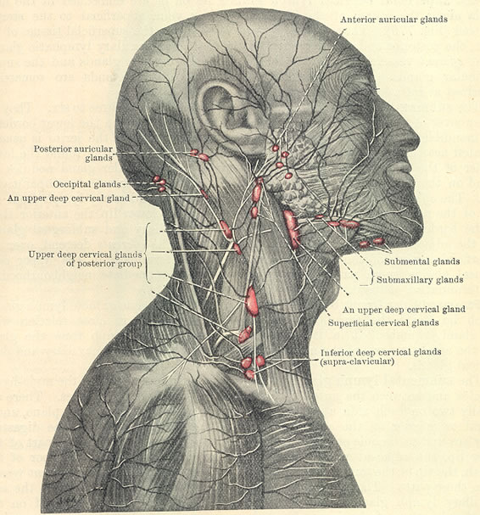
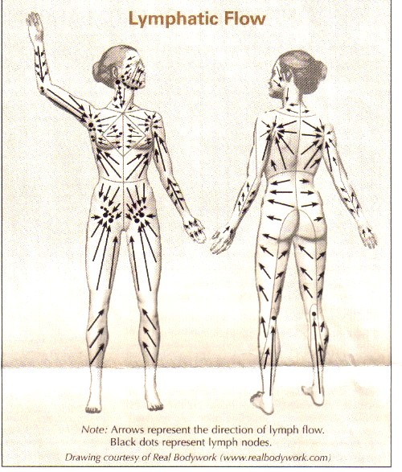

Slide 9
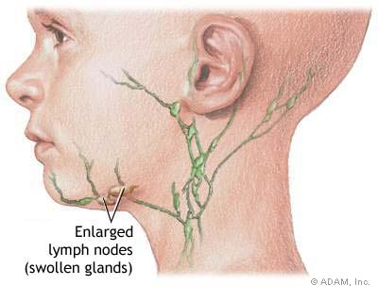
Lymph Movement, Lymph Nodes, Thymus and Spleen

Slide 10
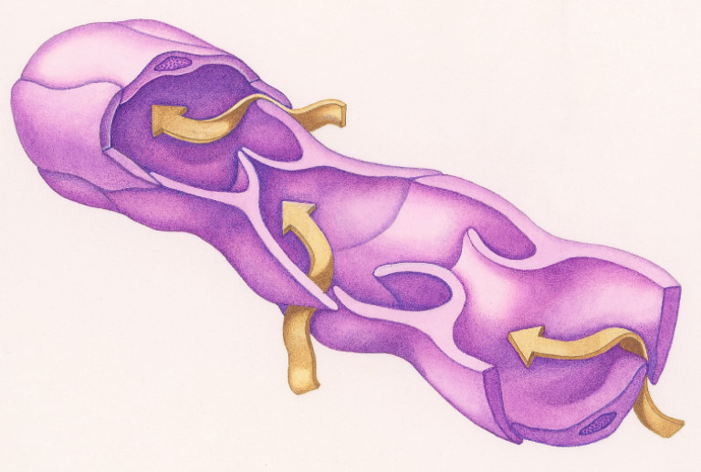
Lymph Movement
Hydrostatic pressure of tissue fluid drives the entry of lymph into lymphatic capillaries
Muscular activity is also a large influence
Contraction of skeletal muscle and smooth muscle
Pressure change due to breathing muscles

Slide 11
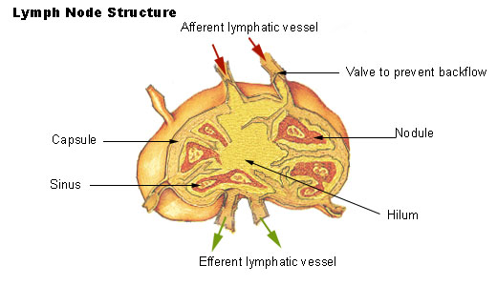
Lymph Node
Aka lymph gland
Contain cells to fight microorganisms
lymphocytes and macrophages
Structure of lymph node
Usually less than 2.5 cm and bean shaped
Hilum: location where blood vessels and nerves join

Slide 12
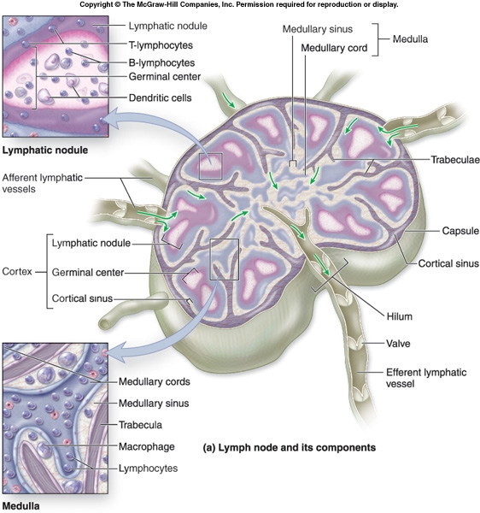

Slide 13
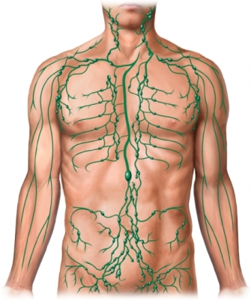
Location of Lymph Nodes
Located along lymph pathways
Subdivided into nodules
Lymph sinuses: spaces within node
Aggregate in groups or chains along the path of larger lymph vessels
Mucous membranes of the respiratory and digestive tracts
Tonsils
Peyre’s Patches: small intestine

Slide 14
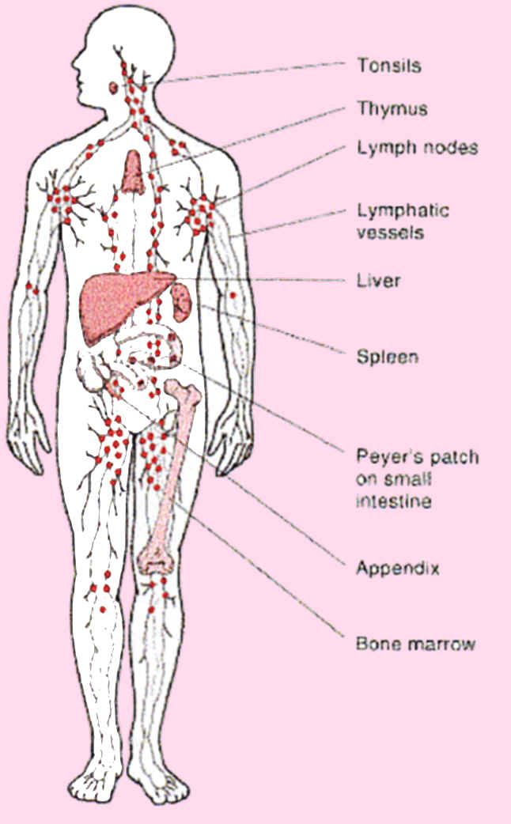
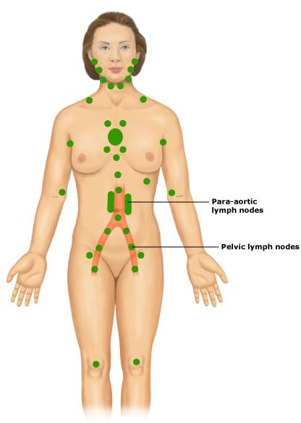
Major Lymph Nodes

Slide 15
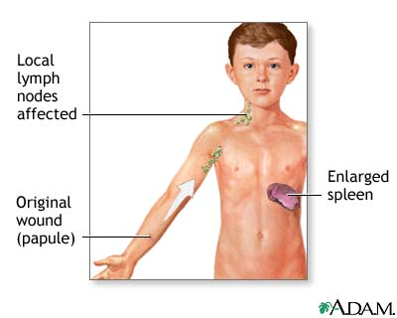
Function of Lymph Nodes
Filter potentially harmful foreign particles from lymph
Immune surveillance
production of lymphocytes
Attack infecting viruses, bacteria, and other microorganisms
Macrophages
Engulf and destroy foreign substances, damaged cells, and cellular debris
Contain phagocytic cells

Slide 16
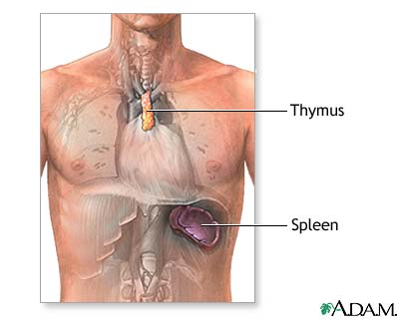
Thymus Gland
Soft, bilobed structure enclosed in a connective capsule
Located anterior to the aorta and posterior to the upper part of the sternum
Shrinks after puberty
Subdivided into lobules
Lymphoctyes, especially thymoctes
T lymphocytes or T cells: leave thymus and provide immunity

Slide 17
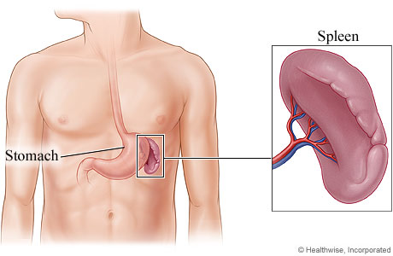
Spleen
Largest lymphatic organ
Filters blood
Upper left portion of the abdominal cavity
Inferior to diaphragm, and posterior and lateral to the stomach
Resembles a large lymph node

Slide 18
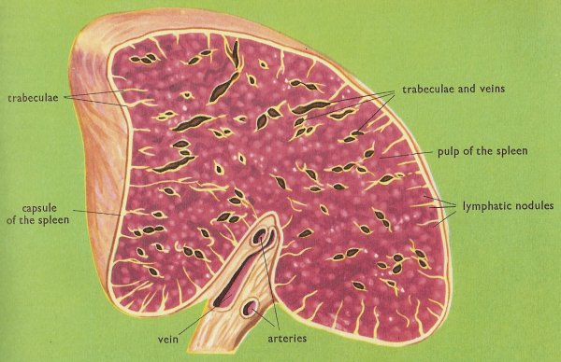
Spleen
Subdivided into lobules
Spaces contain blood
White pulp: composed of splenic nodules
contains lymphocytes
Red pulp: contains RBC, lymphotcytes, and macrophages

Slide 19
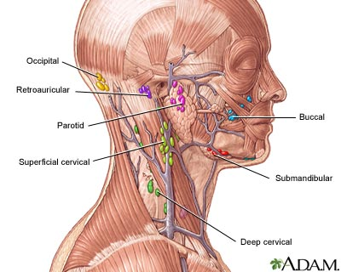
Body Defense

Slide 20
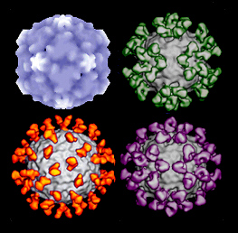
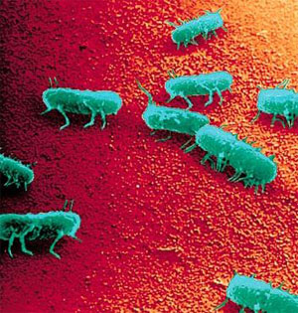
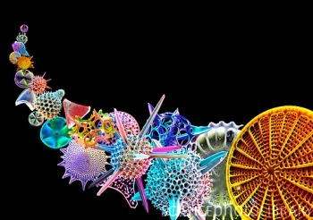
Body Defense
Pathogen: disease causing agent
Viruses, bacteria, fungi, and protozoans

Slide 21
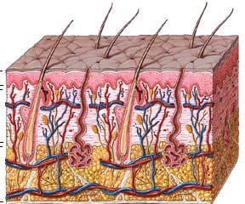
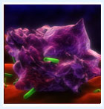
Body Defense
Nonspecific Defense: general protection against many pathogens
Species resistance, skin and mucous membranes, enzyme action, interferon, inflammation, and phagocytosis
Rapid response time
Specific Defense: defense mechanisms that are very precise targeting specific pathogens
Immunity: specific defense
Specialized lymphocytes
Slower response time

Slide 22
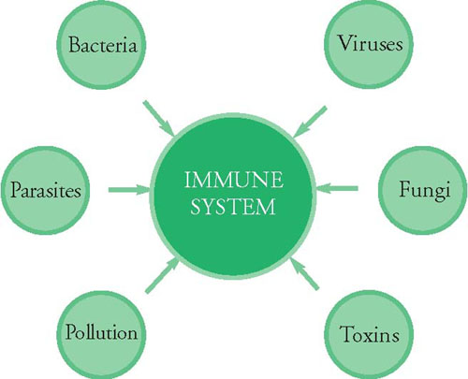

Slide 23
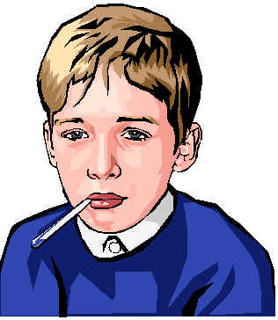
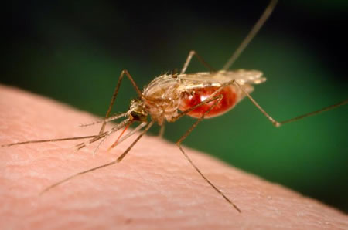
Nonspecific Defense
Species Resistance: a species may be resistant to diseases that affect another species
Variance in temperature or chemical environment
Measles, mumps, gonorrhea, and syphilis
Rats and Mosquitoes act as carriers for human diseases

Slide 24
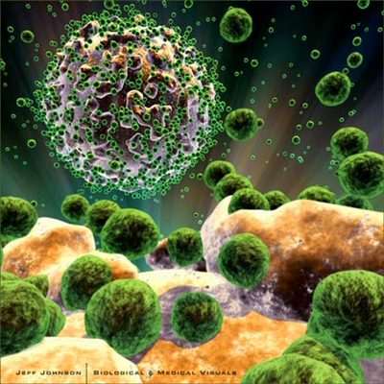
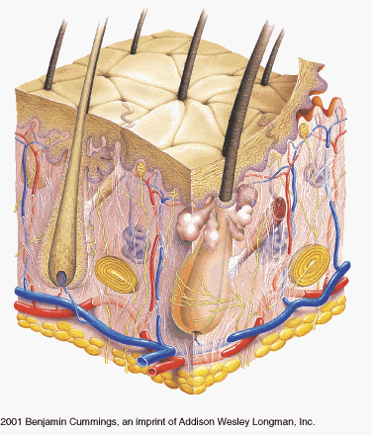
Nonspecific Defense
Mechanical barriers: skin and mucous membranes
Linings of respiratory, digestive, urinary, and reproductive tracts
First line of defense

Slide 25
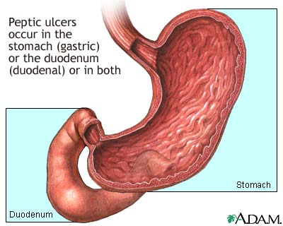
Nonspecific Defense
Chemical barriers: 2nd line of defense
Gastric juices contain protein splitting enzyme, pepsin, & has a low pH
Tears contain lysozyme, antibacterial agent
Accumulation of salt on skin kills bacteria
Interferons: hormone produced by lymphocytes and fibroblasts
Once released from infected cell, binds to receptors on uninfected cells
Stimulates them to synthesize proteins that block replication of a variety of viruses

Slide 26
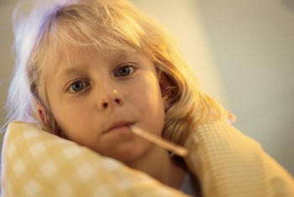
Nonspecific Defense
Fever: 2nd line, powerful protection
Higher body temp. causes the liver and spleen to sequester iron
bacteria and fungi require more of with higher temp.
Growth slows or stops
Increases the attach rate of phagocytic cells

Slide 27
Nonspecific Defense
Inflammation: tissue response to injury or infection
Produces redness, swelling, heat, and pain
Redness: blood vessel dilation
Swelling: increase volume of blood
Heat: blood from deeper parts of the body, which are warmer
Pain: stimulation of nearby pain receptors
Infected cells release chemicals to attract WBC to inflammation sites
Pus: mass of WBC, bacterial cells, and damaged tissue
Fluid: inhibits the spread of pathogens and toxic substances to adjacent tissues

Slide 28
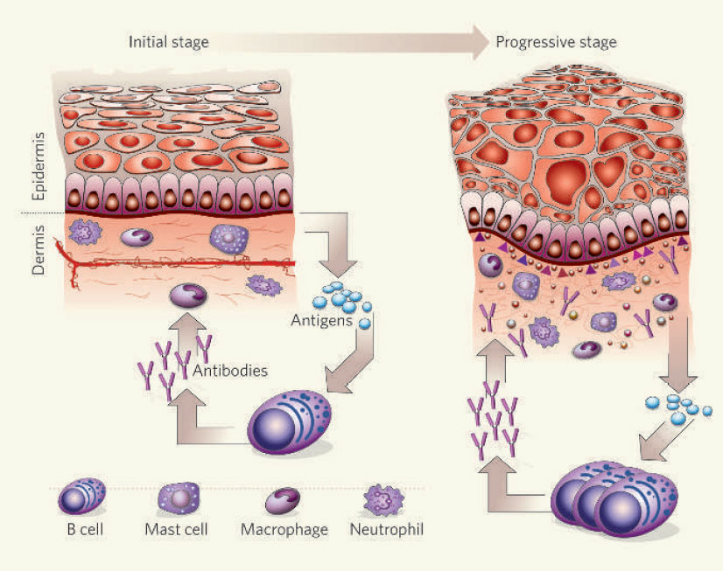

Slide 29
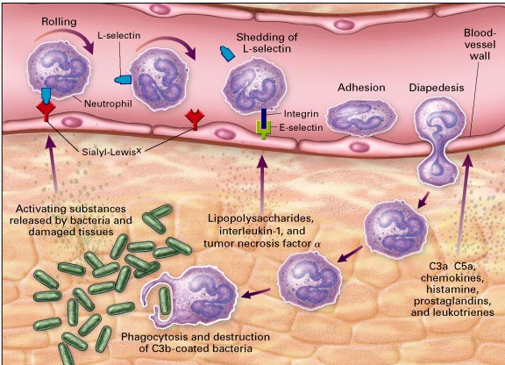
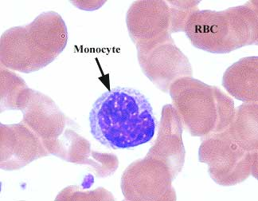
Nonspecific Defense
Neutrophils and Monocytes: attached by chemicals released from injured tissue
Neutrophils: engulf and digest smaller particles
Monocytes: phagocytize larger ones
Give rise to macrophages (histiocytes)
Lymph nodes, spleen, liver, and lungs
Mononuclear phagocytic system

Slide 30
Specific Defense

Slide 31
Specific Defense
Antigens
Before birth, body cells inventory “self” proteins and other large molecules
After inventory, lymphocytes develop receptors that allow them to differentiate between nonself and self antigens
Nonself antigens combine with T cell and B cell surface receptors and stimulate these cells to cause an immune reaction
Haptens: small molecules that can combine with larger one
Become antigenic

Slide 32
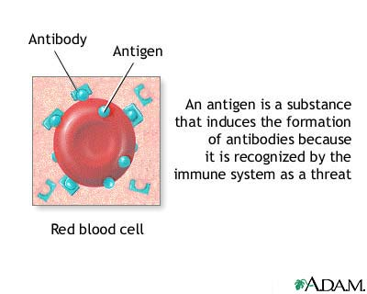

Slide 33
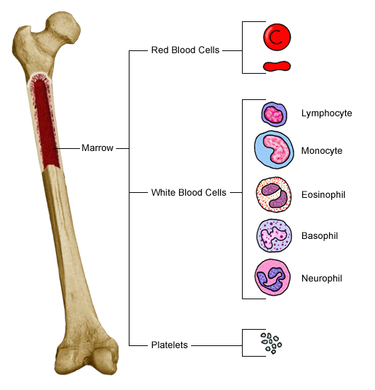
Lymphoctye Origins
Red bone marrow
Released into the blood before they differentiate
At thymus → T cells
B cells: mature in red bone marrow

Slide 34
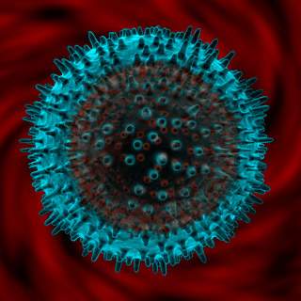
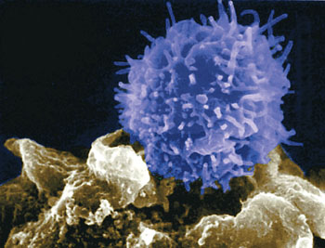
Lymphocyte Functions
Varieties of T and B cells number in the millions
Each variety responds to a specific antigen
T cells:
Interact with antigen-bearing agents directly
Secrete cytokine: enhance cellular responses to antigens
Secrete substances that are toxic to their target cells
B cells: interact indirectly with antigen-bearing agents
Humoral immunity

Slide 35
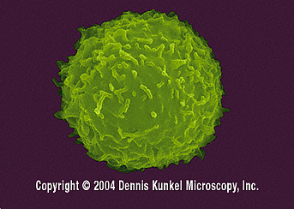
T Cell Activation
An antigen-presenting cell displays a foreign antigen
When T cell act on antigen
Macrophages phagocytizes and digests the agent
Displays the antigens on its cell membrane
Helper T cells: activate when it encounters antigens that its specialized to react to
Contacts a B cell associated with antigen
T cell secretes cytokines, stimulates B cell proliferation, and attracts macrophages

Slide 36
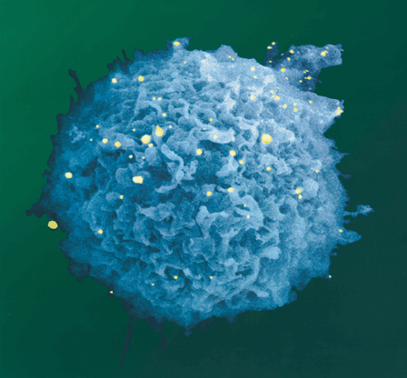
B Cell Activation
When it encounters an antigen that fits its antigen receptors
Proliferates and enlargers its clone
Some specialize into antibody-producing plasma cells
Antibodies react against the antigen-bearing agent that stimulated its production

Slide 37
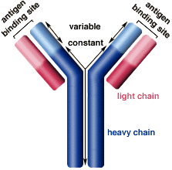
Antibodies
Soluble proteins called immunoglobulins
IgG, IgA, IgM, IgD, and IgE
Attack antigens directly
Agglutination, precipitation, or neutralization
Activate complement
Attract phagocytes or rupture foreign cell membranes (lysis)
Stimulate local tissue changes that are unfavorable to antigen-bearing agents

Slide 38
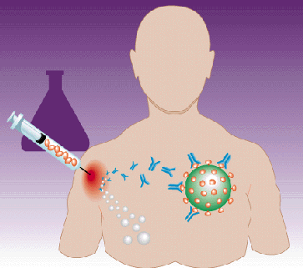
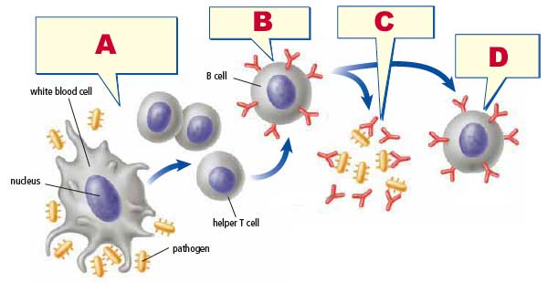
Immune Response
Acquired immunity: natural events
Encounter pathogen and has immune response
Antibodies pass from mother to fetus
Artificial acquired immunity: medical procedure
Vaccine of dead weakened pathogen, injection of antibodies

Slide 39
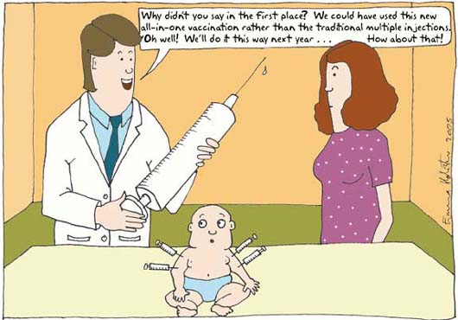

Slide 40
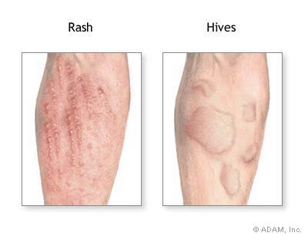
Allergic Reaction
Allergic or hypersensitivity reactions are excessive immune responses that may damage tissue
Allergic reactions result from mast cells bursting and releasing allergy histamine
Hives, hay fever, asthma, eczema, or gastric disturbances
Delayed-reaction allergy: occur in anyone and inflame the skin
Repeated exposure to antigen
Immediate-reaction allergy: inborn ability to overproduce IgE

Slide 41
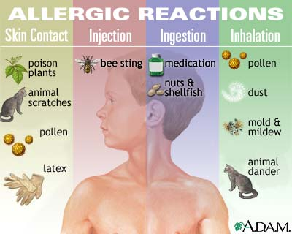

Slide 42
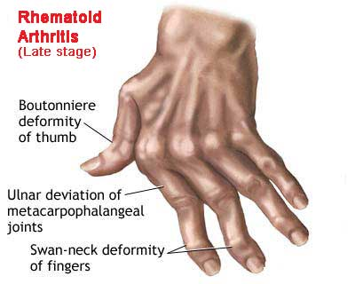
Autoimmunity
Autoimmune Disorder: immune system manufactures autoantibodies that attack one’s own body tissue
Previous viral infection
Faulty T cell development
Reaction to a nonself antigen that resembles a self antigen

