Slide 1
The Art of Interviewing

Slide 2
The Art of Interviewing
Evaluate Yourself
Prepare today!
Types of Interview Questions & Dissecting Effective Responses
General
Behavioral
Case Study
Off-the-wall
Handling Illegal Questions

Slide 3
Prepare for the Interview
Know Yourself. Decision Making Worksheet
Know the position you are applying for – research the employer.
Know the company listing the position – prepare a list of questions.
Practice! Practice! Practice!

Slide 4
Evaluate Yourself
Non-Verbal Communication
Handshake, posture, eye contact, friendliness
Verbal Communication
Grammar, diction, limited use of non-words
Ability to Answer Questions
Preparedness, responsiveness, confidence
Provide Relevant Examples
Illustrate qualifications through relevant experiences

Slide 5
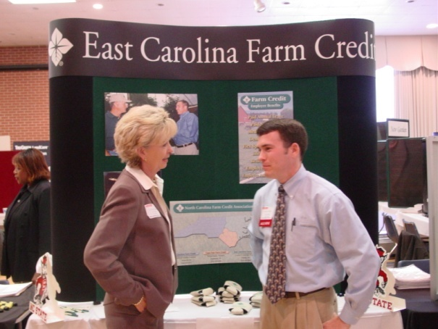
30 Second Impression!
Dress Professionally Tip Sheet
90% of the way you communicate with other people is through body language (gestures, expressions, etc.)
-From Marie Farquharson’s book
Body Talk

Slide 6
Preparing to answer interview Questions
Know the . . . .
Company & Field
Job Description
Yourself (Skills, Values & Interests)
Resume (Experience)
Make connections for the employer between what they are seeking and what you can provide. Scream, “I am the match you are looking for.”

Slide 7
TIPS for Answering!!!
Create a Strategy
Project your image/professional profile
Utilize your experiences, skills, interests and values as a backdrop to answer the question
Provide specific examples
STAR Acronym
Situation
Task
Action
Result (Don’t forget this one)
Convey your individuality and excitement!!

Slide 8
“Tell me about yourself.”
Intro question that appears very broad. However,
Do not answer it in general terms (NO life story or irrelevant information).
Think of it as a 1 – 2 minute “commercial” of your personal highlights.
Focus on skills, accomplishments and relevant experiences.
IMPORTANT: Mention why are you interested in the position/ field.

Slide 9
Other General Questions
What makes you the ideal candidate for this job?
Why did you choose this major?
What do you know about our organization?
How do you plan to contribute to the success of our work place?
What do you value most?
How do you compensate for your lack of experience?
Is this really what you want to do?

Slide 10
A Sample – Dissected!!!
Question: What makes you the ideal candidate for this position?
MENTION YOUR STRONGEST QUALIFICATIONS (Draw connections to the position for the employer).
“My international experience in addition to my position at the Technician as the Director of Advertising makes me an ideal candidate because I offer a global perspective as well as a broad range of skills applicable to public relations. I am also very excited about the position and confident in my abilities to excel in it.”

Slide 11
Behavior Based Questions
Tell me about a time…
Describe for me a situation when…
Give an example of…
Your Goal: To illustrate for the interviewer that you have applied relevant skills in real situations

Slide 12
Examples
Tell me about a time when you came up with a creative solution to a problem you were facing?
Describe a situation where you had to let down a customer in order to uphold company policy.
Have you experienced a failure when organizing a program, and how did you deal with it?
What is the hardest decision you have ever had to make?

Slide 13
Answering the Weakness ?
Make it skill based rather than behavior based.
I don’t feel my publishing skills are as strong as they could be.
Do not disguise a strength as a weakness.
Beware of “canned” responses.
I am a perfectionist.
Close by telling them how you plan to compensate.
Since that experience last semester, I have tried really hard to find a better balance between close attention to detail and keeping sight of the big picture.

Slide 14
A Sample – Dissected!!!
Question: What are your weaknesses?
SKILL BASED WEAKNESS
“My technical skills are a weakness. I recognized it last year when I tried to put together a website for Alpha Zeta.”
HOW YOU COMPENSATE
“Since then, I have taken several of the free computer courses offered at my school and have increased my knowledge of programs like Dreamweaver, which I am excited about.”

Slide 15
Case Study Questions
Case study presents “what would you do if…”
How would you react in given scenario
No right or wrong answers – but, there are better and worse answers
Explain your thought process and support answers with examples when possible

Slide 16
Examples
How would you deal with an irate client?
Give an example of the best way to sell a purse to a man.
What would you do if one of the children you were watching threw a fit in the grocery store because they wanted some candy?
How would you confront a fellow employee who you knew was misusing company equipment for their own private use?
Sell me this calculator on my desk.

Slide 17
A Sample Dissected!!
Question: How would you deal with an irate client?
“First, I would try to calm the client down by assuring them that their needs are very important to the company. Then, I would listen to what their problem was and work with them to decide upon a mutually agreeable resolution. If the client continued to be upset and I knew that I would not be able to resolve the problem, I would have him talk to the manager.”

Slide 18
Off-the-wall Questions
Employers may ask to:
Measure creativity.
Watch for reactions.
Evaluate problem-solving and analytical skills.
Monitor ability to think quickly.

Slide 19
Examples
If you could be a cartoon character, who would you be and why?
Which fruit does your personality most resemble?
If you had to describe yourself as an animal, what animal would you be?
How many street signs are in a four block radius of the NCSU campus?
If you could be anyone from history, who would you be?

Slide 20
A Sample Dissected!!
Question: If you were a cartoon character, who would you be and why?
“Bugs Bunny- because he always likes a challenge, never loses his sense of humor and always ends up on his feet.”

Slide 21
Questions To Ask Employers
Why Ask Questions???
A lack of questions may be mistaken as a lack of interest.
To gain more information about the position/organization for yourself. Remember- it’s a mutual exchange of information.
Questions to Ask!!
Ones that are not readily answered through company literature.
Questions based on your conversation.
Questions that demonstrate your knowledge of the company and field/industry.

Slide 22
Examples
Why do you like working for this organization?
Does your company value professional development among employees?
Would you describe a typical day’s activities?
What are your department’s major projects in the upcoming year?
I know that you’ve recently experienced a period of very rapid growth. How has that changed the ways you operate?
What is the next step in the search to fill this position?

Slide 23
After the Interview
Send personal thank you notes to all interviewers via mail.
Keep records in notebook.
Important dates, good or bad experience
Stay in pursuit.
Follow-up with a phone call to review status of employee selections

Slide 24
Illegal Questions
Birthplace, nationality, ancestry, or descent of applicant, applicant’s spouse, or parents
Your last name, Monet, is that French?
Applicant’s sex or marital status
Race or color
Religion or religious days observed
Physical disabilities or handicaps
Pregnancy, birth control, and child care
Number of dependents

Slide 25
Examples of Illegal questions
Are you married?
Do you have any children?
Do you have any disabilities?
Have you ever been arrested?
How did your parent’s divorce affect you?

Slide 26
How to Handle Illegal Questions
You have the following choices:
Answer
Reply to the underlying concern
Inquire about question’s relevance
Change the subject
End the interview

Slide 27
Thought for the Day
Before everything else, “Getting Ready” is the secret of success.
Henry Ford

