Slide 1
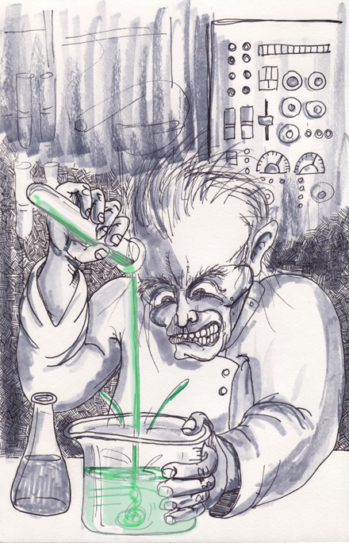
Introduction to Chemistry

Slide 2
Chemistry
Because living and nonliving things are made of matter, chemistry affects all aspects of life and most natural events.
Why some creates can survive deep in the ocean with no light
Why some food is sweet and some is bitter
Matter – anything that has mass and occupies space

Slide 3
Areas of Study
Organic – study of chemicals that contain carbon
Inorganic – study of chemicals that, in general, don’t contain carbon
Biochemistry – the study of processes that take place in an organism
Analytical Chemistry – area of study that focuses on the composition of matter
Physical Chemistry – area of study dealing with the mechanism, the rate, and the energy transfer that occurs when matter undergoes a change

Slide 4
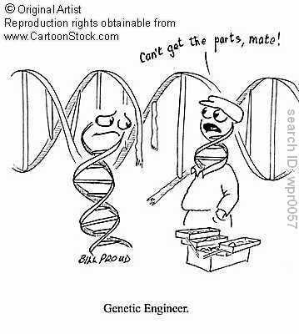

Slide 5
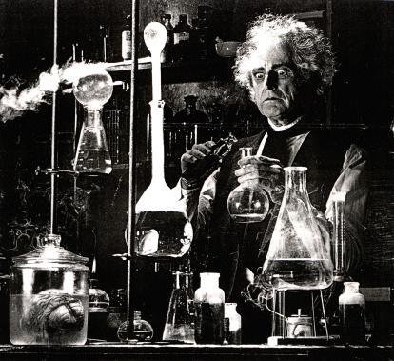
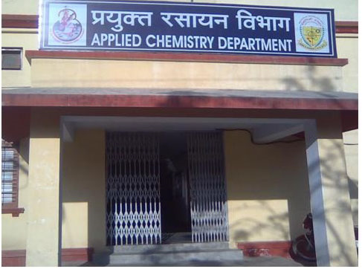
Pure and Applied Chemist
Pure Chemistry – the pursuit of chemical knowledge for its own sake; no immediate practical use for the knowledge.
Applied Chemistry - research that is directed toward a practical goal or application.

Slide 6
Pure and Applied Chemist
Pure research can lead directly to an application, but an application can exist before research is done to explain how it works.
Nylon was research and produced due to low supply of natural silk
Aspirin – historically used to relieve pain; in 1971, it was discovered that aspirin can block the production of a group of chemicals that cause pain, which are also used in the formation of blood clots
Chemistry Far and Wide: chemists design materials to fit specific needs.

Slide 7
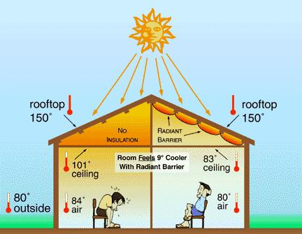
Various Uses of Chemistry
Energy: chemists play an essential role in finding ways to conserve energy, produce energy, and store energy.
Conservation: insulation is one of the easiest ways to conserve energy
Acts as a barrier to heat flow

Slide 8
Various Uses of Chemistry
Production: the burning of coal, petroleum, and natural gas is a major source of energy
Scientists are working with biofuels
Biodiesel from soybeans
Storage: batteries are devices that use chemical to store energy that will be released as electric current when the batteries are used
Rechargeable batteries were first developed for NASA for the Astronauts to collect samples from the moon

Slide 9
Chemistry and the World
Medicine and Biotechnology: chemistry supplies the medicines, materials, and technology doctors use to treat their patients
Medicines – there are over 2000 prescription drugs
Materials – supply materials to repair or replace body parts
Biotechnology – production of insulin by bacteria

Slide 10
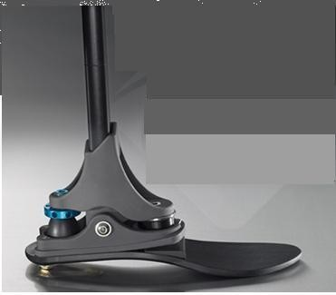
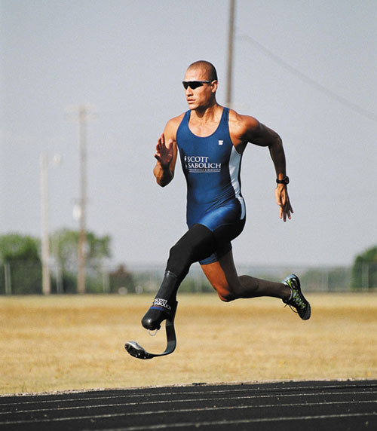
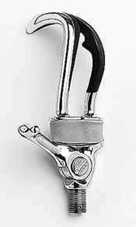

Slide 11
Chemistry and the World
Agriculture: develop more productive crops and safer, more effective ways to protect crops
Productivity – soil tests
Crop Protection – used chemical to treat specific problems, in contrast to killing all insects
Environment: chemists help identify pollutants and prevent pollution
Universe: chemists gather data from afar and analyze matter that is brought back to Earth

