Slide 1
Introduction to Anatomy

Slide 2
Introduction
Interest in injuries and illnesses
Healers relied on superstitions and magic
Discovered useful ways to examine the body
Found certain herbs and potions could treat coughs, headaches, and other problems

Slide 3
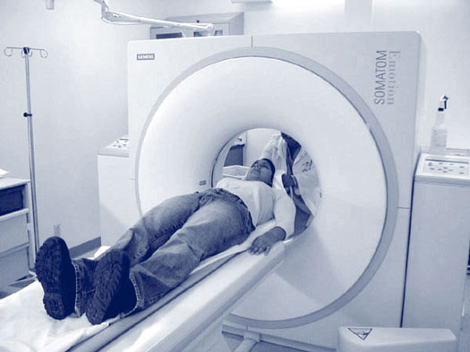
Introduction
Development of Modern Science
accurate observations and careful experiments
Knowledge of human body expanded rapidly
Medical providers named body parts
Describe location
Explain their function

Slide 4
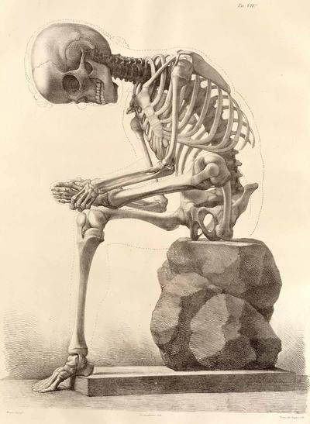
Anatomy and Physiology
Anatomy: morphology or structure of body parts
Forms and organization
Physiology: function of body parts
What they do and how they do it

Slide 5
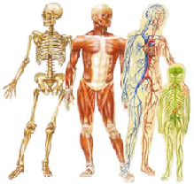
Characteristics of Life
Metabolism: use of resources to supply energy for the body
Movement – external and internal
Responsiveness – ability to sense change and respond to it
Growth- increase in body size
Reproduction – producing offspring and new cells
Respiration – obtaining O₂

Slide 6
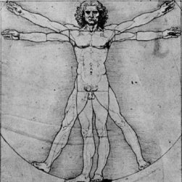
Characteristics of Life
Digestion – break down food into forms the cells can use
Absorption – passage through cell membrane
Circulation – movement of substance within body fluids
Assimilation – changing of absorbed substances into forms that are chemically different from those that entered
Excretion – removal of waste

Slide 7
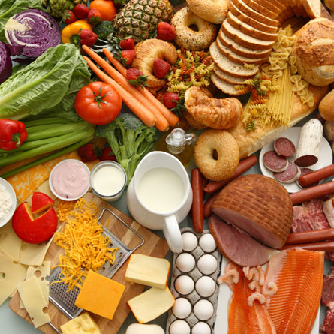
Maintenance of Life
Requirements of Organisms
Water – most abundant chemical in the body
Transport, metabolic processes, temperature
Foods – nutrients
Energy sources and materials for building, regulate vital chemical reactions
Oxygen: 1/5 of air
Used to release energy from food
Heat: form of energy
Product of metabolic reactions
Pressure: application of force
Atmospheric pressure

Slide 8
Homeostasis
Maintaining stable internal conditions
Set Point: various conditions in your body have a range at which they function; i.e. body temp. 98ºF, stomach pH:2
Homeostatic Mechanism: brain senses change and triggers behaviors to reinstate the set point
Shivering, perspiration

Slide 9
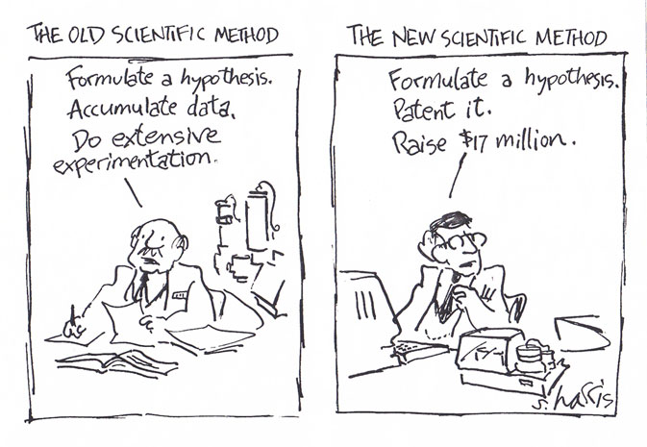
The Scientific Method

Slide 10
The Scientific Method
a logical, systematic approach to the solution of scientific problems
Observation – the use of your senses to obtain information
Hypothesis – proposed explanation for an observation
Experiment – procedure that is used to test a hypothesis
Manipulated variable – the variable you change
Responding variable – the variable that is observed
Theory – a well-tested explanation for a broad set of observations
Scientific Law – a concise statement that summarized the results of many observations and experiments

Slide 11
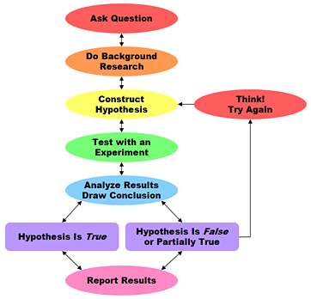

Slide 12
Levels of Organization

Slide 13
Levels of Organization
Atom: invisible particles
Molecules: group of atoms
Macromolecules: small molecules joined together in complex ways
Cell: the basic unit of structure and function
Organelles: parts of cell designed for specific tasks
Tissues: group of related cells
Organs: group of related tissues
Organ System: group of organs functioning together
Organism

Slide 14
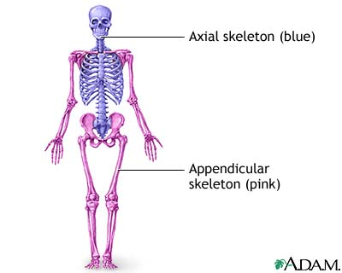
Organization of the Human Body
Body Cavities
Appendicular Portion: upper and lower limbs
Axial Portion: head, neck, and trunk

Slide 15
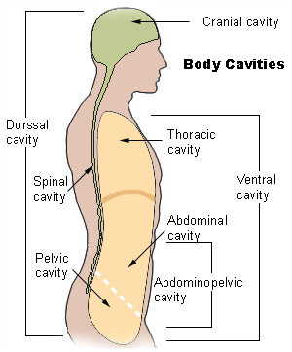
Axial Portion
Dorsal Cavity
Cranial Cavity - skull
Vertebral Canal – spinal cord
Ventral Cavity
Viscera: visceral organs
Thoracic cavity
Mediastinum – separates thoracic cavity into 2 compartments
Diaphragm – separates thoracic cavity from lower abdominopelvic cavity
Abdominopelvic Cavity
Abdominal Cavity – stomach, liver, spleen, gallbladder, kidneys, and small and large intestines
Pelvic Cavity – terminal portion of large intestine, urinary bladder, and internal reproductive organs

Slide 16
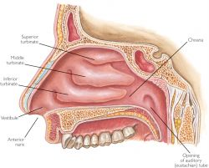
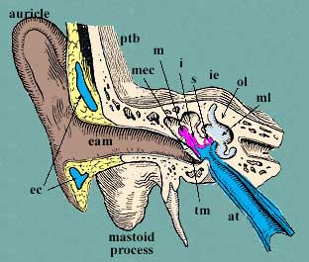
Cavities within the Head
Oral Cavity
Teeth and tongue
Nasal Cavity
Located within nose and divided by nasal septum
Several air filled sinuses
Orbital Cavities
Contains eyes and associated muscles
Middle Ear Cavities
Middle ear bones

Slide 17
Organ Systems
Body Covering
Integumentary: skin, hair, nails, sweat glands, and sebaceous glands
Support and Movement
Skeletal System: bones, ligaments, and cartilage
Muscular System: muscles
Integration and Coordination
Nervous system: brain, spinal cord, nerves, and sense organs
Endocrine System: glands that secrete chemical messengers, or hormones

Slide 18
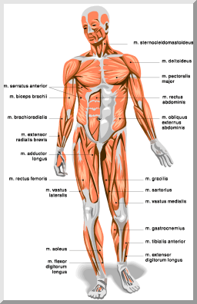
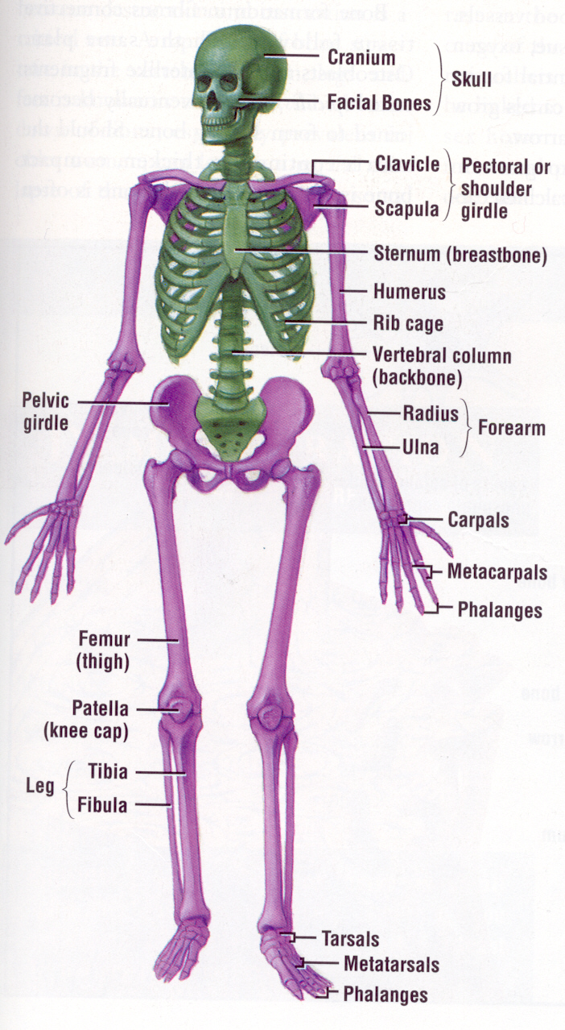
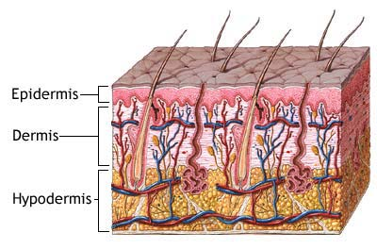

Slide 19
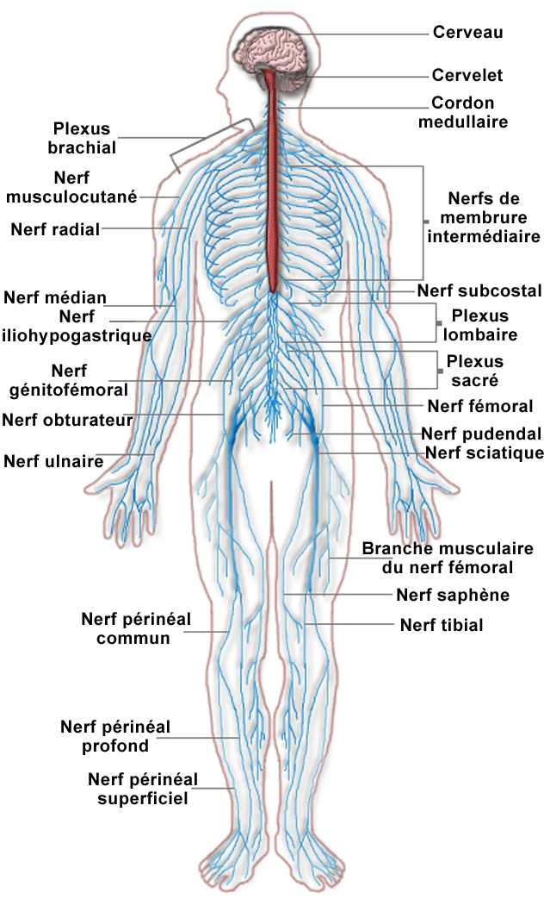
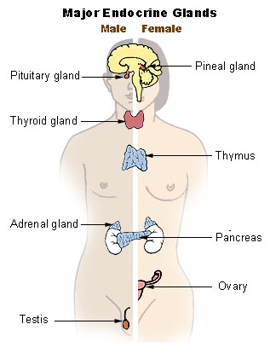

Slide 20
Organ Systems
Transport
Cardiovascular System: heart, arteries, veins, capillaries, and blood
Lymphatic: lymphatic vessels, lymph fluid, lymph nodes, thymus gland, and spleen
Absorption and Excretion
Digestive System: mouth, tongue, teeth, salivary glands, pharynx, esophagus, stomach, liver, gallbladder, pancreas, small intestine, and large intestine
Respiratory System: nasal cavity, pharynx, larynx, trachea, bronchi, and lungs
Urinary System: kidneys, ureters, urinary bladder, and urethra

Slide 21
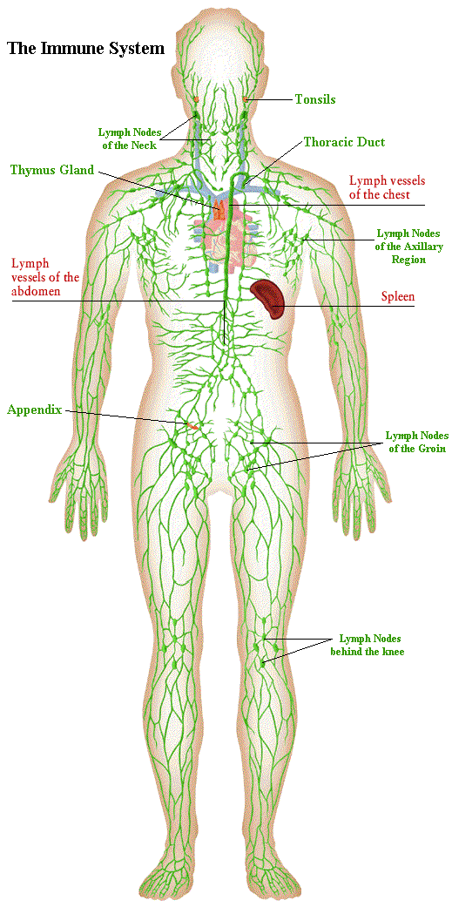
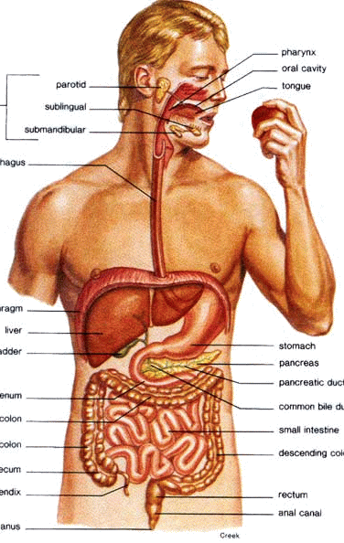
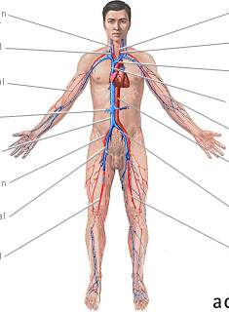

Slide 22
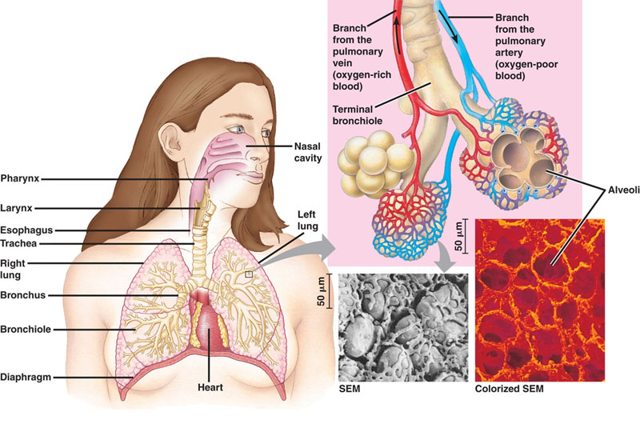
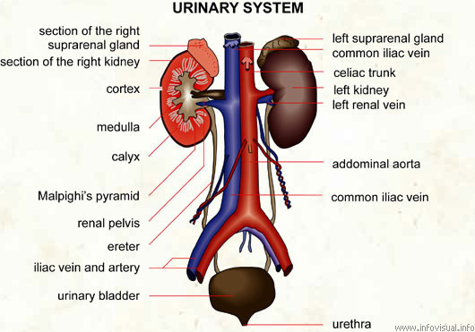

Slide 23
Organ Systems
Reproductive
Reproductive System
Male: scrotum, testes, epididymides, vasa deferentia, seminal vesicles, prostate gland, bulbourethral glands, penis, and urethra
Female: ovaries, uterine tubes, uterus, vagina, clitoris, and vulva

Slide 24
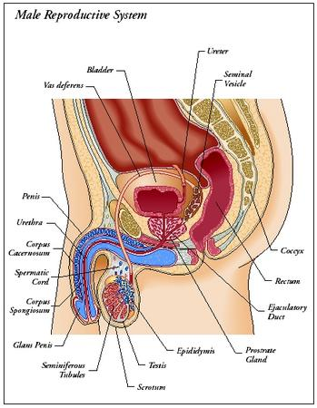
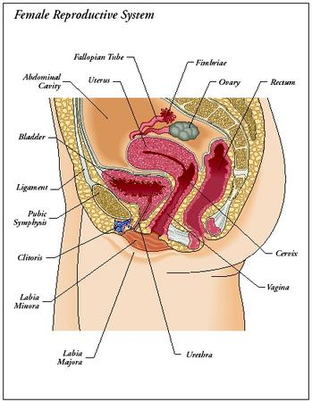
Reproductive Systems

Slide 25
Anatomical Terminology
Relative Positions
Superior: above
Inferior: below
Anterior: toward the front
Posterior: toward the back
Medial: imaginary midline dividing the body in half
Lateral: toward the side
Proximal: closer
Distal: further
Superficial: situated near the surface
Deep: parts more internal

Slide 26
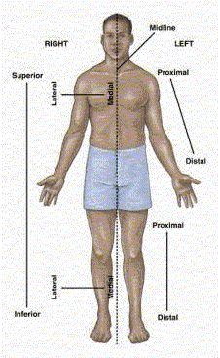

Slide 27
Body Sections
Sagittal : plane dividing the body into right and left portions
Transverse: plane dividing the body into superior and inferior portions, horizontal
Coronal: plane dividing the body into anterior and posterior portions, frontal

Slide 28
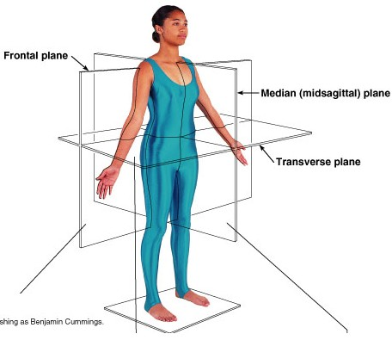
Body Sections

Slide 29
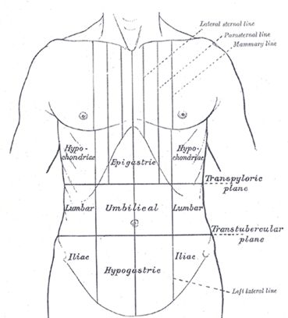
Body Regions
Epigastric
Upper Middle
Left & Right Hypochondriac
each side of epigastric region
Umbilical Region
middle portion
Left and Right Lumbar
Each side of umbilical region
Hypogastric
lower middle portion
Left and Right iliac
each side of hypogastric region

