Slide 1
Skin and the Integumentary System

Slide 2
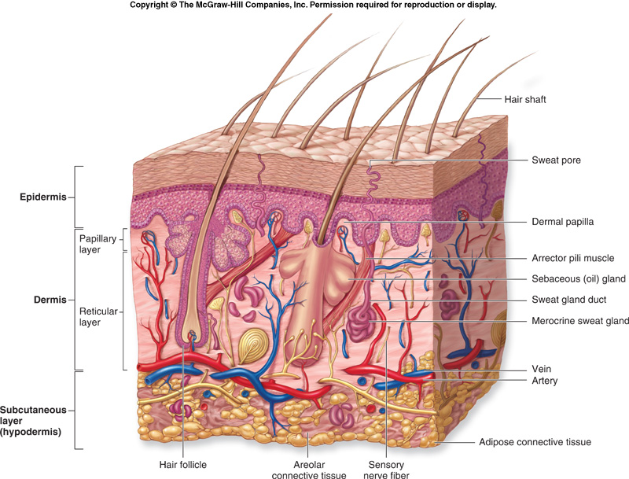
Integumentary System
Cutaneous membrane and certain accessory organs
Epithelium and connective tissue

Slide 3
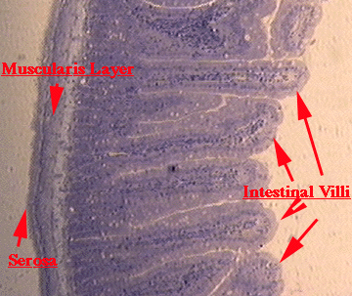
Types of Membranes
Serous: line body cavities that lack outside openings
Thorax, abdomen
Simple squamous epithelium and loose connective tissue
Secrete watery serous fluid: lubricated membrane surface

Slide 4
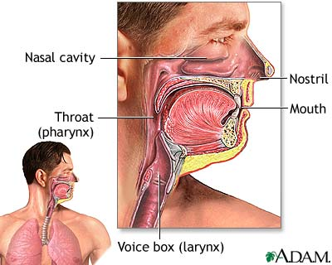
Types of Membranes
Mucous : line cavities and tubes that open to the outside
Oral and nasal cavities
Tubes of digestive, respiratory, urinary, and reproductive systems
Epithelium overlying loose connective tissue
Secrete mucus

Slide 5
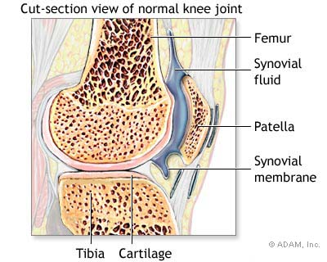
Types of Membranes
Synovial: form inner lining of the joint cavities
Between bones and joints
Dense connective tissue over loose connective tissue and adipose tissue
Secrete a thick, colorless synovial fluid into joint cavity
Lubricated the ends of bones within joint

Slide 6
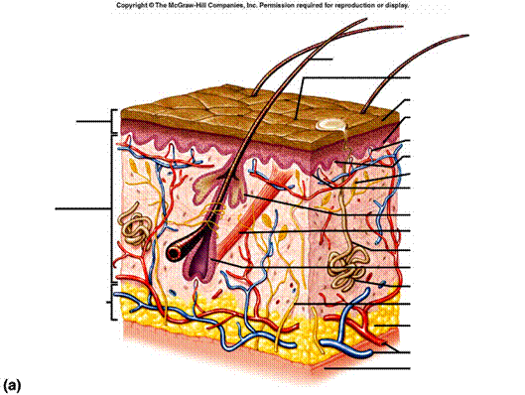
Types of Membranes
Cutaneous membrane: skin
One of the larger and more versatile organs
Vital for homeostasis
Functions
Protective covering
Regulate body temperature
Retards water loss from deeper tissue
Houses sensory receptors
Synthesizes various biochemicals
Excretes small quantities of waste

Slide 7
Skin
Epidermis: outer layer
Stratifies squamous epithelium
Dermis: inner layer
Thicker
Connective tissue: collagenous and elastic fibers
Epithelial, smooth muscle, & nervous tissue
Blood
Basement membrane
Subcutaneous Layer: hypodermis
Masses of loose connective tissue and adipose tissue
Bind skin to underlying organs

Slide 8
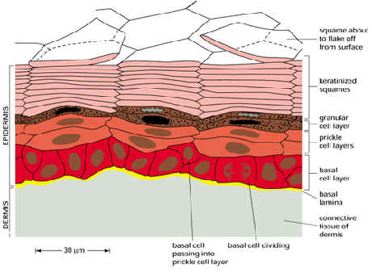
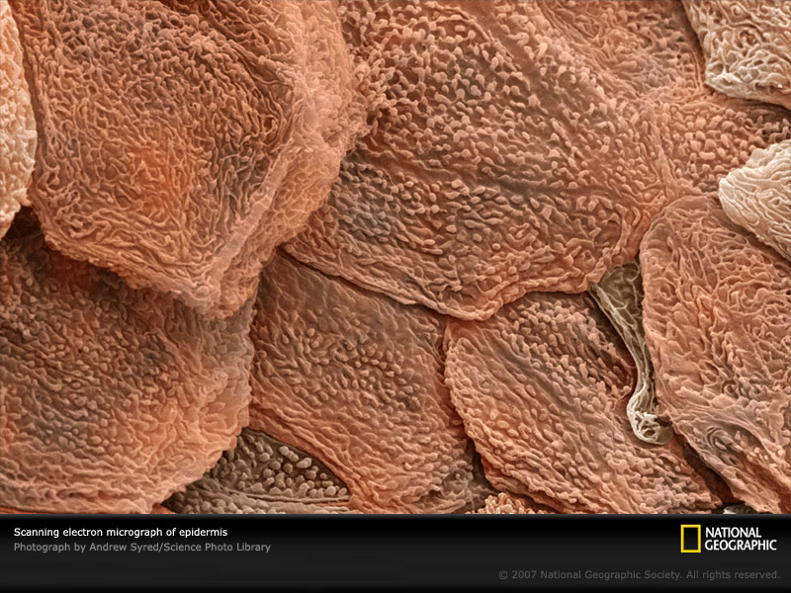
Epidermis
Lacks blood vessels
Stratum basale: deepest layer
Nourished by dermal blood vessels
Cells divide and grow
older epidermal cells are pushed toward the surface
Further to the surface → fewer nutrients
eventually they die

Slide 9
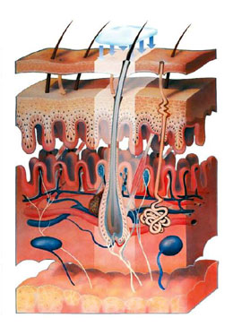
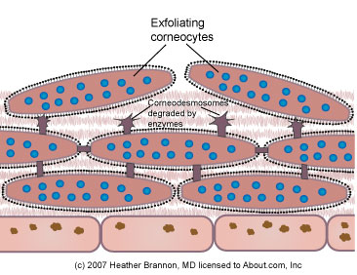
Skin
Kertinocytes: older cells
Keratinization: process of hardening the cells
Cytoplasm fills with keratin protein
Tough, waterproof fibers
Stratum corneum: layers of tough, dead skin on the surface

Slide 10
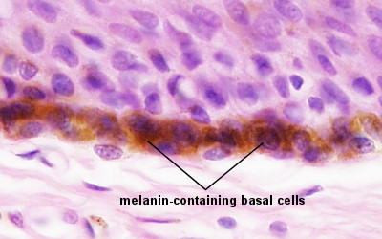
Epidermis
Functions
Shields against excessive water lose
Mechanical injury
Effects of harmful chemicals
Protection against disease causing agents
Melanocytes: cells that produce melanin
Skin color pigment
Absorbs light energy and lessens effects of UV radiation
Lie in deepest part of epidermis and dermis tissue
Cytocrine secretion: transport of melanin to epidermal cells

Slide 11
Skin Color
Due to melanin
All people have about the same number of melanocytes
Genetic
Variations in color
Amount of melanin produce
Distribution and size of pigment granules
Sunlight, UV light, X-rays stimulate production of extra melanin
Oxygen Content of blood
Highly oxygenated → bright red blood→ appear pinkish
Less oxygenated → dark red blood → appear bluish
cyanosis

Slide 12
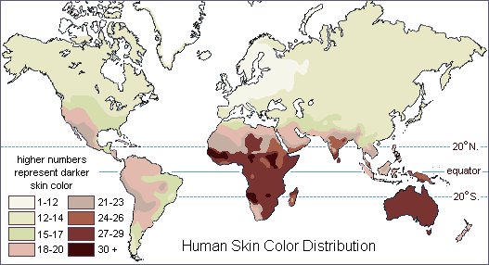
Skin Color Variations

Slide 13
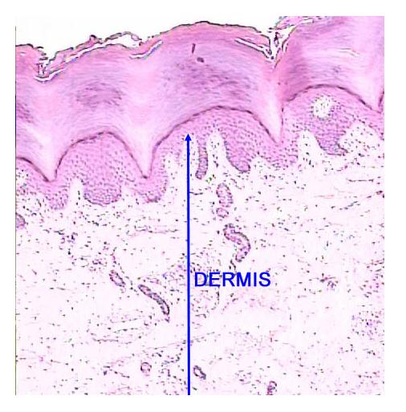
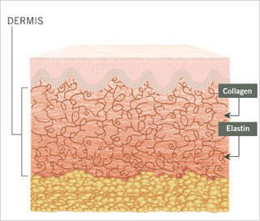
Dermis
Binds the epidermis to underlying tissues
Network of these fibers give the skin toughness and elasticity
Dermal blood vessels supply nutrients for all skin cells
Regulate body temperature

Slide 14
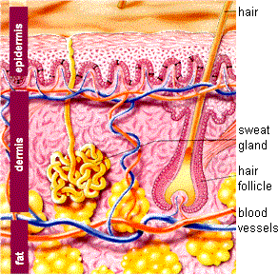
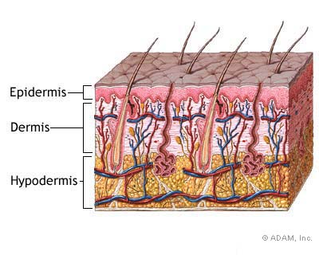
Dermis
Nerve Fibers
Motor Fibers: impulses from brain or spinal cord to dermal muscles and glands
Sensory fibers: carry impulses away from specialized sensory receptors
Touch receptors
Hair follicles, sebaceous glands, and sweat glands

Slide 15
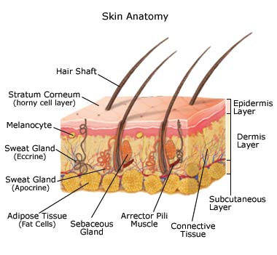
Subcutaneous Layer
Hypodermis: beneath the dermis
Loose connective tissue
Adipose tissues
Insulated heat
Contains major blood vessels

Slide 16
Accessory Skin Organs

Slide 17
Hair Follicles
Present on all skin surfaces except the palm, soles, lips, nipples, and parts of external reproductive organs
Hair Follicle: tubelike depression from which the hair develops
Extends to the dermis and contains the hair root
Nourished from dermal blood vessels
With division and growth, older cells are pushed toward the top
Become keratinized as they move up
Shaft: structure that extends from skin surface
Dead epidermal cells

Slide 18
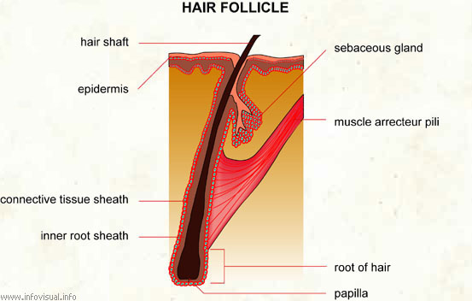

Slide 19
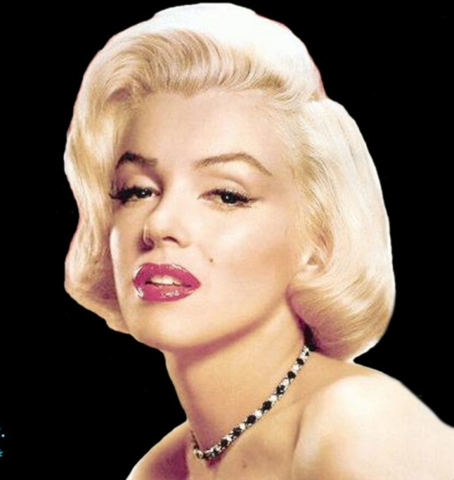
Hair Follicles
Arrector pili muscle: smooth muscles attached to each hair follicle
Short hair stands on end when muscles contract
Emotional upheaval or cold
Goose bumps
Hair color: genetic
Amount of pigment the epidermal melanocytes produced
Dark: a lot of pigment
Blond: intermediate quantity
White: no pigment
Red: trichosiderin

Slide 20
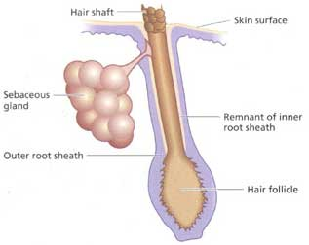
Sebaceous Glands
Groups of specialized epithelial cells
Usually associated with hair follicles
Holocrine glands that secrete fluid through small ducts in hair follicles
Sebum: secrete an oily mixture of fatty material and cellular debris
Skin and hair are kept soft, pliable, and waterproof

Slide 21
Nails
Protective coverings on the ends of fingers and toes
Keratinized stratified squamous epithelial cells
Nail Root: where nail originates
Near the nail’s proximal end
Lunula: whitish, half-moon shaped area
Most active growing region
Nail Bed: epithelium that nail slides over as it grows
Remains attached

Slide 22
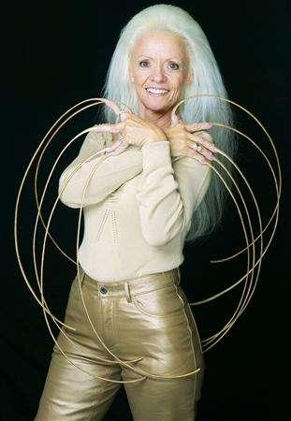
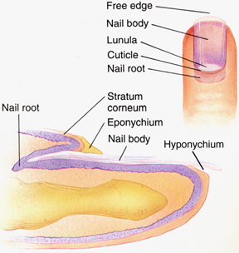
Nails

Slide 23
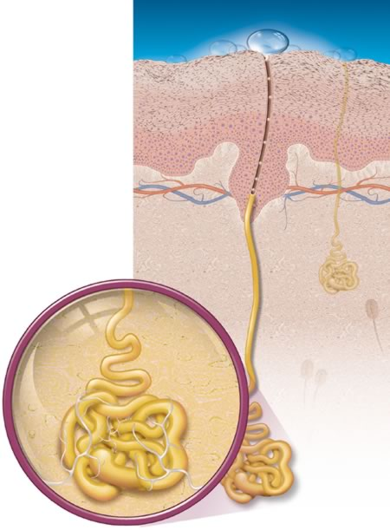
Sweat Glands
Sudoriferous Glands
Widespread exocrine glands
Deeper dermis or superficial subcutaneous layer
Tiny tube that originates as a ball-shaped coil
Coiled portion of the gland is closed and is lined with sweat-secreting epithelial cells

Slide 24
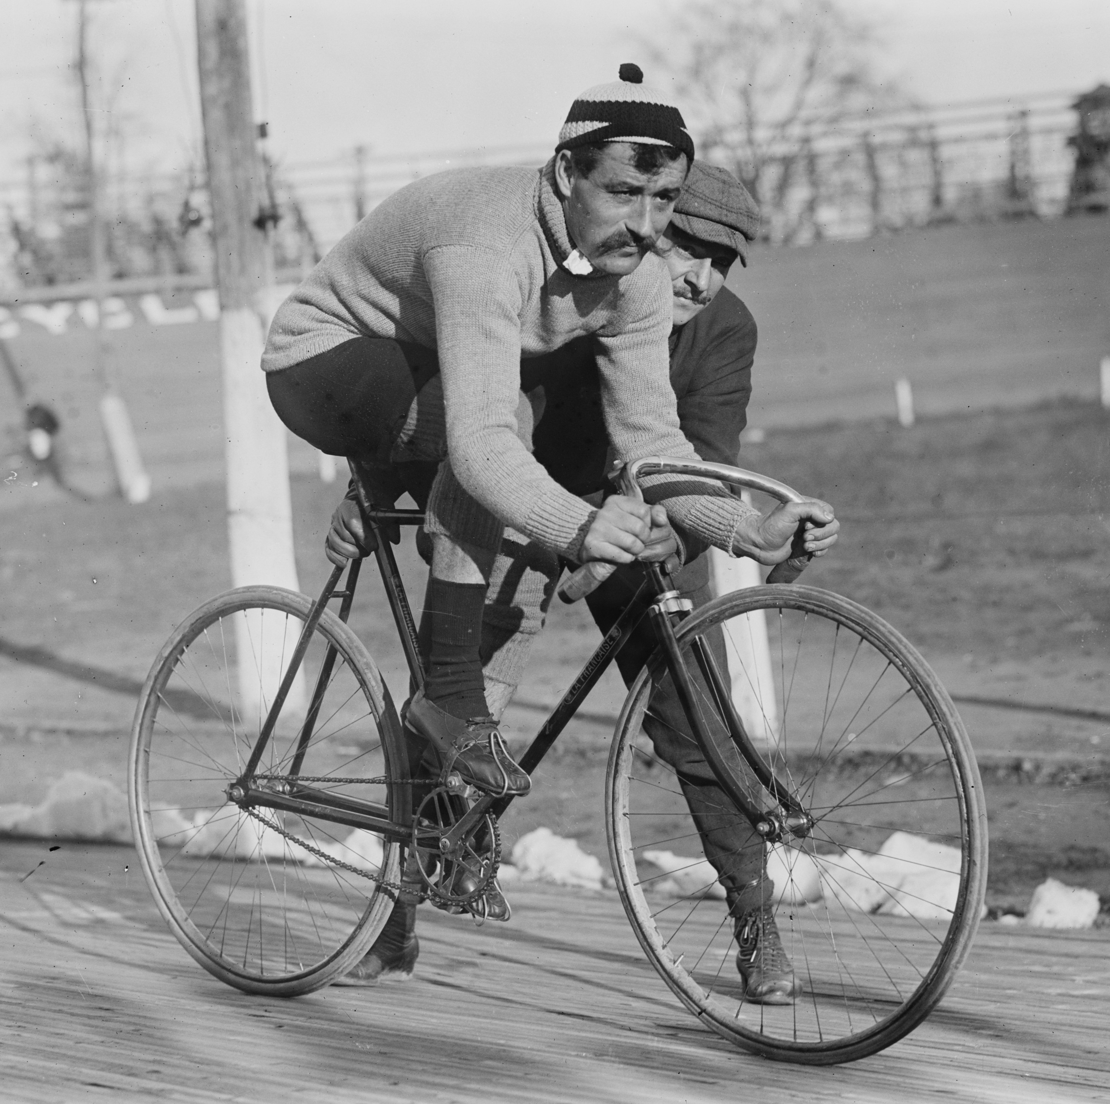
Types of Sweat Glands
Eccrine Glands: most numerous
Respond to temperature
Forehead, neck, and back
Sweat is carried to a pore
Mostly water with small quantities of salts and wastes
Apocrine Glands: activate with emotional distress, fright, or pain
Axillary regions and groin
Connect to hair follicles
Ceruminous Glands: ear wax
Female mammary glands: milk

Slide 25
Regulation of Body Temperature and Wound Healing

Slide 26
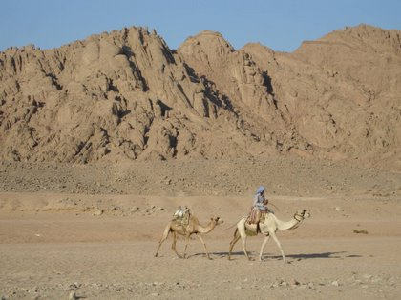
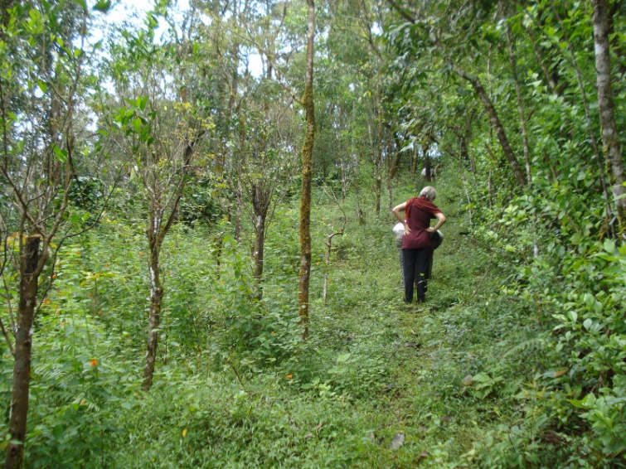
Regulation of Body Temperature
Slight shifts in body temperature disrupts metabolic reaction rates
Deep body temp.: 37ºC or 98.6ºF
Maintain by balancing heat lose with heat gain
Heat: product of cellular metabolism
Higher activity → more heat produced
Skeletal and cardiac muscle and liver cells

Slide 27
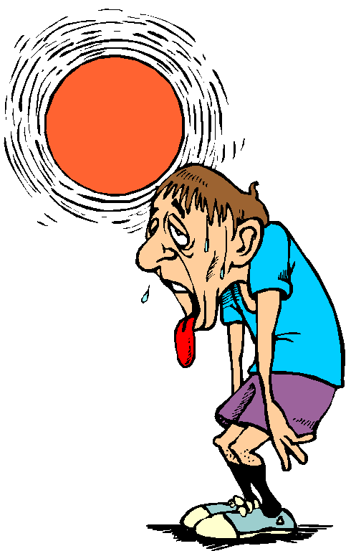
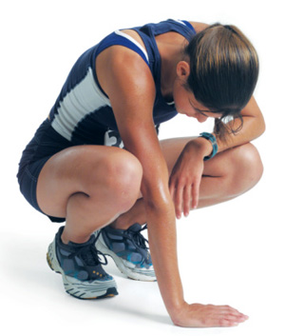
Intense Heat
Nerve impulses stimulate structures in the skin and other organs to release heat
Physical exercise: muscle release heat to the blood which is carried away
Blood vessels dilate and heat escapes to outside
Eccrine Sweat glands become active
Sweat evaporates → cools the surface

Slide 28
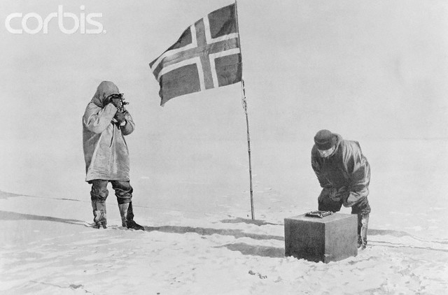
Cold
If too much heat is lost:
Muscles in the walls of dermal blood vessels are stimulated to contract
Decreases blood flow through the skin
Sweat gland remain inactive
Skeletal muscle fibers contract
Increase rate of cellular respiration → heat is a byproduct
Small groups of muscles may contract rhythmically with more force, shiver
Generates more heat

Slide 29
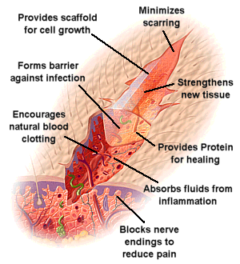
Wound Healing
Inflammation: area around a wound becomes red and painfully swollen
Blood vessels dilate and become more permeable
Forces fluids to leave the blood vessels and enter damaged tissue
Provides more nutrients and oxygen to aid healing
Extent of healing depends on extent of injury

Slide 30
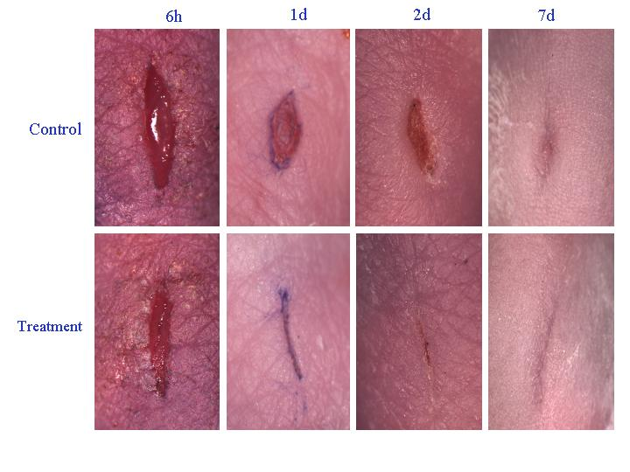
How We Heal
Shallow Skin Break: Epithelial cells along the margin are stimulated to divide more rapidly
Newly formed cells fill the gap

Slide 31
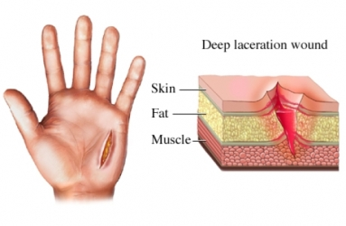
Deep Cut
Injury to dermis or subcutaneous layer
Blood vessels break and escaping blood forms a clot
Scab: blood clot and dried tissue fluids
Covers and protects underlying tissue
Fibroblast migrate into region and form new collagenous fibers that bind wound edges
Closing large wounds speeds the process

Slide 32
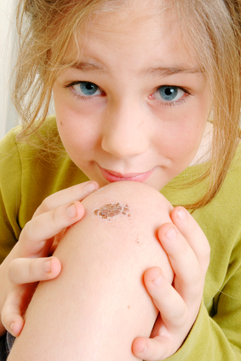
Continuing to Heal
Blood vessels extend to area beneath the scab
cells remove dead cells and other debris
Damaged tissues are replaced
Scab sloughs off
Scar: with extensive wounds, newly form tissue different than surroundings

Slide 33
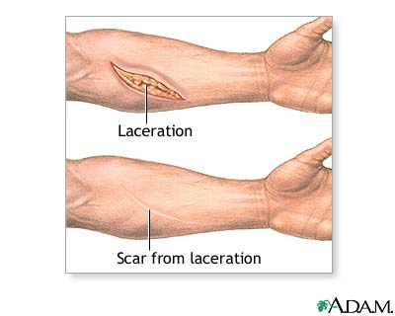
Large Wounds
Granulations: formation of small, rounded masses in the exposed tissue
New branch of a blood vessel
Cluster of collagen-secreting fibroblasts
In time, fibroblasts migrate away and blood vessels are reabsorbed
Leaves a scar

