Slide 1
Ideal Gas Law
And Mixtures and Movements

Slide 2
Ideal Gas Law
To calculate the number of moles of gas
PV = nRT
R : ideal gas constant
R = 8.31 (L·kPa)/ (mol·K)
Varriables

Slide 3
Example Problem
A deep underground cavern contains 2.24 x 10⁶L of methane gas (CH₄) at a pressure of 1.50 x 10³kPa and a temperature of 315 K. How many kilograms of CH₄ does the cavern contain?
P = 1.50 x 10³kPa
V = 2.24 x 10⁶L
T = 315 K
R = 8.31 (L·kPa)/(mol·K)
n = ? moles

Slide 4
Problem Continued
n = (PV)/(RT)
n = (1.50 x 10³kPa x 2.24 x 10⁶L )/ (8.31(L·kPa)/(mol·K) x 315K)
n = 1.28 x 10⁶ mol CH₄
But we need grams? Use molar mass to convert!
1.28 x 10⁶ mol CH₄
2.05 x 10⁴ kg CH₄

Slide 5
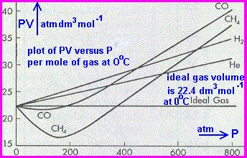
Ideal Gas vs. Real Gas
Ideal gas follows the gas laws at all temperatures and pressures.
Must conform entirely to Kinetic Theory
Particles could have no volume and no attractions
This is impossible → no true ideal gas
At many temp. and pressure, gas do follow ideal gas behavior

Slide 6
Real Gases
Do have volume and there are attractions between particles
Attractions → gases condense or solidify
Real gases differ the most from ideal at low temperatures and high pressures

Slide 7
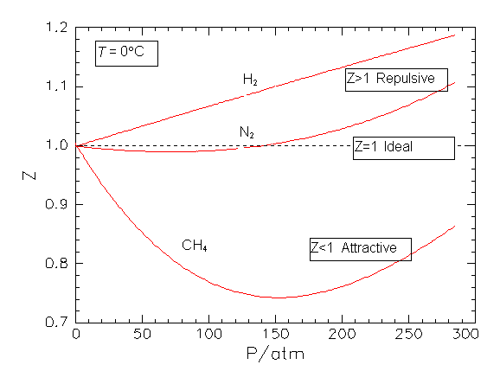
Real vs. Ideal Gases

Slide 8
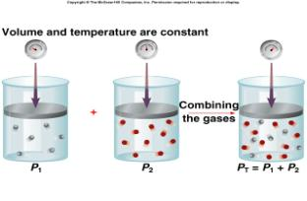
Dalton’s Law
In a mixture of gases, the total pressure in the sum of the partial pressures
P_{total} = P₁ + P₂ + P₃ …+ P_{n}
Example: In a container you have gas A with a pressure of 100 kPa, gas B with a pressure of 250 kPa, and gas C with a pressure of 200 kPa. What is the total pressure?
100 kPa + 250 kPa + 200 kPa = 550 kPa

Slide 9
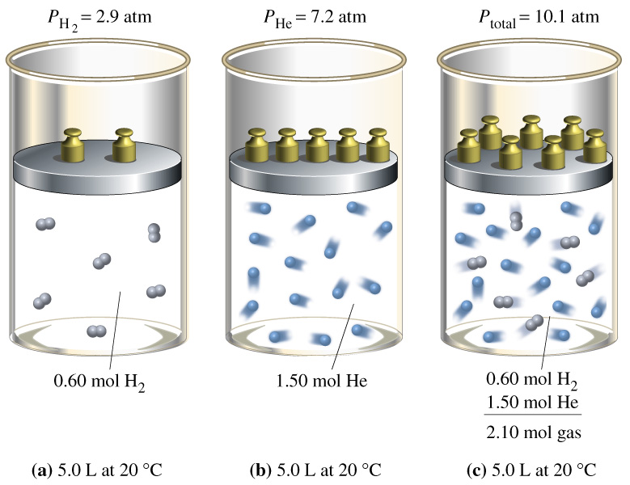

Slide 10
Graham’s Law
Diffusion: the tendency of molecules to move toward areas of lower concentration until the concentration is uniform throughout.
perfume
Effusion: a gas escapes through a tiny hole in its container.
Gases of lower molar mass diffuse and effuse faster than gases of higher molar mass.

Slide 11
Graham’s Law
The rate of effusion of a gas is inversely proportional to the square root of the gas’s molar mass.

Slide 12
Graham’s Law Problem
Compare the rate of effusion of nitrogen gas to helium.
Molar Mass
N₂: 20.8 g/mol
He: 4.0g/mol

