Slide 1
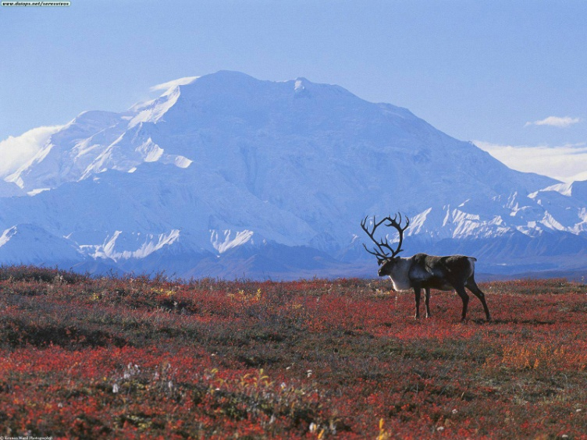
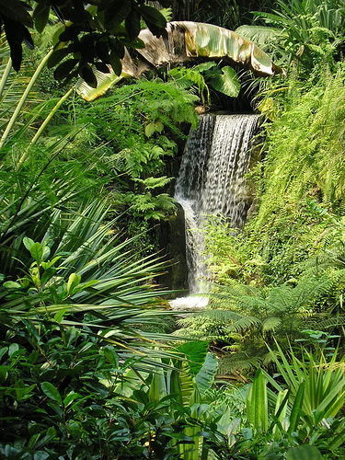
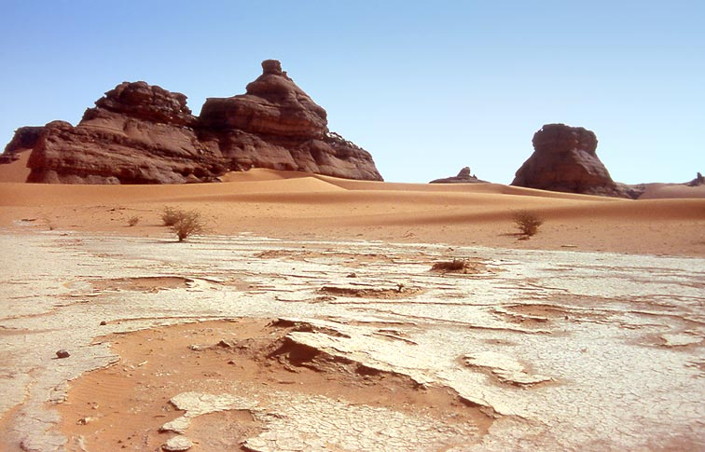
Humans in the Biosphere

Slide 2
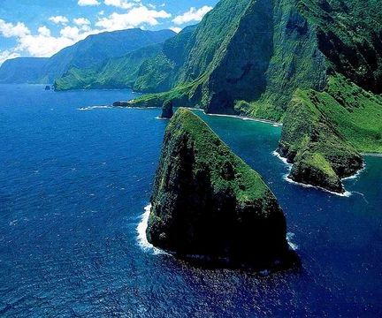
Changing Landscape:
In the 1700’s, Europeans and Asians settled in Hawaii
Farmers cleared vast areas for sugar cane, pineapples
used large amounts of water for agriculture
many native birds and fish are now scares
drinking water is depleted
food is now imported

Slide 3
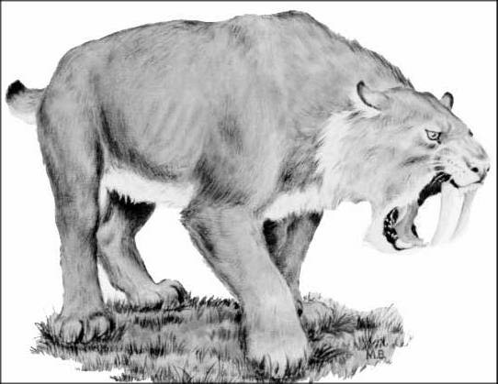
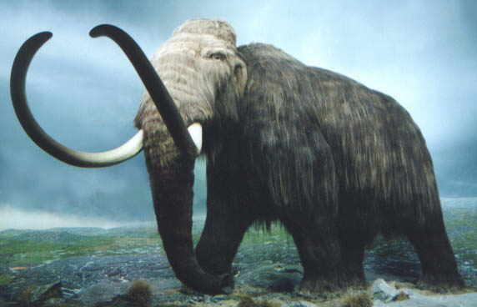
Human Activities
Humans use as much energy and transport almost as much material as all other multicellular species combined.
Human are the most important source of environmental change
North America’s Extinct Species: cheetahs, zebras, wooly mammoths, and saber-toothed cats

Slide 4
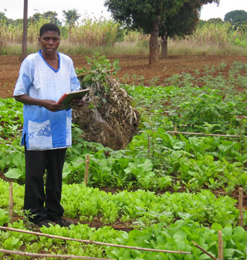
Agriculture
Green Revolution: governments and scientist began a major effort to increase food production in areas with food shortages
monoculture and chemical fertilizers
In the last 50 years, world food production has doubled
Industry & urban development
Pollutes the air, water, & soil

Slide 5
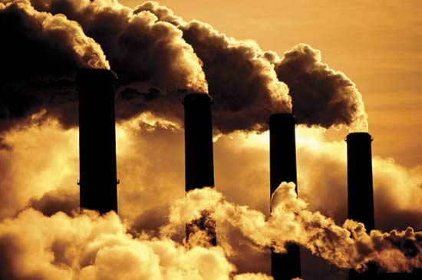
Renewable and Nonrenewable Resources
Tragedy of the Commons
Classifying Resources
renewable resource – can regenerate or be replenished, but not unlimited
fresh water, trees
Nonrenewable resource – cannot be replenished
fossil fuels, oil

Slide 6
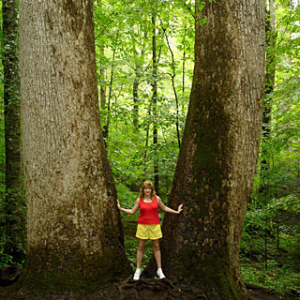
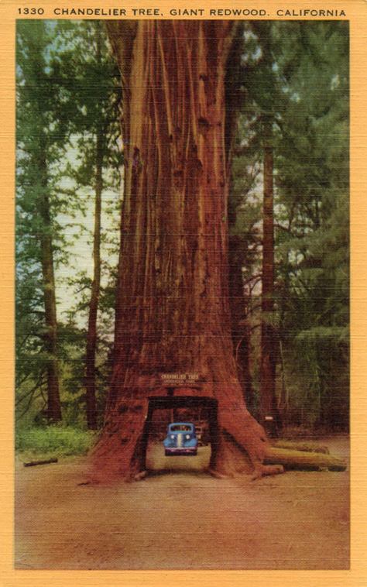
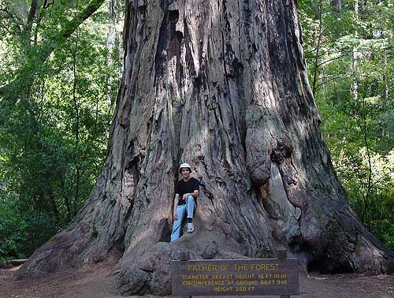

Slide 7
Sustainable Development
method of using natural resources without depleting them and without causing long-term environmental damage
Insects to control pests
Land Resource – space from communities and raw materials
soil erosion – wearing away of the surface soil by water and wind
desertification – productive land being turned into deserts
Forest Resources – remove CO₂ and produce O₂
Deforestation – Loss of Forests

Slide 8
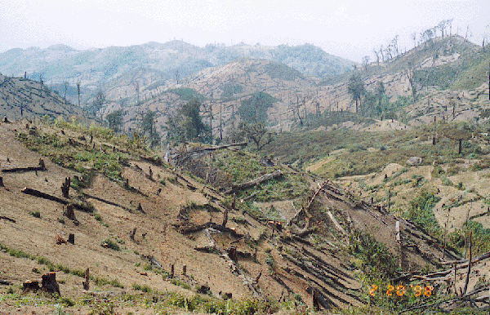
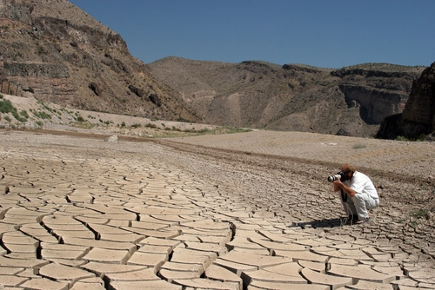

Slide 9
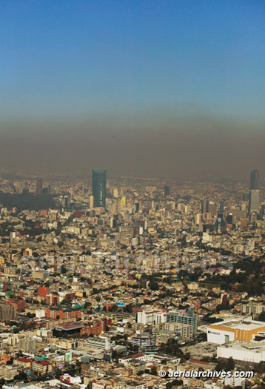
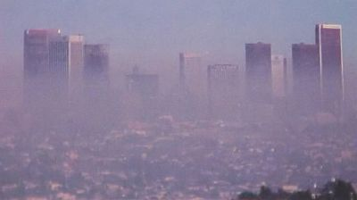
Sustainable Development
Fishery: aquaculture – raising of aquatic animals for human consumption
Air Resource – affects people’s health
Smog – mixture of chemicals that occurs as a gray-brown haze in the atmosphere
Pollutant - harmful material that can enter the biosphere through the land, air or water

Slide 10
Biodiversity
variety of all organisms in the biosphere
provides: foods, industrial products, and medicines
Threats to Biodiversity
Altering Habitats
Habitat Fragmentation – split ecosystems into pieces, leave biological islands
Hunting Species to Extinction
Extinction – species disappears
Endangered – species size is extremely low
Introducing Toxic Compounds
Biological Magnification – concentrations of harmful substance increase in organism at higher trophic level
DDT – widely used pesticide
Introducing Foreign Species to a New Environment
Invasive Species – reproduce rapidly because they lack parasites and predators

Slide 11
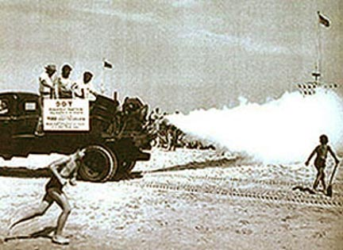
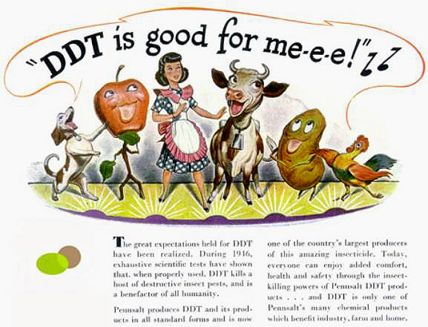
Conserving Biodiversity
Conservation – wise management of natural resources
Preservation of wildlife and habitats
Hot Spots – place where significant numbers of habitats and species are in immediate danger of extinction as a result of human activity

