Slide 1
Heat in Changes of State and Calculating Heat of Reaction

Slide 2
Heat of Fusion and Solidification
Whenever a change of state occurs by a gain or loss of heat, the temperature of the substance undergoing the change remains constant
When an ice cube melts, the temperature of the ice and the liquid remain at 0ºC until all of the ice has melted

Slide 3
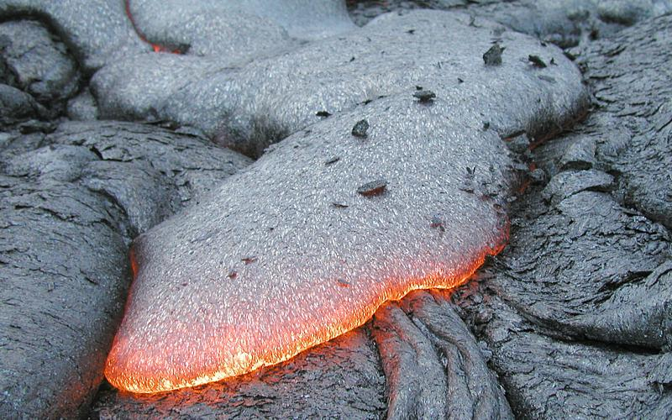
Molar Heat
Molar Heat of Fusion (ΔH_{fus}): heat absorbed by one mole of a solid substance as it melts at a constant temperature
Molar Heat of Solidification (ΔH_{solid}): the heat lost when one mole of a liquid solidifies at a constant temperature
heat absorbed by melting = heat released from solidifying
ΔH_{fus} = -ΔH_{solid}

Slide 4
Vaporization and Condensation
Molar Heat of Vaporization (ΔH_{vap}): amount of heat necessary to vaporize one mole of a liquid
ΔH_{vap} Water: 40.7 kJ
H₂O(l) → H₂O (g) ΔH_{vap} = 40.7 kJ
Molar Heat of Condensation (ΔH_{cond}): amount of heat released when 1 mol of vapor condenses at the normal boiling point
ΔH_{cond} = -ΔH_{vap}
Large values for ΔH_{cond} & ΔH_{vap} are the reason steam is so dangerous
you receive a scalding burn from steam when the heat of condensation is releases as the steam touches your skin

Slide 5
Vaporization and Condensation

Slide 6
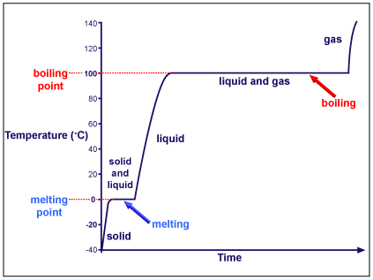
Heating Curve for Water

Slide 7
Example Problem
How much heat is absorbed when 24.8g H₂O (l) at 100ºC and 101.3kPa is converted to steam at 100ºC?
ΔH_{vap}=40.7kJ/mol
So, how many moles do we have?

Slide 8
Heat of Solution
During the formation of a solution, heat is either released or absorbed.
Molar Heat of Solution (ΔH_{soln}): enthalpy change caused by one mole of substance

Slide 9
Hess’s Law
Heat of Summation: if you add 2 or more thermochemical equations to give a final equation, then you can also add the heats of reaction to give the final heat of reaction.
C(s, diamond) + O2(g) → CO2(g) ΔH = -395.4kJ
CO₂(g) → C(s, graphite) + O2(g) ΔH = 393.5kJ
C(s, diamond) → C(s, graphite) ΔH = -1.9kJ

Slide 10
Standard Heat of Formation
ΔH_{f}º: change in enthalpy with the formation of one mole of a compound from its elements with all substances in their standard states at 25ºC.
The ΔH_{f}º of free elements is set at zero
Diatomic (H₂,Cl₂) and C(s, graphite)
ΔHº = ΔH_{f}º(products) - ΔH_{f}º(reactants)

Slide 11
What is the standard heat of reaction(ΔHº) for the reaction of CO(g) with O₂(g) to form CO₂(g)?
ΔH_{f}º O₂(g) = 0 kJ/mol ΔHº = ? kJ
ΔH_{f}º CO(g) = -110.5kJ ΔH_{f}º CO₂(g) = -393.5kJ
2CO(g) + O₂ → 2CO₂

