Slide 1
Graduate School
Keeping Your Options Open

Slide 2
What is Graduate Education?
Obtaining specialized knowledge in a concentrated area of study
Development of specialized skills
to practice a profession or do advanced research
From “tool user” to “tool maker”

Slide 3
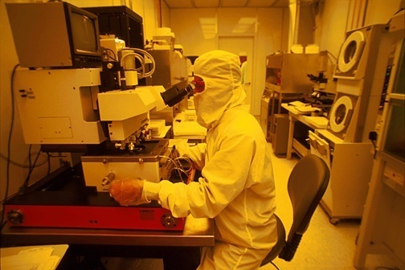
Two Kinds of Graduate Degrees
PROFESSIONAL DEGREES
DVM MPA
MBA MSW
RESEARCH DEGREES
MASTER’S & DOCTORAL

Slide 4
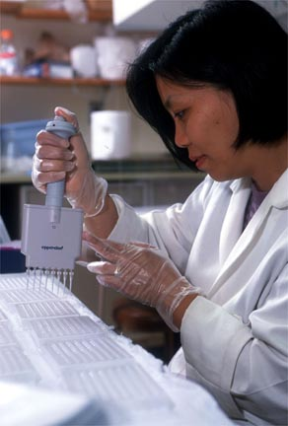
Why Go to Graduate School?
Increase your earning power
Influence how fast and how far
you advance in your career
Enhance your job satisfaction
Give you greater flexibility to
change careers
IT CAN BE A JOB REQUIREMENT:
For faculty positions
For research positions

Slide 5
Reasons NOT to go to Graduate School
You’re going to graduate school to please someone else
You’re clueless about a subject to study
You’re secretly trying to avoid the job market

Slide 6
What Are Graduate Programs Looking For?
Emotional
Maturity
Academic
Preparation
Prior
Academic
Achievement
Curiosity,
Creativity,
Passion
Standardized
Test
Scores
Perseverance,
Persistence
Research
Experience
& Ability
Compatible
Career
Goals

Slide 7
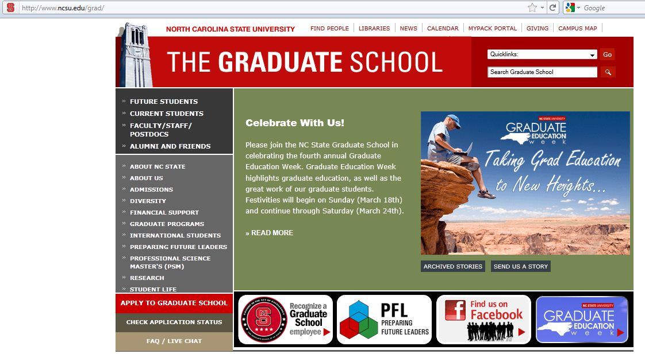
http://www.ncsu.edu/grad/

Slide 8
How to Begin
Talk to Your Advisor
Peterson’s Guide for Graduate and Professional Programs
Ask Alumni
Ask Professionals
Web:
Gradschools.com
Allaboutgradschool.com
Visit
Notes:
ADVISOR:
Where did they do their graduate work? What do they know about graduate programs in their field. Do they know anyone you can speak to at suggested institutions?
Petersons Guide – Copies in Graduate School
SEARH THE WEB: Virtually all universities have own home page.
TALK ABOUT NC STATE GRADUATE SCHOOL WEB SITE

Slide 9
Choosing A Graduate School
Personal Preferences
Size and location
Campus environment
Match your Interest, Academic Background and Goals
Program offering
Prerequisites
Reputation (talk to advisor)
Selectivity
Cost (funding available?)
Notes:
Large versus small (6000 at NC State) BUT may be small department in large institution. So you can benefit from the resources of a large institution – but get individualized attention because you are in a small department.
Make sure that the program matches your interests, academic background and goals. Although you are applying to a university, you are actually applying to a department at that university. VERY important to like the department as well as the university.
Social psychology versus clinical
Look at faculty in departments.
Look at program prerequisites. For a MA or MS, you may have had to major in a particular area as a prerequisite for admissions. For the MBA, maybe you need prior work experience.
Reputation - Talk to your advisor
Selectivity: Contact programs about ratio of admits to applications (Don’t apply to just one graduate school!)
Cost: Funding for Graduate School

Slide 10
How Do I Apply?
Choose a specific program.
Contact department; visit if possible.
Apply to at least 3 or 4 programs.
Submit all requested materials.
Submit application packet on time,
Particularly when applying for financial aid.
Keep copies of everything.

Slide 11
Transcript Analysis
Grade Point Average
Expect 3.0+
Performance in Key Courses
Major courses (GPA = 3.0+)
Math and Science
English
Performance Patterns
Start vs. finish
Strengths/weaknesses

Slide 12
Standardized Test Scores
GRE
Required by most programs
Verbal (English skills)
Quantitative (Math skills)
Writing assessment
Subject tests
TOEFL
For international students
NC State University = 213 (minimum score)

Slide 13
Improving GRE Test Scores
Practice questions
Online at ETS
http://www.gre.org/cbttest.html#description
Buy computer software that give practice tests
http://www.ets.org/gre

Slide 14
Letters of Recommendation
Standard Reference Report Form
Aptitude for graduate research and course work
Comparison with prior students
Formal Letters
Expanded comments
Suitable References (Examples)
Undergraduate advisor
Research project supervisor
Teachers of upper-level Courses (400/500)

Slide 15
Other Suitable References
Former instructors
Managers/supervisors at work
Summer internships
Other technical positions
University faculty/administrators
Faculty/administrators in the Department you wish to enter
Ask yourself:
Do they know me well enough?
Will they say good things about me?
Are they reliable enough to write them on time?

Slide 16
Goals Statement
Clear expression of goals and experiences
Research interests
Career goals
Present progress towards goals
Correct spelling/grammar
Spell cheek misses sum things
Cite published work
Seek suggestions for improvements
Faculty advisor
Current graduate student

Slide 17
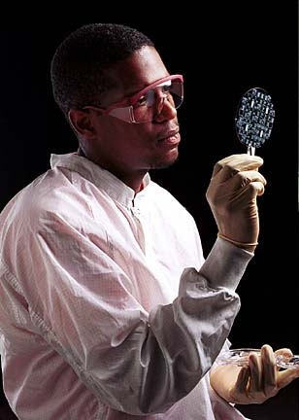
Financing Graduate School?
Loans/
Grants
Assistantships
- research
- teaching
Co-Op
Internships;
part-time
Jobs
Fellowships/
Traineeships
Work-Study

Slide 18
Research and/or Teaching Assistantships (1/2 Time)
Stipend: $10,000 - $18,000 for 9-12 mos.
Often all or part of tuition waived
May also provide health insurance
Work obligation (assisting professor with research or teaching)
Useful credential

Slide 19
What is a Fellowship?
Fellowships, grants and scholarships are outright awards made to graduate students with no service obligation. They usually provide a monthly stipend for living expenses, tuition and required fees.

Slide 20
Summary
Work on your GPA
Undergraduate Research
Practice for standardized tests
Get strong letters of reference
Write Clear Goals
Review package before submission
Do your homework

