Slide 1
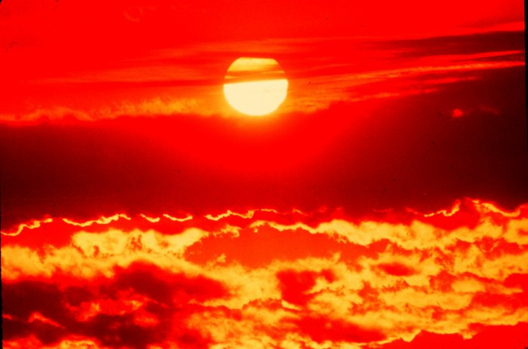
The Flow of Energy

Slide 2
Energy of Transformation
Energy
Capacity of doing work
Supplying heat
Heat (q): energy that is transferred from one object to another because of temperature difference
Flows from hot → cold
Chemical Potential Energy
Stored in chemical bonds

Slide 3
Thermochemistry
Study of energy changes that occur during chemical reactions and change in state.
System: the reaction
Surroundings: everything else in the universe
Law of Conservation of Energy: energy is neither created or destroyed

Slide 4
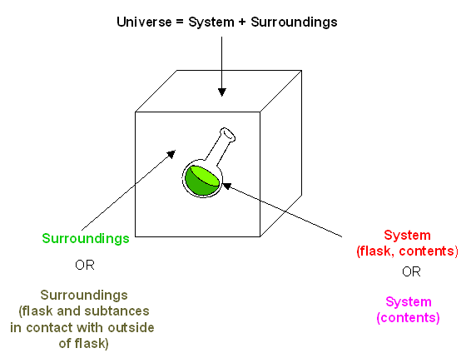
System and Surroundings

Slide 5
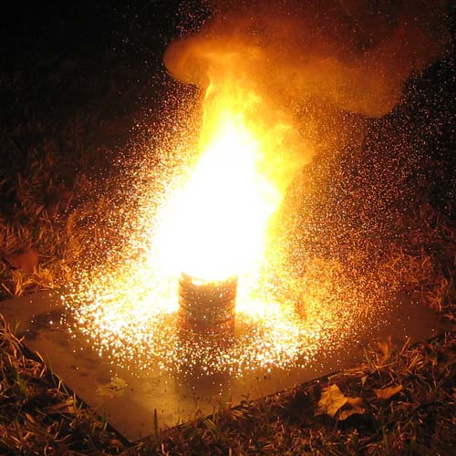
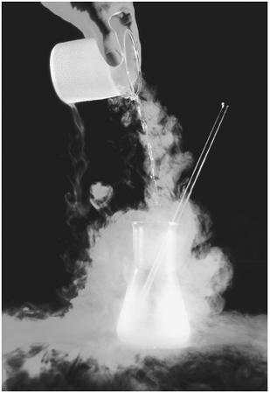
Types of Thermochemical Rxn.
Endothermic Process: absorbs heat from the surroundings
Exothermic Process: heat is released to the surroundings

Slide 6
Measuring Heat
Calorie
Amount of energy needed to raise 1g of H₂0 1ºC
1 Calorie = 1 kilocalorie = 1000 calorie
10g sugar → 41 Calories or 41,000 calories
Joule = SI unit for energy
1 joule raises 1g H₂O 0.2390ºC
1 joule=0.2390cal or 4.184J = 1cal

Slide 7
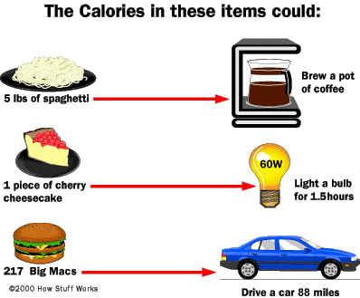

Slide 8
Heat Capacity
Heat Capacity: amount of heat needed to raise the temperature of any object 1ºC
aka Specific Heat
Depends on mass and chemical composition
greater mass → greater the heat capacity
On a sunny day, a piece of steel would be too hot to touch while a puddle would be cool

Slide 9
Calculating Specific Heat
The temperature of a 95.4g piece of copper increases from 25.0ºC to 48.0ºC when the copper absorbs 849J of heat. What is the specific heat of copper?
m_{Cu} = 95.4g C_{Cu}= ? J/(g·ºC)
ΔT= (48.0-25.0)=23.0ºC q = 849J

