Slide 1
Financial Aid for College
2012 - 2013

Slide 2
Scope of this Workshop
What is financial aid
College costs
Determination of eligibility
Need-based programs
Alternatives
How to complete a FAFSA

Slide 3
Types of Student
Financial Aid
Grants
Scholarships
Loans
Employment

Slide 4

Student Financial Aid
Merit-based
  academics
  talent
  athletic
  others
Need-based
  financial considerations

Slide 5
Student Financial Aid
Need-based aid …
Family is responsible for costs to the extent of its ability to pay college costs
Provides access and choice
Annual determination of eligibility

Slide 6


College Costs
Direct
Indirect
Vary widely from college to college

Slide 7




Direct College Costs
Tuition
Required fees
Room
Meals
Books and Supplies

Slide 8

Indirect College Costs
Transportation and miscellaneous personal expenses, including documented costs for a personal computer
Loan fees

Slide 9
Indirect College Costs
Study abroad costs
Dependent care expenses
Disability-related expenses
Cooperative education program costs

Slide 10
Applying for Federal
Financial Aid
Free Application for Federal Student Aid (FAFSA)
  Required for all types of federal aid
  Download the FAFSA on the Web Worksheet via www.fafsa.gov to prepare your form
    99% of forms are filed online!
    Sign the form with a Personal Identification Number (PIN)
  Paper form can be obtained by calling 800-4-FED-AID (1-800-433-3243)
  Complete FAFSA at www.fafsa.gov after January 1st, preceding the academic year
  Results available online in 48 hours and to the institutions you list on the FAFSA

Slide 11
What is a PIN?
What is a Personal Identification Number (PIN)?
  Issued to an individual and is a “signature” for Federal Student Aid purposes
  Faster than using paper signature
  PIN is valid for years
  Parent’s PIN may be used for multiple children
  Each student must have own PIN
  Obtain PIN from www.pin.ed.gov

Slide 12
Applying for State
Financial Aid
The FAFSA is also the application for most major state programs:
  NC Education Lottery Scholarship
  UNC Need-Based Grant
  NC Community College Grant
  New NC Need-Based Scholarship
  And others
Other state programs may require additional forms. See CFNC.org for details by program.

Slide 13

Applying for Financial Aid
Other forms ???
  Institutional application
  College Scholarship Service PROFILE
  State applications
  Outside scholarship applications

Slide 14



Need Help?
FAFSA Day 2012
Saturday, February 18, 2012
  Any time between 9 a.m. and noon in most locations
Get FREE help completing your FAFSA from college financial aid officers.
Visit CFNC.org/fafsaday or call toll-free at 866-866-CFNC (2362) to:
  Learn more
  Find closest location
  Register for FAFSA Day
Sponsored by:
  College Foundation of North Carolina
  North Carolina Association of Student Financial Aid Administrators, and
  State Employees Credit Union

Slide 15

Offers to help get aid are everywhere:
In the mail
Over the Internet
In newspapers
In magazines
Over the phone

Slide 16

Offers may be:
Legitimate offers of information and assistance
  Example: CFNC.org and FAFSA Day
Misleading offers from individuals or companies trying to make money off of unsuspecting parents and students

Slide 17
How do you identify offers that should be avoided?
Organizations that offer to locate more aid and then charge you a fee
Anyone who charges you a fee:
  for information about financial aid
  to complete the FAFSA
  to apply/receive a scholarship
Organizations that guarantee you will get a scholarship or aid.

Slide 18

Potential “Scams”
“The scholarship is guaranteed or your money back.”
No one can guarantee your scholarship before it is awarded.
“Come to our free seminar and we’ll show you how to get more financial aid.”
This is a sales pitch. Don’t pay for information that you can get elsewhere for free.

Slide 19
Other Misleading Offers
“The scholarship requires a small fee.” Never pay a fee to get a scholarship.
“You are a finalist” for an award you never applied for.
If you did not apply, it is not a
legitimate offer.
“You can’t get this information anywhere else.”
Everyone has access to the same information.

Slide 20
Where can you find truly free information about financial aid?
Contact College Foundation of North Carolina at CFNC.org or toll free at 866-866-CFNC
  Service of the State of North Carolina
Talk to the financial aid administrator at the college of choice
Ask your high school counselor or visit the local library
Apply for federal financial aid at FAFSA.gov
    (notice it is not FAFSA.com!)

Slide 21
Remember!
You should never have to pay:
For information about college financial aid
To apply for federal financial aid (FAFSA)
To receive financial aid for college

Slide 22
Applying for Financial Aid
Meet earliest deadline of colleges in which you are interested
Complete all questions accurately
Estimate if necessary to meet early deadlines
Don’t wait until you are admitted to file the FAFSA
Keep a photocopy of all documents for your records

Slide 23
Applying for Financial Aid
Additional documentation may be required… for VERIFICATION of information
  Adjusted Gross Income (AGI)
  U.S. income tax paid
  Untaxed Income – only if reportable on the 2012-2013 FAFSA
    Untaxed IRA distributions
    Untaxed pensions
    Education credits
    IRA deductions
    Tax exempt interest

Slide 24
IRS Data Retrieval Tool
Available February 1, 2012
  Within several days for electronic tax
  Within several weeks for paper tax filers
May use for initial applications & corrections
Applies to
  Those who have filed tax returns
  Those making corrections online after filing tax returns
Does Not apply to
  Married but are filing separately
  Filing status is Head of Household
  Marital status changed after 12/31/11
  Those filing amended or foreign tax returns
Notes:
Important to indicate that this is a significant change from prior years. It is hoped this will result in more accurate data provided on the FAFSA than in the past . Students and parents not using this process will be subjected to more paper work than in prior years and, perhaps, more follow-up from the FAO. Communicate to applicants that using the IRS Data Retrieval process, either when initially when completing a FAFSA or when making corrections, provides them with the fastest, easiest, and most secure solution for meeting verification requirements. Participation is voluntary, although recommended!
It will be important for students and parents to carefully review the SAR/ISIR data if selected for verification. This will help them understand what will be requested by the institution’s financial aid office.
ED will remind students who filed FOTW before completing tax returns to make corrections and use the IRS Data-Retrieval process at that time.
Important to note: all applicants who use the FAFSA-IRS Data Retrieval process to transfer IRS data to their FAFSA, either at the time of initial FOTW filing or later using the FAFSA corrections process, will satisfy any verification requirements with respect to those data items as long as the data items were not subsequently changed.
Applicants who do not use the FAFSA-IRS Data Retrieval process, despite a series of reminders from FSA – as well as those applicants who are not eligible to use the process – will be subject to the usual verification selection process. Applicants with the highest probability of application error are selected by the processor or institution. Long-term verification goal is to develop a customized verification selection approach based on information provided by each applicant when the FAFSA is completed. Due to the need for sufficient historical FAFSA data to properly develop the customized verification model, ED is not implementing a fully customized verification process for the 2012-2013 AY. Instead, for the 2012-2013 AY, ED will implement a variation of the current process.
If an applicant selected for verification has not successfully transferred information from the IRS, or did transfer the information but then changed it, the Department expects the institution to require the applicant, and, if necessary, the applicant’s parents, to provide an official IRS transcript of Federal income tax information.
Details of this process are included in Handouts provided online at CFNC.org.

Slide 25
IRS Data Retrieval Tool
To use the Tool, must have:
  A valid Social Security Number and
  Filed a 2011 federal tax return and
  Same marital status as 12/31/2011
Filtering question helps applicant know
whether to use Tool
IRS Data Retrieval Process meets verification requirements
  Secure and FAST option
Students (and parents) not using the “Tool” and selected for verification:
  In most cases, must submit an IRS Tax Return Transcript rather than a Tax Return
Notes:
Important to indicate that this is a significant change from prior years. It is hoped this will result in more accurate data provided on the FAFSA than in the past . Students and parents not using this process will be subjected to more paper work than in prior years and, perhaps, more follow-up from the FAO. Communicate to applicants that using the IRS Data Retrieval process, either when initially when completing a FAFSA or when making corrections, provides them with the fastest, easiest, and most secure solution for meeting verification requirements. Participation is voluntary, although recommended!
It will be important for students and parents to carefully review the SAR/ISIR data if selected for verification. This will help them understand what will be requested by the institution’s financial aid office.
ED will remind students who filed FOTW before completing tax returns to make corrections and use the IRS Data-Retrieval process at that time.
Important to note: all applicants who use the FAFSA-IRS Data Retrieval process to transfer IRS data to their FAFSA, either at the time of initial FOTW filing or later using the FAFSA corrections process, will satisfy any verification requirements with respect to those data items as long as the data items were not subsequently changed.
Applicants who do not use the FAFSA-IRS Data Retrieval process, despite a series of reminders from FSA – as well as those applicants who are not eligible to use the process – will be subject to the usual verification selection process. Applicants with the highest probability of application error are selected by the processor or institution. Long-term verification goal is to develop a customized verification selection approach based on information provided by each applicant when the FAFSA is completed. Due to the need for sufficient historical FAFSA data to properly develop the customized verification model, ED is not implementing a fully customized verification process for the 2012-2013 AY. Instead, for the 2012-2013 AY, ED will implement a variation of the current process.
If an applicant selected for verification has not successfully transferred information from the IRS, or did transfer the information but then changed it, the Department expects the institution to require the applicant, and, if necessary, the applicant’s parents, to provide an official IRS transcript of Federal income tax information.
Details of this process are included in Handouts provided online at CFNC.org.

Slide 26

Determination of Expected Family Contribution
Parents’ Contribution
Student’s Contribution
= Expected Family Contribution (EFC)
+

Slide 27
Determination of Parents’ Contribution
Parents’ total income for calendar year
(Taxable + Non-taxable)
minus
- Federal Tax Paid (not withheld)
- State Tax Paid
- Social Security Withholding
- Living Allowance
- Child Support paid by parents
- Employment allowance
= Available Parent Income

Slide 28
Determination of Parents’ Contribution
Total net assets (excluding home equity and
retirement accounts)
Protection allowance (varies by age of parent)
Net Worth
x 12%
-
=
=
Amount of assets used in determining EFC

Slide 29
Determination of Parents’ Contribution
Available Income
Asset Contribution
Adjusted Available Income
Percentage
Parent Contribution
Parent contribution will be divided by the number of family members in college, not including parents.
+
=
x
=

Slide 30
Determination of Student’s Contribution
Student’s total income for calendar year (taxable and non-taxable)
- Federal tax paid (not amount withheld)
- State tax paid
- Social Security withholding
- Income protection allowance ($6,000)
= Student’s Available Income
x 50%
= Student’s Contribution from Income

Slide 31

Determination of Student’s Contribution
Total net assets
20%
= Student’s Contribution from assets
x

Slide 32
Determination of Student’s Contribution
Student contribution from income
+ Student contribution from assets
= Total Student Contribution

Slide 33



Determination of EFC
Parents’ contribution
+ Student’s contribution
= Expected Family Contribution

Slide 34

Basic Formula for Aid
  Cost of Attendance
  Expected Family Contribution
Eligibility for Need-Based Funds
-
=

Slide 35
Potential Institutional Adjustments to EFC for Institutional Funds
Expect students to contribute a certain minimum amount to their educational costs (summer earnings)
Use home equity in determination of net assets
Make adjustments for medical/dental expenses
Make adjustments in the losses/depreciation claimed for business/farm operations

Slide 36
Special Circumstances
Significant change in your family…
  Unemployment of a parent
  Death in the family
  Change in parents’ marital status
  Medical expenses not covered by insurance
  Student cannot obtain parent information
Notify the financial aid office at your college of any special circumstances. Be prepared to provide documentation of any change, including the financial impact of the change.

Slide 37

Sources of Financial Aid
Federal Government
State Programs
Institutional funds
Outside agencies

Slide 38


Types of Financial Aid
Gift
Scholarships
Grants
Self-help
Loans
Employment

Slide 39
Federal Aid Programs
Federal Pell Grant
Federal Supplemental Educational Opportunity Grant
Federal Work-Study
Federal Perkins Loan
Ford Federal Direct Loan
Federal TEACH Grant (loan)

Slide 40
North Carolina Aid Programs (partial listing)
NC Community College Grant
UNC Need-Based Grant
NC Education Lottery Scholarship
NC Need-Based Scholarship
Forgivable Education Loan for Service (NC FELS)

Slide 41
NC Reach
(program for foster youth)
Funding for college students who:
  Age(d) out of NC public foster care at age 18
  Were adopted from foster care after age 12
Eligibility requirements
  Age 18 – 25 and meet above criteria
  Enroll at NC Community College or one of UNC System’s 16 campuses
  Enroll on half-time basis or more
  Seek undergraduate degree/certificate /diploma
Program is designed to be combined with other aid and cover the full cost of attendance
Applications and additional information
  www.ncreach.org

Slide 42

Institutional and
Outside Aid
Institutional Aid
Grants & Scholarships
Loan Programs
Student Employment
Outside Agencies
Local organizations
Churches
Civic Groups
Parents’ employers
Veterans Administration
Vocational Rehabilitation Services

Slide 43

What about Federal Loans?
Federal Direct Subsidized and Unsubsidized Loans
Federal Perkins Loans
Federal Direct PLUS Loans for:
  Parents of dependent students
  Graduate or professional students

Slide 44
Is that all there is?
Private alternative loans for students or parents
  Last resort--Always apply for federal loans first!
College payment plans
Outside scholarships
Tax credits—American Opportunity (formerly Hope Tax Credit) & Lifetime Learning

Slide 45
Tax Credits - American Opportunity
Tax Credit
2011 .....& longer?
  Available for the first four years of college to assist with tuition, fees and required books.
  Up to $2500 tax credit –reduces amount of taxes owed; up to 40% refunded when no income tax due.
    100% of first $2,000 expenses and 25% of the next $2,000.
  Examples:
    Tuition of $4000 paid in 2011-- May claim $2500 on the tax return completed for 2011 (filed in 2012).
    Tuition of $1,200--May claim the full $1,200
    Tuition of $3,000--May claim $2,250 (all of the first $2000, and 25% of the remaining tuition…which is $250).

Slide 46
Tax Credits -
Lifetime Learning
Available for all years
Can claim for remaining undergraduate years and graduate study as well as professional development classes.
Can claim credit for 20% of tuition & fees, up to maximum of $2,000.
Income restrictions on who can claim Lifetime and American Opportunity Tax Credits ….. Consult with your tax advisor!

Slide 47
IRS Deductions and
Credits for 2011
Families with adjusted gross incomes up to $80,000 (single filers) & $160,000 (joint filers) can claim tax credits.
Certain taxpayers will qualify to take a tax deduction for tuition and fees of up to $4,000 (even if they don’t itemize).
Cannot claim American Opportunity or Lifetime Learning Credit in the same year as deduction for same student.
Don’t miss out on the tax credits or deductions! Talk to your tax preparer or do your research.

Slide 48
Additional Information
College Foundation of North Carolina www.cfnc.org
The Student Guide
  Published by US Department of Education www.ed.gov/prog_info/SFA/StudentGuide
Student Financial Aid for North Carolinians
  www.cfnc.org/fabook
www.finaid.org
Publications in local libraries

Slide 49
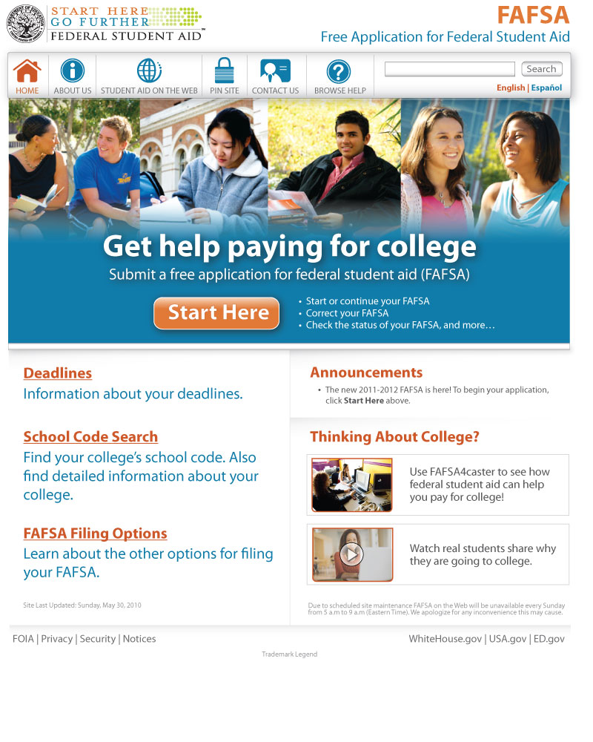
FAFSA on the Web’s Homepage

Slide 50
Before Beginning a FAFSA Overview
Gather the documents you need
Print a FAFSA on the Web Worksheet
Plan how to sign your FAFSA
Apply for a PIN now!

Slide 51
FAFSA on the Web Worksheet
The questions within FAFSA on the Web are presented in a different order than the questions on the paper FAFSA.
The questions that are included on the Worksheet are ordered as they appear online.
Complete the Worksheet rather than the paper FAFSA if you want to use it to help you complete the Web version.
Worksheet is available in PDF form www.fafsa.gov

Slide 52
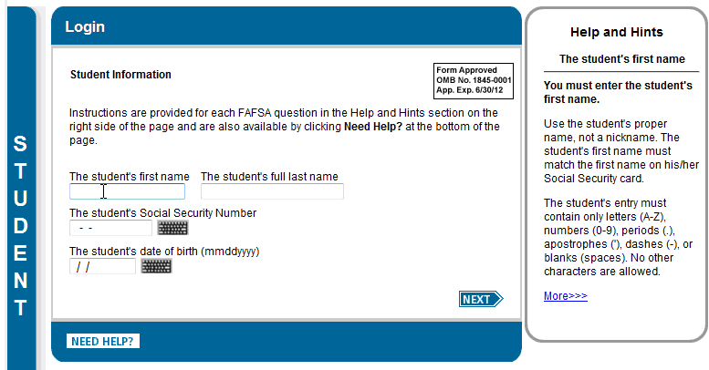
Login Page

Slide 53
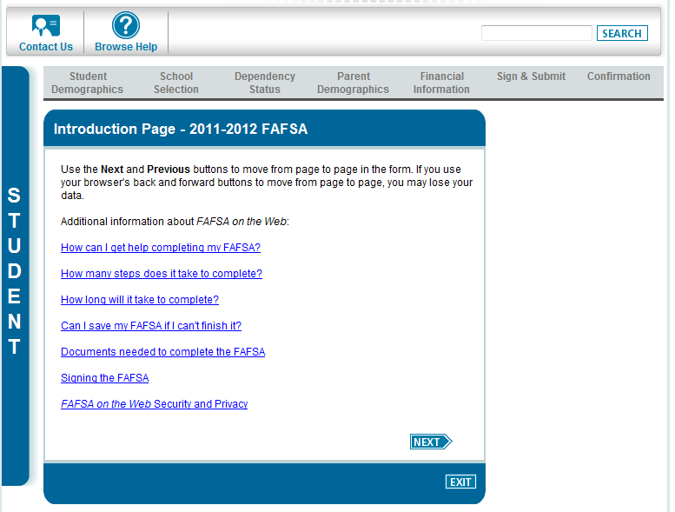
Introduction Page

Slide 54
Dependency
Students are independent if:
  24 years old or older
  Orphan, foster child/ward of the State
  Have children for whom they provide more than 50% support
  Have a legal guardian
  Married
  Veteran or on active duty
  Graduate students
  Legally emancipated
  Homeless or at risk of homelessness
  Students not meeting one of the above must include parental information for full aid consideration.

Slide 55
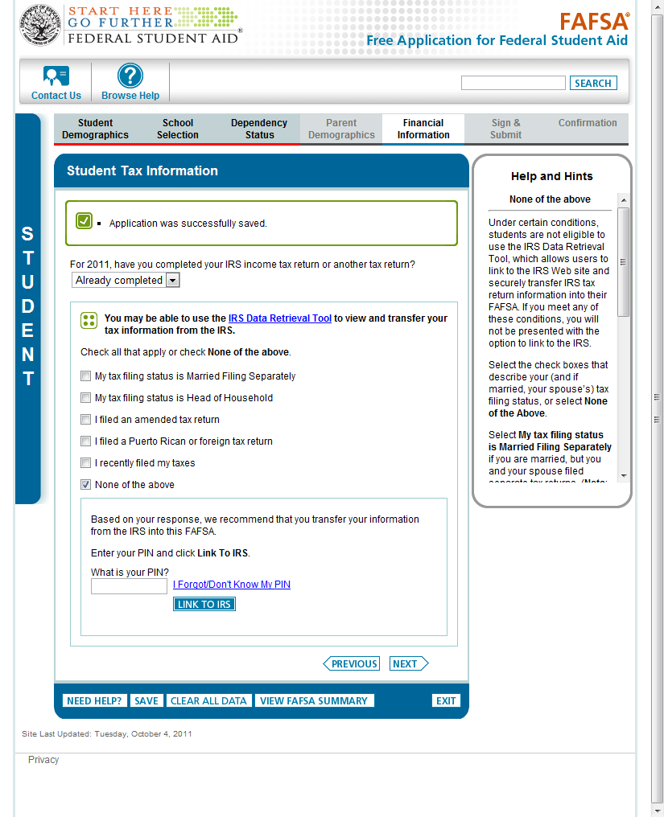
IRS Data Retrieval Tool
Filtering Question

Slide 56
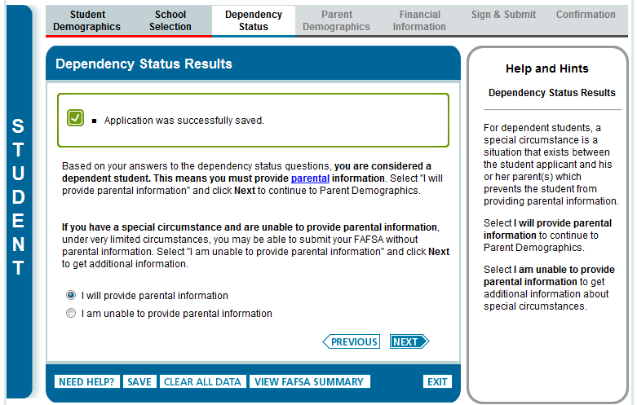
Special Circumstances: Page 1 of 3
Displayed only if student is dependent. Student can indicate that they will provide parental information or they can indicate they have a special circumstance.

Slide 57
Dependent Student Special Circumstance
If parents refuse to complete FAFSA:
Talk to financial aid office.
Student may be allowed to submit the FAFSA without parental information.
Student will only be eligible for an UNSUBSIDIZED Loan.
Parent section is not optional if the student wants total aid eligibility!!

Slide 58

Signing the FAFSA
After completing the FAFSA, student and parent (if dependent) must sign by:
  Entering PIN
    Both student and one parent should each have PINs
  OR
  Print signature page, sign and mail to address provided within 7 days

Slide 59
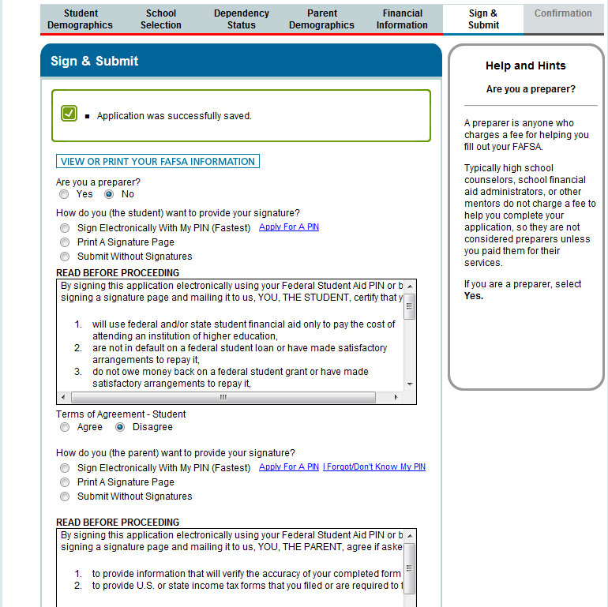
Sign the Application and Submit by clicking “Submit My FAFSA Now”
The Sign & Submit page includes the signature process for the student
and parent.

Slide 60
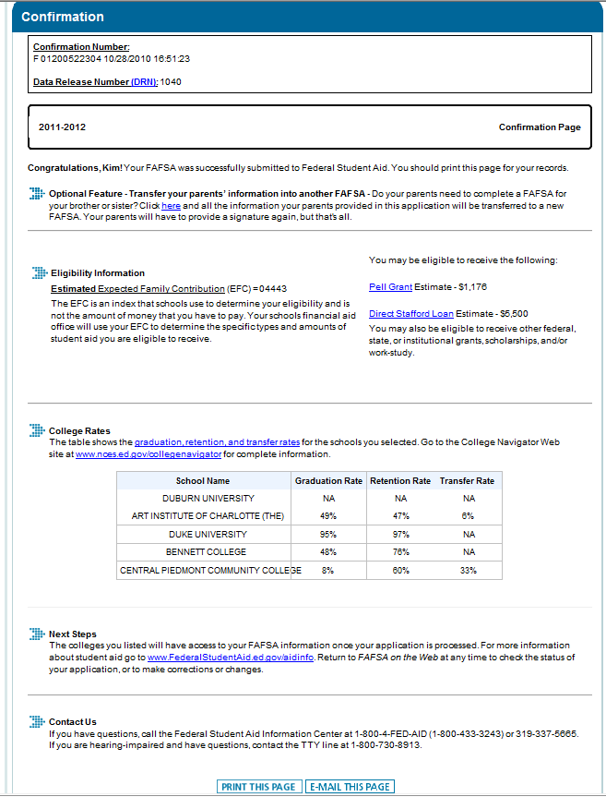
Confirmation Page
Confirmation Number
Option for parents to transfer info to another FAFSA for a sibling
EFC estimate
Pell Grant and Direct Loan estimates
College rates for each college on the FAFSA

Slide 61
Conclusion
Respond promptly to colleges if additional information requested
  Tax return transcripts or other information
College will notify via email, Web or mail of aid eligibility
Student should follow colleges’ instructions to accept or decline aid offered.

Slide 62
Summary
Aid available from federal and state governments
Student and parent should each have a PIN www.pin.ed.gov
Get your taxes done before March, if possible!
Complete forms by deadlines
  More important now than ever
Use www.fafsa.gov to complete, sign and submit application.

Slide 63

Questions?

