Slide 1
Dining Etiquette

Slide 2
Greetings
When meeting someone…
rise if you are seated.
smile and extend your hand.
repeat the other person’s name in your greeting.
A good handshake is important—it should be firm and held for three-four seconds.
In the today’s business world it is not necessary to wait for a female to initiate the handshake. Females & males should both be ready to initiate the handshake.

Slide 3
The Name Tag
Name Tag should be placed on the right hand side of your front shoulder area
The logic: When shaking hands it allows for a natural progression for the eyes to the name tag

Slide 4
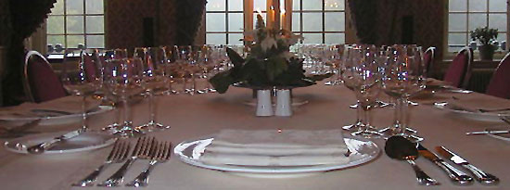
Formal Dinners

Slide 5
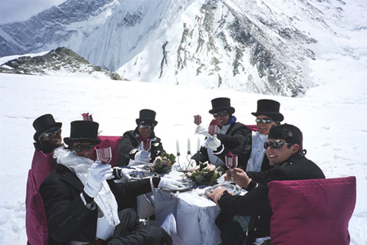
The Worlds Highest Formal Dinner

Slide 6
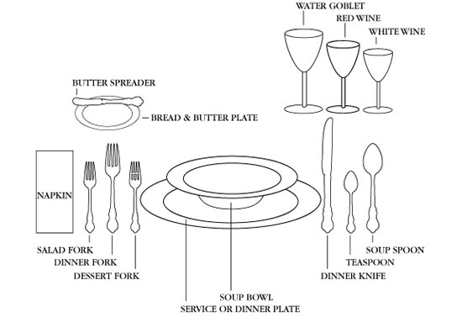
Place Setting
Start from the outside and work your way in

Slide 7
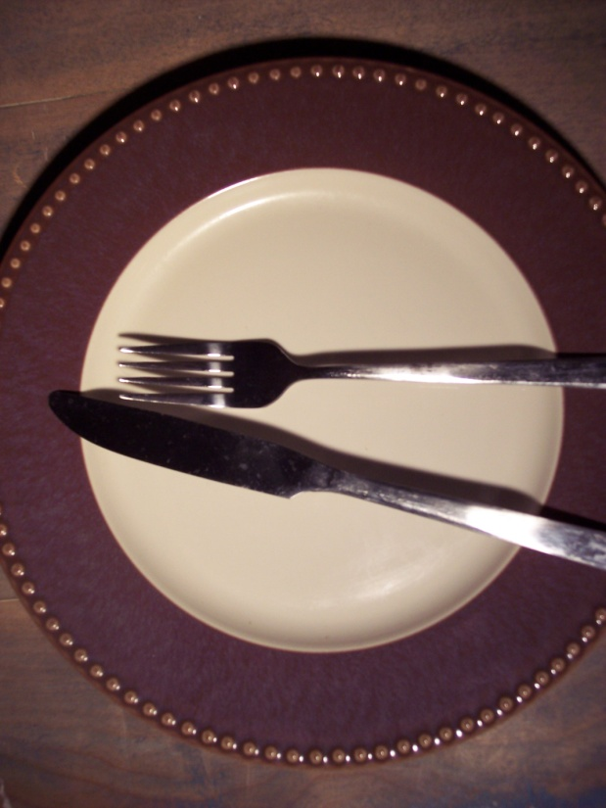
Silverware
If a piece of silverware drops, leave it and ask for a replacement from your server.
Silverware should not touch the tablecloth once used.
Place knife at the top of the dinner plate, facing in, after use.
When you are finished, place your knife and fork in the center of your plate.

Slide 8
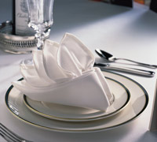
Napkin
Once seated place the napkin, unfolded, on your lap and leave it there until you are finished.
Once you are finished place the napkin folded loosely to the left of your plate.

Slide 9
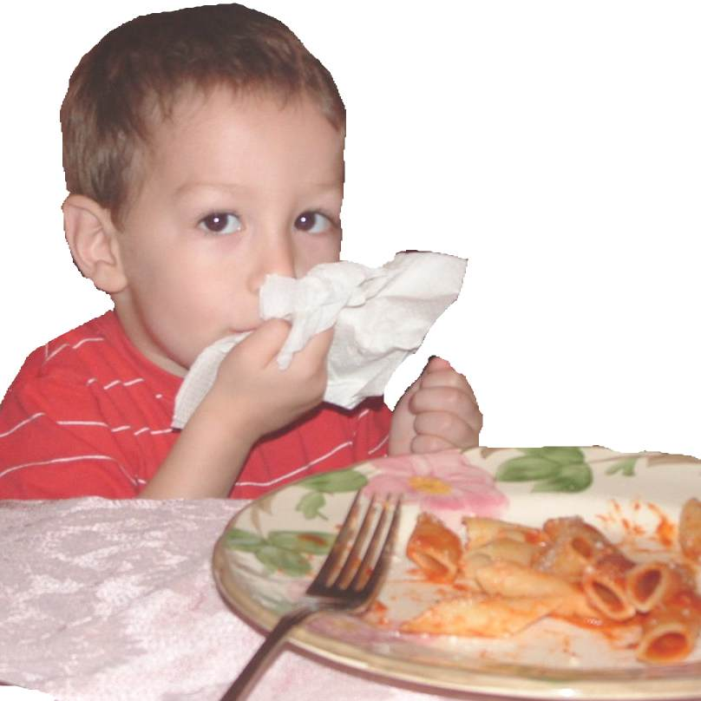
A napkin is used to dab the corners of you mouth.
If you need to leave the table during the meal, place the napkin on the chair and slide the chair under the table.

Slide 10
Posture and Elbows
Sit straight and try not to lean on the table.
Keep your elbows off the table and close to the body when you are eating.
However, when you stop to talk, it is okay to rest your elbows on the table and lean forward.

Slide 11
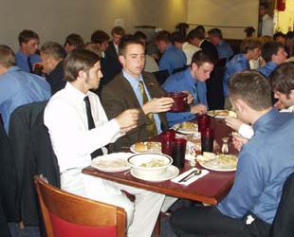
Serving Food
Pass food to the right.
Transfer dip to your plate.
Plates are served on the left.
Dishes removed from the right.
Pass the salt and pepper together.

Slide 12
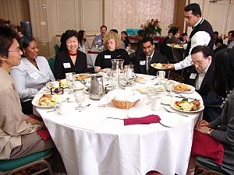
Dining
Wait until everyone is seated before eating.
When dining with others, everyone should start and finish at the same time. If you are a fast eater try to pace yourself. You could make the others feel uncomfortable if you finish before they do.
When you are finished eating do not push your plate away from you.

Slide 13
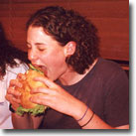
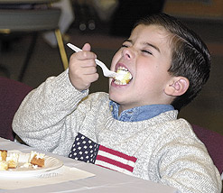
Take small bites, keep your mouth closed and finish chewing before continuing your conversation.
Try not to gulp your food, it isn't very attractive.
Do not blow on food that is hot. Wait until it cools or eat from the side of the bowl, when having soup.

Slide 14
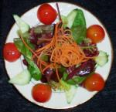
Bread and rolls should be broken with your fingers, in small pieces and buttered one piece at a time.
Cut several pieces of meat(or main course) at a time.
Use your knife to cut lettuce if needed.

Slide 15
Excusing Yourself and Problems
Be discrete if you have problem with the food.
Remove food the same way it went in-on silverware.
Excuse yourself, if you have to leave the table.
Turn your head from the table when you cough or sneeze.
If someone uses your bread plate as their own do not inform them of their mistake, simply use your dinner plate. Do not use the bread plate on your right as a replacement.

Slide 16
Toast
“There are good ships,
and there are wood ships,
The ships that sail the sea.
But the best ships, are friendships,
And may they always be."

Slide 17
¡Buen apetito!
Hyvää ruokahalua!
Mahlzeit!
Smakelijk eten!
Gero apetito!
Smacznego!
Smaklig måltid!
स्वादिष्ट खाना
Buon appetito!
Bon appétit !
Смачного!

