Slide 1
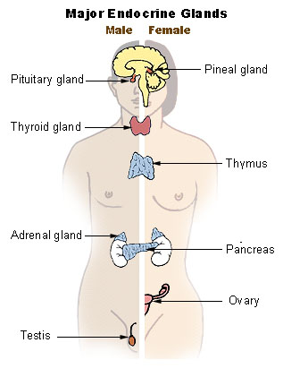
Endocrine System

Slide 2
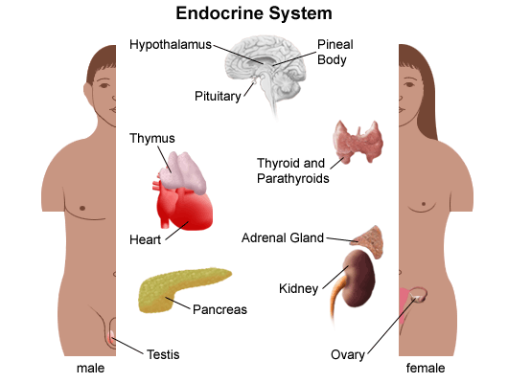
Introduction
Endocrine glands secrete their products into body fluids.
Secrete hormones that regulate metabolism
Exocrine glands secrete their products into ducts that lead to the outside of the body.

Slide 3
Hormone Action
Endocrine glands secrete hormones that affect target cells with specific receptors.
Hormones are very potent.
Steroids, amines, peptides, proteins, or glycoproteins
Steroid Hormones: enter a target cell and combine with receptors to form complex with nucleus
Activate specific genes → protein synthesis

Slide 4
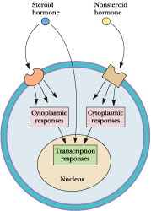
Hormone Action
Nonsteroid Hormones: combine with receptors of target cell membrane
Hormone receptor complex signals a G protein to stimulate a membrane protein
Induce formation of second messenger molecule
cAMP, DAG, or IP₃ activate protein kinases
Active protein substrate molecules → change a cellular process

Slide 5
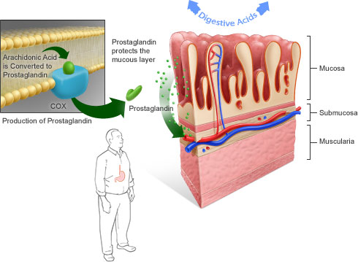
Hormone Action
Prostaglandins: act on the cells of the organs that produce them
Liver, kidneys, heart, lungs, thymus gland, pancreas, brain, and reproductive organs
Present in small quantities
Have powerful effects

Slide 6
Control of Hormones
Concentration of each hormone in body fluids is regulated
Negative feedback system: a gland is sensitive to the concentration of the substance it releases
When concentration becomes to high, it inhibits it
When concentrations fall, it will again release the hormone
Maintains relatively stable concentrations
Release of Hormones:
Response to hormones secreted by hypothalamus
Nerve impulse
Response to levels of substances in the blood

Slide 8
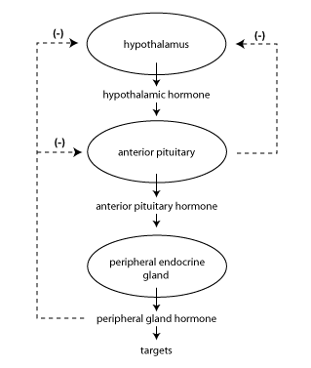

Slide 9
Types of Endocrine Glands

Slide 10
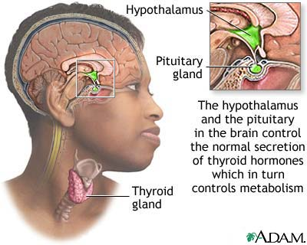
Pituitary Gland
Controlled by hypothalamus
Anterior pituitary hormones
Growth hormones (GH): stimulate cells to increase in size and divide more frequently
Prolactin (PRL): stimulates and sustains a women’s milk production
Thyroid-stimulation hormone (TSH): control secretions of thyroid
Adrenocorticotropic hormone: controls secretions of adrenal cortex

Slide 11
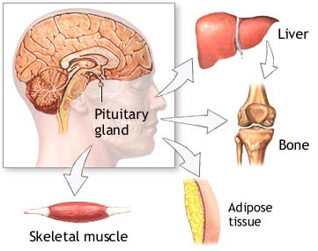
Posterior Pituitary Hormone
Consists largely of neuroglial cells and nerve fibers
Hypothalamus produces the hormones of the posterior pituitary
Antidiuretic hormone (ADH): reduces the amount of water the kidneys excrete
Oxytocin (OT): contracts muscles of uterine wall
Contracts cells with milk production and secretion

Slide 12
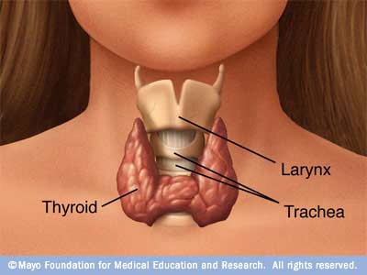
Thyroid Gland
Located in the neck and consists of two lobes
Thyroxine and triiodothyronine
Increase metabolic rate of cells
Enhance protein synthesis
Stimulate lipid utilization
Calcitonin: regulate concentrations of blood calcium and phosphate ions

Slide 13
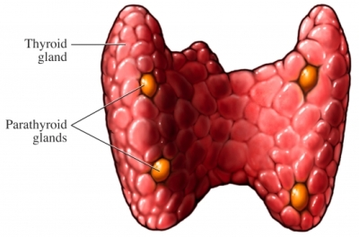
Parathyroid Gland
Posterior surface of thyroid gland
PTH: parathyroid hormone
Increases blood calcium level
Decreases blood phosphate ion concentration
Negative feedback mechanism between the parathyroid glands and the blood

Slide 14
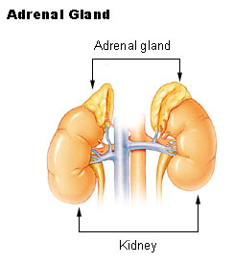
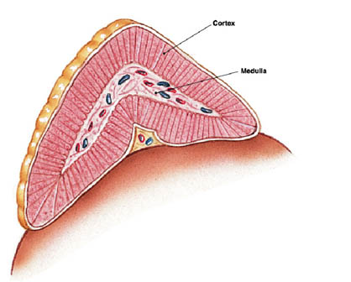
Adrenal Glands
Located atop of the kidneys
Adrenal Medulla
Epinephrine and norepinephrine
Increases heart rate, increased force of cardiac muscle contraction, increased breathing rate, elevated blood pressure, increased blood glucose, and decreased digestive activity
Stimulated by sympathetic impulses → fight or flight

Slide 15
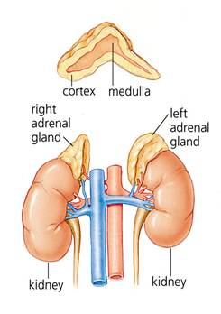
Adrenal Glands
Adrenal Cortex
Aldosterone: kidneys to conserve sodium ions and water, and to excrete potassium ions
Cortisol: affects carbohydrate, protein, and fat metabolism
Adrenal Sex Hormones
Are male type, but can be converted to female type
Supplement the sex hormones produced by the gonads

Slide 16
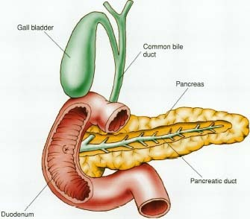
Pancreas
Secretes digestive juices in addition to hormones
Attached to small intestines
Islets of Langerhans: secrete glucagon and insulin
Glucagon: stimulates the liver to produce glucose form glycogen and noncarbohyrates
Insulin: moves glucose across some cell membranes, stimulates glucose and fat storage, promotes protein synthesis

Slide 17
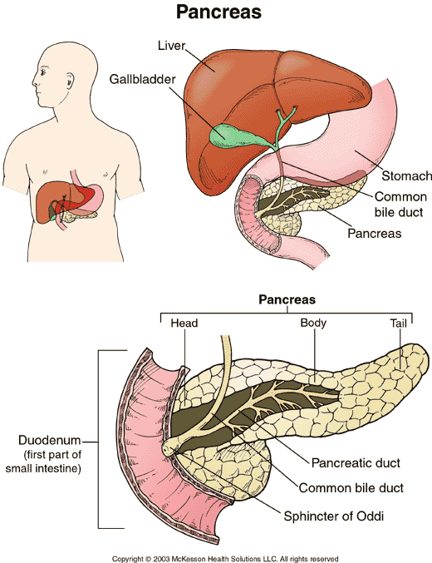

Slide 18
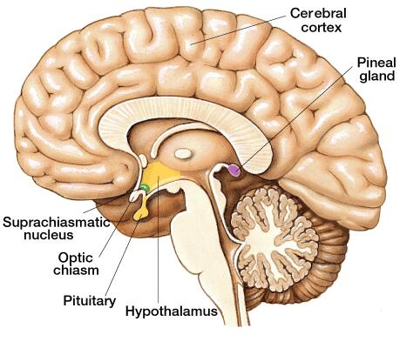
Other Endocrine Glands
Pineal Gland: attached to thalamus
Secretes melatonin in response to light
Assists in regulation of female reproductive cycle

Slide 19
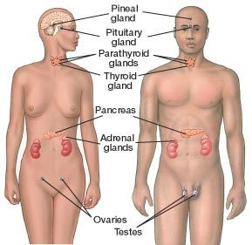
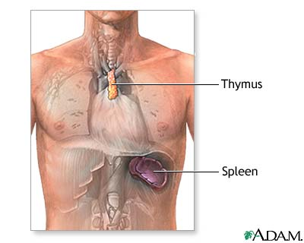
Other Endocrine Glands
Thymus Gland: between the lungs, behind the sternum
Secretes thymosins: affects production of lymphocytes, immunity
Reproductive Glands:
Ovaries: estrogens and progesterone
Placenta: estrogens, progesterone, and gonadotropin
Testes: testosterone

Slide 20
Stress and health
Stress occurs when homeostasis is threatened
Stress responses: increased activity of sympathetic nervous system and increased secretion of adrenal hormone
Types of Stress
Physical: environmental factors
Psychological: thoughts about real or imagined dangers
Responses: help maintain homeostasis
Hypothalamus controls stress syndrome

