Slide 1
Electrochemistry

Slide 2
Electrochemical Process
Conversion of chemical energy and electrical energy
All involve redox reactions
Electrochemical Cell: any device that converts chemical energy into electrical energy or electrical energy to chemical energy

Slide 3
Spontaneous Redox Reaction
When zinc metal is placed in a copper solution, the zinc become copper plated.
Zn(s) + Cu²⁺(aq) → Zn²⁺(aq) + Cu(s)
As the Zn dissolves, electrons are transferred to the copper
For any two metals in an activity series, the more active metal is oxidized

Slide 4
Voltaic Cells
Alessandro Volta (1800)built the 1st electrochemical cell used to generate DC current
Spontaneous Redox Rxn
Voltaic Cells:
Half-Cells: a piece of metal (Zn or Cu) immersed in a solution of its own ions
Anode: electrode at which oxidation occurs, Zn
Cathode: electrode at which reduction occurs, Cu
Salt Bridge: a tube containing a strong electrolyte, K₂SO₄, allowing ions to pass between the half-cells
Zn(s)|ZnSO₄(aq)||CuSO₄(aq)|Cu(s)

Slide 5
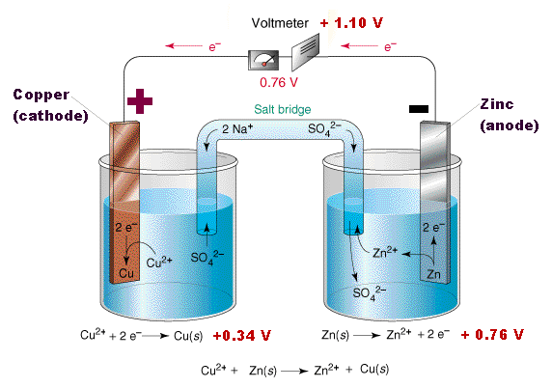

Slide 6
Dry Cells
A voltaic cell in which the electrolyte is a paste
Not a true battery
Common flash light battery
A zinc container is filled with electrolyte paste of MnO₂,ZnCl₂, NH₄Cl, and H₂O
Graphite rod is embedded in the paste (cathode)
Zinc Container is the annode
The thick paste and paper liner prevent the contents from mixing, no salt bridge
Alkaline battery: KOH paste

Slide 7
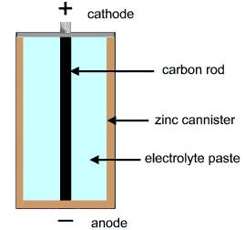
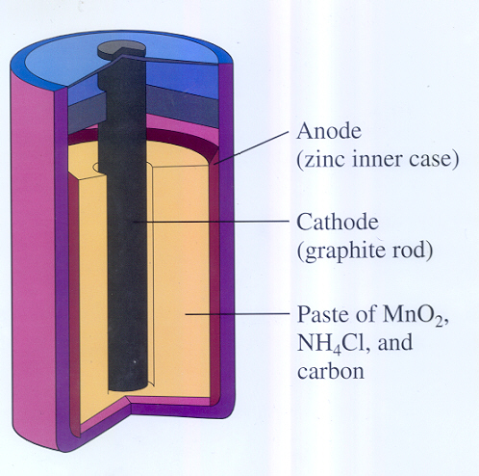

Slide 8
Lead Storage Batteries
Battery: group of cells connected together,
12V car battery: six voltaic cells connected
Pb(s) + 4H⁺(aq) + SO₄²⁻(aq) + 2e⁻ → PbSO₄ (s) + 2H₂O(l)
Sulfate builds up on the plates, and the concentration of the sulfuric acid decreases
Car’s generator recharges the battery
PbSO₄ (s) + 2H₂O(l) → Pb(s) + 2HSO₄(aq)
Small amounts of lead sulfate fall form the electrodes and collect on the bottom of the cell
Electrodes loose so much lead sulfate, they can no longer be recharged

Slide 9
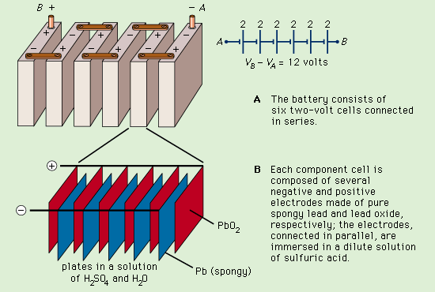

Slide 10
Fuel Cells
Fuel substance undergoes oxidation, which electrical energy is continuously obtained
Don’t have to be recharged
Designed to emit no pollution
More quiet and cost effective than conventional generators
Space Shuttle: astronauts drink water produced by hydrogen-oxygen fuel cells
Auxiliary power sources for submarines

Slide 11
Fuel Cells
Three compartments separated form one another by two electrodes made of porous carbon
Oxygen, the oxidizer, is fed into the cathode
Hydrogen, the fuel, is fed into the anode
Electrolyte in the central compartment is hot, concentrated solution of potassium hydroxide
Electrons from the oxidation half-reaction at the anode pass through an external circuit to enter the reaction half-reaction cathode

Slide 12
