Slide 1
Setting Financial Goals
FDIC Money Smart for Young Adults
Building: Knowledge, Security, Confidence

Slide 2
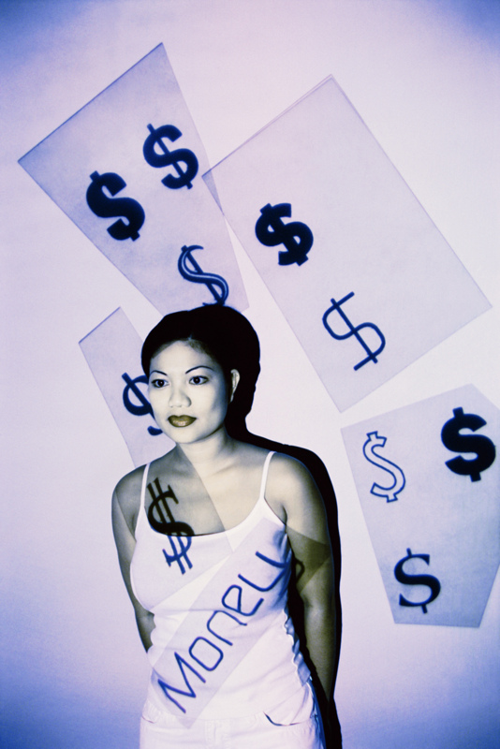
Purpose
Learn how to manage money by preparing a personal spending plan
Identify ways to decrease spending and increase income

Slide 3
Objectives
By the end of this course, you will be able to:
Track daily spending habits
Prepare a personal spending plan or budget to estimate monthly income and expenses
Identify ways to decrease spending and increase income
Identify budgeting tools that will help you manage your money

Slide 4
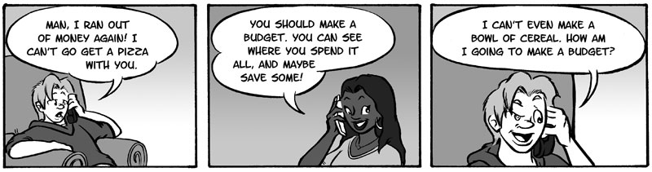
To make a Budget or to NOT Make a Budget?

Slide 5

What is a Budget?
Budgeting is:
An important step to financial security
About choices – choosing how to make and spend money

Slide 6
Why Budget?
Develop a budget
What is a budget?
A plan for meeting expenses
Why make a budget?
To take control of your finances...
Usually for
1 month

Slide 7

Preparing a Budget
Budgeting is about:
Choosing how to use your money
Knowing what your income and expenses are every month

Slide 8
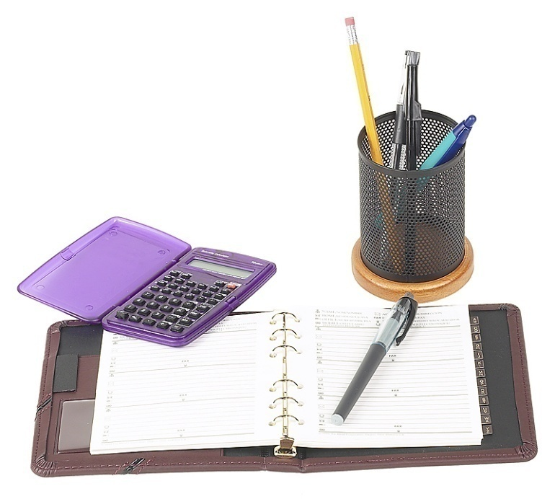
Four Steps to Preparing a Budget
  Keep track of your daily spending
  Determine what your monthly income and expenses are the month before they are due
  Decrease spending
  Increase income
Notes:
Suggested changing top question to: How Do I Know What Bank is Right for Me?. If that is too big a change, add to the slide content question the phrase: “about the bank” as in “You should ask yourself several questions about the bank, including:”
JK: I kept the question since it matches the lesson, but changed the “Before you open….” wording.

Slide 9

Step 1: Keep Track of Daily Spending
Many people spend all their money—Do you know where your money goes each month?
Have you ever had any money and then spent it?
Do you remember exactly what you bought?
Control Your Money!
Know where your money goes
Keep a personal spending diary

Slide 10

Set Your Goals
Consider them when planning a budget:
Be realistic
Be specific
Have a time frame
Say what you want to do
Have milestones

Slide 11

Daily Spending Diary
Watch Spending Closely
Use a daily spending diary or log
Know where your money goes
Cut expenses to save for goals
Notes:
Changed dash from keyboard dash to symbol to be consistent with other slides..

Slide 12
Step 2: Income
Income comes in the form of:
Allowances
Wages from a job
Miscellaneous work (like cutting grass)
Interest and dividends from investments

Slide 13

Step 2: Expenses
Expenses: items you pay for each month
Housing and car payments
Insurance
Food and clothing
Utility bills
Personal, child or pet care
Eating out or other entertainment
Educational costs

Slide 14

Expenses
Expenses:
Everything you pay for in a time period
There are three types of expenses:
      Fixed
      Flexible
      Periodic

Slide 15
Expenses (continued)
Fixed Expenses do not change
Car payment
Rent
Flexible/ Variable/ or Discretionary Expenses might change
Electricity
Food
Clothing or entertainment
Periodic Expenses occur regularly but not frequently
Insurance
Subscriptions
Warranties/ Service Agreements
License renewals
Notes:
Changed dashes to symbols to be consistent with other slides.–

Slide 16
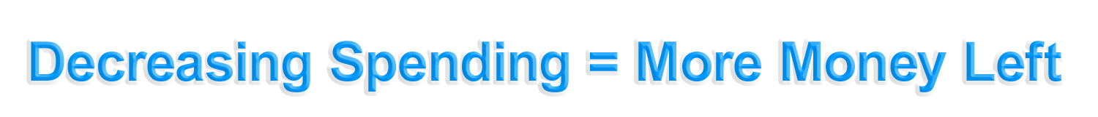

Step 3: Find Ways to Decrease Spending

Slide 17
Step 3: Find Ways to Decrease Spending
You can decrease spending by:
Carrying little cash and controlling your credit card use
Not shopping “for fun”
Remembering your savings goals
Buying only what you need
Paying your bills on time to avoid extra fees and charges

Slide 18

Step 4: Find Ways to Increase Income
Get a second job or a job that pays more to increase income
Use certain tax credits that can help you increase your income (or pay fewer taxes so that you get more in your paycheck)

Slide 19

Budgeting Tools
These help you manage your budget:
Monthly payment schedule
Monthly payment calendar
Computer system

Slide 20
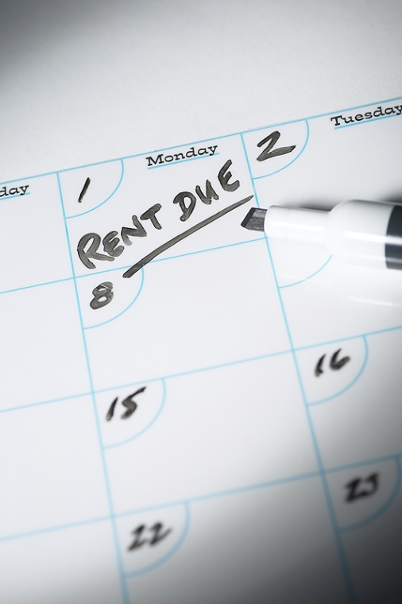
Budgeting Tools (continued)
We will focus on two:
  Monthly payment schedule
  Monthly payment calendar
These help you:
  Record income in advance
  Plan ahead to pay your bills

Slide 21
Monthly Payment Calendar
Month________________________________
Sunday | Monday | Tuesday | Wednesday | Thursday | Friday | Saturday
1 | 2 $400 paycheck $25 savings $150 car $25personal $30 insurance | 3 $16600 transportation | 4 | 5 $25 interest (income) | 6 $30 cell phone | 7
8 | 9 | 10 | 11 | 12 | 13 | 14
15 | 16 $40 phone bill | 17 | 18 | 19 | 20 $10 credit card/ loan | 21
22 | 23 | 24 | 25 | 26 | 27 | 28 $40 entertain-ment
29 | 30

Slide 22
Help! I Can’t Pay My Bills!
Scenario: You add up your bills and the total is $900, but your income is only $600….
What do you do?
Think about the bills that would be the most important!

Slide 23
Help! I Can’t Pay My Bills! (continued)
Pay your rent or mortgage
Pay high-interest loans
Talk to your creditors
Pay necessary household expenses
If you have to choose, think of major obligations first:

Slide 24
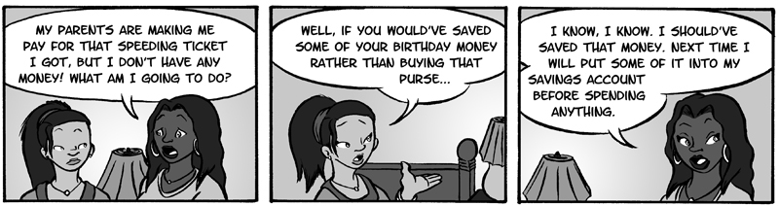
CONCLUSION: To make a Budget or to NOT Make a Budget?

Slide 25

Setting Financial Goals
Congratulations! You have completed the Setting Financial Goals module. You have learned:
How to track what you spend each day
How to prepare a personal budget to estimate monthly income and expenses
Ways to decrease spending and increase income
About tools for better money management

