Slide 1
Concentrations of Solutions

Slide 2
Concentration
Amount of solute dissolved in a given amount of solvent
Describing Concentration
ppm, ppb - water contaminants
molarity – moles of solute/L of solution
molality – moles of solute/kg of solvent
% by volume - rubbing alcohol
% by mass - medicated creams

Slide 3
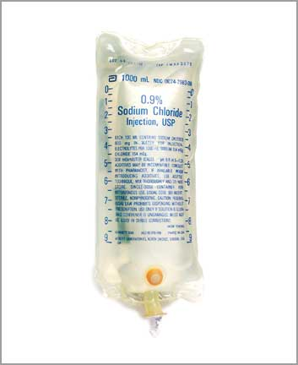
Molarity
IV solution contains 0.90g NaCl in exactly 100mL of solution. What is the molarity of the solution?
M=moles/Liter

Slide 4
Molality
Find the molality of a solution containing 75 g of MgCl₂ in 250 mL of water.
75 g MgCl₂
1 mol MgCl₂
95.21 g MgCl₂
0.25 kg water
= 3.2m MgCl₂

Slide 5
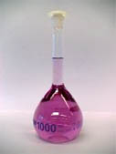
Dilutions
Dilution: reduces the number of moles of solute per unit volume, but the total number of moles of solute in solution doesn’t change.
M₁V₁=M₂V₂

Slide 6
Dilution Problem
How many mL of water are needed to prepare 100.0 mL of 0.400M MgSO₄ from 2.00M MgSO₄?
M₁V₁=M₂V₂
M₁= 2.00 M V₁ = ?
M₂ = 0.400M V₂ = 100.0 mL
(2.00M)V₂ = (0.400M)(100.0mL)
V₂ = 20.0mL

Slide 7
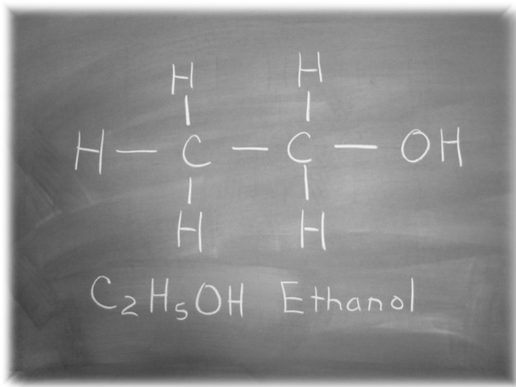
Percent Solutions
Percent by volume
What is the %v/v of ethanol in the final solution when 85 mL of ethanol is diluted to a volume of 250 mL of water?

Slide 8
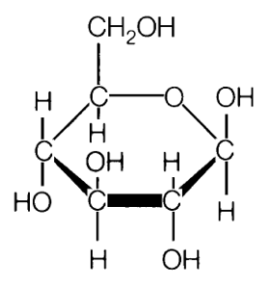
Percent by Mass
Suppose you want 2000g of a solution of glucose in water that has 2.8% (m/m) concentration. How much glucose should you use?

