Slide 1
Colligative Properties of Solutions

Slide 2
Colligative Properties
A property that depends only upon the number of solute particles, and not upon their identity
Vapor-Pressure Lowering
Boiling Point Elevation
Freezing Point Depression

Slide 3
Vapor Pressure
A solution with nonvolatile solute has a lower vapor pressure than the pure solvent
Decrease in a solution’s vapor pressure is proportional to the # of solute particles in solutions
Example 0.10M solute in 1000g H₂0
glucose → glucose (1 particle)
NaCl → Na+Cl (2 particles) → 2x the effect
CaCl₂ → Ca+Cl+Cl (3 particles) → 3x the effect

Slide 4
FP depression and BP elevation
Freezing Point Depression (Δt_{f})
f.p. of a solution is lower than f.p. of the pure solvent
magnitude of the fp depression is proportional to the number of solute particles
Solute particles disrupts the formation of the solid
Boiling Point Elevation (Δt_{b})
b.p. of a solution is higher than b.p. of the pure solvent
magnitude of the bp elevation is proportional to the number of solute particles

Slide 5
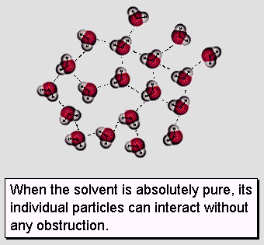
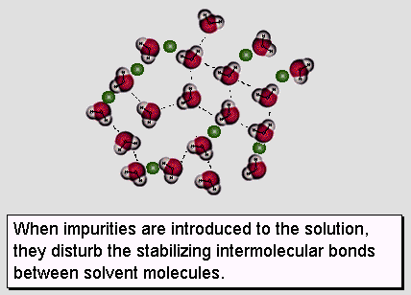
Freezing Point Depression

Slide 6
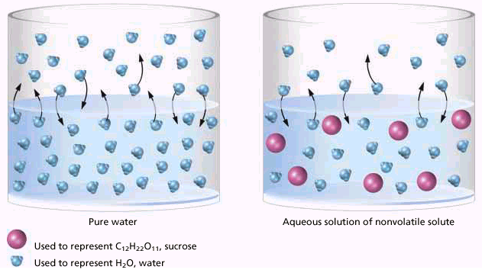
Boiling Point Elevation
Solute particles weaken IMF of solvent

Slide 7
Applications
salting icy roads
making ice cream
antifreeze
cars (-64°C to 136°C)

Slide 8
Mole Fraction
Ratio of the moles of that solute to the total number of moles of solvent and solute
Moles of ethylene glycol (n_{EG}) is 1.25 mol EG
Moles of water (n_{H20}) = 4.00 mol H₂0

Slide 9
FP and BP Calculations
ΔT_{f} = K_{f}mn ΔT_{b}=K_{b}mn
K = constant dependent on the solvent (ºC/m)
m = molality
n = number of particles
What is the boiling point of a 1.50m NaCl soln?
m = 1.50 m n=2 (Na+Cl) K= 0.512ºC/m
ΔT_{b}= (0.512ºC/m)(1.50m)(2)=1.54
T_{b} = 101.54ºC

