Slide 1
Chemical Bonding

Slide 2
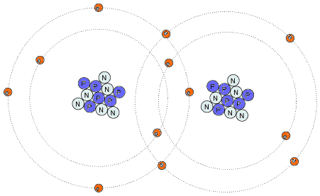
Chemical Bond
attractive forces between 2 atoms
overcomes the repulsion of 2 positively charged nuclei
Lewis Symbols
represents atoms using the element symbol and valence electrons as dots
only valence electrons participate in bonding

Slide 3
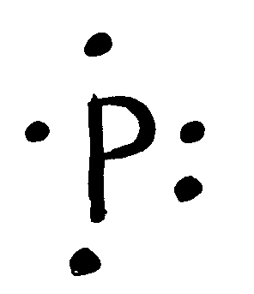
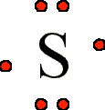
Lewis Symbols
Each “side” of the symbol represents an atomic orbital, which may hold up to two electrons
Place 1 dot on each side until 4 dots are around the symbol
Add a second dot to each side
# of dots = # of valence electrons
Each unpaired dot can form a chemical bond

Slide 4
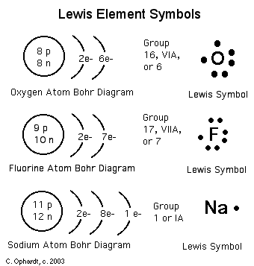

Slide 5
Let’s Try Some:
Na C Pb
Mg F Ne
Cl⁻ Ca²⁺ N³⁻

Slide 6
Bonding and Nomenclature

Slide 7
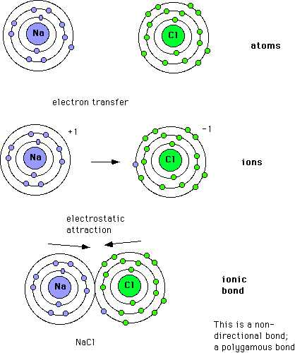
Ionic Compounds
Transfer of an electron
Metal and nonmetal
Cation and anion
Electrically neutral
Each atom achieves a “Noble Gas” configuration

Slide 8
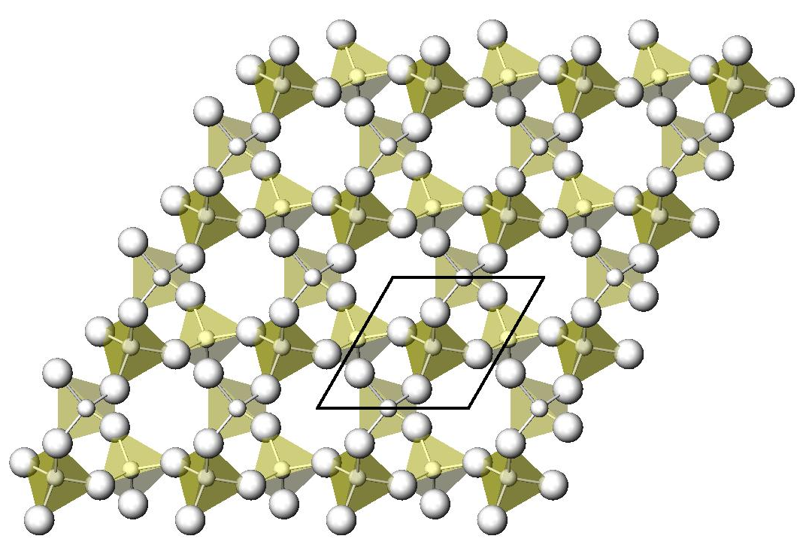
Formula Unit
Chemical formula: represents the kinds and numbers of elements in a compound
NaCl
Doesn’t represent a single discrete unit
Formula Unit: the lowest number ratio of ions in an ionic compound
NaCl: 1 Na and 1 Cl
Mg₂Cl: 2 Mg and 1 Cl
AlBr₃: 1 Al and 3 Br

Slide 9
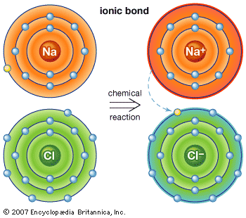
Predicating Formulas for Ionic Compounds
Determine the charge of each element
Determine the ratio needed to have a neutral atom
Write the formula

Slide 10
Let’s Try Some:
1. sodium and oxygen
2. lithium and bromine
3. aluminum and oxygen
4. barium and fluorine

Slide 11
Let’s Try Some:
1. sodium and oxygen: Na₂O
2. lithium and bromine: LiBr
3. aluminum and oxygen: Al₂O₃
4. barium and fluorine: BaF₂

Slide 12
Naming Ionic Compounds
1st name the cation then the anion
Cation: name doesn’t change
Anion: suffix become –ide
Chlorine → Chloride

Slide 13
Ionic Compounds: Name the Following
NaCl
Na₂O
Li₂S
AlBr₃
CaO

Slide 14
Ionic Compounds: Name the Following
NaCl sodium chloride
Na₂O sodium oxide
Li₂S lithium sulfide
AlBr₃ aluminum bromide
CaO calcium oxide

Slide 15
Transition Metals
cations have multiple ion charges
use a Roman numeral to give the charge following the name
Examples:
FeCl₃ is iron(III) chloride
FeCl₂ is iron(II) chloride
CuO is copper(II) oxide

Slide 16
Polyatomic ions
2 or more atoms bonded together with an overall positive or negative charge
Within the ion itself, the atoms are bonded using covalent bonds
Examples:
NH₄⁺ ammonium ion
SO₄²⁻ sulfate ion

Slide 17
Naming Polyatomic Compounds (p. 257)
NH₄Cl
BaSO₄
Fe(NO₃)₃
Cu(HCO₃)₃
Ca(OH)₂

Slide 18
Naming Polyatomic Compounds (p. 257)
NH₄Cl: ammonium chloride
BaSO₄: barium sulfate
Fe(NO₃)₃ : iron (III) nitrate
Cu(HCO₃)₃: copper (III) bicarbonate
Ca(OH)₂: calcium hydroxide

Slide 19
Writing Ionic Formulas from Compound’s Name
Writing Formulas of Ionic Compounds from the Name of the Compound
Determine the charge of each ion
Compound must be neutral
Example: barium chloride
barium is +2, chloride is -1
Formula is BaCl₂

Slide 20
Write the Formulas for the following ionic compounds:
sodium sulfate
ammonium sulfide
magnesium phosphate
chromium (II) sulfate

Slide 21
Write the Formulas for the following ionic compounds:
sodium sulfate:
ammonium sulfide
magnesium phosphate
chromium (II) sulfate

Slide 22
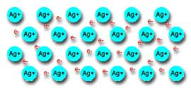
Bonding in Metals
Metallic Bonds: the attraction of free-floating valence electrons from the positively charge metal ions
Forces of attraction that hold metals together
valence electrons of metals → sea of electrons; electrons are mobile and drift freely
Crystalline Structure of Metals: metal atoms are arranged in very compact, orderly patterns

Slide 23
Alloys
mixtures composed of two or more elements, at least one of which is a metal
alloys are often superior to their component elements
brass: zinc and copper
sterling silver: silver and copper

Slide 24
Covalent COmpounds

Slide 25
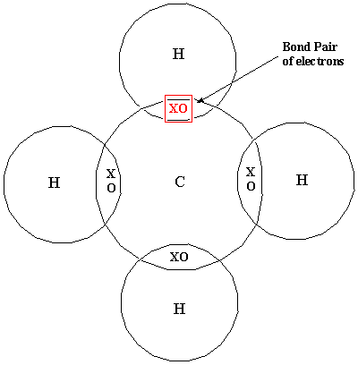
Covalent Bonds
Two nonmetal atoms share electrons
Form between atoms with similar tendencies to gain or lose electrons
Form bonds to obtain a full octet
Diatomic Elements
H₂, N₂, O₂, F₂, Cl₂, Br₂, I₂
The Magic Seven

Slide 26
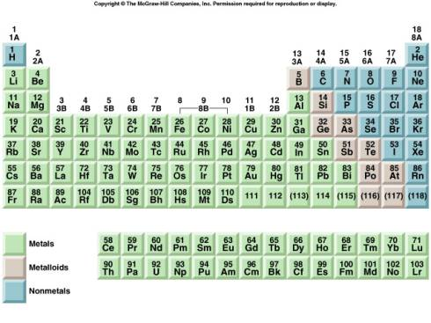
Diatomic Elements

Slide 27
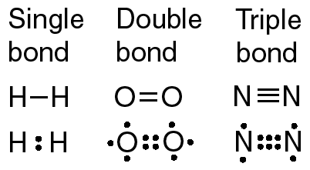
Types of Bonds
Single bond: share two electrons or 1 pair
H₂
Double bond: share four electrons or 2 pairs
O₂
Triple bond: share six electrons or 3 pairs
N₂
Unshared Pair: a lone pair or nonbonding pair

Slide 28
Bond Energies and Length
Bond dissociation energy - the energy required to break a bond
triple bond > double bond > single bond
Bond length - the distance separating the nuclei of two adjacent atoms
single bond > double bond > triple bond
Resonance: the structure that occurs when it is possible to draw two or more valid electron dot structures
the actual bonding of resonance structures is a hybrid of the possible structures

Slide 29
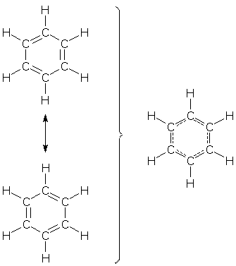
Bond Resonance

Slide 30
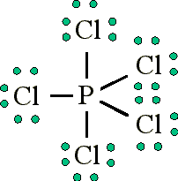
Exceptions to the Octet Rule
Odd number of electrons
NO₂
Expanded Octet: a few atoms expand the octet to include ten or twelve electrons
PCl₃ and PCl₅
SF₆
Less than an Octet
BeH₂
BF₃

Slide 31
Naming Covalent Compounds
Nonmetals
Molecules – covalently bonded compounds
Mono – 1 Di -2
Tri – 3 Tetra – 4
Penta – 5 Hexa -6
Hepta – 7 Octa – 8
Nona – 9 Deca- 10

Slide 32
Naming Covalent Compounds
The names of the elements are written in the order in which they appear in the formula
A prefix indicates the number of each kind of atom
1st element: if only one is present, no prefix is used
Last element: use the suffix –ide
Example: CO is carbon monoxide
The final vowel in a prefix is often dropped before a vowel in the stem name
Correct: monoxide
Not: monooxide

Slide 33
Name These Covalent Compounds
SiO₂:
N₂O₅:
CCl₄:
IF₇ :

Slide 34
Name These Covalent Compounds
SiO₂: Silicon Dioxide
N₂O₅: Dinitrogen Pentoxide
CCl₄: Carbon Tetrachloride
IF₇ : Iodine Heptafluoride

Slide 35
Writing Formulas of Covalent Compounds
Use the prefixes in the names to determine the subscripts for the elements
Examples:
nitrogen trichloride NCl₃
diphosphorus pentoxide P₂O₅
Some common names that are used:
H₂O – water NH₃ – ammonia
C₂H₅OH – ethanol C₆H₁₂O₆ - glucose

Slide 36
Provide Formulas for These Covalent Compounds
nitrogen monoxide
dinitrogen tetroxide
diphosphorus pentoxide
nitrogen trifluoride

Slide 37
Provide Formulas for These Covalent Compounds
nitrogen monoxide NO
dinitrogen tetroxide N₂O₄
diphosphorus pentoxide P₂O₅
nitrogen trifluoride NF₃

Slide 38
Properties of Ionic & Covalent Compounds

Slide 39
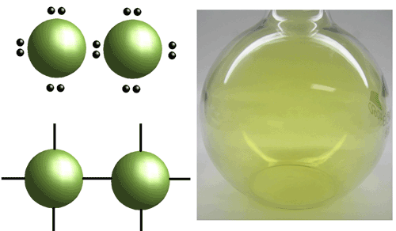
Properties of Ionic and Covalent Compounds
Physical State
Ionic compounds: solids
Covalent compounds: solids, liquids, and gases
Melting and Boiling Points
Ionic compounds: higher melting & boiling points
ionic bonds are stronger → more energy is needed to break bond
melt at several hundred ºC

Slide 40
Properties of Ionic and Covalent Compounds
Structure of Compounds in the Solid State
Ionic compounds: crystalline
Covalent compounds are crystalline or amorphous – having no regular structure

Slide 41
Properties of Ionic and Covalent Compounds
Solutions
Ionic compounds
dissolve in water
Ions dissociate or separate
Electrolytes - ions in solution conduct electricity
Covalent Molecules:
solids do not dissociate
Nonelectrolytes: do not conduct electricity

Slide 42
 | Ionic | Covalent
Composed of | Metal + nonmetal | 2 nonmetals
Electrons | Transferred | Shared
Physical state | Solid / crystal | Any / crystal OR amorphous
Dissociation | Yes, electrolytes | No, nonelectrolytes
Boiling/Melting | High | Low

Slide 43
Acids: molecular compound that produces H⁺ (hydrogen ions) in solution
Memorize these Acids
HCl | Hydrochloric acid
HBr | Hydrobromic acid
HI | Hydroiodic acid
H₂SO₄ | Surlfuric acid
HNO₃ | Nitric acid
HClO₄ | Perchoric acid
HC₂H₃O₂ | Acetic acid

Slide 44
Naming Acids
1. When the anion ends in –ide, the acid name begins with hydro- and the anion has the suffix –ic then acid.
chloride → hydrochloric acid
2. When the anion ends in –ite, the anion name has the suffix –ous then acid.
sulfite → sulfurous acid
3. When the anion ends in –ate, the anion name has the suffix –ic then acid.
nitrate → nitric acid

Slide 45
Molecular Structure

Slide 46
Drawing Lewis Structures on Molecules and Polyatomic Ions
Lewis Structure Guidelines
Use chemical symbols for the elements
Least electronegative atom: center
Hydrogen and halogens: outside
Carbon: chains of carbon-carbon covalent bonds
Determine the # of valence electrons for each atom
Find the total number of valence electrons
Polyatomic cations: subtract one e⁻ for every (+) charge
Polyatomic anions: add one e⁻ for every (-) charge

Slide 47
Connect the central atom to surrounding atoms using electron pairs
Complete octets of the atoms bonded to the central atom
Hydrogen: only 2 electrons
Electrons not involved in bonding are represented as lone pairs
Count the electrons in the diagram & compare to total from step 2

Slide 48
Carbon Dioxide
Draw the Lewis structure of carbon dioxide, CO₂
Arrange the atoms in their most probable order
C-O-O or O-C-O
Place the least electronegative atom, carbon, in the center, O-C-O
Find the number of valence electrons for each atom and the total for the compound
1 C atom x 4 valence electrons = 4 e⁻
2 O atoms x 6 valence electrons = 12 e⁻
16 e⁻ total

Slide 49
Use electron pairs to connect the C to each O with a single bond
O : C : O
Place electron pairs around the atoms
: O : C : O :
This satisfies the rule for the O atoms, but not for C
Redistribute the electrons moving 2 e⁻ from each O, placing them between
C:O → O::C::O
In this structure, the octet rule is satisfied
Four electrons in this arrangement signify a double bond
Recheck the electron distribution
8 electron pairs = 16 valence electrons, number counted at start
8 electrons around each atom, octet rule satisfied

Slide 50
Using the guidelines presented, write Lewis structures for the following:
H₂O
NH₃
CO₂
NH₄⁺
CO₃²⁻
N₂

Slide 51
Lewis Structures and Resonance
Actually, all bonds are the same length, so there’s no true double or triple bonds
the actual structure is an average the three Lewis structures
Resonance - two or more Lewis structures that contribute to the real structure

Slide 52
Exceptions to the Octet Rule
Incomplete octet - less than 8 e⁻ around an atom other than H
Let’s look at BeH₂
1 Be atom x 2 valence electrons = 2 e⁻
2 H atoms x 1 valence electrons = 2 e⁻
total 4 e⁻
Resulting Lewis structure:
H : Be : H or H – Be – H

Slide 53
Exceptions Continued
Odd electron - if there is an odd number of valence electrons, it is not possible to give every atom eight electrons
NO, nitric oxide
I t is impossible to pair all electrons as the compound contains an ODD number of valence electrons
Expanded octet - an element in the 3rd period or below may have 10 and 12 electrons around it
Expanded octet is the most common exception
Consider the Lewis structure of PF₅
Phosphorus is a third period element
1 P atom x 5 valence electrons = 5 e⁻
5 F atoms x 7 valence electrons = 35 e⁻
40 e⁻ total

Slide 54
Bonding Theories
Molecular Orbitals: when two atoms combine, their atomic orbitals combine
each atomic orbital can contain 2 electrons
Sigma Bonds (σ): 2 s atomic orbitals combine
Oval or oblong
Pi Bond (π): 2 p atomic orbitals overlap
Mirror image jelly beans split by the bond axis
Sigma bonds are stronger than Pi bonds

Slide 55
Hybrid Orbitals
Carbon: 2s²2p²
Draw the orbital diagram. How many lone electrons does it have?
Draw the Lewis dot structure? How many lone pairs does it have?
Why? 1-2s electron is moved up to the 2p orbital so that it can have 4 bonds and a full octet.
Are the bonds the same? Yes
They hybridize to form 4-sp³ orbitals
They extend further into space than s or p orbitals
Form 4 C-H sigma bonds, which are unusually strong covalent bonds

Slide 56
Hybridization and Double Bonds
C₂H₄: ethane
Draw the Lewis diagram → 4 single bonds and1 double bond
The C-H bonds are sp² from 1-2s and 2-2p atomic orbitals
The sp² orbitals are sigma bonds
The 3rd sp² orbital form a C-C sigma bond
The nonhybridized 2p carbon orbitals form 1-pi bond
In chemical reactions, a pi bond is more likely to break than a sigma

Slide 57
Molecular Geometry

Slide 58
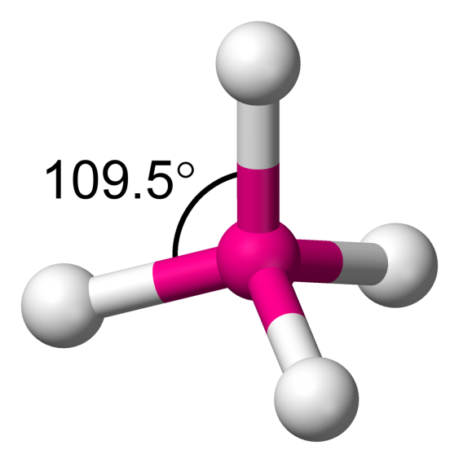
Molecular Geometry
VSEPR theory - Valance Shell Electron Pair Repulsion theory
covalent bonds
predicts a molecule’s shape
electrons around an atom arrange themselves to maximize their distance from each other to minimize electronic repulsion

Slide 59
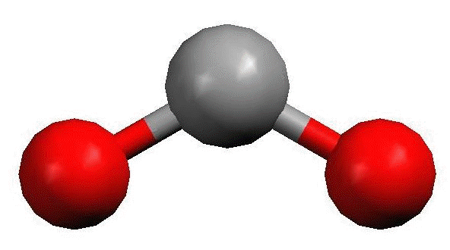
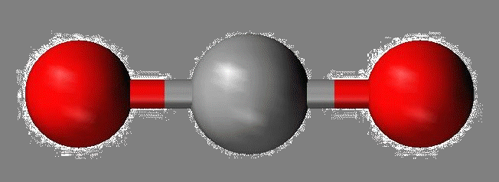
Molecular Geometry
Linear structure
2 single bonds or 2 double bonds; 0 lone pairs
bond angles of 180°
BeH₂ or CO₂
Bent or Angular
2 shared electron pairs & 2 lone pairs
104.5° bond angles
H₂O

Slide 60
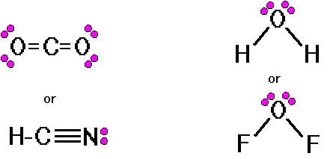
Linear and Bent Molecules

Slide 61
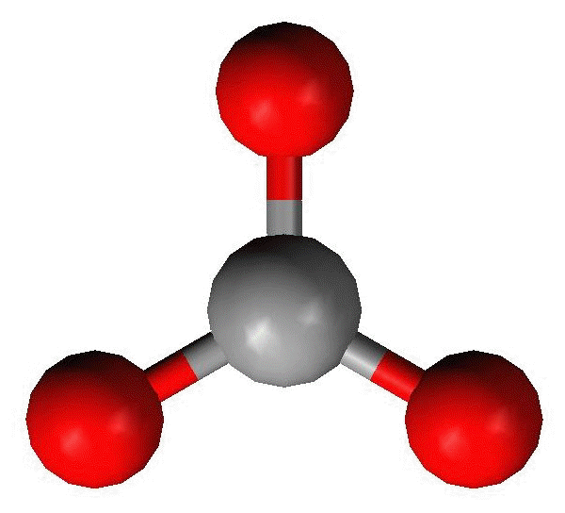
Molecular Geometry
Trigonal planar
3 single bonds or 2 single bonds & 1 double; 0 lone pairs
bond angles of 120°
BF₃, SO₃
Trigonal Pyramidal
3 shared electron pairs and 1 lone pair
107° angles
NH₃

Slide 62
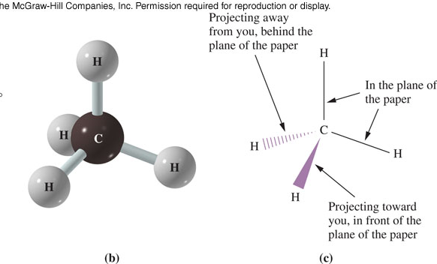
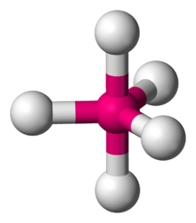
Molecular Geometry
Tetrahedron
4 shared electron and 0 lone pairs
Bond angle: 109.5°
CH₄
Trigonal Bipyramidal
5 atoms around the central atom
Bond angles: 90 º, 120 º, 180 º

Slide 63
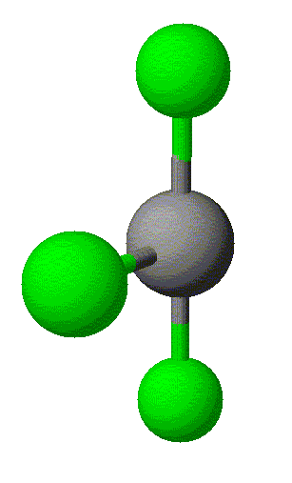
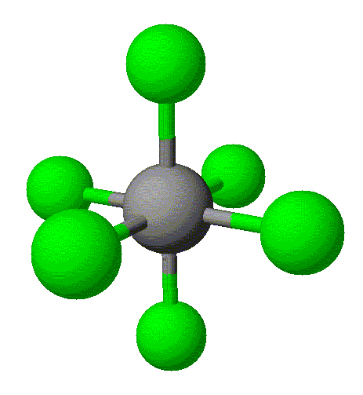
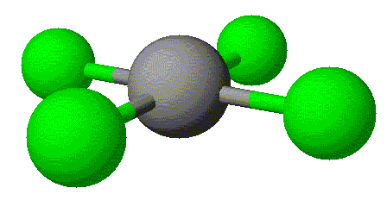
Molecular Geometry
T-shaped
3 atoms and 2 lone pairs
Bond angles: 90 º, 120 º, <180 º
Octahedral
6 atoms around the central atom
Bond angles: 90 º, 180 º
Square Planar
4 atoms and 2 lone pairs
Bond angles: 90º, 180º

Slide 64
Determine the Molecular Geometry
PCl₃
SO₂
PH₃
SiH₄
PCl₅
SF₆

Slide 65
Determine the Molecular Geometry
PCl₃
Trigonal pyramidal
SO₂
Bent
PH₃
Trigonal pyramidal
SiH₄
tetrahedral
PCl₅
Trigonal bipyramidal
SF₆
octahedral

Slide 66
Polarity

Slide 67
Polarity
Polar molecules
Molecules that are polar behave as a dipole (having two “poles” or ends)
One end is positively charged the other is negatively charged
Atoms in molecules, covalent bonds, share electrons, but don’t share them equally
Polar Bonds
The more electronegative atom will pull the electrons toward it
If the electrons are not shared equally → polar bond
Positive end of the bond, the less electronegative atom
Dipole: a molecule with two ends; positive and negative

Slide 68
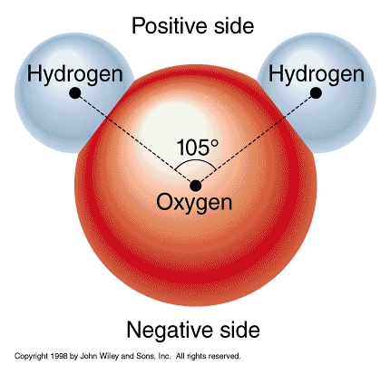
Polar Bond

Slide 69
Nonpolar Bonds
When electrons are shared equally
Bond between two of the same atom: N₂
A central atom with 4 identical species surrounding it: CH₄
A central atom with 3 identical species and no lone pairs; BH₃

Slide 70
Determine whether the following molecules are polar:
NH₃
O₂
BH₃
HF
BH₂F
CH₄
CO₂
H₂O
CH₃F

Slide 71
Determine whether the following molecules are polar:
NH₃:P
O₂: NP
BH₃: NP
HF: P
BH₂F: P
CH₄: NP
CO₂ : NP
H₂O: P
CH₃F: P

Slide 72
Intermolecular forces

Slide 73
Properties Based on Electronic Structure and Molecular Geometry
Intramolecular forces: attractive forces within molecules – chemical bonds
Intermolecular forces: attractive forces between molecules
Solubility - the maximum amount of solute that dissolves in a given amount of solvent at a specific temperature
“Like dissolves like”
Polar dissolves in polar; Nonpolar dissolves in nonpolar

Slide 74
Intermolecular Forces
Intermolecular attractions are weaker than either ionic or covalent bonds.
Van der Waals Forces: dipole interaction and dispersion forces
Dipole interactions: polar molecules are attracted to one another
Much weaker than ionic bonds

Slide 75
Dispersion Forces
when the moving electrons happen to be momentarily more on the side of the a molecule closest to a neighboring molecule, their electric force influences the neighboring molecule’s electrons to be momentarily more on the opposite side, this causes an attraction between the two molecules
Nonpolar molecules
Caused by the motion of electrons
Weakest intermolecular force
Increases as the number of electrons increase

Slide 76
Hydrogen bonds
hydrogen that is covalently bonded to a very electronegative atom is also weakly bonded to an unshared electron pair of another electronegative atom
H₂O, DNA

Slide 77
Water & Ammonia
δ⁻ end of NH₃, N, is attracted to δ⁺ end of H₂O molecule, H
δ⁺ end of NH₃, H, is attracted to δ⁻ end of H₂O molecules, O
The attractive forces, hydrogen bonds, distribute NH₃ molecules throughout H₂O, forming a homogeneous solution

Slide 78
Factors Influencing Boiling & Melting Points
Molecular mass
Larger molecules have higher m.p. and b.p. b/c it is more difficult to convert a larger mass to another phase
Polarity
Polar molecules have higher m.p. and b.p. than nonpolar molecules of similar molecular mass due to their stronger attractive force

