Slide 1
Cell Cycle and Cell Death

Slide 2
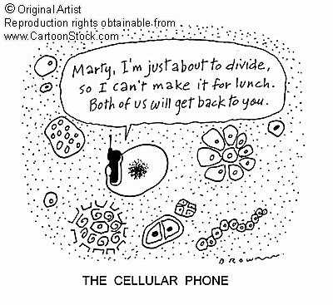
Cell Cycle
The series of changes that a cell undergoes from the time it forms unit it divides
Hormones can trigger cell division
Most cells only divided 40 to 60 times
Telomers (clock) structure that shortens with each division
When they reach a certain length, the cell no longer divides

Slide 3
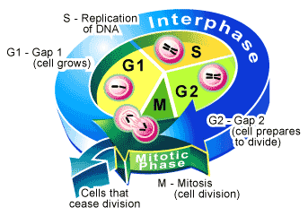
Interphase
Period of growth and duplication
Obtains nutrients
Manufacture new living material
Duplicates membranes, ribosomes, lysosomes, and mitochondria
Replicates genetic material
G1: duplicate structures
S: DNA replication
G2: duplicate structures

Slide 4
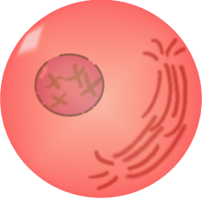
Mitosis and Cytokinesis
Mitosis: division of the nucleus
Prophase
chromosomes appear
2 sister chromatids attached to a centromere
nuclear envelope breaks down
centrioles move to opposite ends of the cell
Spindles made of microtublues forms between centrioles

Slide 5
Mitosis
Metaphase: chromosomes line up in the middle of the spindle fibers
Anaphase: sister chromatids are pulled to opposite ends of the cell
Telophase: chromatids reach centrioles
Chromatin or DNA unwinds
Nuclear envelope reforms
Micro =tubules disassemble

Slide 6
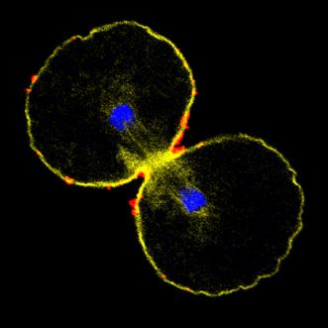
Cytokinesis
Division of the cytoplasm
Begins during anaphase
Cell membrane begins to constrict down the middle of the cell
Cell Pinches inward
Distributes half the organelles to each cell

Slide 7
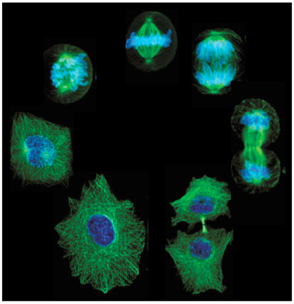
Cell Cycle

Slide 8
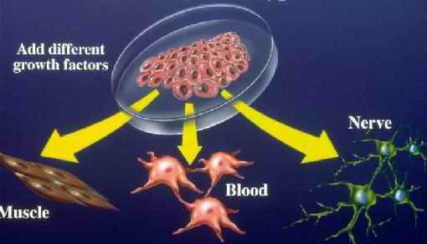
Cell Differentiation
Differentiation
After division, cell specialize to their function
Develop special structures
Begin to function specific ways
The DNA is identical between cells
The portion of DNA that is expressed is what determines its function
By birth, a human has more than 200 types of cells

Slide 9
Cell Death
Apoptosis: cell death
Normal part of development
In a fetus, carves away webbing between developing fingers and toes
Removes extra brain cells
Preserves only immune cells that recognize the body’s cell surface
Prevent autoimmune disease
Peels away sun burnt cell that could become cancerous

Slide 10
How Cells Die
It round up and bulges
Nuclear membrane breaks down
Chromatin condenses
Enzymes chop chromosomes into equal-sized pieces
Cell shatters into membrane enclosed fragments
Scavenger cells mop it up

Slide 11
