Slide 1
Atomic Structure

Slide 2
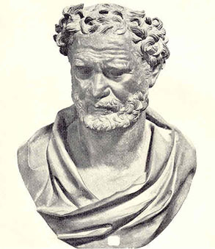
Atoms
Atom: smallest particle of an element that retains its identity in a chemical reaction
Democritus’s Atomic Philosophy (460-370 B.C.): atoms were indivisible and indestructible

Slide 3
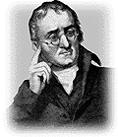
Dalton’s Atomic Theory
(1766-1844): studied ratios in which elements combine in chemical reactions
1- All elements are composed of tiny indivisible particles called atoms.
2- Atoms of the same element are identical. The atoms of one element are different from any other element.

Slide 4
Dalton’s Atomic Theory
3- Atoms of different elements can physically mix together or chemically combine in simple whole-number ratios to form compounds
4- Chemical reactions occur when atoms are separated, joined, or rearranged. Atoms of one element, however, are never changed into atoms of another element as a result of a chemical reaction.
Atoms are divisible & can change into different elements

Slide 5
J.J. Thomson
(1856-1940): the electron is a negatively charged particles
Cathode-Ray Tube Experiment: passed electric current through gases at low pressure sealed in glass tubes fitted at both end with metal disks, or electrodes. The anode was positively charged while the cathode was negatively charged.
Result: Cathode Ray: glowing beam that traveled from the cathode to the anode.
Ray can be deflected by a magnet or charged metal plates.
Because Thomas knew opposites attract, he hypothesized the cathode ray was a stream of tiny, negative particles moving at high speed, or electrons.

Slide 6
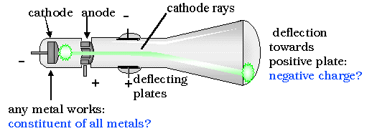
Cathode Ray Tube

Slide 7
Others
Robert A. Millikan (1868-1953): calculated the mass of an electron
Electron: 1 negative charge and its mass is 1/1840 the mass of a hydrogen atom
Eugene Goldstein (1850-1930) observed the cathode ray tube and saw rays traveling in the opposite direction.
Protons: positive particles; mass 1840 x an electron
James Chadwick (1891-1974) Neutrons: no charge mass ~ protons

Slide 8
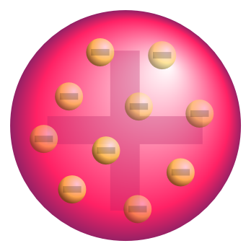
Atomic Structure
J.J. Thomson: Plum Pudding Model
Electrons were evenly distributed throughout an atom filled uniformly with positively charged material.
raisin in dough

Slide 9
Rutherford’s Gold-Foil Experiment (1911)
used alpha (α) particle: helium atoms that have lost its two electron and has a 2+ charge
a narrow beam of alpha particles were directed at a very thin sheet of gold foil
the α particles should have passed easily through the gold with only a slight deflection due to the positive charge throughout
the particles actually passed straight through without deflection
a small portion bounced off the gold at very large angles, some even straight toward the source

Slide 10
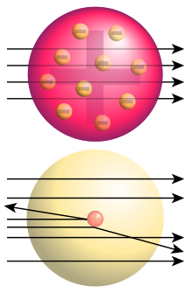
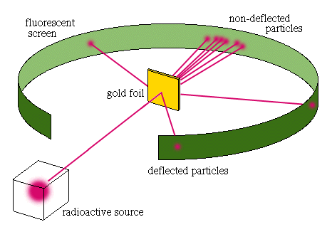
Rutherford’s Gold-Foil Experiment (1911)

Slide 11
Rutherford’s Model
The Nuclear Atom: the atom is mostly empty space → the lack of deflection
all the positive charge and almost all the mass are concentrated in a small region that has enough positive charge to account for the great deflection of some of the alpha particles
Nucleus: tiny, central core of an atom that is composed of neutrons and protons
Electron are distributed around the nucleus and occupy almost all the volume of the atom
Size of Atom to Nucleus → Football Stadium: Marble

Slide 12
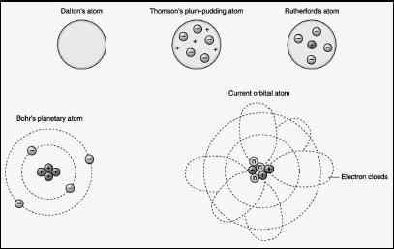

Slide 13
Atomic Number, Atomic Mass, and Isotopes

Slide 14
Important Numbers
Atomic Number (Z): # of protons
the number of protons identifies the element
change the number of protons → change the element
Mass Number (A): (# of protons) + (# of neutrons)
Atomic Charge (C): (# of protons) – (# of electrons

Slide 15
Isotopes
same element, but different masses
same # of protons
different # of neutrons
Hydrogen (H-1), Deuterium (H-2), Tritium (H-3)
Atomic Mass: a weighted average mass of the atoms in a naturally occurring sample of the element.

Slide 16
Isotopic Calculations
atomic mass: weighted average of the masses of all the isotopes
Ex: Chlorine
What is the mass?: 35.45
Chlorine consists of chlorine-35 and chlorine-37 in a 3:1 ratio

Slide 17
Ex: Chlorine
What is the mass?: 35.45
Chlorine consists of chlorine-35 and chlorine-37 in a 3:1 ratio
Calculate the atomic mass of naturally occurring chlorine if 75.77% of chlorine atoms are chlorine-35 and 24.23% of chlorine atoms are chlorine-37

Slide 18
Chlorine
Step 1: convert the percentage to a decimal fraction:
75.77% → 0.7577 chlorine-35
24.23% → 0.2423 chlorine-37
Step 2: multiply the decimal fraction by the mass of that isotope:
chlorine-35: 0.7577 x 35.00 amu = 26.52 amu
chlorine-37: 0.2423 x 37.00 amu = 8.965 amu
Step 3: add the partial weights:
26.52 amu + 8.965 amu = 35.49 amu

Slide 19
Atomic Mass Determination
Nitrogen consists of two naturally occurring isotopes
99.63% nitrogen-14 with a mass of 14.003 amu
0.37% nitrogen-15 with a mass of 15.000 amu
What is the atomic mass of nitrogen?

Slide 20
Answer
Step 1:99.63% → 0.9963 N-14 0.37% → 0.0037 N-15
Step 2:0.9963 x 14.003 amu = 13.95 amu 0.0037 x 15.000 amu = 0.0555 amu
Step 3: 13.95 + 0.0555 = 14.01 amu

Slide 21
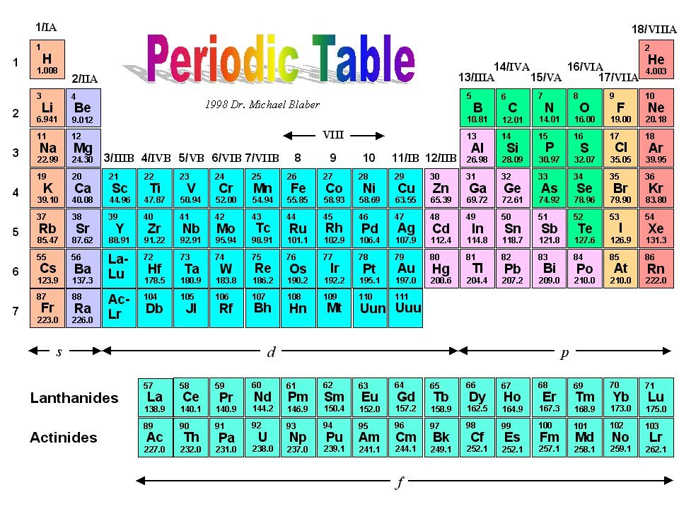
Periodic Table
Period: horizontal row
Group (Family): vertical row
similar chemical and physical properties

