Slide 1
Dorm vs. Apartments

Slide 2
Why Live On Campus?
Students who live on campus statistically achieve higher academic success, are more engaged with faculty, more connected with campus, more likely to return for a second year, and go on to graduate.

Slide 3
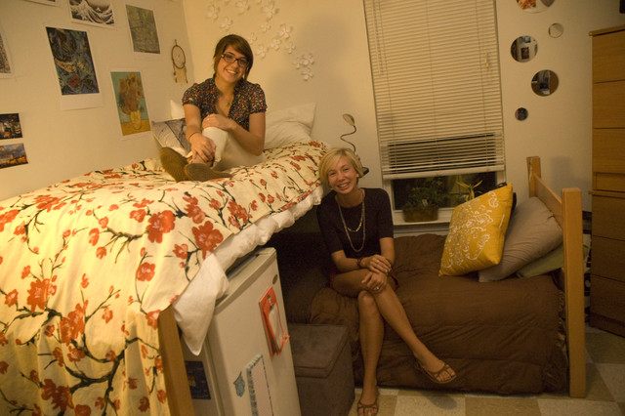
Why Live On Campus?
Develop time management skills
Living with peers and forming new friendships

Slide 4
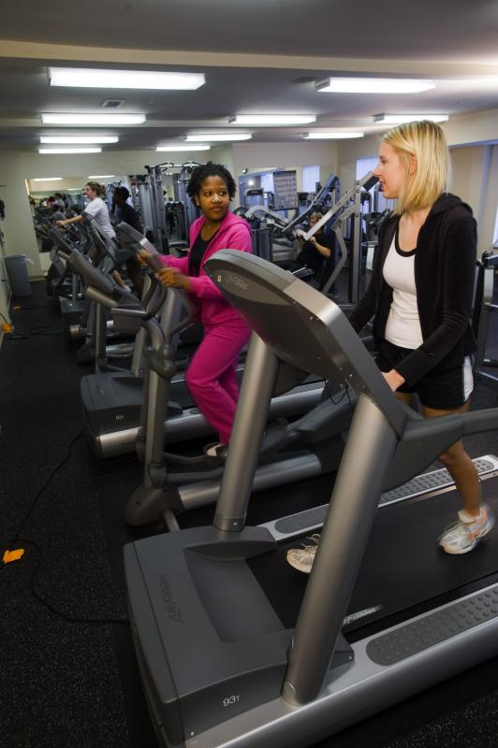
Why Live On Campus?
Students are in the classroom only 16 of the 168 hours in a week
Getting involved outside the classroom is important

Slide 5
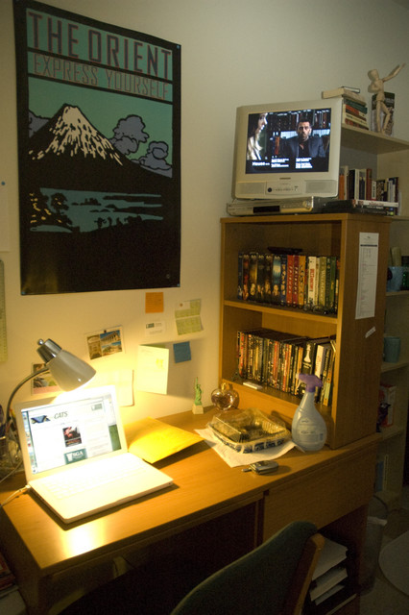
Service and Convenience
One bill that includes:
All utilities (no caps)
Local telephone services
High-speed Internet
Expanded cable television

Slide 6
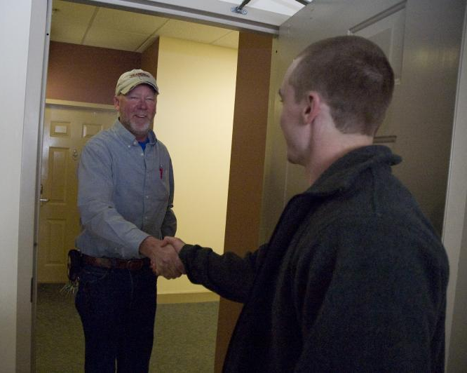
Service and Convenience
Prompt maintenance response
No need to hunt for parking
Laundry
$1.25 to wash, $0.50 per cycle to dry
High-efficiency washers

Slide 7
Safety and Security
Emergency notification buttons
Blue light emergency phones
Cameras
Public Safety

Slide 8
Living With a Roommate
Make plans over the summer, determine what to bring to avoid duplication
Communicate with each other
Be careful judging a roommate based upon Facebook or MySpace
Treasure diversity and learn from it

Slide 9
Living With a Roommate
Utilize the roommate/suitemate agreement
(available online)
The building staff is there to a assist if needed

Slide 10
Living off Campus
YOUR FIRSTQUESTIONS
How much rent can you afford?
Do you need a roommate?
Where do you want to live?
What are your housing needs?

Slide 11
YOUR ROOMMATES
“The Good”
Share expenses
Share housework
Larger living space
Not being alone
“The Bad”
No privacy
Roommate may run out of money
Personal possessions/food issues
You may not get along

Slide 12
YOUR ROOMMATE QUESTIONS
Are you neat or messy?
Do you pay bills on time?
How late or early do you go to bed?
Do you have a pet?
Can you agree on visits from friends,
study hours, grocery shopping, etc?
Meet in a public place and interview possible roommates.
You and your roommate should be well-matched.
Use a roommate contract.

Slide 13
YOUR NEEDS
An apartment, a house, or a rented room?
How many bedrooms and bathrooms?
Near a bus route or close to campus?
Upstairs or downstairs apartment; furnished or unfurnished?
What amenities, (dishwasher, central heat and air, microwave, washer and dryer)?
Pets?

Slide 14
YOUR LEASE
READ THE LEASE!
Amount of rent?
Length of lease?
Furnished or unfurnished?
Appliances? Is there a laundry mat on site?
Utilities (electricity, gas, cable, water, trash, internet)?
Lease automatically renewed?
Ask around to see if others have been happy living there.

Slide 15
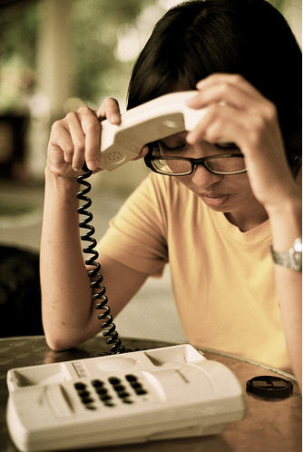
Do you get the security deposit back when you move out?
If two or more people sign the lease, what happens if one person moves out?
Are there penalty fees for moving out early?
Who do you call for repairs? How long
will it take to be fixed?

Slide 16
YOUR MOVE-IN
Do a walk-through with the landlord.
Is it clean? Is anything broken? Do the locks work?
Write down problems and give to landlord. Date and sign. (keep a copy)
Take dated pictures of each room before you move in and before you move out.

Slide 17
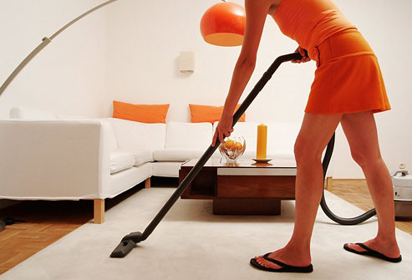
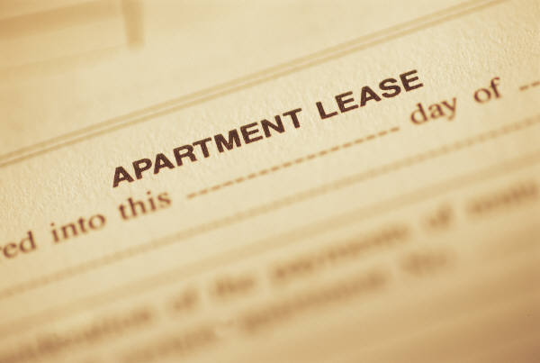
YOUR PLACE
Keep your home clean and in
good condition.
Pay rent by due date.
Don’t allow other people to
live there if their name is not on the lease.
The lease is a legal document. By signing it, you agree to obey its rules. Be sure to keep a copy.

Slide 18
YOUR MOVE-OUT
Consult your lease and give required notice.
Leave the property in the same or better condition as when you moved in.
Do a walk-through with your landlord to check for any damages.
Use the dated photos you took when moving in as documentation.

Slide 19
Being a Good Citizen
YOU are responsible for your own safety.
Know emergency contact information
Lock your doors and windows
Don’t travel alone, especially at night
Report any crime by calling 911
Never use a basement or attic as a bedroom, these are traps in a fire.

Slide 20
Fire
80% of student fatalities due to fire occur in off-campus housing.
Know the location and proper use of fire extinguishers.
By law your landlord must provide fire alarms but you must test and maintain them.

Slide 21
Fire Safety Check-list
Smoke Alarms
alarms are clean and in good working condition
alarms are tested once a week
alarms are installed in every bedroom, the kitchen, the attic, the basement, and on each floor of the building

Slide 22
Fire Safety Check-list
Kitchen
there is a fire extinguisher in the immediate area and you are familiar with its operation
flammable materials are away from the stove and other heating elements
you know how to work all cooking appliances
the cooking areas are clean of grease

Slide 23
Fire Safety Check-list
Electrical
No signs of frayed, exposed, burnt or otherwise damaged insulation and/or wiring
outlets and surge protectors are not overloaded
extension cords are only used temporarily and are capable of handling the required current
outlet plates adequately cover all wiring and are completely intact

Slide 24
Fire Safety Check-list
Exits
emergency exits are easily accessible and unobstructed
exit doors are operable from inside without a key
escape windows can easily be opened
there is an evacuation plan for each room
Living Spaces
Smoke detectors are installed in each room
Flammable items are at least 3 ft. away from heat sources

Slide 25
Unreasonable noise prohibited.
The creation of any unreasonable noise is prohibited. Unreasonable noise shall be any excessive or unusually loud sound which either annoys, disturbs, injures or endangers the comfort, repose, health, peace or safety of a reasonable person of normal sensibilities.

Slide 26
Examples of “Unreasonable Noises”
Vehicles: horns, loud engines, broken mufflers, etc.
Interference with activity: schools, institutions, places of worship, businesses, etc.
Use of loud tools, machinery equipment, etc, is prohibited 9pm-7am.
Screaming, parties, singing, social gatherings, animals/pets, etc.
No loud instruments (like drums), sound amplifiers, loud speakers, radio/stereo, television.
*Sounds should not be heard inside of any dwelling
that is across property boundaries*

Slide 27
Being a Good Tenant
As a tenant you have many rights as well as responsibilities.
It is important you are familiar with both ends of the spectrum-know your rights as a tenant but also making sure you are fulfilling your responsibilities to your landlord.

Slide 28
Common Things to Look Out For
You are entitled to your privacy. Before entry, the landlord must provide you with advanced notice, usually at least 24 hours in advance and during reasonable hours.
It is illegal for a landlord to rent you a room in a basement or an attic unless equipped with a fire escape. Additionally, there must be a fire alarm in each bedroom.
Learn the difference between damage and “normal wear and tear”.

Slide 29
Landlords
The relationship between you and your landlord is business first.
Get everything in writing and keep copies of all correspondences.
This ensure you can hold your landlord accountable for things like repairs.

Slide 30
Renter’s Insurance
It is CHEAP; as little as $12/month
It can cover:
Stolen belongings (from your car as well as your home
Property damaged in a fire
Liability claims (your dog bites someone, someone falls in your home)

Slide 31
Tenant’s Responsibilities
Keep any space you use clean and in good condition.
Maintain the smoke detector, fire extinguisher and carbon monoxide detector.
Be respectful of the property, your landlord, your room/housemates and the neighbors.
Notify the landlord if you will be away for an extended period of time. You must still pay rent while away.
Repair any damage occurring to the apartment you or your guests have caused. Notify the landlord of such damages when the occur.

Slide 32
Tenant’s Responsibilities
Give the landlord permission to enter the apartment at reasonable times and with advance notice (24 hours is common) to inspect or to make necessary repairs.
Know your lease agreement for the terms of moving out and return the key promptly thereafter.
Do not move additional people in without landlord approval.
Never sneak in a pet. It violates the terms of the rental agreement and isn’t fair to the animal.
Immediately notify the landlord if the apartment needs repair with a phone call and in writing.
Pay the rent on time. Failure to pay rent on time may result in late fees and can be the basis for eviction.

Slide 33
Money
Create a budget:
1. Gather every financial statement you can—the more information you have concerning your income and expenses the better.
2. Record all sources of income you have, remember to account for taxes.
3. Create a list of monthly expenses (everything from tuition and grocery costs to movie tickets and cell phone bills).

Slide 34
Money
4. Break expenses into two categories: fixed and variable. Fixed expenses are generally the same and can’t be changed from month to month (ex: payment plan for tuition, car insurance). Variable expenses can change from month to month (ex: entertainment costs, ordering food).
5. Total your monthly income and your monthly expenses.
6. Adjust expenses as necessary to make sure they fall within your means. Usually you can cut some variable expenses—these are more likely to be the things that you waste money on.
7. Review your budget monthly to make sure your actual expenses match your estimates and edit as needed.

Slide 35
Being a Good Neighbor
Replace anything that belongs to your neighbor that you, your friends, or your pets break, dirty, or ruin.
Interact with and learn from neighbors who have different cultural backgrounds from your own.
Minimize the noise produced from your property especially at night and on weekdays.

Slide 36
Planning a Get Together
Make sure cars are parked in appropriate areas.
Let your neighbors know when you are planning something and find out their concerns. Give them your phone number so they can call you (before they call the police) if it gets too loud.
If alcohol is present, make sure everyone can legally drink. Serve food and make non-alcoholic drinks available. If people under 21 are present and drinking, you may be held legally responsible and arrested.

Slide 37
Planning a Get Together
Throughout the event go outside and check how loud it is. If you cross your property line and can hear noise, by law, it is too loud.
Discourage guests and friends from wandering away from your apartment/house.
Clean up any mess after your get together and generally maintain your property.

Slide 38
Being a Good Student
Remember that ultimately you are still here for your education.
But also keep in mind that ALL student services are still available to you:
Counseling Center
Gym
Health Center
Meal Plans
Career Resource Center

