Slide 1

Cleaning to Maintain a Healthy Home
Steps to a Healthy Home Series
Educational programs of the Texas A&M AgriLife Extension Service are open to all people without regard to race, color, sex, disability, religion, age, or national origin.
The Texas A&M University System, U.S. Department of Agriculture, and the County Commissioners Courts of Texas Cooperating

Slide 2

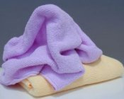
Cleaning
Regular housecleaning C it’s essential to good health.
Regular cleaning of surfaces in the home removes dirt and food particles on which pollutants can grow.
Notes:
Regular housecleaning is essential to good health.
Regular cleaning of surfaces in the home removes dirt and food particles on which pollutants can grow.

Slide 3
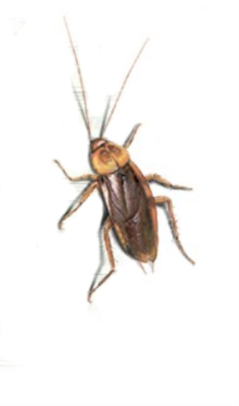
Household Pollutants to Control
Germs, bacteria
Animal hair and dander
Dust mites
Pollen
Mold and mildew
Pests (cockroaches, ants, mice, etc.)
Notes:
This slide shows a listing of some of the common pollutants found in households. They can be greatly reduced by regular cleaning.

Slide 4
Reasons to Clean
Germs can be transferred from inanimate surfaces to hands and vice-versa.
Some germs can live on dry surfaces (such as toys) for several hours and moist surfaces (like bathroom sinks) for up to three days.
Salmonella can survive freezing and can survive on dry surfaces for at least 24 hours.
The average kitchen dishcloth can contain 4 billion living germs.
Cockroach and dust mite droppings cause asthma attacks in some people.
Mold can cause allergic reactions or trigger asthma attacks.
Notes:
Germs can enter our bodies through the mouth, nose, eyes, and breaks in the skin without our even knowing we've been infected.
Americans spend about $5 billion each year on their colds, about $3 billion on doctors’ visits, and $2 billion on treatments.
An estimated 60 million days of school and 50 million days of work are lost annually because of the common cold.
Some 5.5 million visits to doctors’ offices each year are due to skin infections.
Since most people spend at least half of their lives inside their homes, it only makes sense that we work to make that air as healthy as possible.

Slide 5
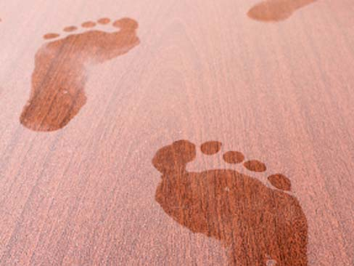
Cleaning for a Healthier Home
Clean and disinfected surface areas are a key to a healthy home.
Household cleaning products that contain an active antibacterial or antimicrobial ingredient provide extra protection against pollutants, including those that may cause disease.
Notes:
Break your cleaning into small tasks. Spread it out over several days instead of doing it all at once.
Household cleaning products that contain an active antibacterial or antimicrobial ingredient provide extra protection against pollutants, including those that may cause disease.
The words antibacterial and antimicrobial are often used interchangeably. Strictly speaking, however, antimicrobial means activity against a wide variety of microorganisms, while antibacterial refers to activity against bacteria.
Together with good cleaning habits and practices, these products play an important role in helping to prevent germs from spreading.

Slide 6
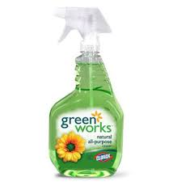
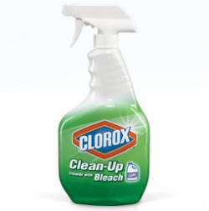
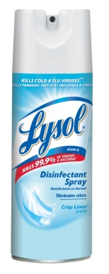
Cleaning Products
Disinfectants and disinfectant cleaners are the only products that kill germs
Household cleaning products intended to kill germs on inanimate surfaces must carry an EPA registration number on their label.
Notes:
Depending on their active ingredients and specific formulation, these products may kill a wide variety of microorganisms that can live on household surfaces, such as foodborne bacteria like Salmonella; the cold virus; and fungus that causes athlete’s foot. Household cleaning products designed to kill germs on surfaces have been available for more than 100 years. They are regulated by the U.S. Environmental Protection Agency (EPA).

Slide 7
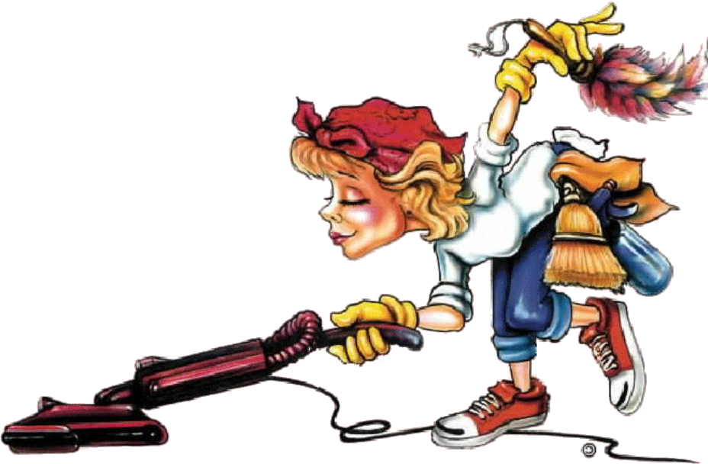
Getting Started – Make a Plan
Clean kitchen daily
Clean bedrooms weekly
Clean bathrooms 1-2 times a week
Vacuum & dust at least once a week
Control clutter daily
Discard quarterly

Slide 8
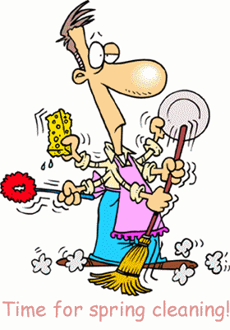
Cleaning Plan
Break your cleaning into small tasks.
Spread it out over several days instead of doing it all at once.
Involve all family members in the cleaning.
Clean one room at a time.

Slide 9
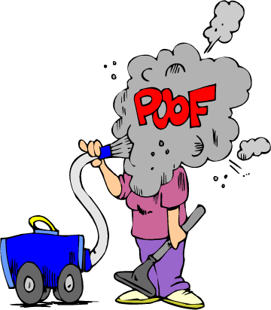
Make a Plan for Cleaning in Each Room
Clean out clutter
Clean from top to bottom
Sweep
Dust
Vacuum

Slide 10
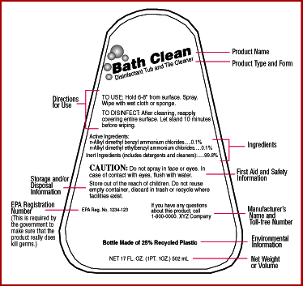
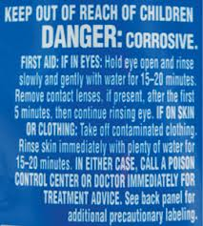
Cleaning Product Labels
Read the label.
Follow the instructions.
Different products have
different instructions.

Slide 11
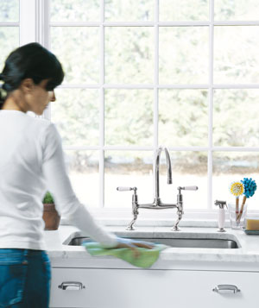
Kitchen
Clean up food spills, crumbs, and liquids on countertops and floors immediately.
Empty trash daily; clean and disinfect weekly.
Clean food and grease from the stove daily.
Wash and dry dishes as soon as possible after eating (or put in dishwasher).
Wash floors weekly.
Notes:
Cockroaches are attracted to food and moisture – including crumbs, cooking grease, and plain water. It is important to remove or tightly cover all food and water, especially at night when cockroaches are more active.
Cockroaches are often found around the refrigerator because of food spills and dampness. These spills and moisture also grow mold and mildew.

Slide 12
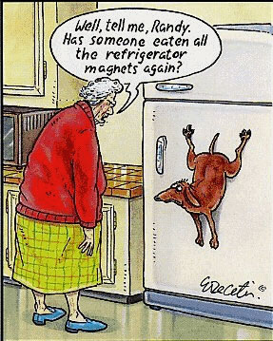
Kitchen
Keep the refrigerator clean and disinfected.
Clean the outside and inside of the refrigerator.
Clean the drip pan monthly.
Notes:
To clean your refrigerator, follow these steps:
Turn off the controls.
Unplug the refrigerator.
Remove the grille, and clean using a hand-dishwashing detergent or an all-purpose cleaner.
Remove the drip pan; then clean and disinfect it.
Clean mildew on the rubber stripping around the refrigerator door using a solution of ¾ cup bleach with 1 gallon water (or 3 tablespoon bleach and 1 quart water).
Clean the walls and shelves with an all-purpose cleaner or a solution of baking soda and water.
Wipe up any water in the inside drawers, and clean them regularly.
Clean up spills immediately, especially raw meat, poultry, and fish juices. Use a disinfectant (antibacterial) cleaner.

Slide 13
Bathroom
Keep shower doors and curtains open after use to allow air circulation.
Shake water from curtains, and squeegee water from the shower walls and door.
Wipe up spills around shower or tub.
Use an exhaust fan to remove moisture in the air.
Regularly check for and repair leaks.

Slide 14
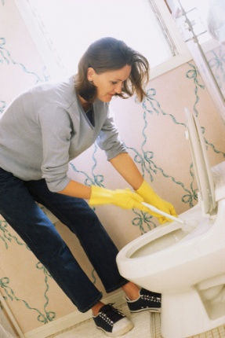
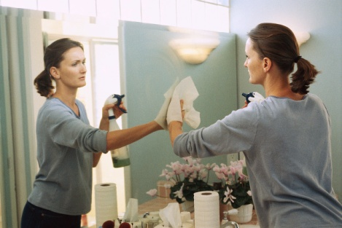
Bathroom
Sanitize and disinfect toilets.
Wash rugs weekly.
Hang towels and wet items to dry, and launder at least weekly.
Sanitize and disinfect sinks weekly.
Wash shower curtains.

Slide 15
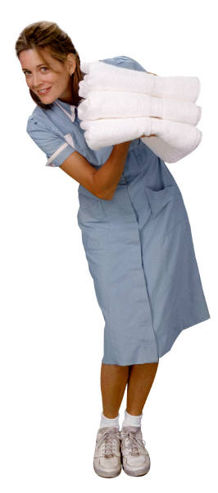
Bedroom
Wash bed sheets weekly in hot water, and dry them in a hot dryer.
Wash pillows 4 times a year (replace annually).
Wash blankets, comforters, and mattress pads monthly.
Vacuum weekly, or damp mop hard-
surface floors weekly.
Dust furniture weekly.
Notes:
Dust mites in the bedroom are a trigger for people with allergies and asthma. Every home has dust mites. You can’t see them. They feed on invisible skin flakes in pillows, bedding, upholstery, and carpeting. You can control them by keeping bedding clean and by controlling dust.
If someone in the family has allergies or asthma, use special dust mite-proof covers to keep dust mites from going through pillows and mattresses. They’re sometimes called “allergen-impermeable” covers. Wipe the covers with a damp cloth every week. If you don’t use covers, wash pillows at least 4 times a year, and replace them every year.
If a family member has allergies or asthma, it is better if you don’t use carpet in their bedroom. Use linoleum, vinyl, tile, or wood flooring and washable area rugs. Wash the rugs once a week.
If you have carpet in the bedroom, vacuum at least once a week. If you have pets in the bedroom, vacuum more frequently. If you have hard-surface floors, wet mop weekly.
Dust furniture weekly, using a dusting product or a special cloth that attracts dust (a dry cloth spreads dust around).
Wipe blinds weekly with a clean, damp cloth. Wash curtains monthly. If you have drapes, vacuum them weekly.
Keep closet doors closed.

Slide 16
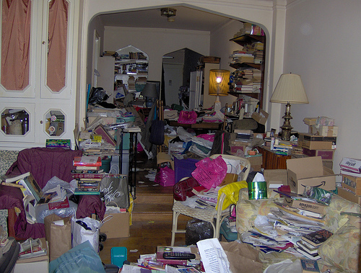
Reduce Clutter
Clutter make cleaning more difficult.
Clutter creates more surfaces that must be dusted.
Clutter causes chaos.

Slide 17
Tips for Vacuuming
Use vacuum that has a HEPA filter and/or exhaust filter, or use a special bag that holds allergens inside the bag.
Vacuum at least once a week – more often if you have a pet.
Empty the canister when it’s half full (or throw it away if it’s disposable).
An upright vacuum or a canister with a powered nozzle is best for carpet.
A canister vacuum without a powered nozzle is good for cleaning upholstery, draperies, blinds, light dusting, and hard-surface floors.

Slide 18
Tips on Cleaning Refrigerator
Turn off the controls.
Unplug the refrigerator.
Remove the grille, and clean using hand-dishwashing detergent or an all-purpose cleaner.
Remove the drip pan – clean and disinfect.
Clean mildew on the rubber stripping around the refrigerator door using a solution of 3/4 cup bleach with 1 gallon water (or 3 tablespoons bleach and 1 quart water).
Clean the walls and shelves with all-purpose cleaner or a solution of baking soda and water.
Wipe up any water in the inside drawers, and clean them regularly.
Clean up spills immediately, especially raw meat, poultry, and fish juices; use a disinfectant (antibacterial) cleaner.

Slide 19
Safety Tips to Follow when Cleaning
Open the windows when using cleaning products.
Don’t leave cleaning buckets where children or pets can get into them.
Close caps and spouts, and put cleaning products away right after you use them.
Store cleaning products out of the reach of young children and pets and away from food.
Keep products in their original containers with their labels on.
Read and follow label directions.
Notes:
Open windows when using cleaning products, especially if the asthmatic person is home while you are cleaning. Ask that person to go into another room when you are cleaning.
Don’t leave cleaning buckets where children or pets can get into them. Young children can drown in very small amounts of liquid. Large buckets are especially dangerous.
Keep products in their original containers with their labels on. It’s important to know what the product is if a child accidentally swallows it. Never re-use an empty bottle or box for a different product.
Read and follow label directions. Call the toll-free (1-800) number on the product’s label if you have questions.

Slide 20
Cleaning for Health
  ● Resources – Cleaning for Health
  Soap and Detergent Association - http://www.cleaning101.com/health/health/cleaninghealth1.html
  ● New Cleaning Product Trends
  Soap and Detergent Association –
  http://www.cleaning101.com/about/news06-27-03.html

