Slide 1
College Course Structure
Survivor Guide

Slide 2
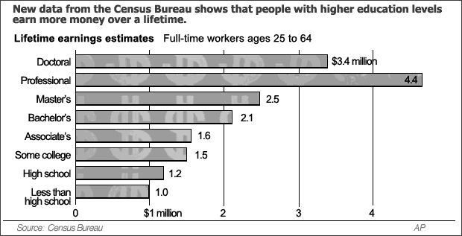
Why Bother?

Slide 3
Comparison to High School
Hours of Classes Per Week:
HS: 35
College: 12-18
Hours of Homework Per Week:
HS: 10-20
College: 20-30
Rules in Class:
HS: No eating, drinking, gum, electronics, coats, or hats
College: Generally allowed to eat, drink, chew gum, bring electronics (although not use them), and wear a coat or hat

Slide 4
College is Great
Number of Organizations/Clubs:
HS: 5-15
College: Hundreds!
First Class Starts At:
HS: 8:00 am
College: You make your own schedule!

Slide 5
Responsibilities/Staying on Track:
High School
College
Classes are picked for you
Teachers make sure you are in class
Teachers meet with and call your parents
Often, parents remind you of homework and to study
You choose the classes
You set times to meet advisors
You choose to come to class on time
Grades are usually not sent to your parents

Slide 6
College is great
The Bottom Line:
Going to college means more responsibility and harder work!
But… with that responsibility comes more fun, freedom, and opportunities!

Slide 7
Excuses, Excuses, Excuses
I can't afford it.
Nobody in my family has ever gone.
I don't know what I want to do with my life.
College is too hard for me.
I just won't fit in.

Slide 8
A Few More Details
Each course is 3 credit hours, which implies you spend three hours in class a week
Exceptions: Science labs = 1 credit hour, but you spend 3 hours in lab per weeks
For every hour in class, you need to spend 3 hours studying
Homework is generally not graded, but very important to understand the material

Slide 9
To Earn a Degree
Depending on your major
120-128 credit hours
You need to take 12 hrs to be considered a full-time
required for many scholarships and financial aid
You can take up to 21 without signing a waiver
At 12hr/semester, it will take 10 semesters
At 17 hr/semester, it will about 7.5 semesters
Might need to consider summer school

Slide 10
Summer School
Two Five-Week Summer Sessions
Can take two courses plus a PE (7 hours)
You could earn up to 14 hours in one busy summer
Most people take one course each session and earn 6 hours
Over three summers, that would be 18 credits
Will be an additional cost

Slide 11
Rough Draft
128 Credit Hours
128 Credit Hours
Freshmen Year 15 + 15
Summer: 6 hr
Sophomore Year 15 + 15
Summer: 3 hr + Internship
Junior Year 15 + 15
Summer: Internship
Senior Year 15 + 14
Slow and steady wins the race!
Freshmen Year 15 + 15
Summer: 6 hr
Sophomore Year 17 + 17
Internship
Junior Year 17 + 17
Summer: Internship
Senior Year 12 + 12
Have time to apply to Grad School!

Slide 12
Grades
Most Classes at a Big University
3 Exams + 1 Final
Each exam is worth 25% of your grade
Cannot afford to fail an exam
Labs will have weekly assignments
i.e. Lab Reports, Pre-Lab Assignments, and Quizzes
GPA needs to be 3.0 at senior year
Much easier to maintain a high GPA than bring one up
Classes become more difficult as you go, so do all you can freshman year

Slide 13
GPA
10 Point Scale
Duke University
Letter Grade | Percent Grade | 4.0 Scale
A+ | 97-100 | 4.0
A | 93-96 | 4.0
A- | 90-92 | 3.7
B+ | 87-89 | 3.3
B | 83-86 | 3.0
B- | 80-82 | 2.7
C+ | 77-79 | 2.3
C | 73-76 | 2.0
C- | 70-72 | 1.7
D+ | 67-69 | 1.3
D | 65-66 | 1.0
E/F | Below 65 | 0.0
90: A
80: B
70:C
60: D
50: F
Classes in your major are “C-wall”
You have to make at least a C to earn credit
So, a 70 is still failing

Slide 14
Additives
Double Majors
Some degree are similar enough, you can easily finish with a summer sessions or a fifth year
Minors
Can allow you to explore you interest without going out for the entire degree
Looks great on resumes
Communication, Psychology, Business

Slide 15
What college is for me?
The Big School: Pros & Cons
Pros | Cons
Wide variety of majors and courses Well-stocked libraries Variety of housing opportunities Well-funded sports programs Wide range of academic and social opportunities Distinguished or famous faculty | Large class sizes Many courses taught by teaching assistants, not professors Professors focused on their own research and graduate thesis projects—little student-teacher interaction Pressure on students to take initiative; to be go-getters More rules and procedures related to enrolling in and designing course study—red tape Potential of getting lost in the crowd

Slide 16
What college is for me?
The Small College: Pros & Cons
Pros | Cons
Small class sizes Hands-on learning opportunities Individually-designed majors Strong advising system; advisors know students very well Strong sense of community Professors, not graduate students, teach most courses Opportunity to get to know professors well | Limited housing options Fewer majors to choose from Fewer physical resources Smaller libraries Fewer entertainment and social opportunities Less emphasis on sports programs

Slide 17
Treat it like a job, 8-5 is for college.
Even if you do not have classes until lunch, learn to get up early, at least by 9, and use that time to STUDY!
Do not procrastinate.
You can go party for a year, or you can go four and earn a degree!

