Slide 1
Academic Advising & Selecting Courses

Slide 2
Academic Advising
Developing meaningful educational plans that fit into life goals.
The ultimate responsibility for making decisions about educational plans and life goals rests with the student.

Slide 3
Academic Advising
IS…
Going to an appointment prepared to:
share information
ask questions
IS NOT…
Going to an appointment expecting the advisor to:
create your schedule
make decisions for you

Slide 4
Advising: Student Responsibilities
Know who your advisor is and if they are in the advising office or the health careers office
Look on the Q under “student biography” OR
Read the letter that is mailed mid-semester
Contact your Advisor or the Advising Center EARLY for an appointment.
Be persistent, use e-mail, phone, or leave a note.
The advising center gets very busy; don’t wait until the last minute!

Slide 5
Advising: Student Responsibilities
Semester Planning Chart (2 Options)
Course Schedules (2 - 3 Options)
Print outs of:
Your placement exam scores
Your student biography
Your current/past course schedules

Slide 6
Advising: Student Responsibilities
What to bring to your appointment:
Placement test scores
Semester Planning Chart and Course Schedules
Booklet of course offerings for next semester
The college catalog or a copy of the page(s) of your academic major requirements
include the major you are waiting to be accepted into

Slide 7
Reading the College Catalog
Your Requirements and Options

Slide 8
Reading the College Catalog
First, you will learn how to read the college catalog:
The Table of Contents
The Program of Study Page
Find the Table of Contents now
It is at the beginning of the catalog

Slide 9
Reading the College Catalog
Everything you need is listed in the Table of Contents.
Programs of Study: Lists all programs with page numbers
Course descriptions: Describes all of the courses offered.
Browse the rest of the pages later!

Slide 10
Selecting Courses Part I
Planning Your Academic Future

Slide 11
Selecting Courses: Preparing
Before beginning you must have your:
placement test exam scores
current/past course schedule
college catalog
two copies of the “semester planning chart”
copy of the handout “courses sequences, electives, and courses with no pre-requisites”

Slide 12
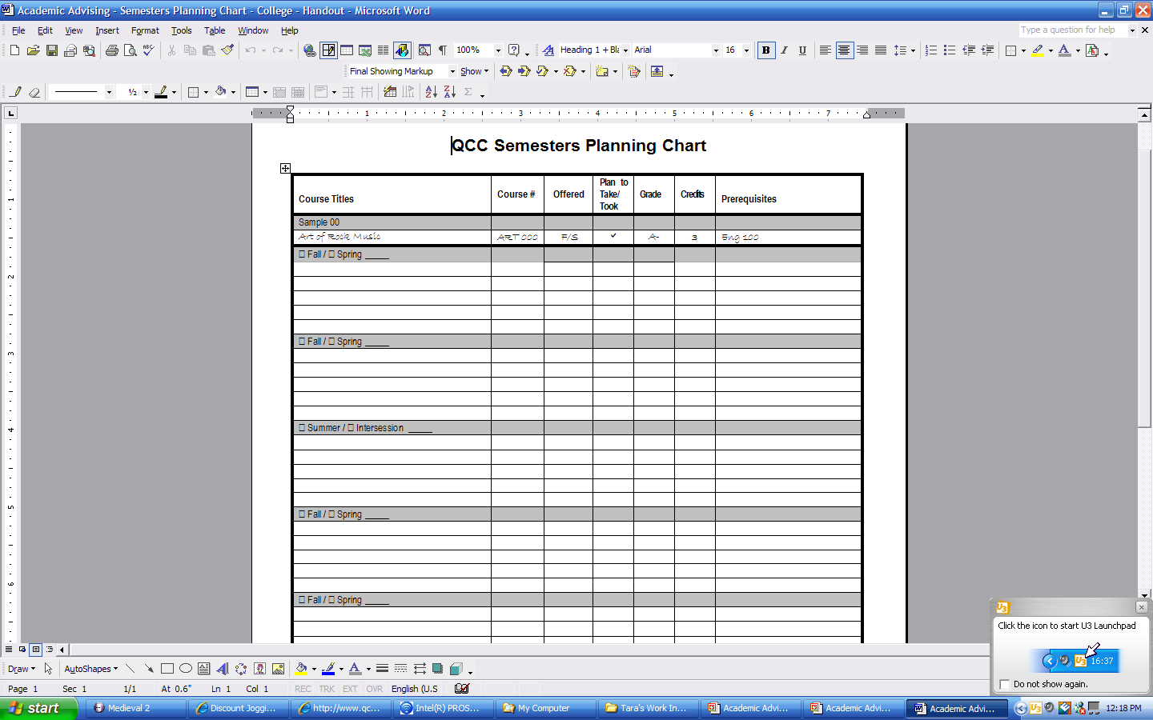
Selecting Courses: Planning
The planning chart is used to plan several semesters.
No matter what college you attend you are expected to know what to take and when.

Slide 13
Selecting Courses: Choosing
Now that you know how to fill out the semester planning chart, make your choices.
Remember to use the “course descriptions” page in the catalog to check for pre-requisites.
Begin filling out the “Semester Planning Chart” with courses you have already taken!
You don’t know where you are going unless you know where you’ve been.
Next, look at your “Programs of Study” page(s)
What comes next for you? Focus on basic courses first!
Plan several semesters ahead (approximately four).

Slide 14
Selecting Courses Part II
Your Schedule for Next Semester

Slide 15
Selecting Courses: Planning
You should be finished planning your academic goals several semesters ahead using the “Semester Planning Chart”.
Now you will select which days and times you want to take courses next semester using the “Course Schedule Booklet” and a schedule worksheet.
If you are intending to take a winter intersession or summer course, understand that they are very fast and do the same amount of work in less time. Plan wisely!

Slide 16
Selecting Courses: Preparing
Before beginning you will need:
Your “Semester Planning Chart”; focus on next semester only.
Your copy of the “Course Schedule Booklet”
A “Course Schedule Worksheet” of your choosing.

Slide 17
Selecting Courses: Preparing
Every semester the college puts out a “Course Schedule Booklet” which lists:
Every course offered next semester and who is teaching it.
If it is a fall, the winter intersession courses are included.
If it is spring, summer schedules have their own book.
Each course is listed alphabetically and also with a course number AND a section number.

Slide 18
Selecting Courses: Tips
Tuesday and Thursday only schedules are the hardest to get so go EARLY!
Schedule Labs/Sciences and other courses that have fewer time choices FIRST!
Sometimes classes fill-up fast, so always have other course times as a SECOND CHOICE!
Include the course number and title and section number in your selections ALWAYS!

Slide 19
Selecting Courses: Tips
Even if you are unsure of a course, always go to your appointment with a PLAN!
If you are a Health Careers student, you MUST see a Health Careers Advisor.
They have very specific information about the health programs that a general advisor would not have.
Because you’ve made decisions ahead of time, your advisor can give you quality ADVICE!

