Slide 1
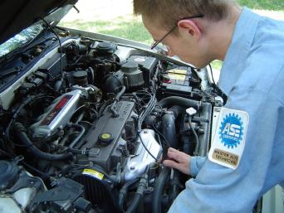
Vehicle Maintenance

Slide 2
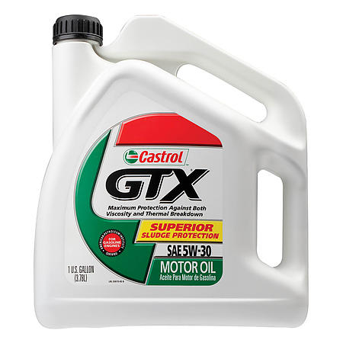
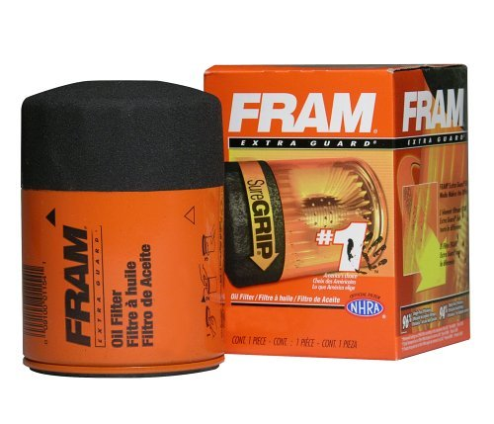
Oil
Your car’s lifeline
The most important issue in your vehicle’s life is selecting the correct oil and changing it regularly.

Slide 3
Changing your oil
Refer to your owner’s manual, but change your oil more often than the manual may suggest.
Never go beyond 4,000 miles between oil changes. Some would recommend every 3,000.
Oil is cheap, engines are expensive.
Always replace the filter.

Slide 4
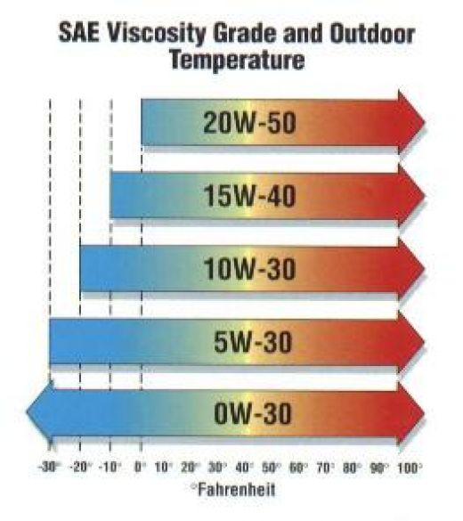
Selection of an oil
A. Brand name. There are many choices. Check the web for those rated best.
B. Grade, SE or better. All oils are good enough. Diesels use a different type.
C. Weight. Consult your owner's manual
D. Always use the SAME brand and weight.

Slide 5
Fuel System
Fuel tank: stores fuel
Fuel pump: moves fuel from tank
Fuel filter: removes impurities
Carburetor/fuel injectors: mix fuel
with air and put into cylinder
Air filter: removes dust from air

Slide 6
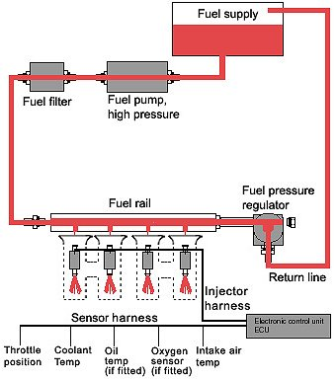
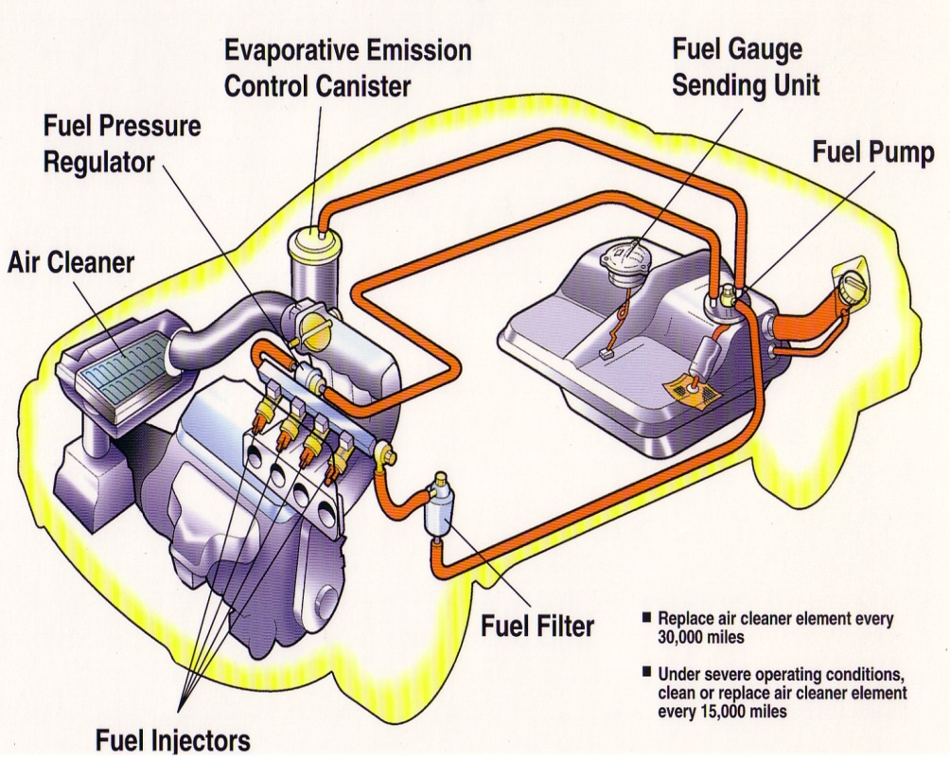

Slide 7
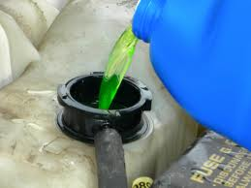
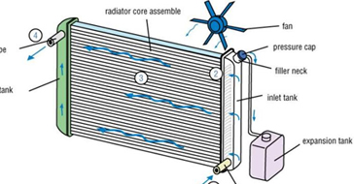
Cooling Systems
Cooling Systems: keep engine from overheating
Circulates coolant
Water & Antifreeze
Stored in radiator and overflow tank
Water pump pushes coolant through engine
Thermostat keeps temp constant

Slide 8
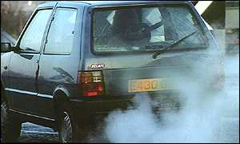
Carbon Monoxide
Odorless, colorless & tasteless
Small amounts make you sleepy/headache:
reduce ability of red blood cells to carry oxygen
Large amounts: will kill you
Avoid driving in a car with a leaky exhaust pipe
Gases may leak into car
Don’t….
– Run car in closed garage
– Sit in parked car with windows closed & heater running

Slide 9
Coolant (anti-freeze)
A. Strong enough to protect your engine. You can buy a hydrometer at Advance for a couple bucks, test it.
B. Clean. When it becomes dirty, have the system flushed and replaced with new coolant.
Be careful about the new GM coolants, they can NOT be mixed with ethylene glycol.

Slide 10
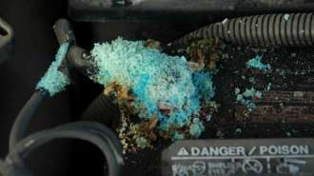
Batteries
Most maintenance free batteries are just that. It is still a good idea to have the battery terminals cleaned each year (Fall is best).
An old tooth brush and baking soda will clean the junk off. Flush with a hose to make sure everything is off.
Buy a terminal cleaner for a dollar at AutoZone.
If you are having trouble, Advance and AutoZone will test your system and your battery for free.

Slide 11
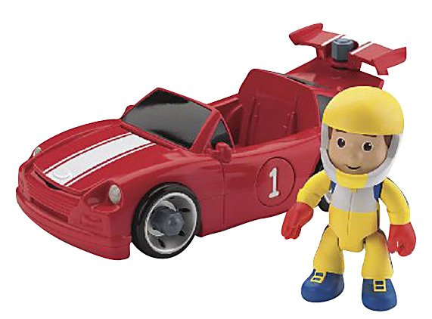
Tune ups
On today's vehicles, there is virtually no tune up necessary. New cars require new plugs @ 100,000 miles. Be careful of dealerships wanting to bring your car back for "routine" maintenance.
Change the oil.
Change the air filter at least once a year. If you live on a dirt road, more often.

Slide 12
Timing belts
Timing belts are an exception. They need to be replaced about every 60,000 miles, before they break. When they break, they will leave you stranded on the road or may cause serious damage to your engine. ($2,000) check you owner’s manual.
(Timing chains are not necessary to replace because they seldom break).

Slide 13
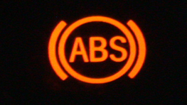
Brakes
The brake light on the dash might mean you parking brake is on, your brake fluid is low, or your pads/shoes are worn and need replaced.
If at any time you hear strange noises when applying the brakes, have them checked. Unfortunately, on some vehicles, some noise is inevitable.

Slide 14
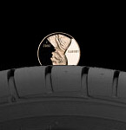
Tires
Tire tread: On wet or slippery surfaces, the amount of tread
determines how much traction you have
Replace when depth of tread is 1/16inch
Rotate every 5,000 miles
Balance to make sure weight is even

Slide 15
Tires

Slide 16
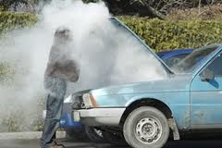
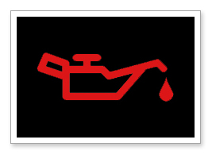
Warning Light
If the oil light comes on..
stop right away, don’t drive at all
If car overheats:
Stop driving as soon as possible
Don’t open radiator until cool
Add water to drive to service station

Slide 17
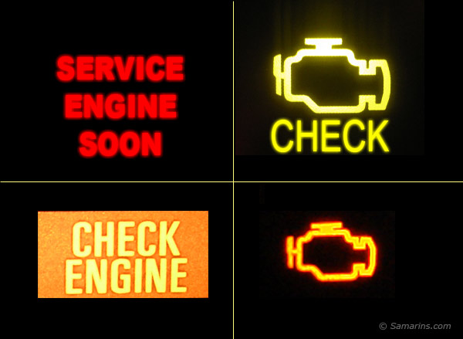
The dreaded check engine light
Since 1996, OBD or on board diagnostic units have been installed in all vehicles sold in the US.
These units are designed to inform the driver that something is wrong with one or more of the systems in their vehicle.
These smart cars (OBD) should help the mechanic fix the right thing first.

Slide 18
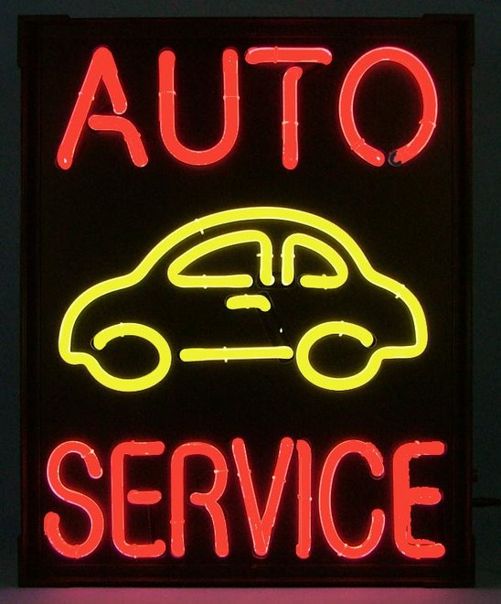
If you find an honest repair place...
If you are fortunate enough to find one of these, take him a turkey at the holidays.
Many exposes have been done about how people are ripped off by repair shops. Be extra careful. Ask for a second opinion.

