Slide 2
What are the benefits of healthy eating and active living?
Helps you learn
Promotes healthy weight
Sports performance
Keeps you healthy
Prevents diseases
Dental health
Sleep better
Increase self-esteem & self-confidence
Decrease depression & anxiety
Notes:
Brainstorm:
Why healthy eating matters for young people:
helps you learn (concentrate, attend etc.)
keeps you healthy
promotes healthy weight
helps prevents chronic disease
dental health
performance in sports
etc.

Slide 3
Environment
Think for a minute about the food:
in grocery stores
in corner stores
in movie theatres
at fast food restaurants
at sports events
at school
Notes:
Are unhealthy eating practices and physical inactivity all in our individual control?
Think about: (5 minutes)
· Environment (in your own community) - is it easy to make healthy choices? Have students discuss each scenario as to whether it would be easy to make healthy choices of foods in each of these places.
·

Slide 4
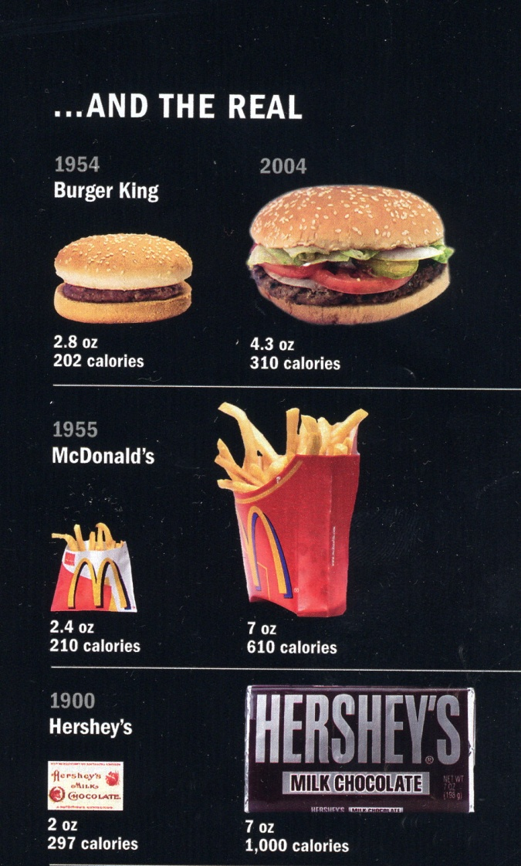
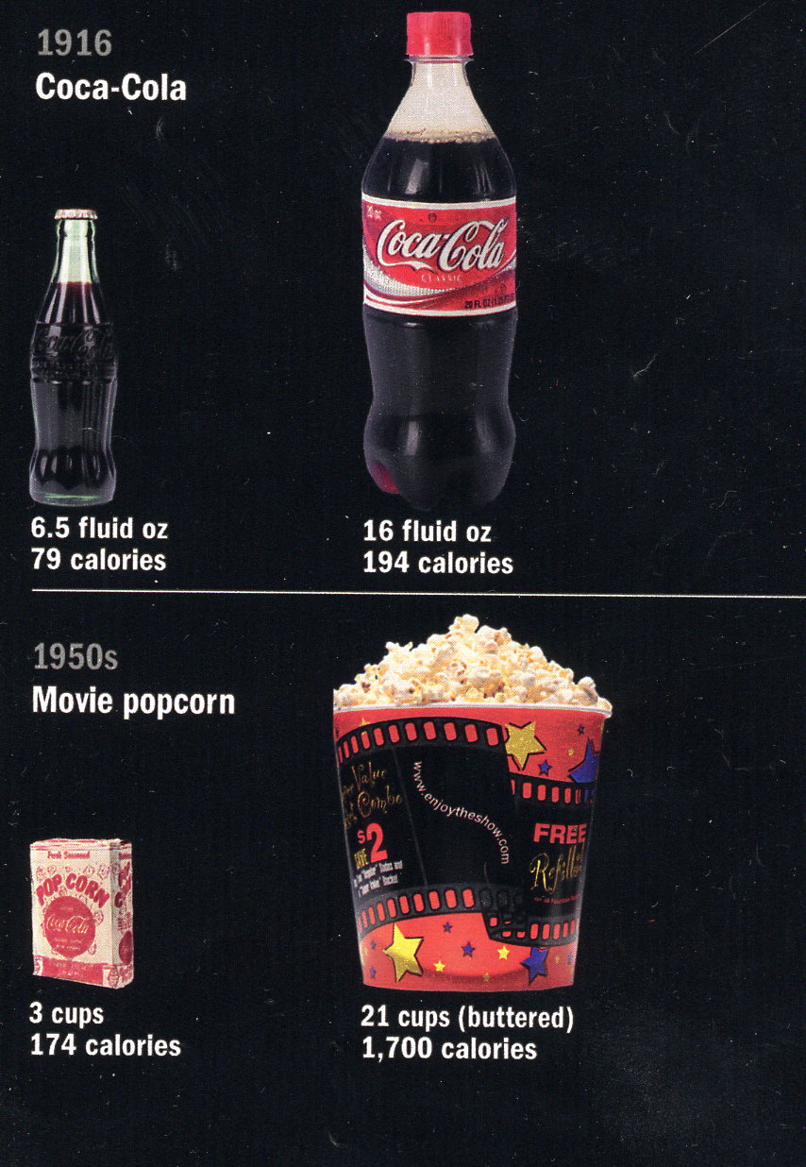
Portion Sizes
Notes:
Portion sizes (how they’ve changed) – (could also mention that soft drink consumption has increased a lot over the years and milk consumption has declined. p.119 Improving the Health of Canadians)
And the industry is pushing food…super-sizing for only pennies more

Slide 5
Advertising… Can Nutrition Education Compete?
Notes:
Advertising (how we’re all influenced) – think about all the advertising that we’re exposed too from an early age. How much advertising is there for healthy food choices? It’s easy to get sucked in by advertising
The industry tries to hook people early! (young)

Slide 6
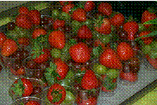
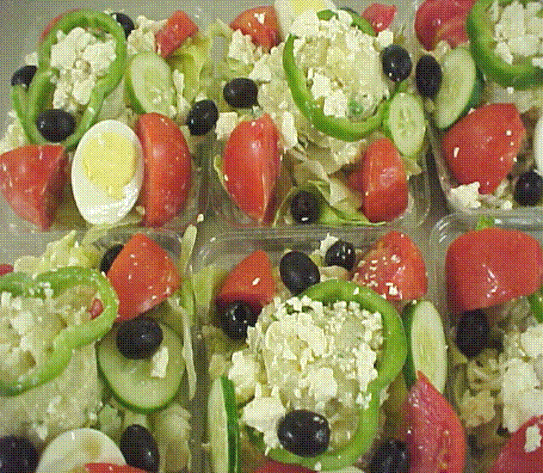
Change is happening at many levels
You can help create
a school environment that
supports healthy eating!
Notes:
. L
otsLots of things are happening. People are starting to look at what is being offered in various settings and trying to make changes eg.the Boys and Girls Clubs in NL have declared themselves as “Junk-free zones”. Many schools are already making changes on their own.

Slide 7
School Food Guidelines
Foods served or sold in school should make a positive contribution to students’ eating habits
Schools teach about healthy eating. They should also model healthy eating.
Guidelines include 3 categories of food:
Serve Most
Serve Moderately
Foods Not Included
Notes:
• Based on the premise that foods served or sold in school should make a positive contribution to students’ eating habits ie. belong to CFG.
• Schools teach about healthy eating. They should also model healthy eating by offering healthy food and beverage choices (often a contradiction at present)
• Guidelines include 2 categories of food:
o Serve most
o Serve moderately
Does it mean that all foods not in the 4 food groups are “bad” and should never be eaten? No. Lots of other opportunities to enjoy them in moderation
Let’s see what you think about some of the issues. (12 minutes)
Everybody stand up. On one side of room you’ll see the sign “Strongly Agree”. On the other side “Strongly Disagree”. If you’re not sure or if you’re “on the fence” you can stand in the middle or somewhere in between. There is no absolute right or wrong. We are interested in your opinion. It is what you feel about each issue today.
I’d ask you to listen to the following statement and think about whether you agree or disagree. Go where you think bests represents your view. (Do one or two depending on time)
“Schools shouldn’t sell soft drinks to any students from kindergarten to grade 12”
“ The School Food Guidelines should apply to all school-related activities, on or off the school premises”
“Junior and senior high school students will eat healthy foods and beverages if they are readily available at school.”
Thanks for your input. As you can see, a lot of this is not black and white. Later in the summit there will opportunities to talk about the barriers to healthy eating and how some schools have been working to overcome them. Each school needs to start where they are. Even small changes can make a big difference. Build on your successes.

Slide 8
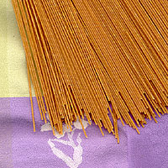
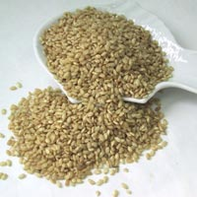
Grain Products
Choose whole grains more often
Breads, cereals, pasta, rice, tortilla wraps, crackers
Serve Moderately: White based grains

Slide 9
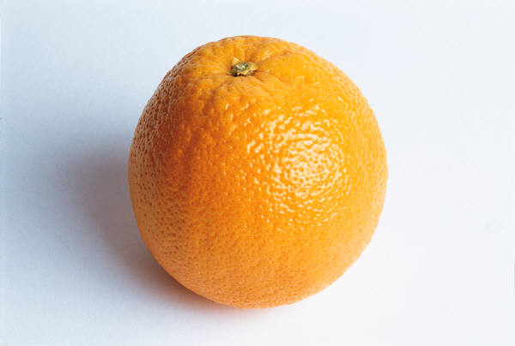
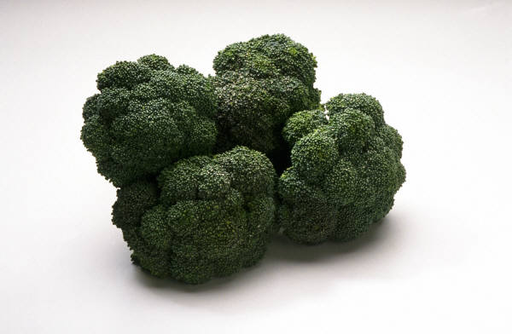
Fruits and Vegetables
Fresh
Frozen
Fruit can also be:
Canned in juice
Dried fruit
Serve Moderately:
Sweetened fruits/juices
French fries (once a week)

Slide 10
Milk Products
Choose lower fat & unsweetened products
White milk (<2% milk fat - M.F.)
Lower fat cheese (<20% M.F.)
Yogurt (<2% M.F.)
Serve Moderately
Chocolate milk
Yogurt drinks
Ice cream (once a week)

Slide 11
Meat and Alternatives
Choose lean cuts of meat, fish, poultry and dried beans and peas
Use lower fat cooking methods
Use in moderation any added fats such as oil, gravy, cream sauces
Serve Moderately:
Salami, pepperoni, bologna, wieners, bacon, chicken wings, or fried meats (once a week)

Slide 12
Foods Not Included
Some foods provide very few nutrients
Students can fill up on these foods and will not have room for healthier foods
Examples:
Cookies, cakes, pies, donuts, chocolate bars
Popsicles, Jello
Potato chips
Pop, fruit drinks, sports drinks, energy drinks
Battered & fried products – nuggets, battered & fried chicken pieces, onion rings

Slide 13
Active Living
Do you get 60 minutes of physical activity every day?

Slide 14
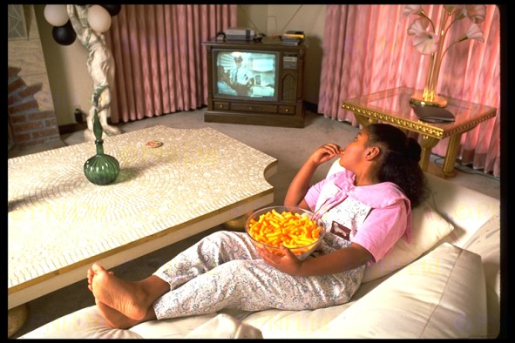
Notes:
64 percent of NL students are inactive – not active enough to realize health benefits)* Only 38 percent of girls and 48 per cent boys are considered active enough * * Stats Canada and the Canadian Fitness Lifestyle Research Institute – or CFLRI Regular exercise among youth declines as the grade of schooling increases (World Health Organization)

Slide 15
Encouraging Active Living
Active Transportation
Intramurals & Informal activities
Access to school/community resources after school hours
Physical Education
Activities in other classes

Slide 16
Key Messages
Healthy eating & active living matters
It’s not always easy to eat healthy in today’s world
There are opportunities to increase physical activity within our school community
We can all be agents of change
Let’s all work together to make the healthy choice the easy choice for students!

