Slide 1

The Costs of Raising a Child

Slide 2


Your half million dollar child…
Children are priceless, but
raising them is probably the
most expensive thing you'll
ever do. Here are some
breakdowns on where the
expenses may be.

Slide 3

Raising Costs of a Newborn
The costs in the child's first year continue to add up. The amounts spent vary depending on whether one looks at a single parent, or two parent home, whether there is more than one child in the home, and what the income range of the family is.

Slide 4

In the first year alone, you can easily spend between $4,000-$6,000 for diapers, formula, baby furniture, clothing, baby gear, etc.
If you go back to work right away, childcare can cost as much as $3,000-$4,500 in your baby’s first year.

Slide 5

Diapers
If you plan to use disposable diapers, plan on spending between $2,000-$3,300 by the time your baby is potty trained.
Expect your baby to go through at least 7-8 diapers a day on average and spending $80-$130 a month on diapers alone (especially in the first few months, when changes are more frequent.)

Slide 6
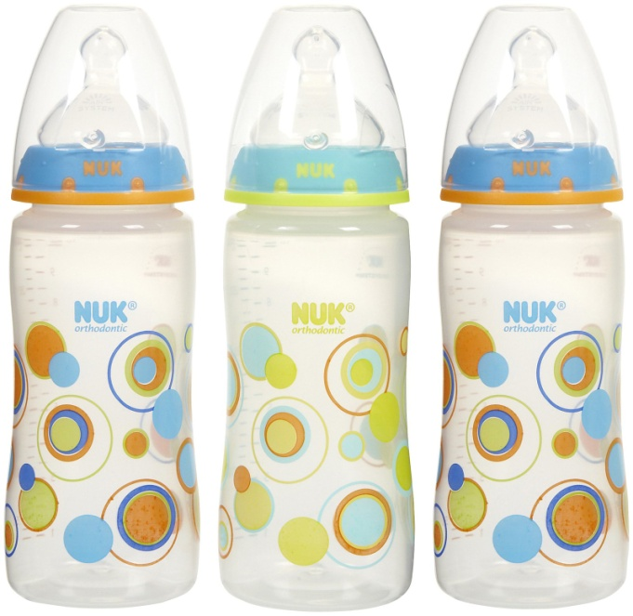
Baby Bottles
Formula (up until your baby is one-year-old), will most likely cost between $1,000-$2,300. Plan to spend at least $40 a week on infant formula.

Slide 7

Baby Arrival
Don’t forget about the delivery! It easily costs between $8,000-$12,000 for a normal delivery, up to $15,000 for a cesarean delivery, and much more if there are complications.
If you are covered by insurance, it may cover most of the cost.

Slide 8
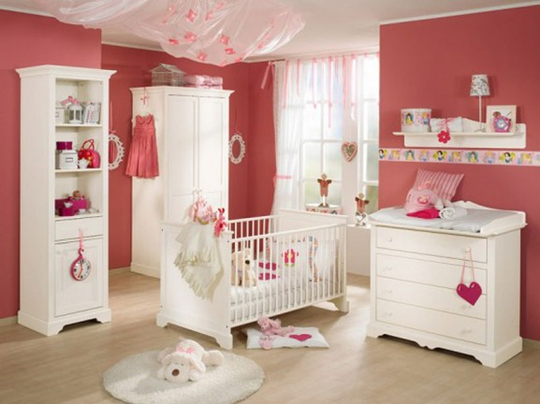
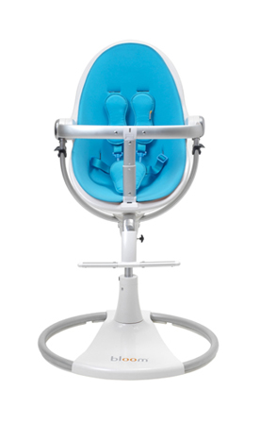
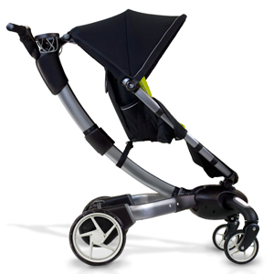
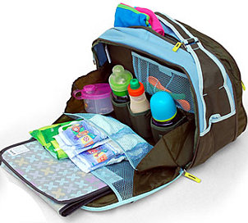
New Baby “Stuff”
Baby Furniture/Bedding: $400
Stroller : $100
Car Seat: $100
High Chair: $75
Diaper Bag: $50
Baby Monitors: $50

Slide 9

Costs for 1 year of child’s life
Housing: $2770-$5960
Food: $1000-$1590
Transportation: $880-$1830
Clothing: $350-$540
Healthcare: $550-$830
Childcare/education: $1080-$2690
Miscellaneous: $670-$1750

Slide 10
Housing
This is the biggest single expense of raising children, comprising anywhere from 33% to 37% of the overall annual expense.
Plan on a minimum of $200 a month per child. Each child takes an additional 100 square feet of housing space.

Slide 11

Childcare/Education
$840-$5100
Day care: $450 + a month
Public/Private Education
Educational Toys and Books
Educational Lessons (piano, sports)
Piano $50 a month x 12=$600
Sports Camp $1,000

Slide 12
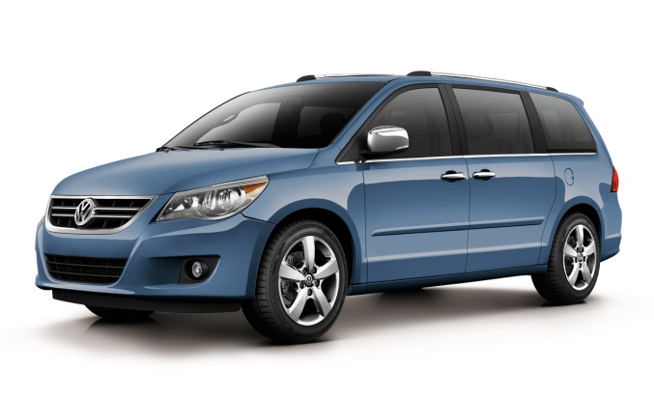
Transportation $800-$1670
These costs are about 13% of your budget:
Car
Gasoline
Insurance
Stroller -$50-$200 Car Seat $100-$200
Trike $50-$100 Bike $100-$200

Slide 13


Clothing $420-$640
7% of your budget or about$44 a month
Relatives become a main clothing provider
This cost has decreased over last 5 years

Slide 14

Healthcare $550-$830
Doctor
Dental
Illness
Accidents
Disability

Slide 15
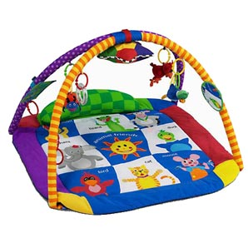
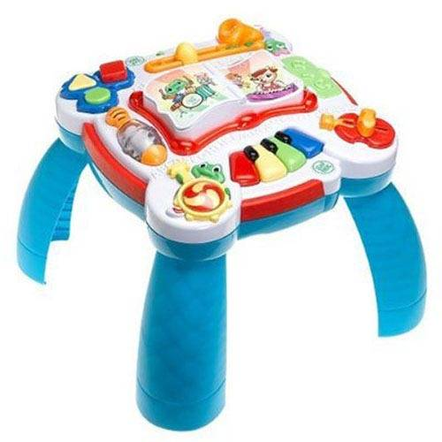

Miscellaneous $700-$1700
Plan on about $50 a month of
Unexpected costs.
Toys/Books/Computers
Sports Equipment
Personal care items/Hair care
Entertainment

Slide 16

Over the child's first 17 years of age, the cost is currently estimated to add up to $139,000-$279,000.
However by the time a newborn reaches age 17 in the year 2022, this total is estimated with inflation to add up to $183,000-$366,000.

Slide 17

Factors Affecting Costs
Two Parent Family
Single Parent Family
Divorce

Slide 18

Parenting Cost Difference
The cost of raising a child in a single parent home are higher.
Reasons:
2 homes
added transportation
additional child care for working parent.

Slide 19

Additional Cost Factors
Number of siblings
Urban/Rural family
Health care
Income bracket (low/middle/upper)
-upper income families will spend 2 x the amount that a low income family will spend per child.

