Slide 1
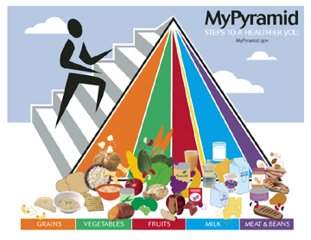
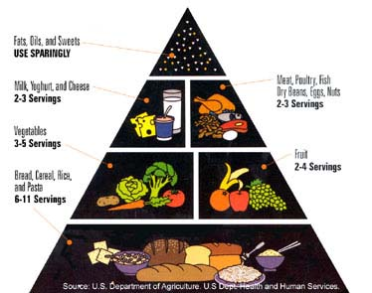
NUTRITION
Notes:
What do we know about these 2 pyramids?
Old one-specific servings for everyone-no physical activity incorporated
New one- no serving sizes-activity is emphasized
Handout-Anatomy of mypyramid

Slide 2
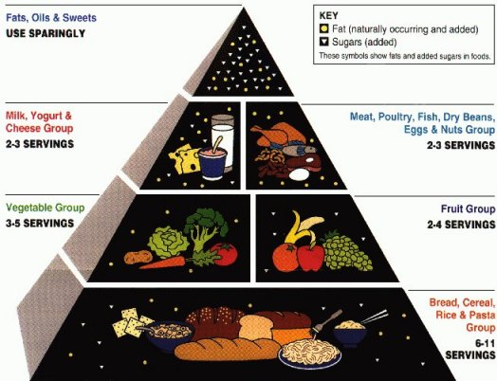

Slide 3
Grain Group
Make half your grains whole
Eat at least 3 oz. of whole grains every day
Cereal -Breads
Crackers -Rice
Pasta
Notes:
Look for the word whole in front of the word grain on a product -whole wheat

Slide 4
Vegetable Group
Vary your veggies
Eat more dark green veggies like broccoli, spinach and other dark, leafy greens
Eat more orange vegetables like carrots and sweet potatoes
Notes:
Starchy vegetables-potatoes, corn, lima beans
Dry beans and peas
Orange vegetables- carrots, squash, sweet potatoes
Dark green vegetables- spinach, collard greens, broccoli

Slide 5
Fruit Group
Focus on fruits
Eat a variety of fruits
Choose fresh, frozen, canned, or dried fruit
Go easy on fruit juices
Notes:
Variety of fruits- apples, bananas, mangoes, oranges, papayas, grapes, pineapples

Slide 6
Milk Group
Get your calcium-rich foods
Go low-fat or fat-free when you choose milk, yogurt, and other milk products
If you don’t or can’t consume milk, choose lactose free products
Notes:
3-A-DAY CAMPAIGN
-not adding milk products, it’s replacing things that aren’t as healthy, like soda, tea, coffee, and snacks.
-choosing yogurt, low-fat cheese, etc. instead will help you become healthier

Slide 7
Oil/Fat Group
Make most of your fat sources from fish, nuts, and vegetable oils.
Limit solid fats like butter, stick margarine, shortening, and lard, as well as foods that contain these.
Check the Nutrition Facts label to keep saturated fats, trans fats, and sodium low.
Choose food and beverages low in added sugars. Added sugars contribute calories with few, if any, nutrients.

Slide 8
MODERATION
Represented by the narrowing of each food group from bottom to top. The wider the base stands for foods with little or no solid fats or added sugars. These should be selected more often. The narrower top area stands for foods containing more added sugars and solid fats. The more active you are, the more of these foods can fit into your diet.
Notes:
By looking at the new pyramid which groups shouldn’t be chosen very often?
-oils, fruits
Why??

Slide 9
PROPORTIONALITY
Proportionality is shown by the different widths of the food group bands. The widths suggest how much food a person should choose from each group. The widths are just a general guide, not exact proportions. Check the website for how much is right for you.
Notes:
By looking at the new pyramid which groups should make up most of our diet?
-grains, vegetables, milk

Slide 10
VARIETY
Variety is symbolized by the 6 color bands representing the 5 food groups of the Pyramid and oils. This illustrates that foods from all groups are needed each day for good health

Slide 11
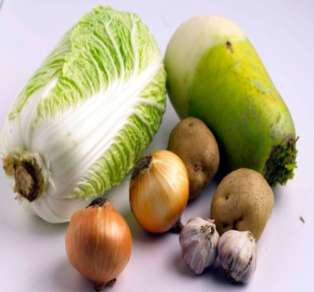
Nutrients
What are nutrients?
Essential substances that your body needs in order to grow and stay healthy
Six categories of nutrients:
Carbohydrates
Proteins
Minerals
Vitamins
Fats
Water
Notes:
-Substances that the body needs to regulate body functions, promote growth, repair body tissues, and obtain energy.
-Your body requires more than 40 different nutrients for these tasks but only 6 are essential.
-define what essential means

Slide 12
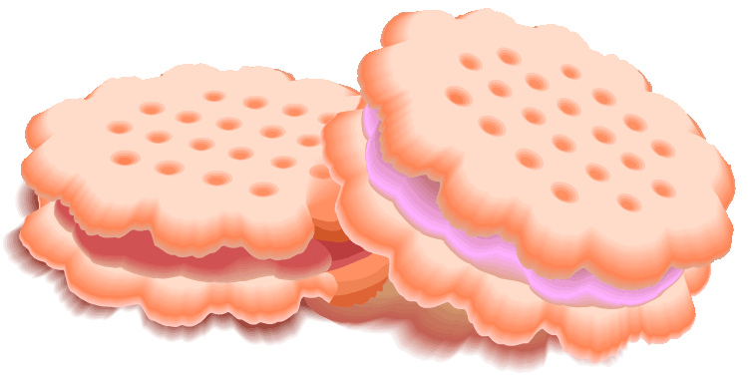
Carbohydrates
Structure and function: Carbohydrates are sugars and starches that the body uses for ENERGY!
PLANTS are the major source of carbohydrates in the food we eat.
© 2005 JupiterImages Corporation
Notes:
-Made up of carbon, hydrogen, and oxygen
-2 different types we are going to talk about
-simple
-complex
-45-65% of a persons daily caloric intake should be from carbohydrates
-foods rich in complex carbs are better than simple carbs.

Slide 13
Simple Carbohydrates
Sugars that are quickly digested and provide a BOOST of energy for the body
Foods with LOTS of sugar: oranges, milk, cookies, candy
Notes:
-Added to manufactured foods like cookies, candies, and soft drinks
-occurs naturally in fruits, vegetables, and milk
-all sugars are converted to glucose for the body to use.

Slide 14
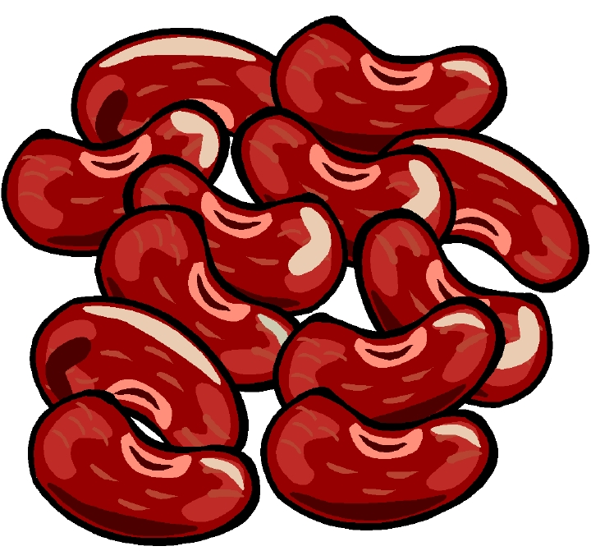
Complex Carbohydrates
Starches that are composed of many sugars linked together
They provide the body with long-term energy since they are digested more slowly than sugars.
Foods with
LOTS of starch: rice, beans, potatoes
Notes:
-Found in many plant foods such as potatoes
-grains-rice, cereals, and wheat
-when you eat complex carbohydrates your body (digests) breaks the starch into simple sugars that can be absorbed into your bloodstream. That’s why its slower to digest.
-FIBER
-is a complex carbohydrate but is not considered a nutrient because its not broken down and absorbed into your bloodstream.
-still necessary for the proper functioning of your digestive system.
-helps prevent constipation
-may reduce risk of colon cancer
-may help prevent heart disease

Slide 15
Protein
Structure: Proteins are made from many amino acids connected together in different arrangements.
Function: Provide the building materials your body needs to grow and repair itself
Notes:
-High protein foods
-meats, eggs, poultry, milk and milk products
-Nuts, dried beans, dried peas, and lentils contain a lot of protein also.
-10-35% of diet needs to be protein

Slide 16
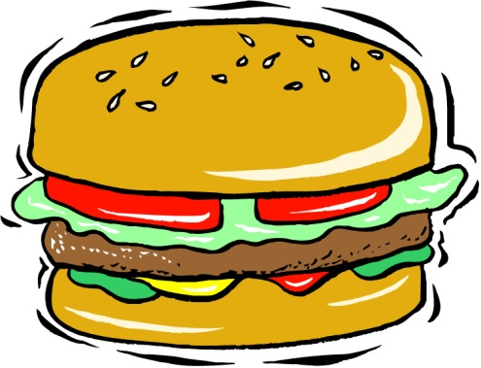
Fast Food Choices
Fast food consumption should be limited since it generally includes foods that are high in calories, fat, and/or sodium.
Try to choose smaller portions since larger portion sizes greatly increase the calorie, fat, and sodium content of your meal.

Slide 17
Physical Activity
Regular exercise, included as part of the new food pyramid, is an important part in maintaining a healthy lifestyle.
Exercise (physical activity) involves any form of movement such as walking, jogging, climbing stairs, or playing basketball.

Slide 18
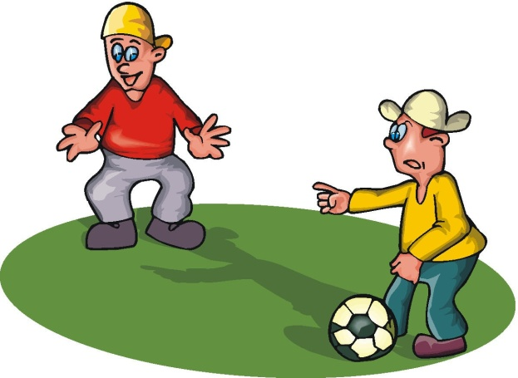
Physical Activity
Benefits of Regular Exercise
Helps relieve stress and depression
Adds years to your life by lowering your risk of heart disease, colon cancer, diabetes, and high blood pressure

Slide 19
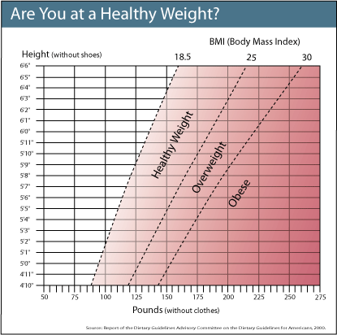

Slide 20
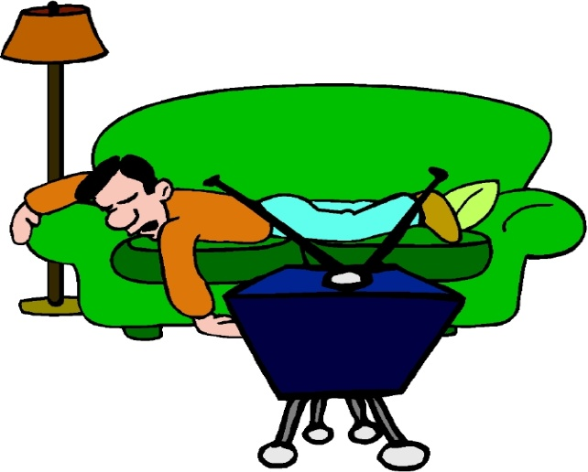
Obesity
Caused by an excess amount of body fat
People are usually considered “obese” if their weight is 30% or more above their ideal weight.
2 main causes:
Unhealthy eating habits
Lack of physical activity

Slide 21
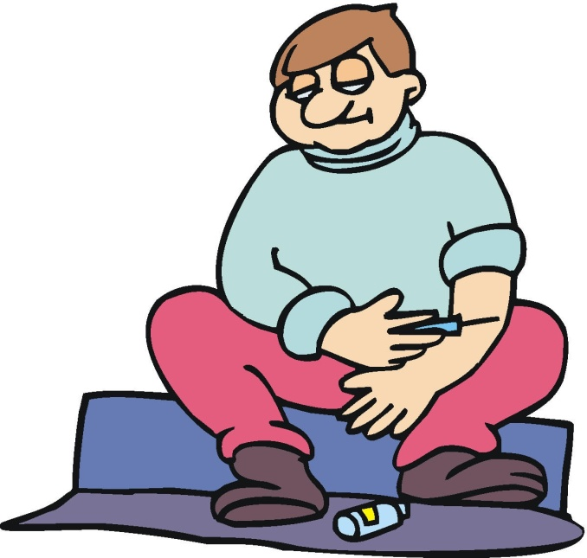
Obesity
Health Risks:
Lower self-esteem
High blood pressure
Blocked arteries
Diabetes
Cancer

