Slide 1
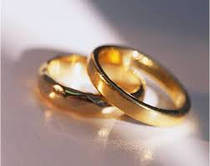
Positive Characteristics and Behaviors of a Strong Marriage!
To keep your marriage brimming with love in the loving cup, whenever you’re wrong – admit it. Whenever you're right – shut up.
--Ogden Nash

Slide 2
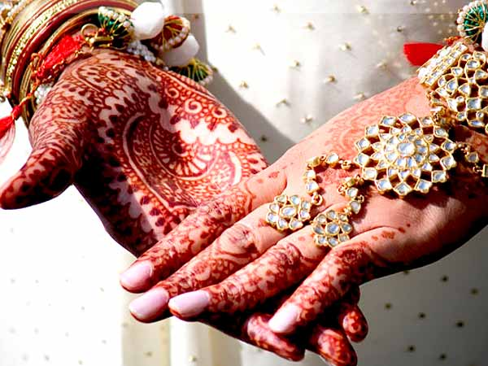
Competencies / Objectives
Identify positive characteristics and behaviors of strong marriage relationships.
Identify specific behaviors found in strong marriage relationships.
Develop a list of ways to personally build and strengthen a marriage.

Slide 3
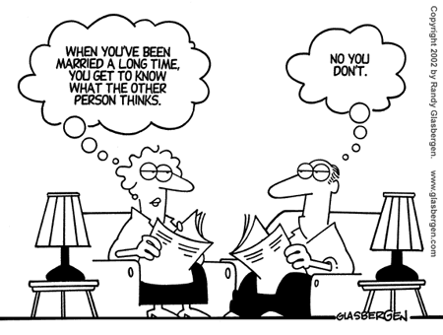
What is a marriage?
Is there a difference between marriage and just living together?
What might be gained by living alone prior to marriage?

Slide 4
What are your feelings about MARRIAGE?
Are you idealistic about marriage?
What do you expect in a marriage partner?
What anxieties or fears do you have about marriage?
Are you optimistic or pessimistic about being able to sustain a marriage relationship? Where do they come from?

Slide 5
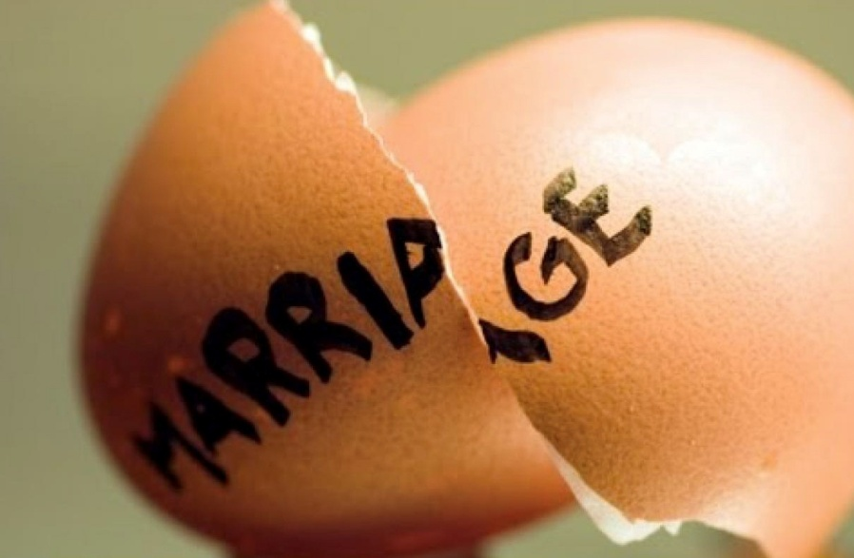
What makes it difficult
to sustain a marriage
in the current world?

Slide 6
Commitment:
What does commitment mean?
Is commitment the difference between marriage and just living together?
How much is commitment role modeled today? Give an example of someone that has modeled commitment.
What does commitment have to do with working through problems?
Are we being trained by society to be committed? Or to blame others? To compete rather than cooperate?

Slide 7
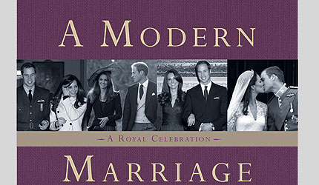
What kind of images do various media present about marriages?
What are some TV soap opera images? Disney movie images? Romance novel images? Movie star images? TV sitcom images?
How do these images affect a young persons expectations of marriage? What attitudes do these images portray ?

Slide 8
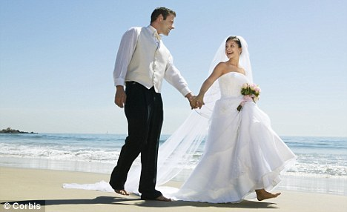
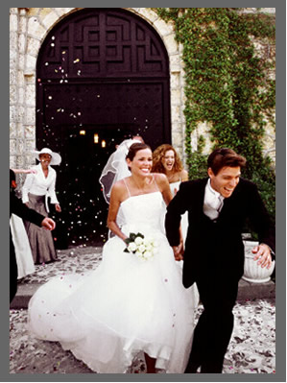
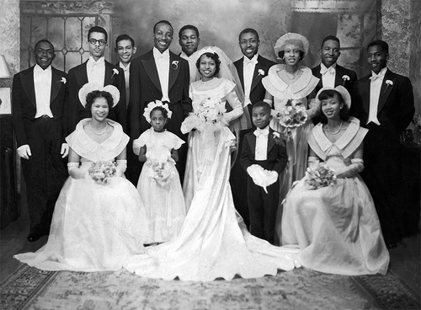

Slide 9
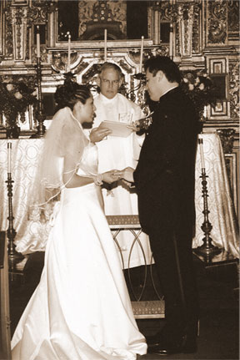
Expectations?
What expectations are appropriate for the marriage relationship?
Does everyone bring into marriage a fantasized belief that all needs will be taken care of?
Do these fantasized beliefs put too much pressure onto the spouse?

Slide 10
What factors can affect your marriage chances of success before marriage? After marriage?
Before
Parents’ Marriage
Childhood
Length of Acquaintance
Age
Parental Approval
Premarital Pregnancy
After:
Attitudes
In-laws
Common Interests
Do Opposites Attract?
Children
Communication
Roles
Personality
Religious Participation

Slide 11
Think, Pair, Share
Have students quietly make a list of specific behaviors that they think are found in a strong marriage relationship.
Have students pair up with one other person and share their ideas.
Have paired students group with another group of two and share their list of strong marriage behaviors. Write these behaviors on blank overhead projector sheets.
Have the class compare the groups behavior sheets.
As a class come up with 10 most important behaviors for a strong marriage.

Slide 12
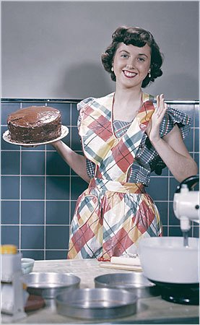
In the 1950s Home Economic Textbooks:
Guidelines to prepare for and have a strong marriage:
Have dinner ready when the husband arrives home from work.
Prepare yourself by taking 15 minute to rest and touch up your hair and make up prior to husband’s arrival, so you look refreshed.
Clear away the clutter. Make one last trip through the house to make sure it looks neat and tidy, so your husband will feel like he has reached a haven of rest.
Prepare the children, make sure they look like little treasures. Minimize the noise, eliminate all the noise from washer, etc. Encourage children to be quiet.
Make your husband comfortable in his favorite chair with pillows, newspaper,.
Make the evening his.
Don’ts: Do not greet him with problems or complaints.

Slide 13
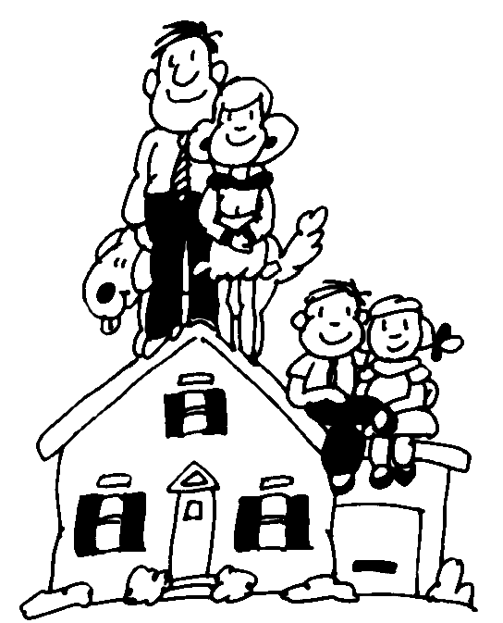
A Happy Marriage Components!!
Marriage is #1
Fidelity
Commitment
Unselfishness
Putting Time into the Relationship.
Talking and Listening
Touching
Being Positive about Your Mater and Marriage

Slide 14
Components of a Satisfying Marriage!
Trust
Commitment
Skills
Caring
Reciprocity
Effort
Realistic Expectations
Flexibility
Shared Decision Making
Pulling Together
Having a Sense of HUMOR
Staying Individuals

Slide 15
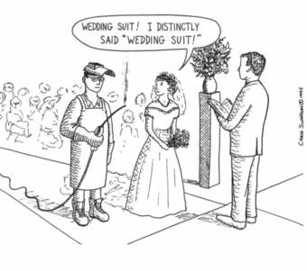

Slide 16
Secrets of Happy Couples
Sex: Monogamous relationship
Money: Strive to live within your means and be good money managers.
Love: Love unconditionally
Work: Division of labor is equal and each spouse supports the other spouse’s employment.

Slide 17
Marriage Enrichment Plan
Enriching and strengthening your marriage involves learning to share with each other at the deepest levels.
Set aside a certain time each day – make it prime time not left- over time.
Share positive thoughts, feelings, and wants only. (not the time to complain or debate)
Emphasize the sharing of feelings.
Use language that expresses appreciation
Have a time out rule. (when one or the other spouse does not want to continue the discussion; it helps the spouse to not feel trapped)
Learn to Listen!!!
Again share expressions of appreciation.
(Caution Marriage Enrichment is not the same as marriage counseling.)

Slide 18
Will you marriage stand the test of time?
The other day my husband and I walked to the top of Antelope Island. As we reached the top the view was breath taking. What was just as breath taking was looking back over the trail from the top. We could see the trail weaving back and forth, in some places steep or flat; and over there is place where I had to walk sideways because I was afraid of falling. As we looked back over this trail we felt such a sense of satisfaction to see what we had accomplished. We just celebrated our 28th wedding anniversary. As we looked over the view in front of us we were reminded of our marriage trail. We have had steep places, places where we lost our way, hard places when money got in the way, grassy valleys that seemed to level out the journey. As we reflected over the last 28 years we questioned ourselves: “What is it that we have done in order to grow strong in our marriage?”

Slide 19
Happily Married People
People in vital marriages are giving people.
They have a strong sense of commitment.
They are strong-minded. They do not lose themselves in the relationship.
They like to talk and listen.
They have a positive outlook on life.
They do not take the good things for granted. They express appreciation and are generous with praise.
They are deeply spiritual.
They are sensitive to other people.
They are willing to grow, change, and work hard at their marriages.

Slide 20
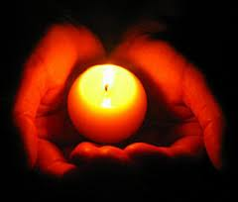
Has the Light Gone Dim? Suggestions to put some love back into your Marriage Relationship.
--Make your spouse Number ONE ---
--Start each day with a hug.
--Send a card or love note to your spouse.
--Give a small gift on ordinary days.
--Telephone to say “I love you” during the day.
--Praise daily
--Give the gift of listening: refrain from judging.
--Complete daily chores together and let this time become a special sharing time.
--Put on a slow song and dance before retiring for the evening.

Slide 21
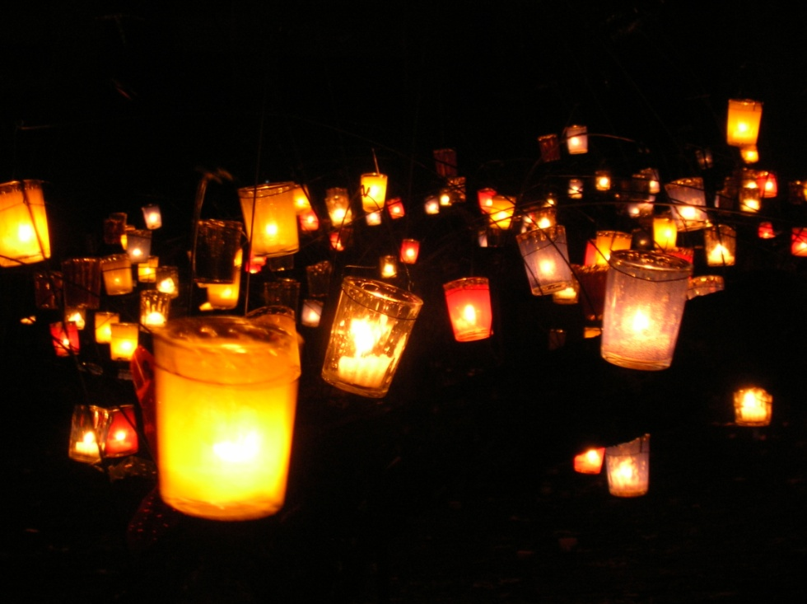
Has the Light Gone Dim? Suggestions to put some love back into your Marriage Relationship.
----On a clear evening share a brief star gazing experience.
--Help without being asked.
--Identify one of your spouse’s weakness and forget it
--Make having fun together a priority.
--Arrange couple time.
--Look for the good in your partner and praise it.
--Admire each other’s achievements.
--Buy a book on Marriage and read it
--During tough times tell each other why you fell in love the first time.
--List all the ways your partner enriches your life and share your list with your spouse.

Slide 22
John Gottman, The Seven Principles of Making Marriage Work.
Stay in Touch
Show appreciation
Show kindness
Give the gift of understanding.
Learn your spouse’s love language.
Make time for fun.
Balance being a parent with being a partner.

Slide 23
Summary:
There are many factors that tend to be in a couple’s favor for having a successful marriage. Many couples with or without these factors will fail; nevertheless, part of the difference lies in the extent to which couples take care of their marriage. Every marriage needs thought and effort to improve and last.

Slide 24
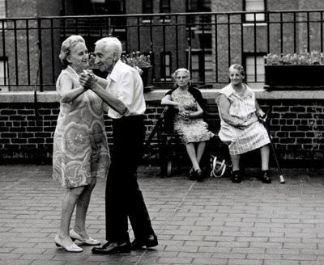

Slide 25
http://www.utahmarriage.org/index.cfm?id=STRENGTH46&print=YES
http://eesc.orst.edu/agcomwebfile/edmat/html/EC/EC1460/EC1460.html
www.1075.COM/tips.htm
http://www.utahmarriage.org/index.cfm?id=STRENGJT15&print=YES

